Slide 1
AI赋能的生物大分子模拟和计算
Week 03
Yi Xue, School of Life Sciences, THU Mar. 11, 2026

Slide 2
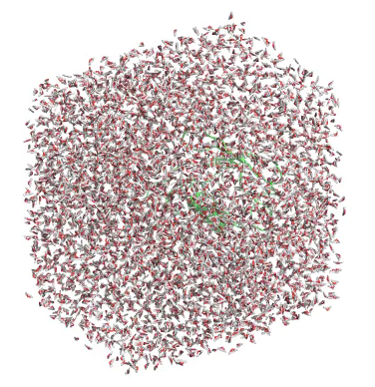
Molecular Dynamics Simulation: the numerical simulation of molecular motion
According to this movie, several basic questions one may raise:
What is needed to make this video?
—Just like normal video, it’s composed of frames
What is the “frame” in MD simulation?
—Each frame stores a set of Cartesian coordinates of all atoms
Would coordinates just be enough?
—Description of the properties of each atom is also required.
How dose the system evolve from frame(t) to frame(t+Δt)?
—Newton’s law and classical mechanics, under specific force field
The realistic time of this simulated trajectory?
—tens of nanoseconds (can it be longer? how much longer?)
Why is the motion confined in a cubic box?
—Periodic Boundary Condition (PBC)
The thermodynamic ensemble of the system?
—Here, it is an NPT ensemble. (NVE, NVT are also common)
You might have more questions, let’s find out …
Notes:
We’ll get to that shortly

Slide 3
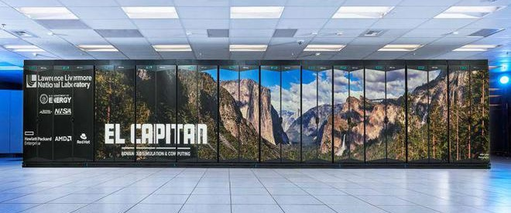
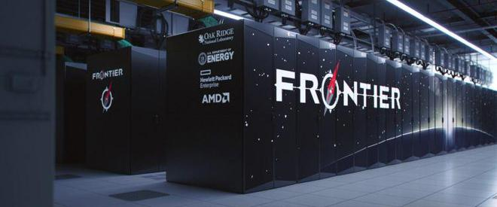
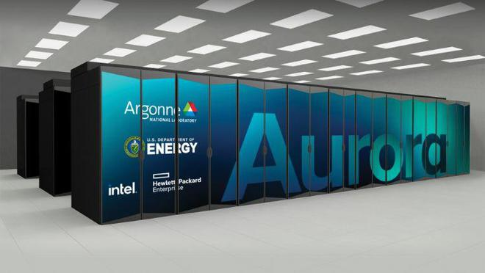
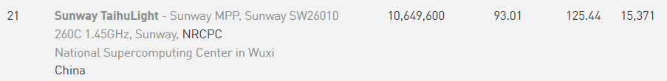
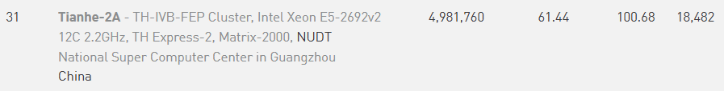
Supercomputer
As of June 2025
#1: El Capitan
LAWRENCE LIVERMORE NATIONAL LABORATORY
#2: Frontier
Oak Ridge National Laboratory
#3: Aurora
Argonne National Laboratory
CPU: AMD 4th Gen EPYC 24C 1.8GHz
Core#: 11,039,616
GPU: AMD Instinct MI300A
Linpack Performance: 1,742.00 PFlop/s
Power: 29,580.98 kW
CPU: AMD Optimized 3rd Generation EPYC 64C 2GHz
Core#: 9,066,176
GPU: AMD Instinct MI250X
Linpack Performance: 1,353.00 PFlop/s
Power: 24,607.00 kW
CPU: Xeon CPU Max 9470 52C 2.4GHz
Core#: 9,264,128
GPU: Intel Data Center GPU Max
Linpack Performance: 1,012.00 PFlop/s
Power: 38,698.36 kW
Notes:
China's supercomputing is no longer participating in data updates for the benchmark test. (for reasons we all understand sanction?)
2010, Milky Way 1 #1
2013-2015, Milky Way 2 #1
2016, sunway TaihuLight became #1; operated by Tsinghua University.
Sunway OceanLight 海洋之光

Slide 4
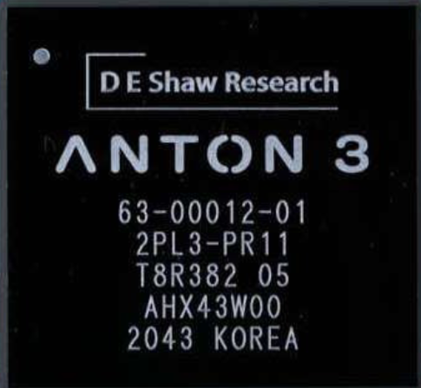
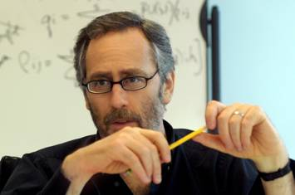
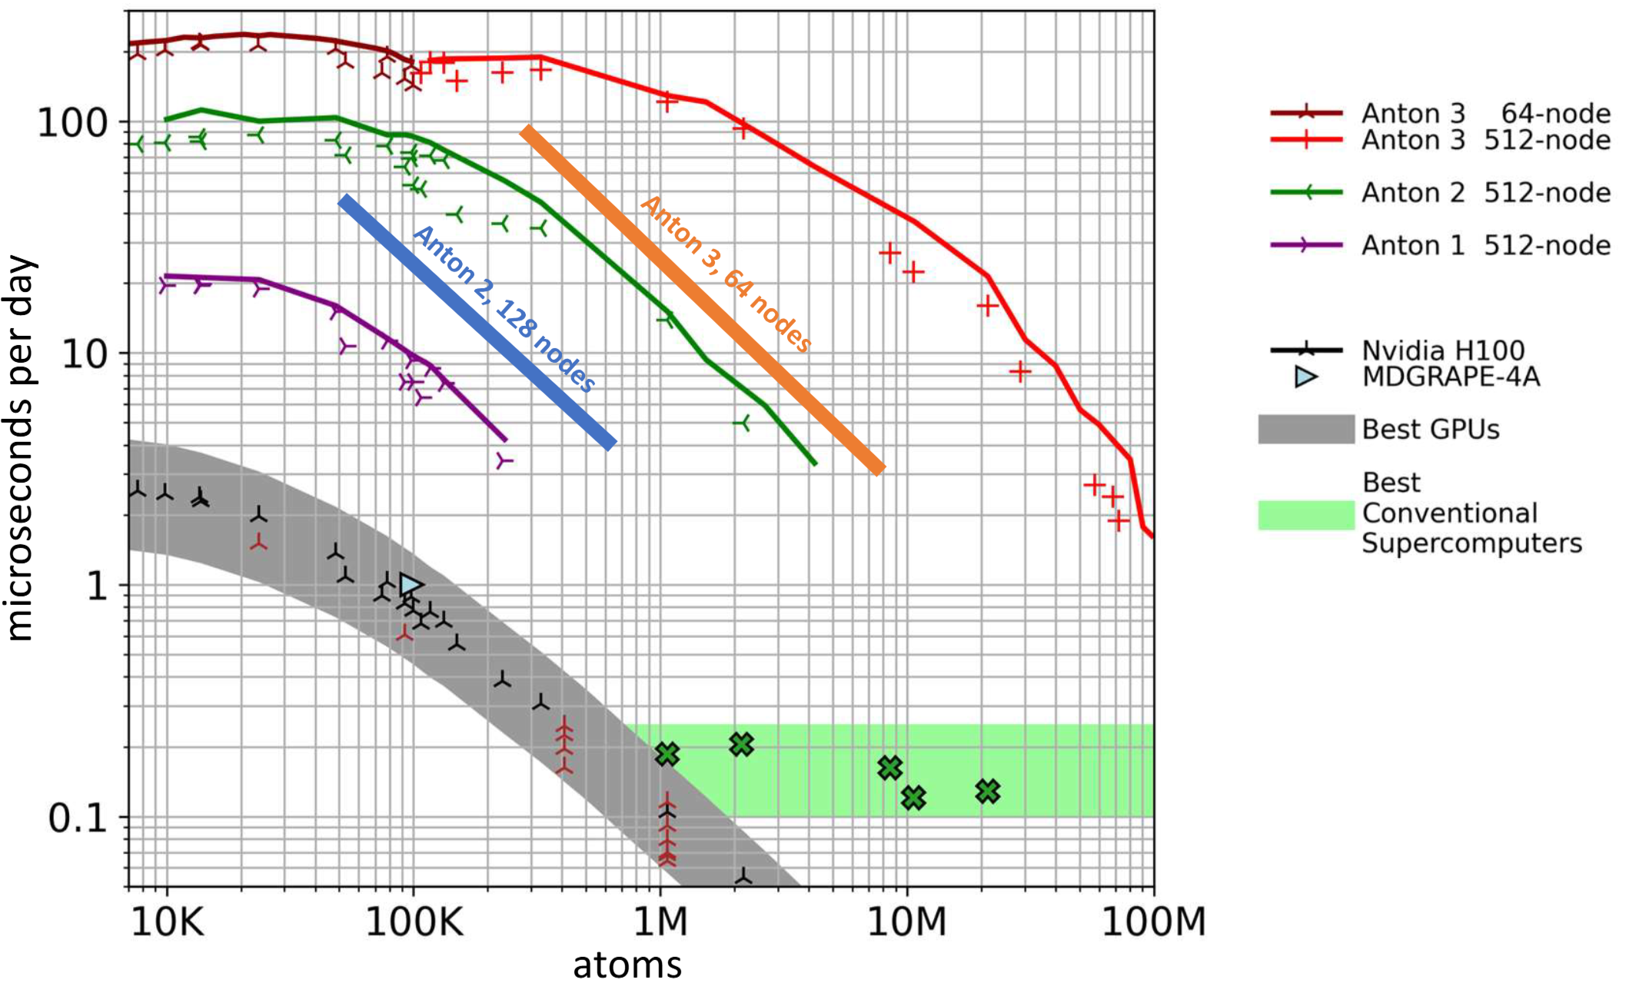
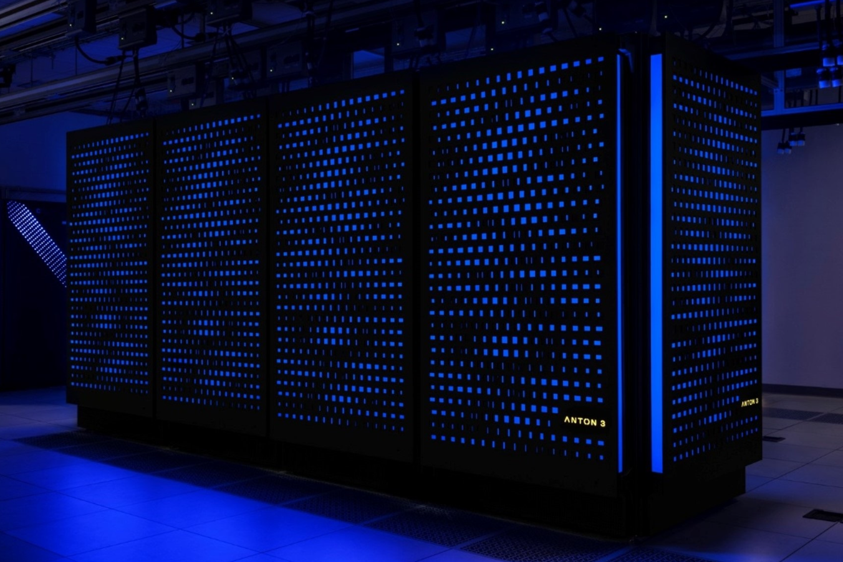
Specialized supercomputer
Anton, a specialized supercomputer for
MD simulations at millisecond-scale and more
D. E. Shaw
Anton 1 (2008), Anton 2 (2013), Anton 3 (2021)
Notes:
David E. Shaw​​ entered Columbia University as a professor before turning 30, specializing in ​​ultra-large-scale parallel computing​​. At 35, he left academia to join ​​Wall Street​​, working in ​​quantitative trading​​ at ​​Morgan Stanley​​. Two years later, he resigned to found his own ​​hedge fund​​, focusing on ​​high-frequency trading arbitrage​​. By 2015, at the age of 64, his personal wealth had reached ​​$4.1 billion​​ (ranked among Forbes Top 500). Returning to academia, he established the ​​D. E. Shaw Research Institute​​ and began developing the ​​Anton​​ supercomputer.
No CPUs: Special integrated circuits, or application-specific integrated circuits (ASICs). cannot perform General-purpose computing
3-gens of Anton: roughly 100 times faster than the fastest general‑purpose supercomputers of its day
https://www.zhihu.com/question/30454088
https://www.psc.edu/resources/anton/ https://sc21.supercomputing.org/proceedings/tech_paper/tech_paper_pages/gb101.html

Slide 5
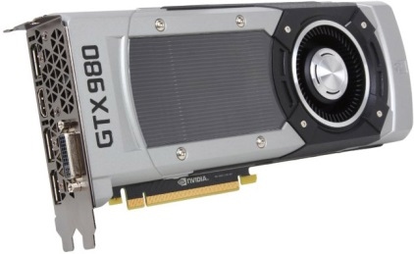
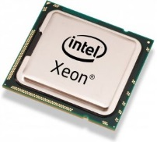
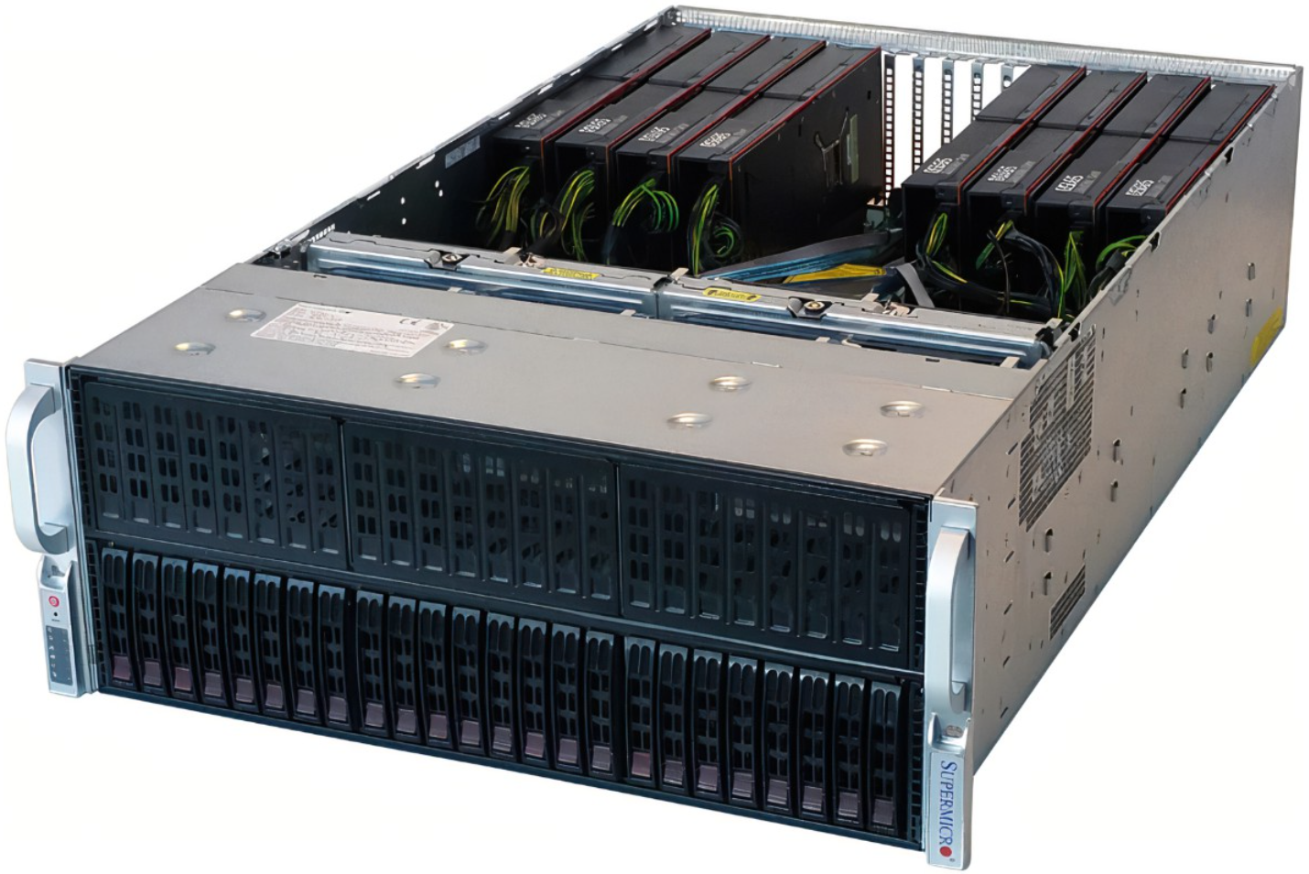
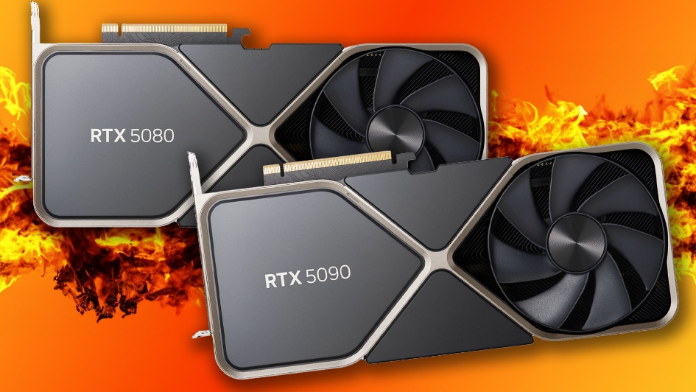
“Personal supercomputer”
9 x faster!
2x Intel Xeon E5-2650 v3 Haswell
NVIDIA Geforce GTX 980
2013
4 G, 2,048 cores, 165 W
20 cores
$1170
~ $500
NVIDIA Geforce RTX 5080
16 G, 10,752 cores, 360 W
~ $1,649
2025
Notes:
GTX980, Xeon E5-2650 v3 Haswell: release date 2014 (Consumer-grade, cost-effective)
You can consider it as a poorman’s solution. It is a sweet solution, though

Slide 6
MD software
CHARMM (Chemistry at HARvard Macromolecular Mechanics) Developed by Martin Karplus’s group at Harvard (https://academiccharmm.org/)
Amber (Assisted Model Building with Energy Refinement) Developed by Peter Kollman’s group at UCSF (https://ambermd.org/)
Gromacs Developed at the University of Groningen at Zurich (https://www.gromacs.org/)
Others: NAMD (https://www.ks.uiuc.edu/Research/namd/), OpenMM (https://openmm.org/), Tinker (https://dasher.wustl.edu/tinker/), GPUMD (https://gpumd.org/)
Notes:
now free for non-commercial use

Slide 7
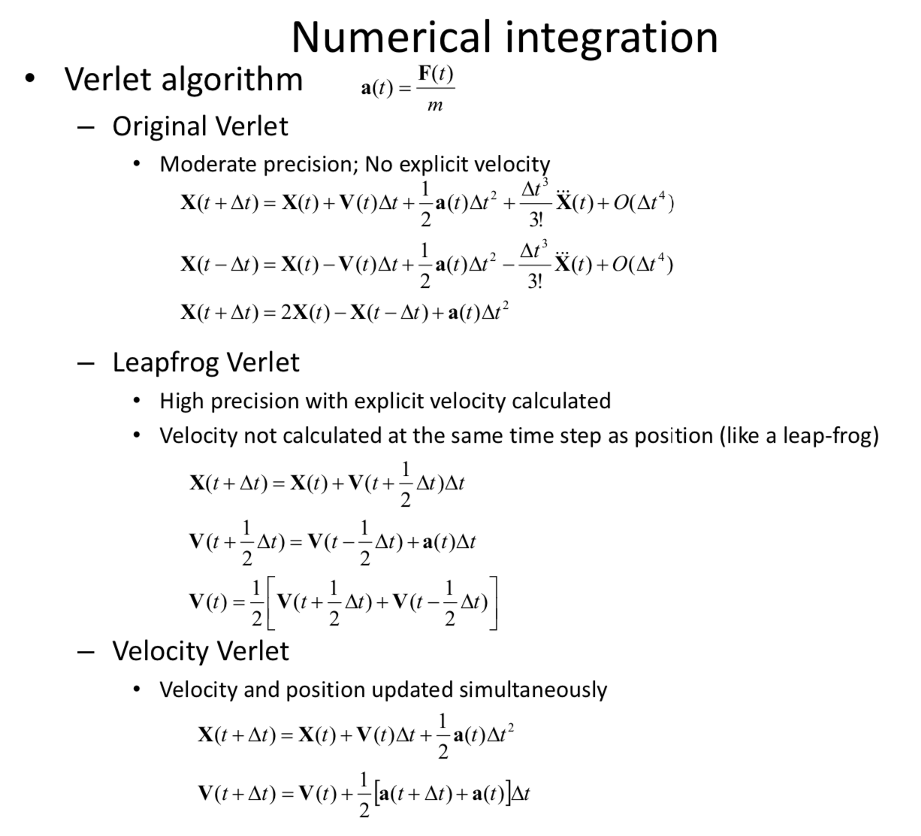
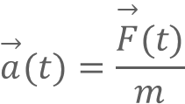

How does the system evolve from frame(t) to frame(t+Δt)
Numerical integration
The time iteration of calculation
Force field, coordinates, and control parameters input
Classical mechanics
Calculate the potential and force on each particle
t=t+∆t
$$\overset{→}{F}(t)=−∇U$$
false
Calculate the acceleration
Update velocity and coordinate
t > tmax?
$$\overset{→}{a}(t)=\frac{\overset{→}{F}(t)}{m}$$
true
Output coordinates, velocities, energies, etc for later analysis
End of simulation
Notes:
Classical mechanics states that a system's future state can be predicted from its current momentum and coordinates. MD is based precisely on this principle, continuously calculating the current positions and velocities to predict the subsequent positions and velocities, and so forth, in the form of numerical simulations.
Regarding this iterative cycle, the most classic and widely used algorithm is the Verlet series of algorithms. It offers the advantage of computational simplicity.
根据经典力学，如果已知某个系统某时刻的动量和坐标，该系统的下一刻状态则可以由上一个状态推算得到。MD就是基于这样一个原则，去不断的计算当前时刻的位置和速度，去推算下一个时刻的位置和速度以此类推，以数值模拟的形式。
关于这个推算的循环，最经典，也是目前最常用的迭代算法就是verlet系列算法。它具有计算简单的优点。
Nevertheless, Amber implements a variant of “half Leapfrog and half velocity” verlet…

Slide 8
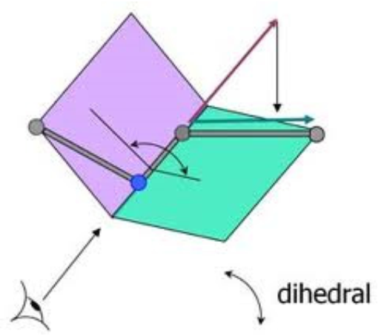
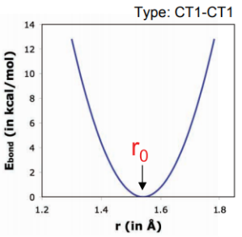
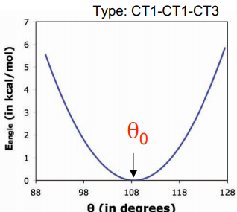
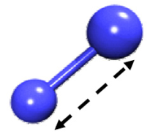
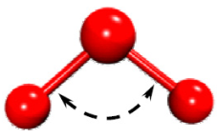
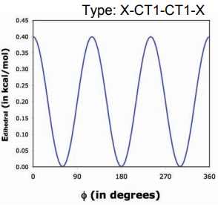
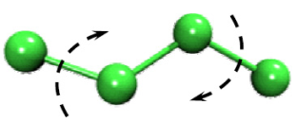
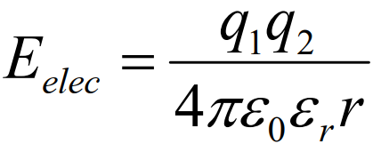
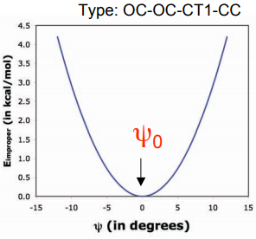
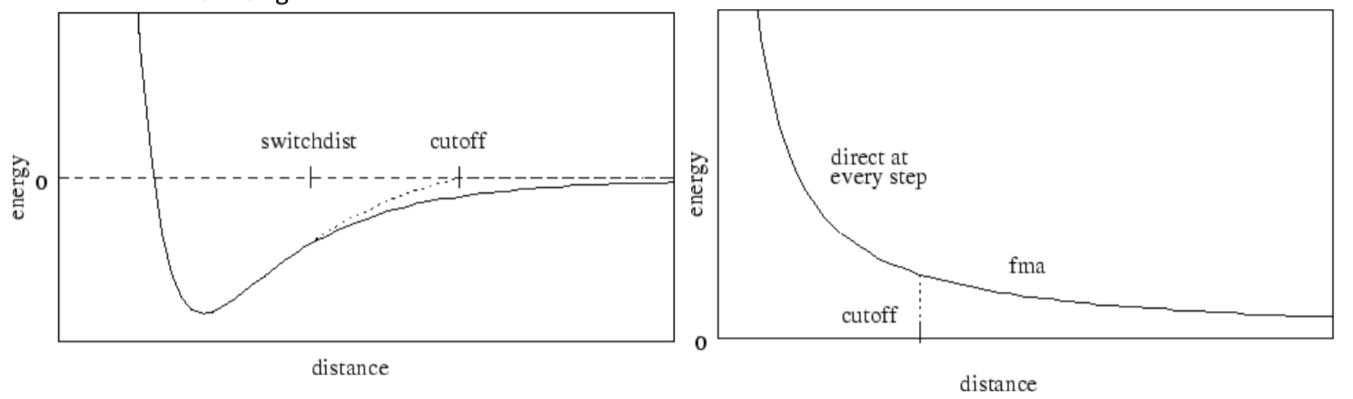
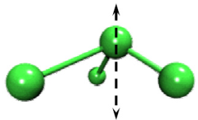







Force field: potentials
Bonded terms
Non-bonded terms
$U=\underset{bonds}{∑}k_{r}(r−r_{0})^{2}+\underset{angles}{∑}k_{θ}(θ−θ_{0})^{2}+\underset{dihedrals}{∑}\frac{V_{n}}{2}[1+cos(nφ+φ_{0})]$ $+\underset{i}{∑}\underset{j≠i}{∑}\left[\frac{A_{i,j}}{r_{i,j}^{12}}−\frac{B_{i,j}}{r_{i,j}^{6}}\right]+\underset{i}{∑}\underset{j≠i}{∑}\frac{q_{i}q_{j}}{4πεr_{i,j}}$
Bond stretching potential
Angle bending potential
Dihedral angle potential
$$U_{bond}=k_{r}(r−r_{0})^{2}$$
$$U_{angle}=k_{θ}(θ−θ_{0})^{2}$$
$$U_{dihedral}=\frac{V_{n}}{2}[1+cos(nφ+φ_{0})]$$
Improper dihedral potential
Electrostatics
van der Waals
$$U_{improper}=k_{ψ}(ψ−ψ_{0})^{2}$$
$$U_{vdw}=4ε\left[(\frac{σ}{r})^{12}−(\frac{σ}{r})^{6}\right]$$
Particle Mesh Ewald (PME) algorithm for long-range force evaluation
$$U_{elec}=\frac{q_{1}q_{2}}{4πεr}$$
$$σ⋅2^{\frac{1}{6}}$$
$$ε$$
ε: well-depth
σ: van der Waals radius
For a system w/ 1500 atoms
→ ~10⁶ atom pair interactions!

Slide 9
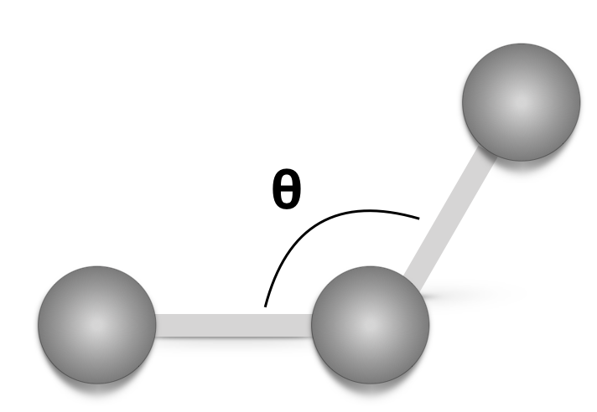


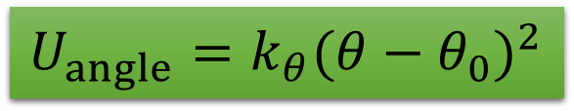

Force field: from potentials to forces
(xc, yc, zc)
C
A
B
(xc-xb, yc-yb, zc-zb)
$$\frac{∂U}{∂x_{a}}=2k_{θ}⋅(θ−θ_{0})⋅\frac{∂θ}{∂x_{a}}$$
(xa, ya, za)
(xb, yb, zb)
(xa-xb, ya-yb, za-zb)
$$\frac{∂θ}{∂x_{a}}=\frac{∂[arccos(cosθ)]}{∂x_{a}}=\frac{−1}{\sqrt{1−cos^{2}θ}}⋅\frac{∂cosθ}{∂x_{a}}$$
$$U_{angle}=k_{θ}(θ−θ_{0})^{2}$$
$$\frac{∂cosθ}{∂x_{a}}=\frac{∂}{∂x_{a}}[\frac{(x_{a}−x_{b})(x_{c}−x_{b})+(y_{a}−y_{b})(y_{c}−y_{b})+(z_{a}−z_{b})(z_{c}−z_{b})}{\sqrt{[(x_{a}−x_{b})^{2}+(y_{a}−y_{b})^{2}+(z_{a}−z_{b})^{2}]⋅[(x_{c}−x_{b})^{2}+(y_{c}−y_{b})^{2}+(z_{c}−z_{b})^{2}]}}]$$
Now do you know how to handle $U_{dihedral}=\frac{V_{n}}{2}[1+cos(nφ+φ_{0})]$?

Slide 10
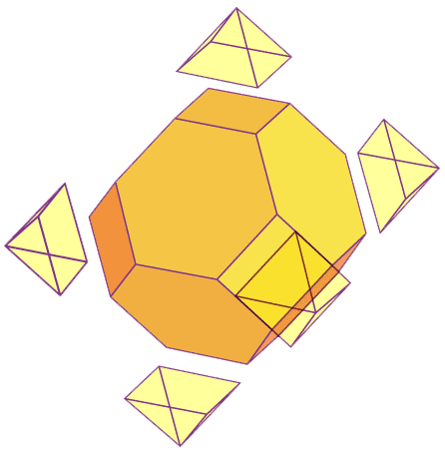
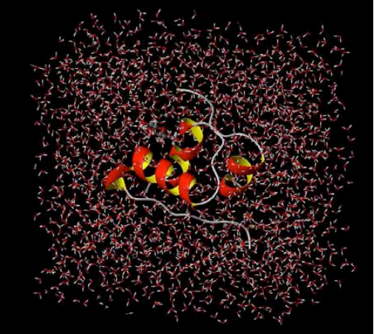
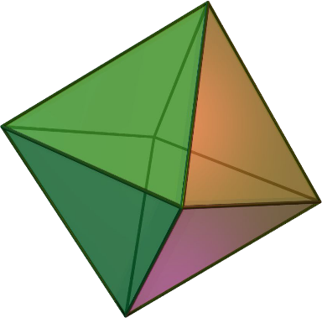
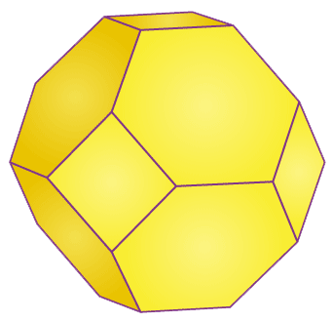
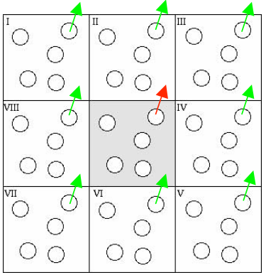
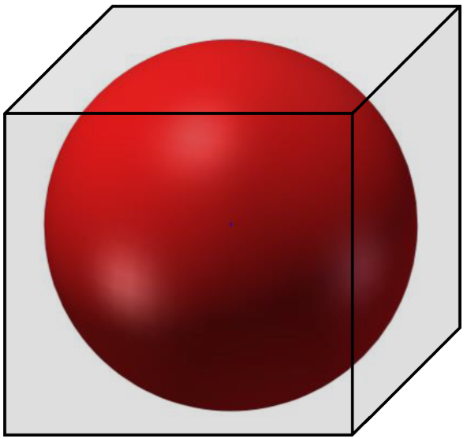
Periodic boundary condition and water box
octahedron
truncated octahedron
Commonly used water models:
3-site: TIP3P, SPC/E
4-site: TIP4P/Ew, OPC, TIP4P-D
5-site: TIP5P
Why bother using the truncated octahedron box?
Explicit solvent methods v.s. Implicit solvent methods
Implicit solvent: approximating the discrete solvent as a continuum. The generalized Born (GB) solvation model is the most commonly use one
Notes:
water models: dummy atoms
Implicit: drastically reducing the number of particles in the system
∆Gsolv = ∆G_el (GB or PB) + ∆G_nonel (SA). PB is more computationally costly.

Slide 11
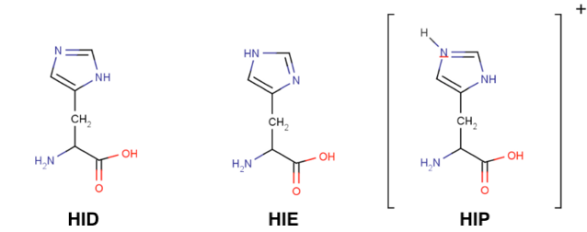
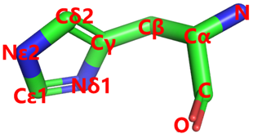
Amino acid residues may exist in different forms
GLU vs GLH ASP vs ASH
CYS is for normal CYSTEINE CYM for CYSTEINE with negative charge CYX for CYSTINE with disulfide (S-S BRIDGE)
pKa₁ (Nδ-H⁺) ≈ 6.0
pKa₂ (Nε-H⁺) ≈ 6.5
HID = delta protonated HIE = epsilon protonated HIP = doubly protonated (+1 charge)
By default, Amber assumes HIE (i.e. translating HIS into HIE)

Slide 12
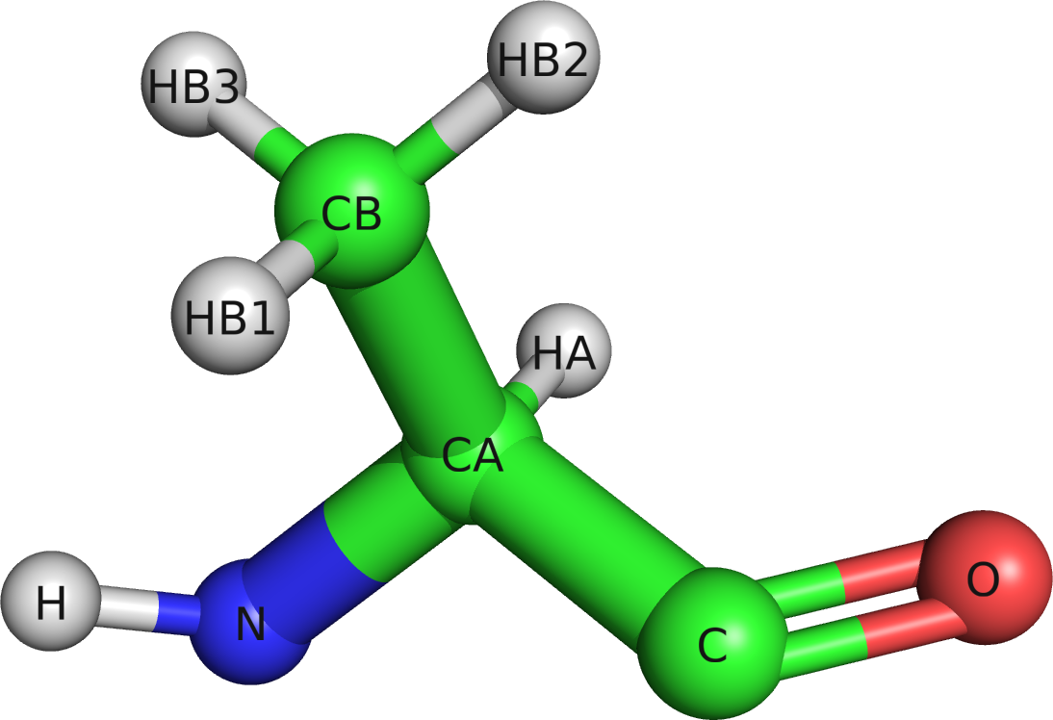
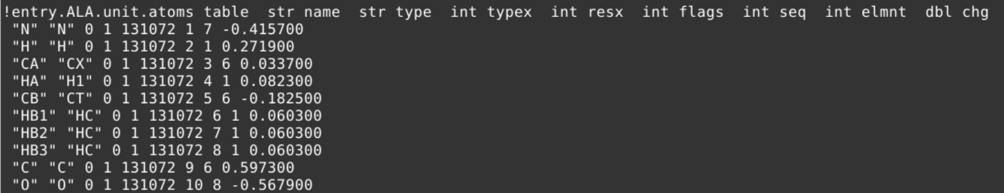
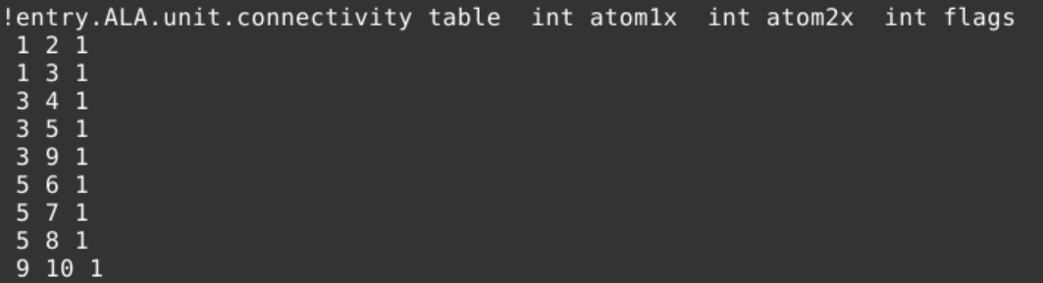
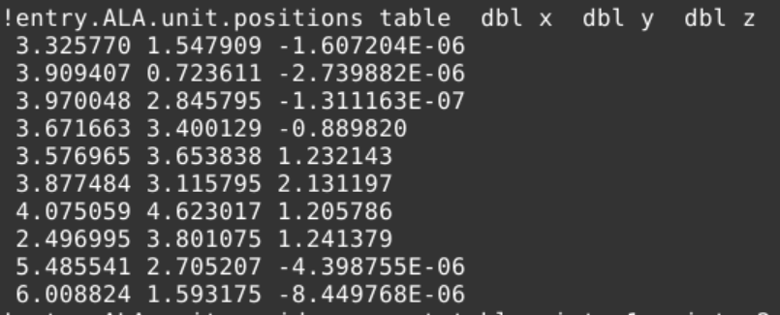
Topology parameters
Include connectivity, atomic charges, etc.
$AMBERHOME/dat/leap/lib
Amber file formats introductions: http://ambermd.org/FileFormats.php
amino12.lib

Slide 13
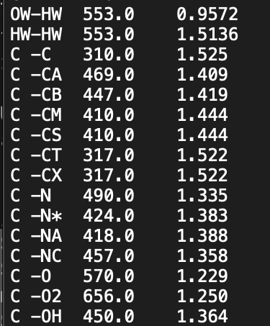
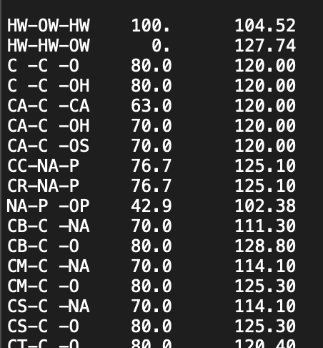
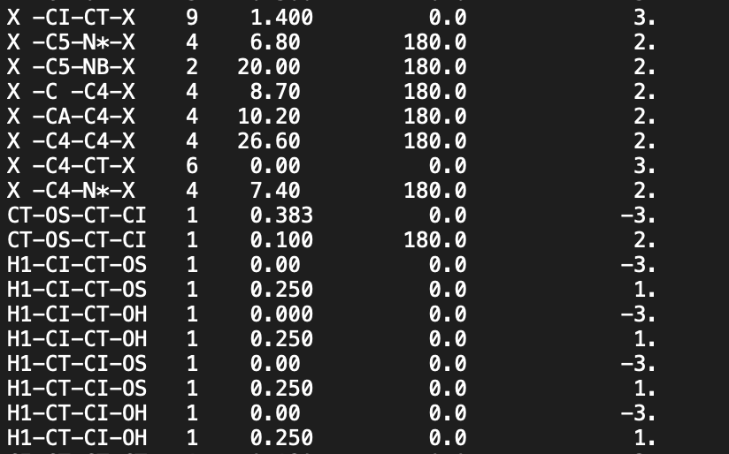
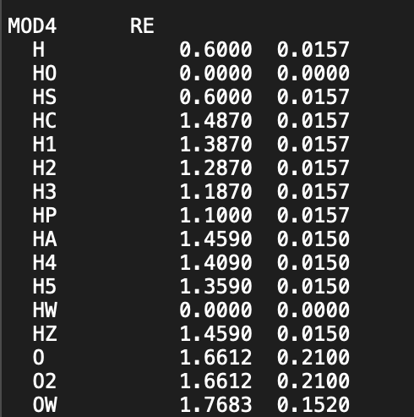

Potential parameters
$E=\underset{bonds}{∑}k_{r}(r−r_{0})^{2}+\underset{angles}{∑}k_{θ}(θ−θ_{0})^{2}+\underset{dihedrals}{∑}\frac{V_{n}}{2}[1+cos(nφ+φ_{0})]$ $+\underset{i}{∑}\underset{j≠i}{∑}\left[\frac{A_{i,j}}{r_{i,j}^{12}}−\frac{B_{i,j}}{r_{i,j}^{6}}\right]+\underset{i}{∑}\underset{j≠i}{∑}\frac{q_{i}q_{j}}{r_{i,j}}$
Amber’s potential parameter file: parmYY.dat
$AMBERHOME/dat/leap/parm
Amber file formats introductions: http://ambermd.org/FileFormats.php
bond
angle
dihedral
van der Waals
kr
r0
kθ
θ0
$$V_{n}=\frac{V_{n}^{′}}{m}$$
m
Vn’
φ0
n
σ
ε

Slide 14
Thermodynamic ensemble
There are three types of thermodynamic systems (ensembles)
Micro-canonical ensemble (NVE)
E: the intrinsic energy of the system
Canonical ensemble (NVT)
Thermostat: Berendsen thermostat Andersen thermostat Langevin dynamics Nose-Hoover thermostat Bussi thermostat, etc.
Isothermal-isobaric ensemble (NPT)
Mimic the experiment condition
Barostat: Berendsen barostat Monte Carlo barostat
Ensemble: An assembly of independent systems with identical structure but different state at certain macroscopic condition.

Slide 15
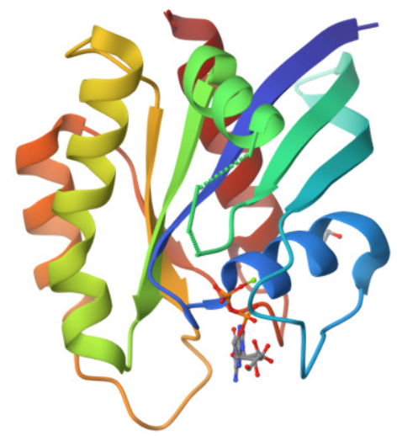
Demo: setup a protein simulation using Amber
5UK9

Slide 16
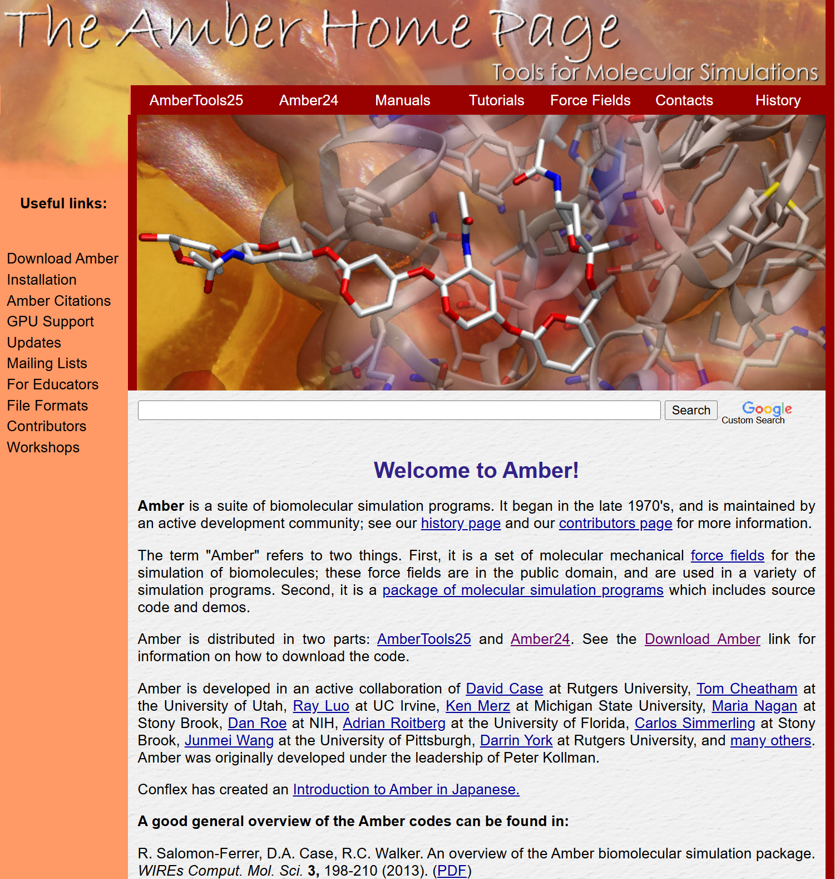
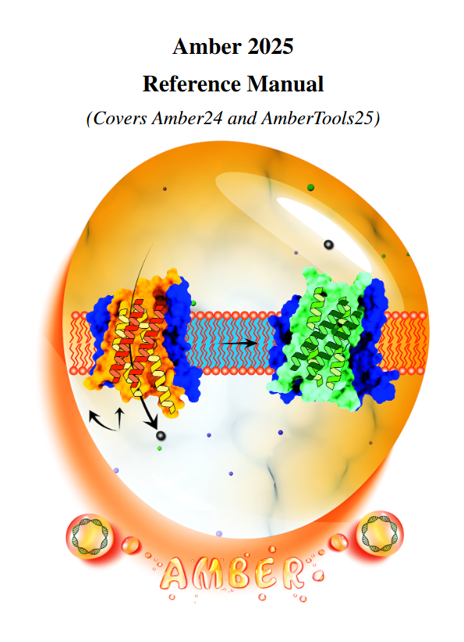
https://ambermd.org/

