Slide 1
AI赋能的生物大分子模拟和计算
Week 04
Yi Xue, School of Life Sciences, THU
Mar. 18, 2026

Slide 2
Atom Mask Selection Syntax
https://amberhub.chpc.utah.edu/atom-mask-selection-syntax/
Syntax | Example
:{residue numlist} | ’:1-10’, ’:1,3,5’, ’:1-3,5,7-9’
@{atom numlist} | ’@12,17’, ’@54-85’, ’@12,54-85,90’
:{residue namelist} | ’:LYS’, ’:ARG,ALA,GLY’
@{atom namelist} | ’@CA’, ’@CA,C,O,N,H’
@%{atom type name} | ’@%CT’
@/{atom_element_name} | ’@/N’
Selection for CHAIN ID’s | #Select chain A ::A # Select residues 1-10 of chains A, B, and C ::A,B,C:1-10 # Select protein backbone atoms of residues 2-20 in chains A and B ::A,B:2-20@CA,C,O,N
:ALA,TRP | All alanine and tryptophan residues.
:5,10@CA CA | carbon in residues 5 and 10.
:*&!@H= | All non-hydrogen atoms (equivalent to “!@H=”).
@CA,C,O,N,H | All (protein) backbone atoms.
!@CA,C,O,N,H | All non-backbone atoms (=sidechains for proteins only).
:1-500@O&!(:WAT|:LYS,ARG) | All backbone oxygens in residues 1-500 but not in water, lysine or arginine residues.
(:11@CD<:5.5)&:Na+ | Select all residues within 5.5 Ang. of atom CD from residue 11) AND those residues must be named Na+

Slide 3
cpptraj
https://amberhub.chpc.utah.edu/cpptraj/

Slide 4
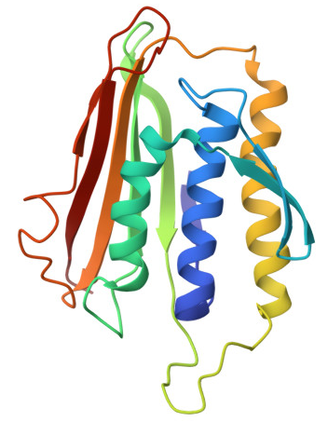
Homework: simulation and analysis of MAD2
Deadline: 4 weeks
Mutate residue R135 to Alanine (R135A), and record a 1-µs trajectory
Plot RMSD and RMSF (using the python code in Week01) time course
Plot per-residue secondary structure content
Perform PCA analysis, make a PCA plot, pick up one representative structure for each cluster and render them according to Fig. 1 in https://ambermd.org/tutorials/advanced/tutorial41/index.php
Make gif animations for the first 3 principal components
PDB ID: 1DUJ
Relevant paper: https://www.nature.com/articles/nsmb748

