Slide 1
AI赋能的生物大分子模拟和计算
Week 05
Yi Xue, School of Life Sciences, THU Mar. 25, 2026

Slide 2
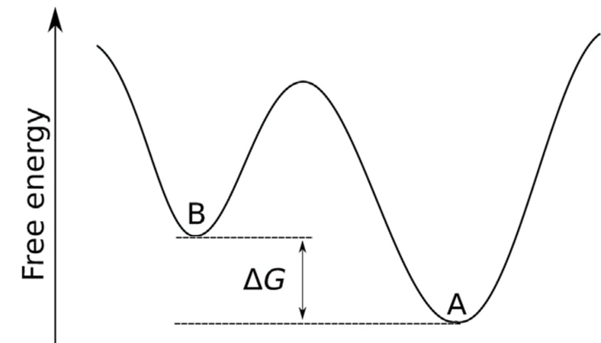
Boltzmann distribution
Collective variables (CV), reaction coordinates,
order parameters, generalized coordinates

Slide 3
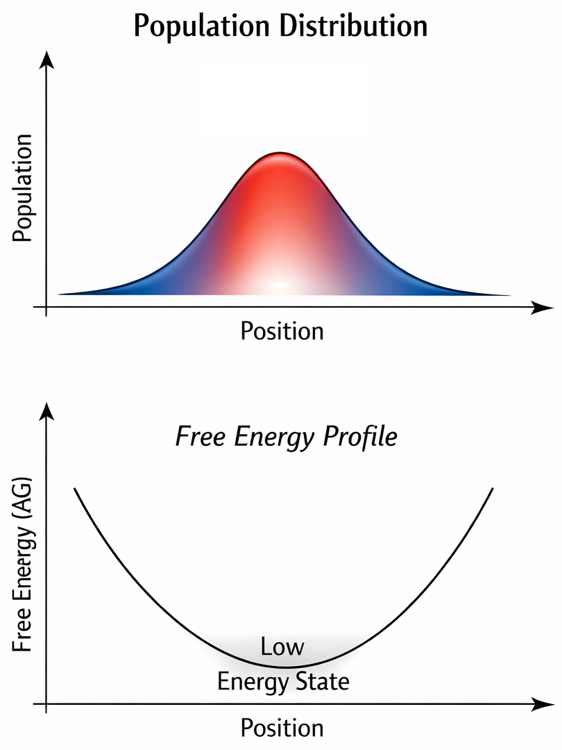
Free energy and population
Collective variables (CV), reaction coordinates,
order parameters, generalized coordinates

Slide 4
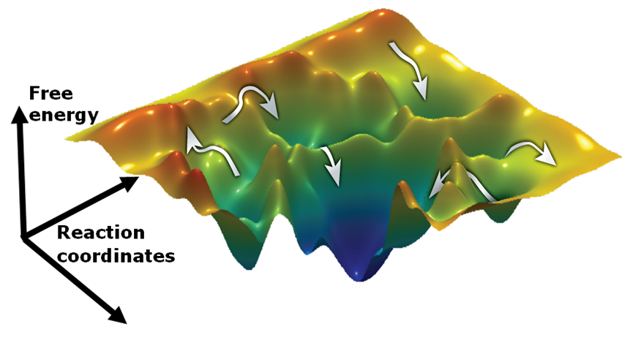
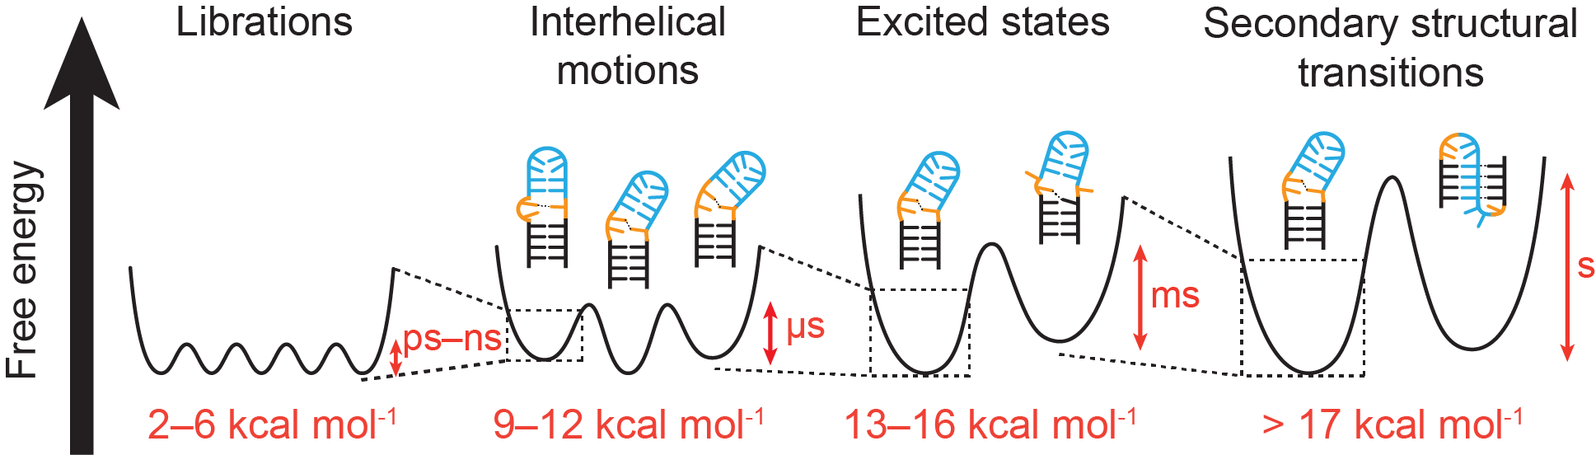
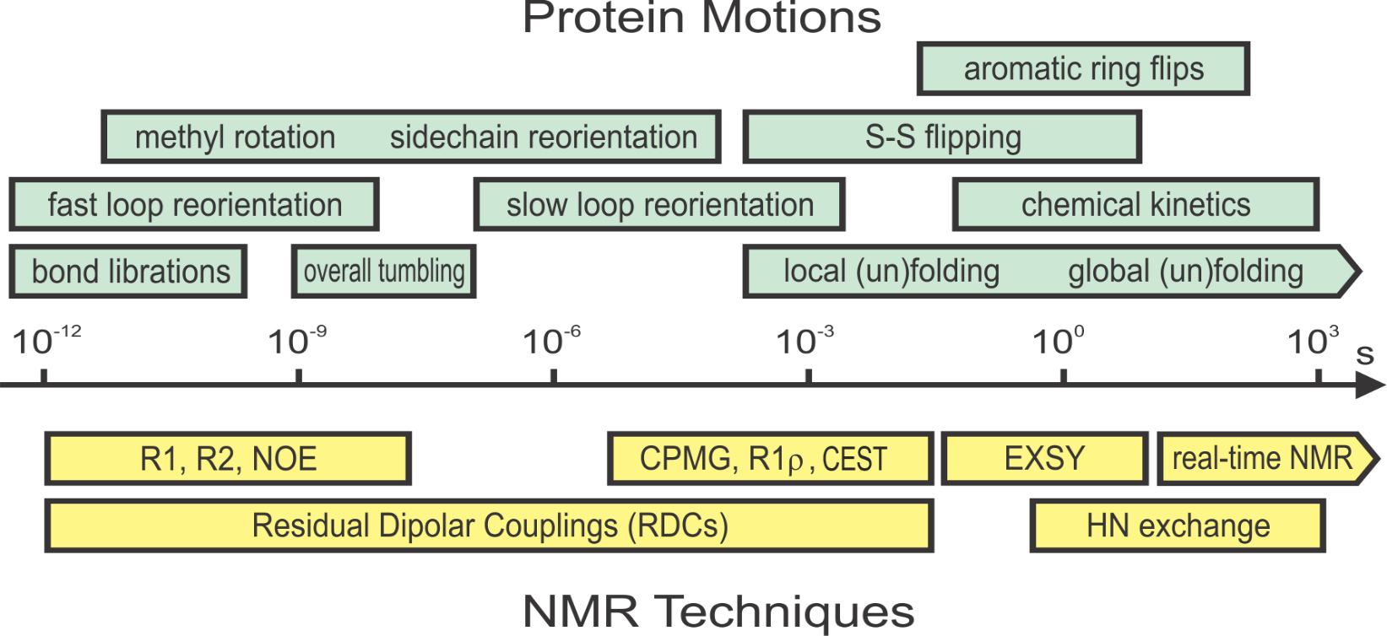
Dynamics of biomacromolecules
Timescale of RNA dynamics
Bothe, et. al. Nature Methods (2011). 8: 919

Slide 5
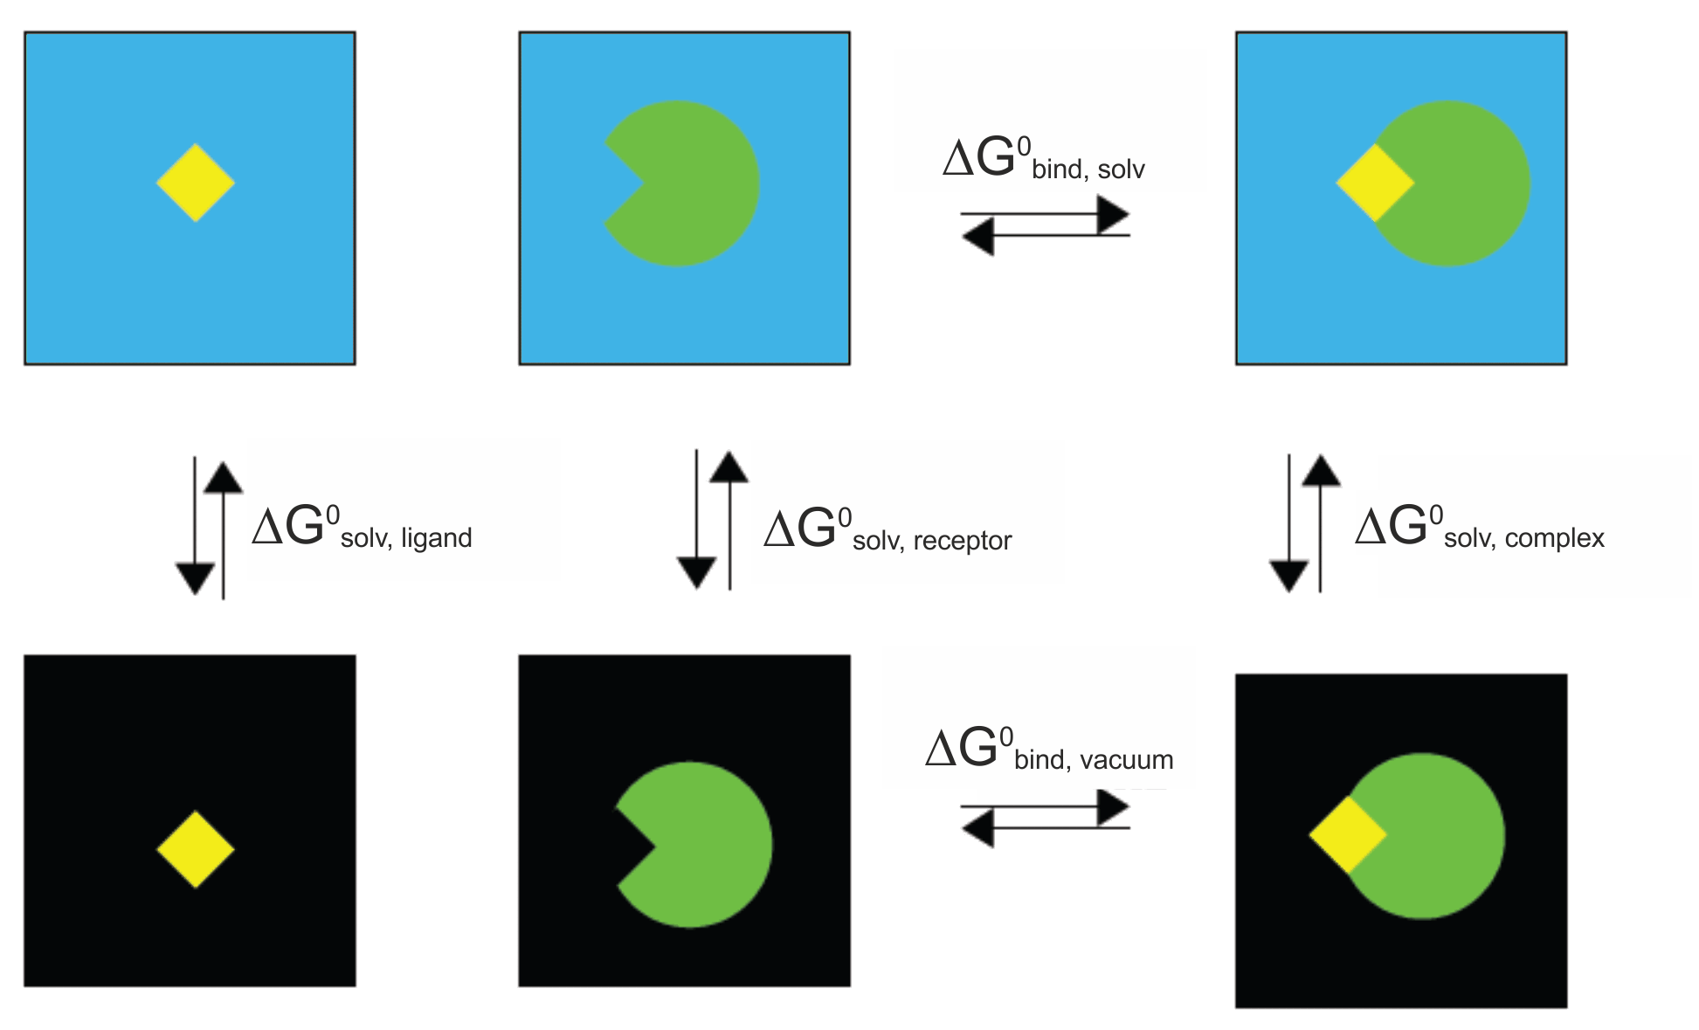
Binding free energy calculation: MM-PBSA
Collective variables (CV), reaction coordinates,
order parameters, generalized coordinates
Notes:
upside-down umbrellas

Slide 6
Binding free energy calculation: MM-PBSA
ΔH: from MD potentials
ΔS: from normal mode analysis
PBSA (Poisson-Boltzmann Surface Area)
Or
GBSA (Generalized Born Surface Area)
PB/GB: 连续介质静电溶剂化能
SA: 非极性溶剂化贡献
Notes:
In practice entropy contributions can be neglected if only a comparison of states of similar entropy is desired such as two ligands binding to the same protein. The reason for this is that normal mode analysis calculations are computationally expensive and tend to have a large margin of error that introduces significant uncertainty in the result.
In principle, three independent MD simulations of the complex and both individual proteins are required. However, typically one makes the approximation that no significant conformational changes occur upon binding, so that the calculation can be performed from a single trajectory.

Slide 7
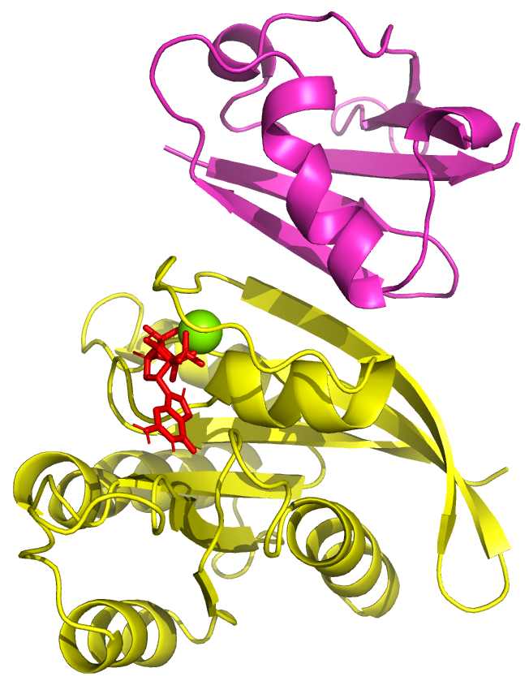
Demo 1
Collective variables (CV), reaction coordinates,
order parameters, generalized coordinates
Notes:
We will simply remove the GTP. While not strictly correct this approximation is somewhat reasonable since, as can be seen from the figure above, GTP is not directly involved in the binding interface.
Similarly, we will remove Mg2+

Slide 8
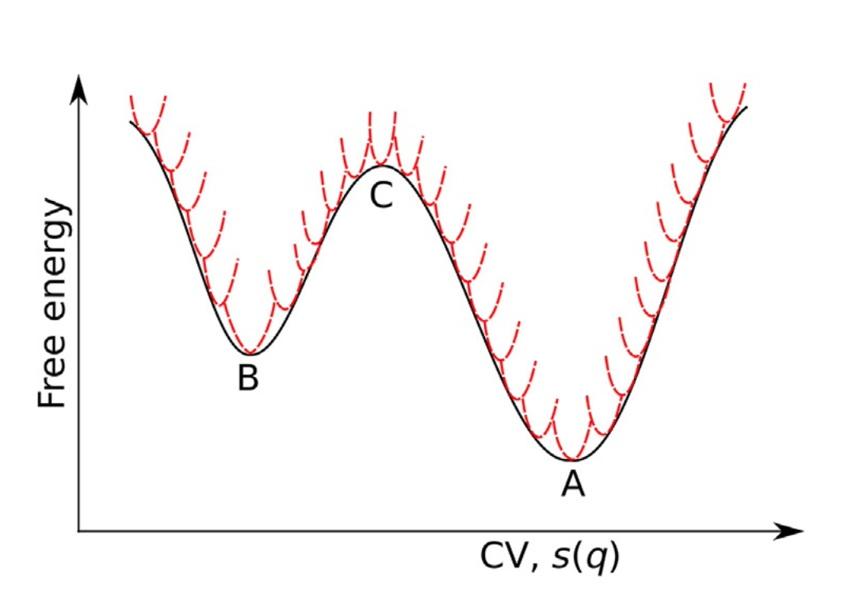
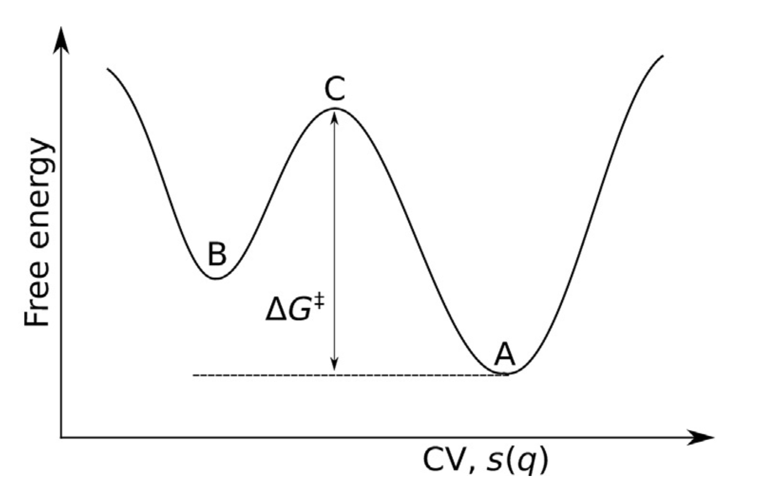
Umbrella sampling
apply harmonic restraint along CV
Collective variables (CV), reaction coordinates,
order parameters, generalized coordinates
Notes:
upside-down umbrellas

Slide 9
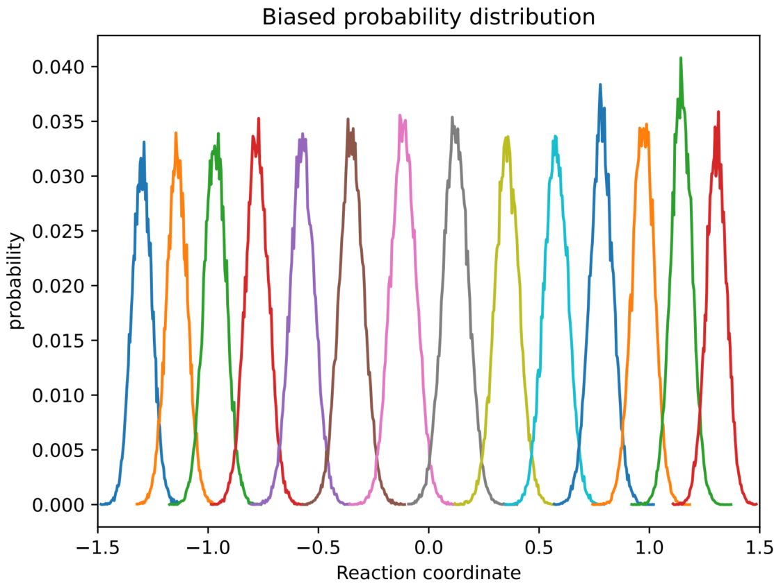
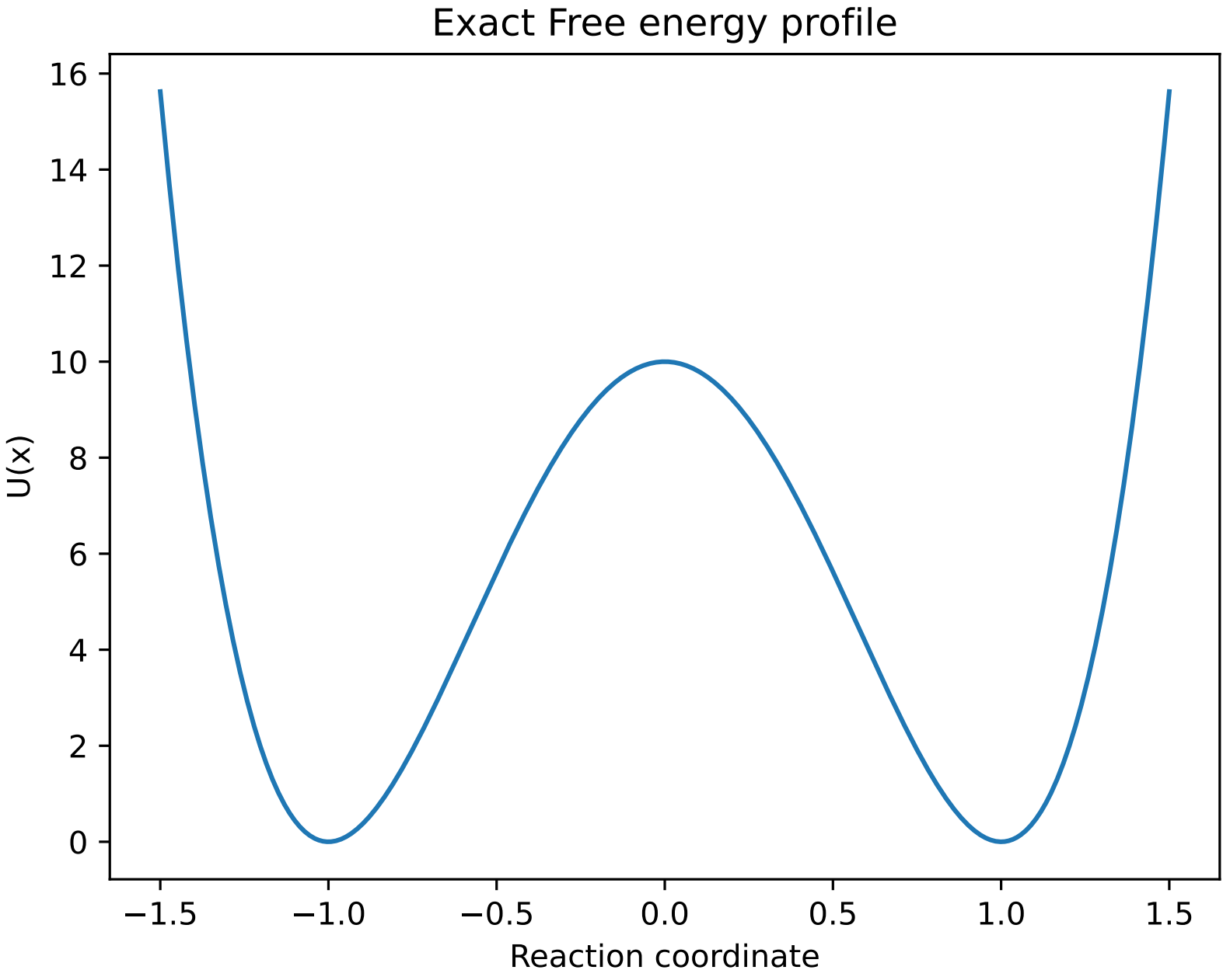
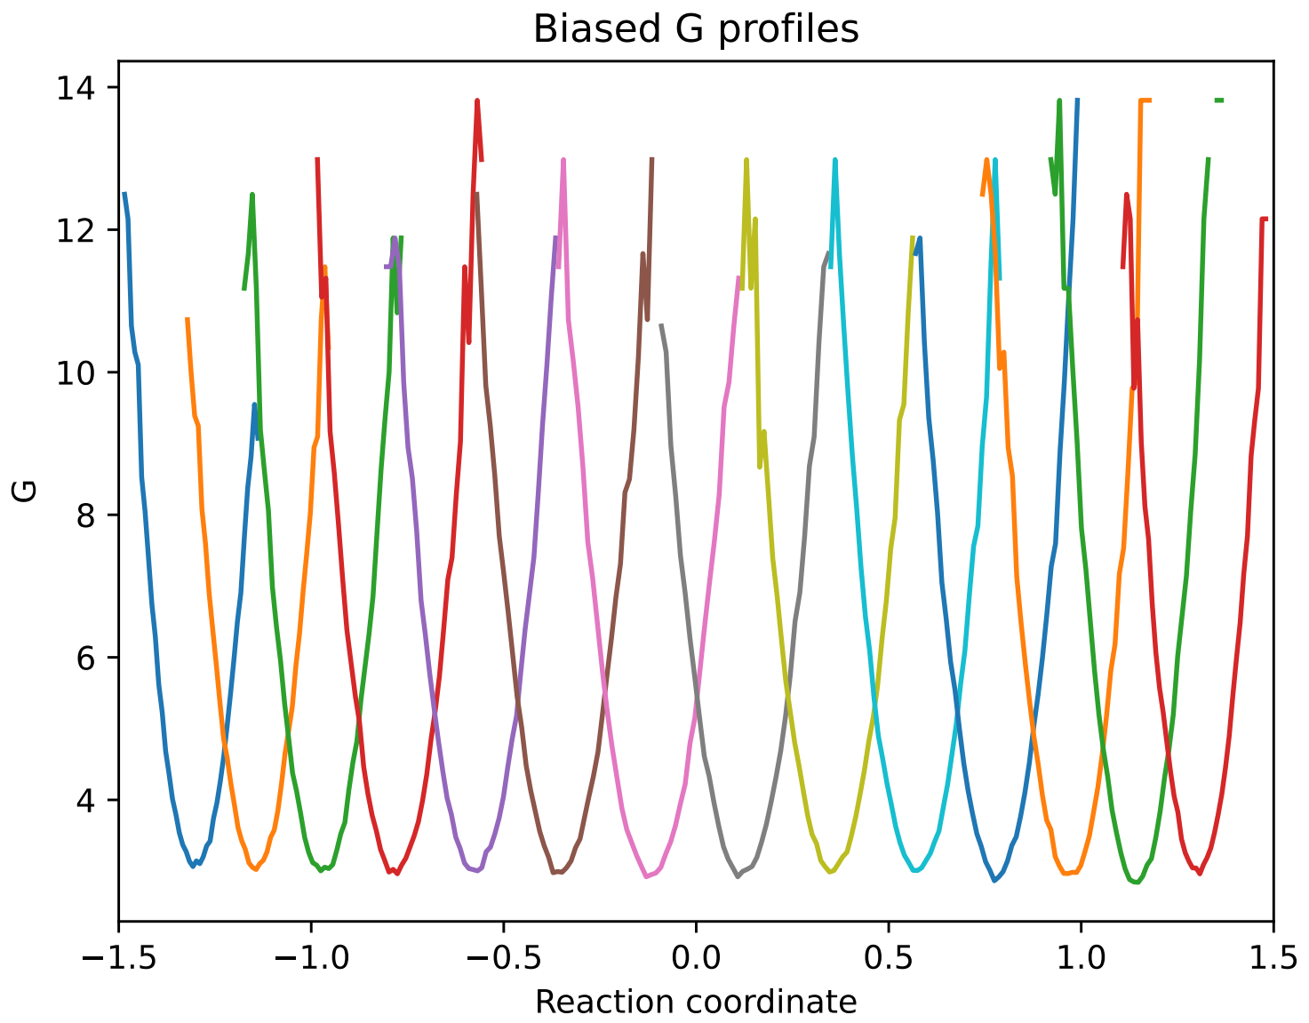
A simple demo
to derive potentials of mean force (PMF) from Boltzmann equation
MM: Molecular Mechanics
QM: Quantum Mechanics
MC: Monte Carlo
Notes:
Then we remove the standard harmonic potential that we applied previously from every energy profile

Slide 10
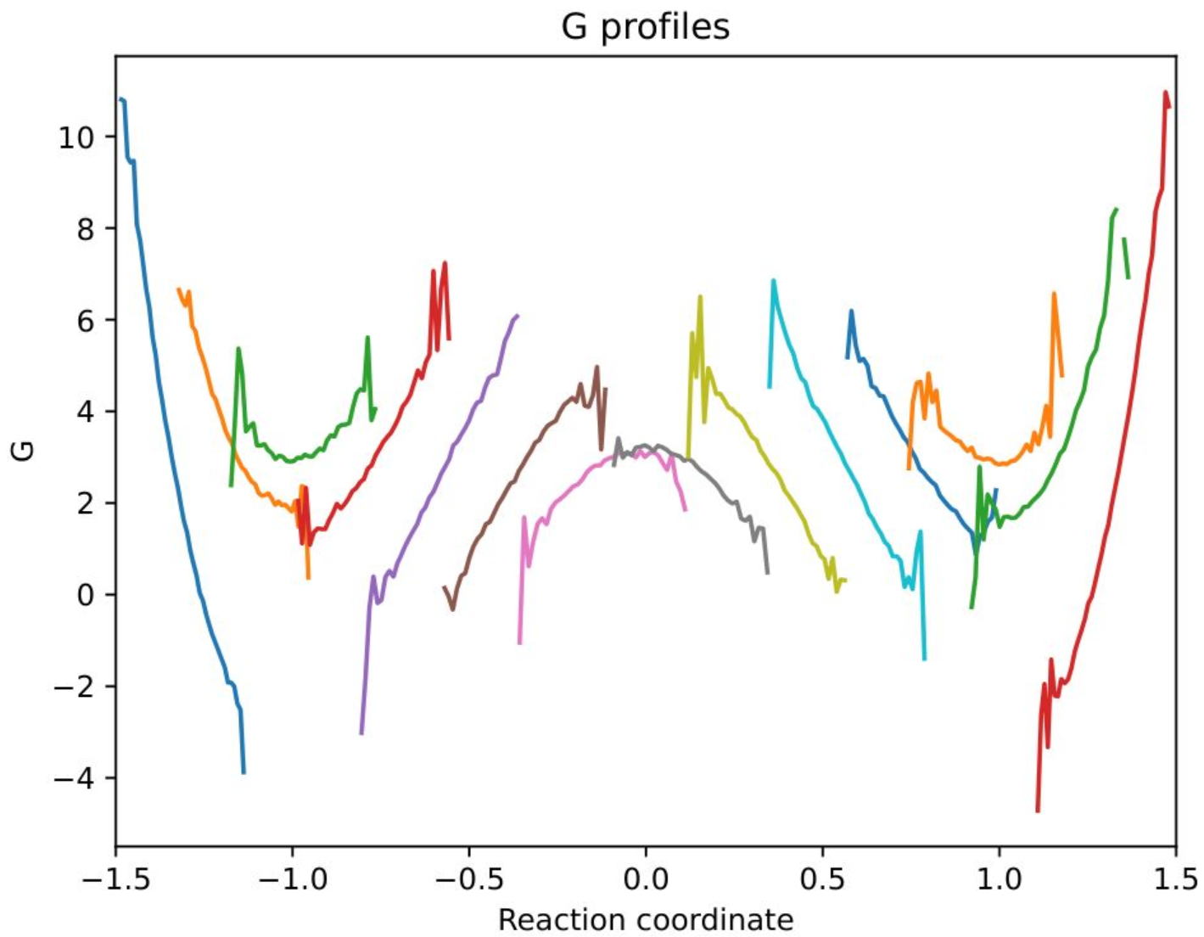
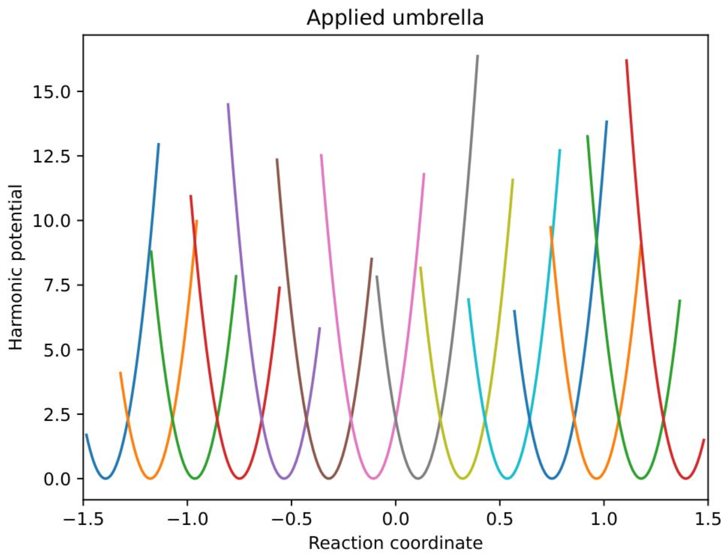
相减 =

Slide 11
Notes:
Play a Jigsaw puzzle

Slide 12
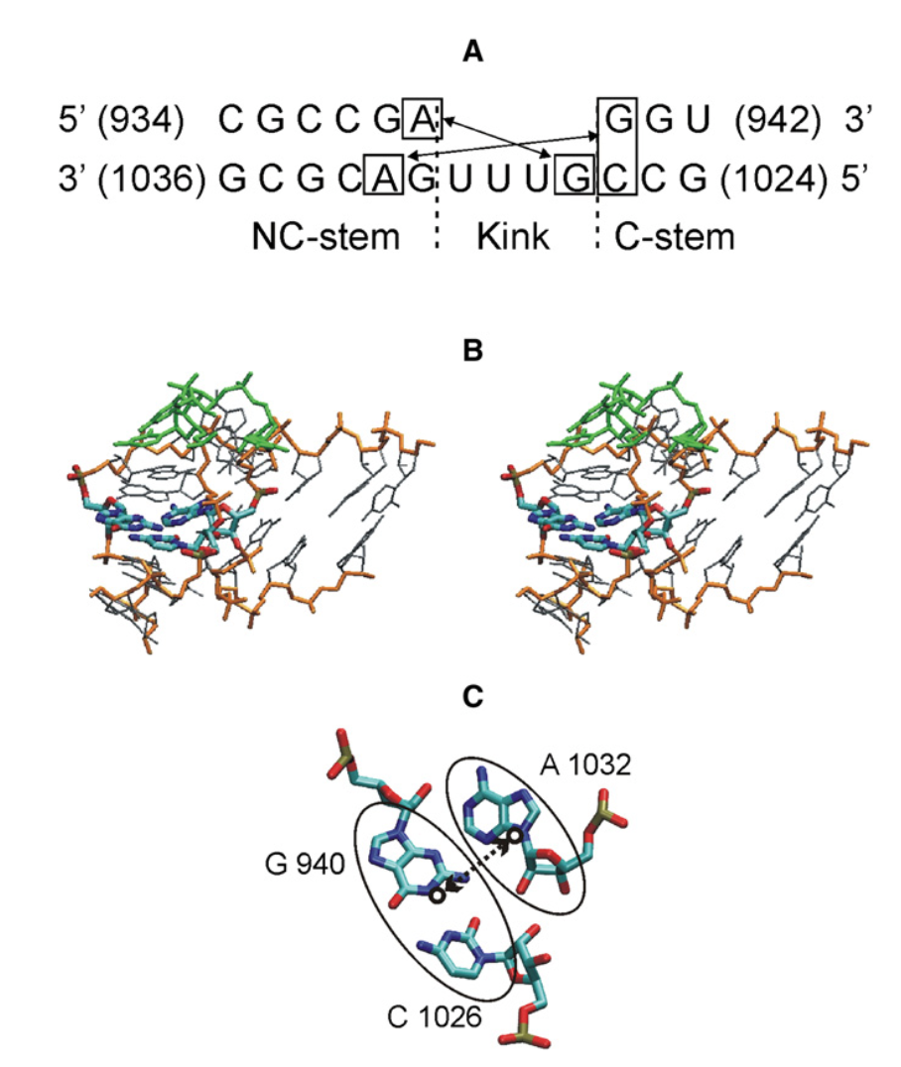
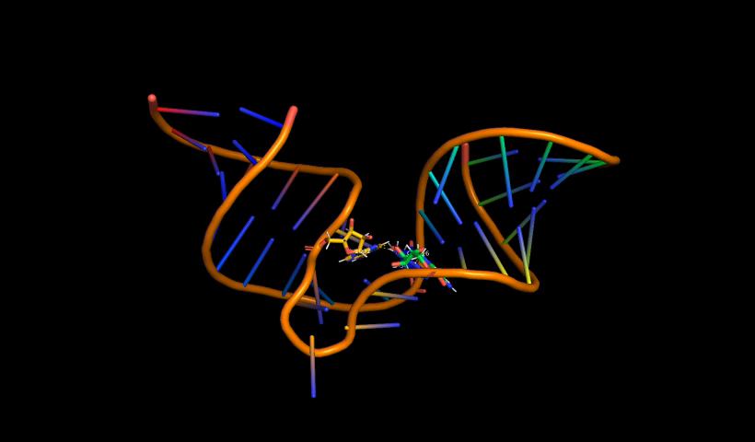
Case study: kink-turn motif
kink-turn motif in this study
Curuksu J., Biophysical J, 2009, 97(7):2004-2013.
A-minor in kink-turn is represented in stick-model
12
Notes:
ribosomal RNA
use US to disrupt an A-minor interaction in the ribosomal kt38 turn and to calculate the associated free-energy change

Slide 13
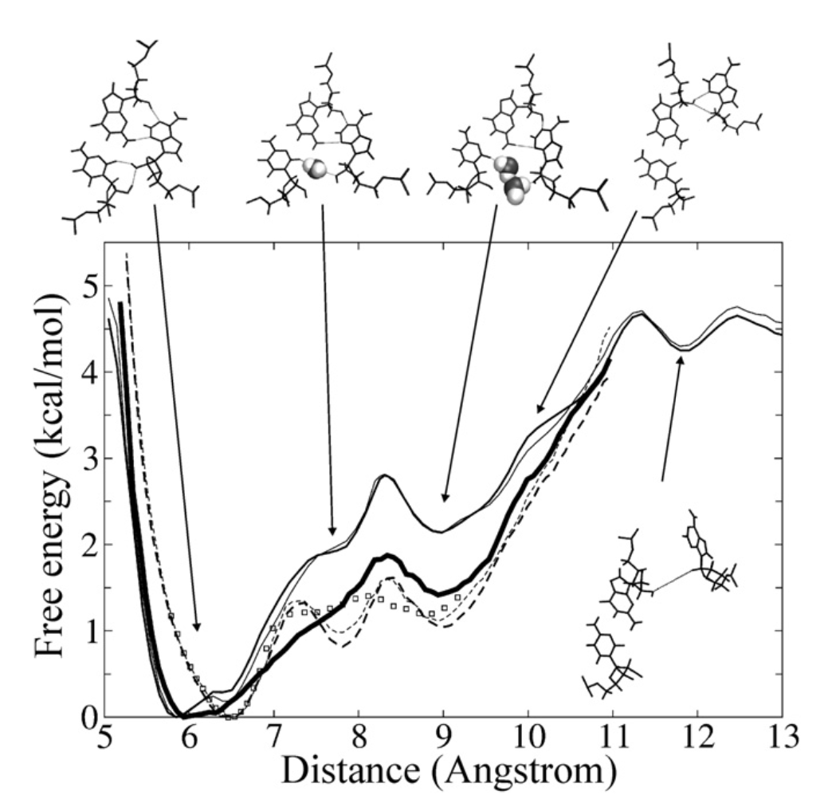
Case study: kink-turn motif
closed
semi-open
open
Thin lines: PMFs in the forward (full line) and backward (dashed line), 2 ns per interval
Hair lines: PMFs in the forward (full line)and backward (dashed line), 1 ns per interval
Bold line: PMF by REUS method, forward (full line) or backward (open squares)
13
Notes:
The reaction coordinate (d) was defined as the distance between the center of mass of nucleoside A1032 and the pair of nucleosides G940 and C1026
a meta-stable, semi-open structure, and an open structure
Thin lines correspond to PMFs calculated in the forward (full line)and backward (dashed line) simulations, respectively. Hair lines correspond to a data-gathering time of 1 ns per umbrella-sampling interval. Thin lines indicate the same simulations but extended to 2 ns per interval. The bold line is the PMF obtained by using the REUS method with starting conformations in each window as obtained after the forward (full line) or backward(open squares) umbrella-sampling production runs.

Slide 14
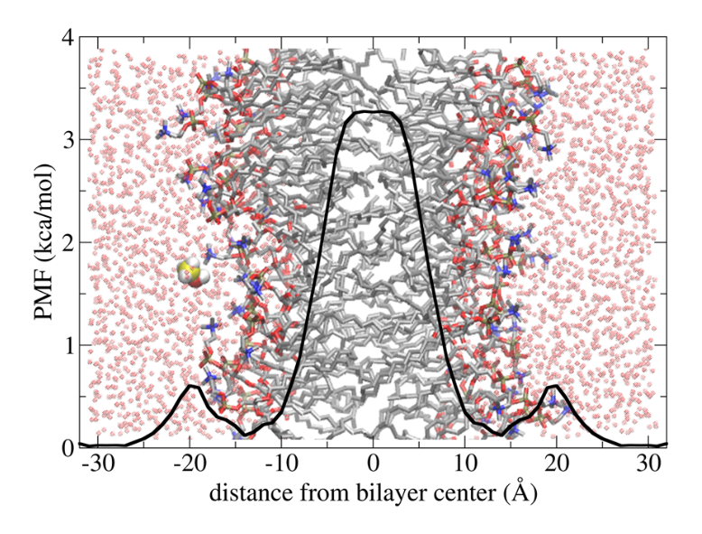
Demo 2
Collective variables (CV), reaction coordinates,
order parameters, generalized coordinates
Notes:
We will simply remove the GTP. While not strictly correct this approximation is somewhat reasonable since, as can be seen from the figure above, GTP is not directly involved in the binding interface.
Similarly, we will remove Mg2+

