Slide 1
AI赋能的生物大分子模拟和计算
Week 06
Yi Xue, School of Life Sciences, THU April 1, 2026

Slide 2
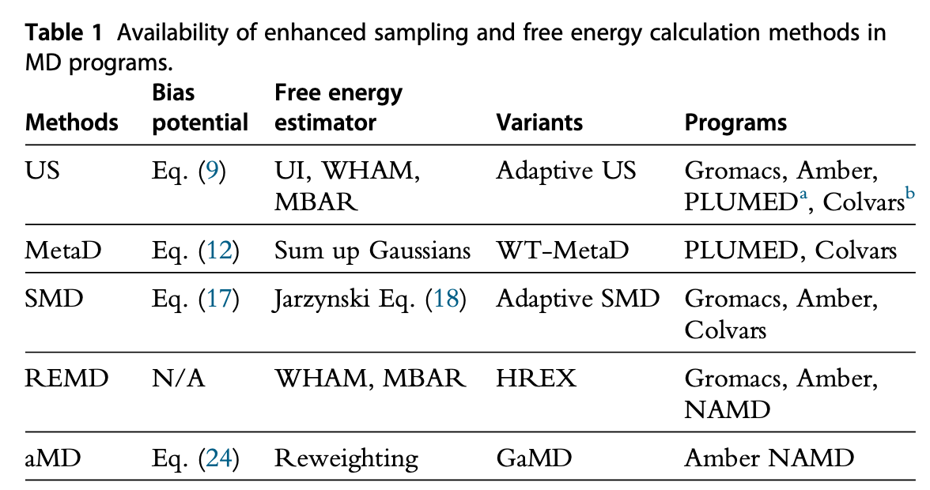
Enhance conformational sampling
REMD (Replica Exchange MD)
Umbrella sampling
Metadynamics
aMD (accelerated MD)
Steer molecular dynamics (SMD)
Liao Q., Prog Mol Biol Transl Sci. 2020;170:177-213.

Slide 3
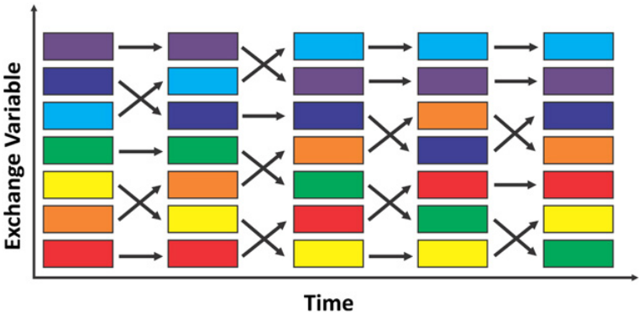
Enhance conformational sampling
REMD (Replica Exchange MD)
Umbrella sampling
Metadynamics
aMD (accelerated MD)
Steer molecular dynamics(SMD)

Slide 4
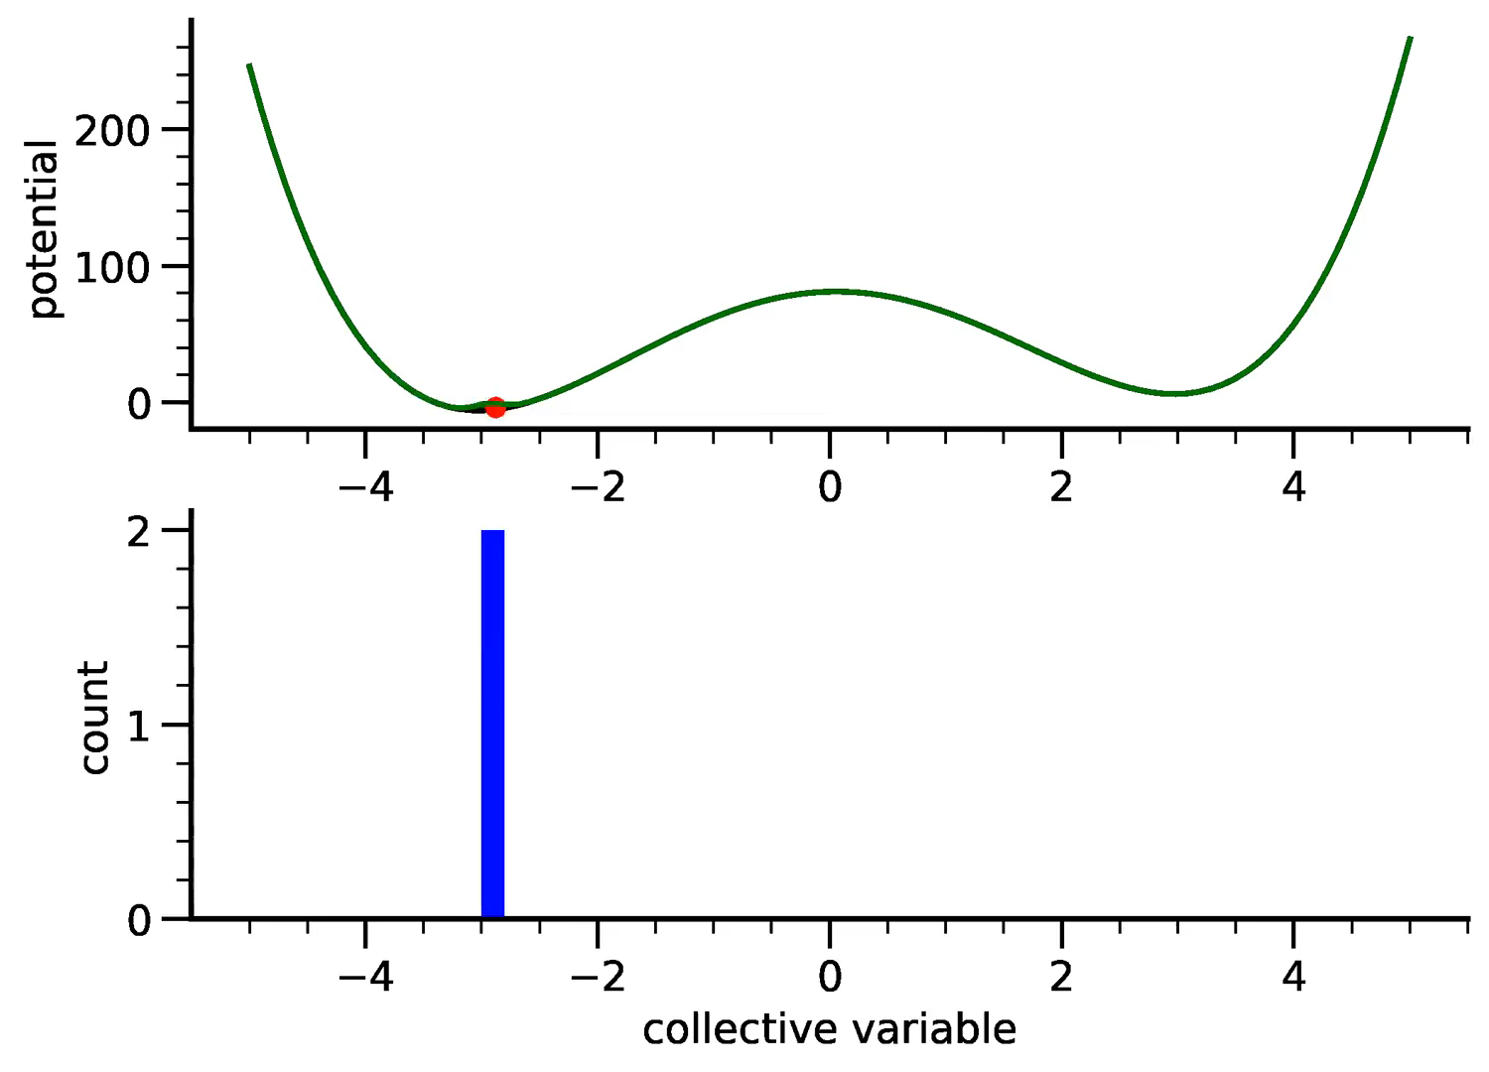
Enhance conformational sampling
REMD (Replica Exchange MD)
Umbrella sampling
Metadynamics
aMD (accelerated MD)
Steer molecular dynamics(SMD)
a.k.a: MTD, METAD or MetaD
During the simulation, more and more positive Gaussians are added to the landscape, until the system explores the full energy landscape
Finally, the energy landscape can be recovered as the opposite of the sum of all Gaussians
filling the free energy wells with computational “sand”
Notes:
Umbrella sampling is digging the pit, while metadynamics is filling the pit.
The algorithm assumes that the system can be described by a few collective variables (CV). During the simulation, the location of the system in the space determined by the collective variables is calculated and a positive Gaussian potential is added to the real energy landscape of the system. In this way the system is discouraged to come back to the previous point. During the evolution of the simulation, more and more Gaussians sum up, thus discouraging more and more the system to go back to its previous steps, until the system explores the full energy landscape—at this point the modified free energy becomes a constant as a function of the collective variables which is the reason for the collective variables to start fluctuating heavily. At this point the energy landscape can be recovered as the opposite of the sum of all Gaussians.

Slide 5
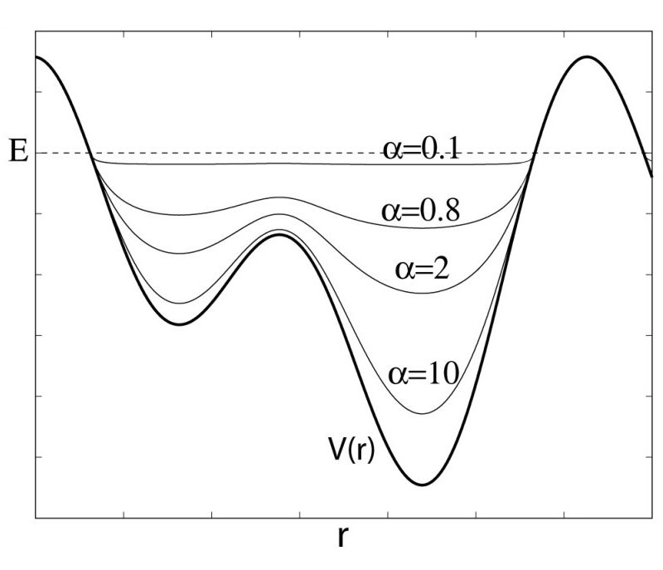
Enhance conformational sampling
REMD (Replica Exchange MD)
Umbrella sampling
Metadynamics
aMD (accelerated MD)
Steer molecular dynamics(SMD)
Variants:
Gaussian aMD (GaMD)

Slide 6
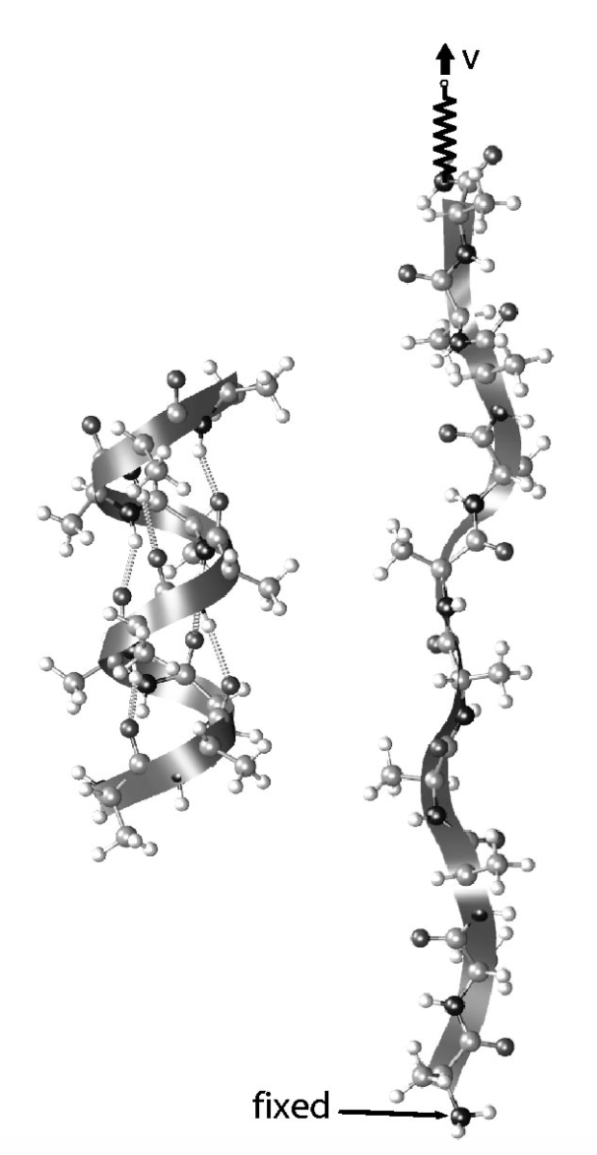
Enhance conformational sampling
REMD (Replica Exchange MD)
Umbrella sampling
Metadynamics
aMD (accelerated MD)
Steer molecular dynamics(SMD)
Torrie G.M, Valleau J.P., J Comput Phys. 1977;23:187–199.

Slide 7
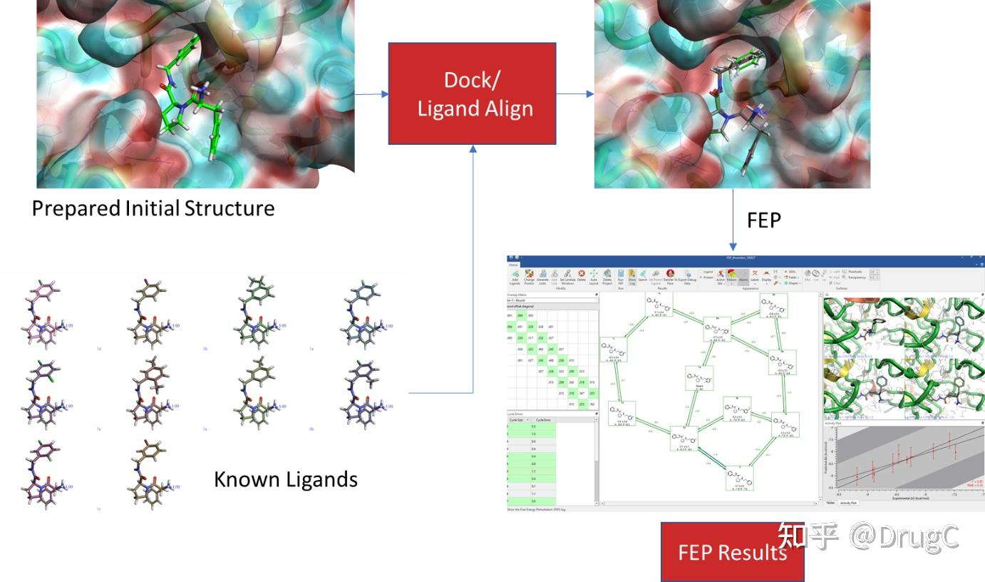
Alchemical Free Energy Calculations
Binding pocket
Known ligands
Method | docking | MM/PB(GB)SA | FEP
Precision | <50% | 50~60% | 60~70%
Computation cost | 1 | > 100 | > 100
Setup | easy | middle | difficult
Notes:
对于已知活性位点的一个蛋白质，我们可以用计算的手段对小分子库进行筛选，小分子库可以是一个大的化合物库，也可以是对某个已知活性小分子的类似物. 计算方法有很多种 1. docking是计算量比较小、实现比较方便的一种；
2. 可以做MM/PBSA，一般是把小分子和蛋白质先做多个ns的模拟，计算量比docking会打上百倍，实现还是比较方便，就是跑一个CMD，然后用Amber自带的MMPBSA.py做一下分析
3. 还有一种方法就是FEP，计算量很大，配置起来也是最麻烦的，但是精度是最高的
自由能微扰（free energy perturbation, FEP）的构建: https://zhuanlan.zhihu.com/p/596703265

Slide 8
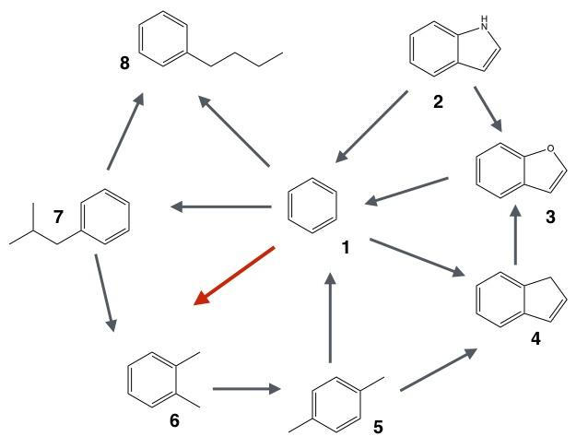
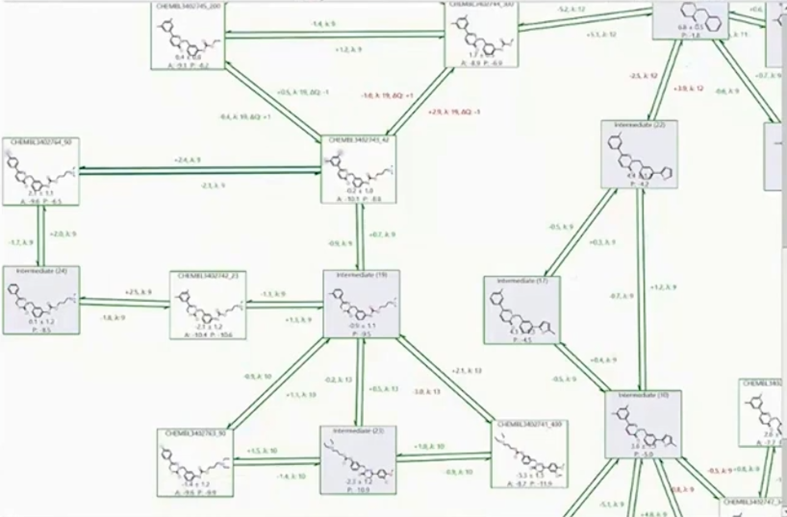
Perturbation Map
3) Optimal map
1) Star map
2) Wheel map
Accelerate Drug Discovery with Free Energy Perturbation for Predicting Molecular Binding Affinities
Notes:
回到生物背景，我们对于多个小分子，可以利用FEP去计算比较两两之间结合能的高低，找到结合能最低的分子，我们可以两两之间计算相对结合能，但是为了节省计算资源，可以找更简单的路径，将分子两两之间串联起来
start map：找一个中心分子，符合于其他分子相连；1-2, 1-3, …, 1-8
wheel map：1-2, 2-3, 3-4, …, 7-8，最不常用
optimal map：很多商用的软件会有这种功能，会尽量让计算相对结合能的分子之间差异最小；差异越小，计算的准确度越高

Slide 9
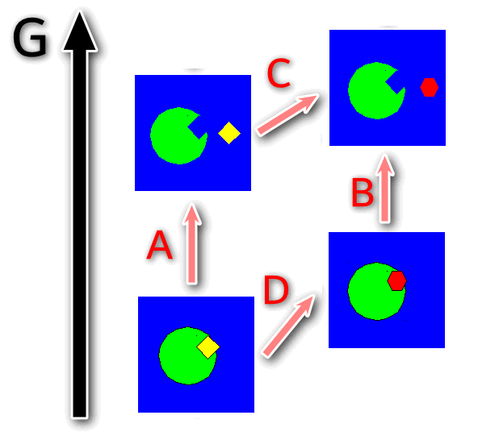
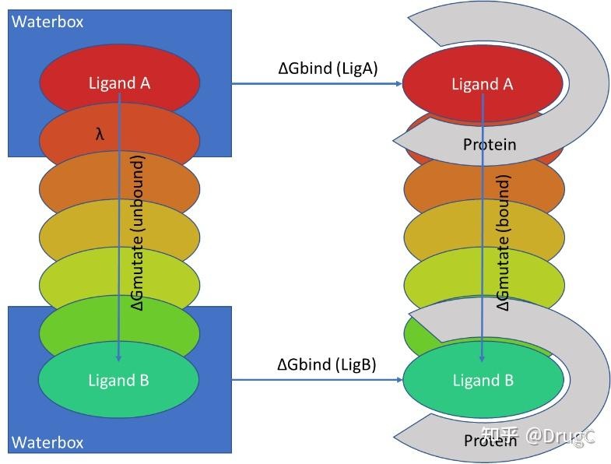
Alchemical Relative Binding Free Energy (RBFE)
Illustration of TI/FEP
Darrin, ACS Phys. Chem Au (2023)
Notes:
现在有一堆分子ligand1/ligand2，分别有自己的结合能。一对分子的相对结合能，也就是delta G1减去delta G2。如果大于零，表示ligand1结合能更低，结合更稳定；如果小于零，表示ligand2结合更稳定
直接计算delta G1/delta G2，再比较两者之间的相对结合能是比较困难的，因为会受到多种因素的影响
那么怎么计算水相中的delta G q和复合物中的delta G呢，就需要用到炼金术结合能计算；因为这种变化，不是基于物理和化学规则的，而是直接在原位进行了化学元素种类和原子数的改变，像炼金术一样，所以叫这个名字
再具体的来说，炼金术结合能的计算，需要建立多个窗口，用lambda表示转换的进程
lambda=0的时候，体系完全是ligand1
lambda=1的时候，体系完全是ligand2
lambda会经历从零到一的逐渐变换，通过累计相邻窗口之间的自由能的差异，最终累计得到两个端点的相对自由能

Slide 10
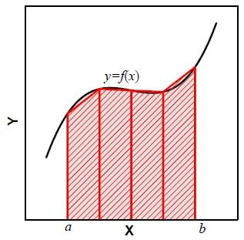

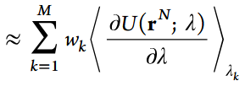
TI (Thermodynamic Integration)
integration of the thermodynamic derivative
ensemble average: <∂U/∂λ>_{λ} = mean((∂U/∂λ)_{frame=0…N})
derivative for one sample: ∂U/∂λ = U_{lig2}-U_{lig1}
discrete integral of windows from 0 to 1
Notes:
lambda从0到1，体系的总能量，实际变成了一个对各原子坐标以及lambda的函数；根据热力学基本关系，自由能随lambda的变化速率，等于能量函数对lambda偏导数的平均值
误差来源：采样不足；积分近似误差

Slide 11





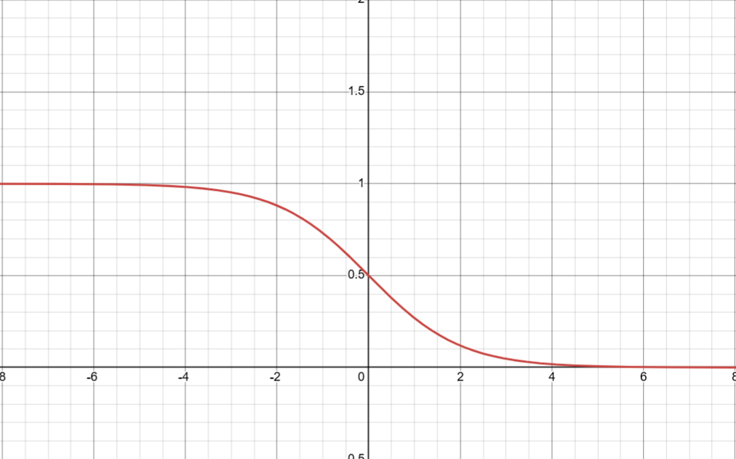
FEP (Free Energy Perturbation)
integration of several windows
“forward” or “backward”
BAR (Bennett’s acceptance ratio)
, λ_{k} < λ_{k+1}, λ₁ = 0, and λ_{M} = 1
ΔU_{k+1,k} - (-C)
Notes:
正向，其实是对所有lambda_k所在的相空间的构象，都计算他变化到lambda_k+1所在的相空间的能量，做了一个指数平均。但是很多能量差大于零的，也就是不可能从k变到k+1的构象，也考虑进去了。反向依然
BAR，通过费米方程，也就是一个接受率函数，当k空间的构象变化到k+1空间，能量差远大于C，即能量会升高很多，则接受零为0；能量差远小于C，即能量会降低很多，则接受率为1；能量差在C附近的，接受率在0-1之间
公式的上面表示k到k+1的接受率，公式下面表示k+1到k的接受率，如果接受率相当，表示两个空间互相之间达到了平衡，公式左边这一项会变成0，这时候的结合能差值等于C
BAR方法通过迭代求解，找到让公式成立的C
误差来源：相空间重叠不足；采样不充分

Slide 12
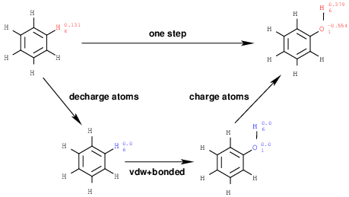

Setup of TI/FEP
Two systems
ligands / complex
Equilibrium of two systems each with dual topology for ligand1 and ligand2
Three steps
decharge : decharge of lig1
vdw_bonded : trans from lig1 to lig2
recharge : recharge of lig2
windows
lambda from 0 to 1

Slide 13
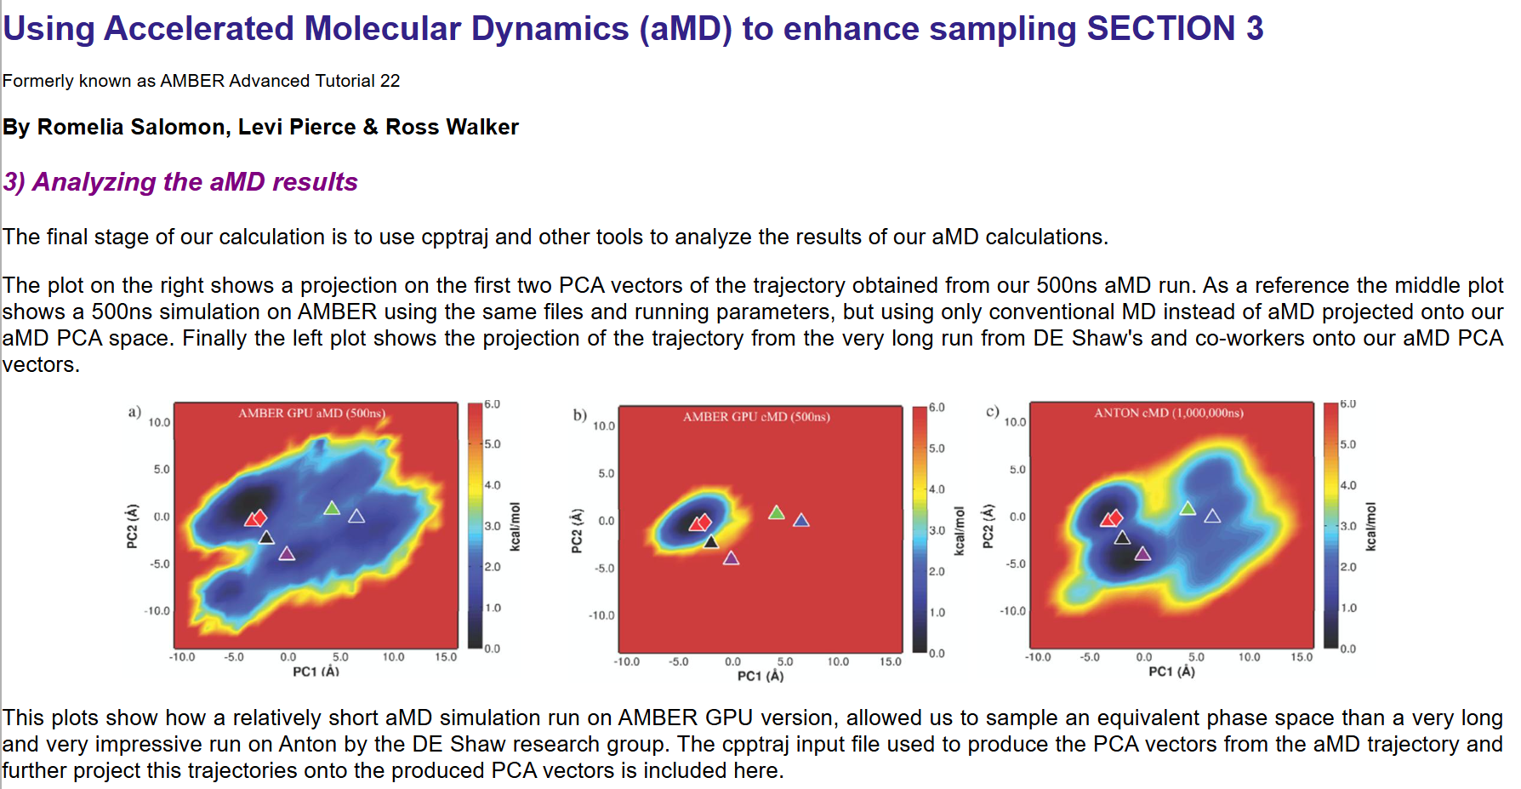
Demo 1
https://ambermd.org/tutorials/advanced/tutorial22/index.php

Slide 14
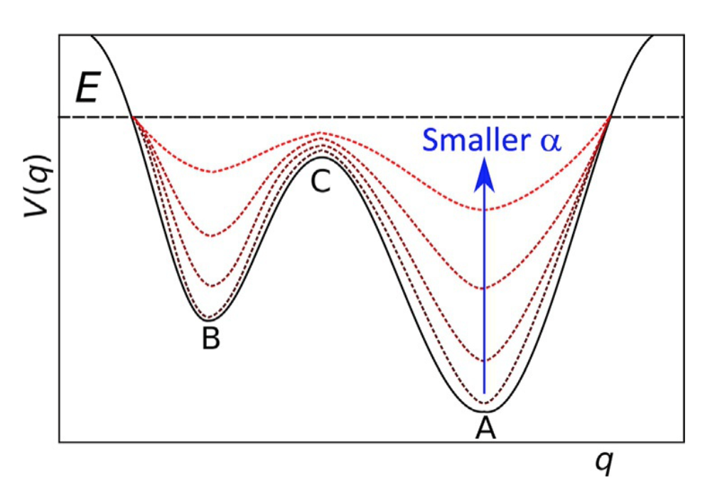

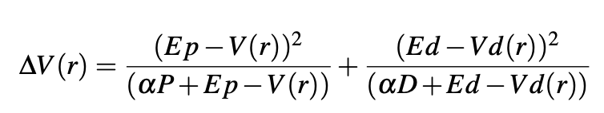
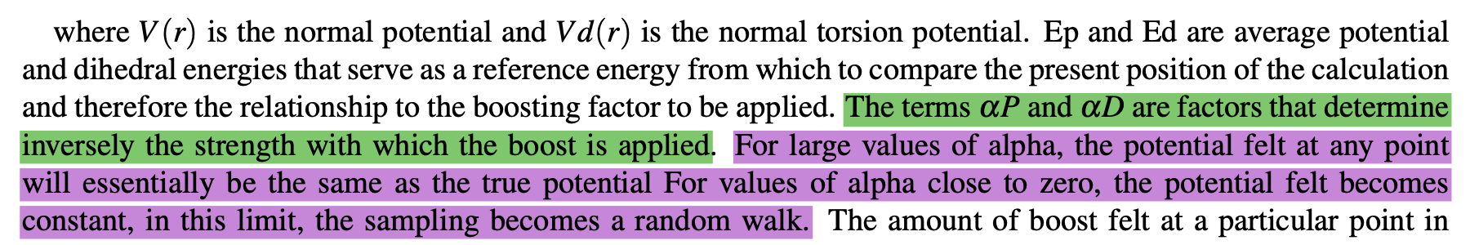
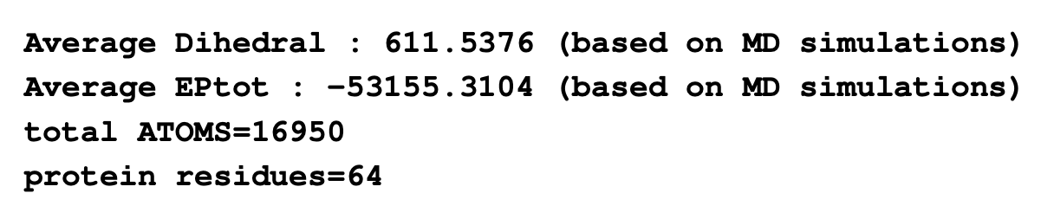
Amber’s implementation of accelerated MD
14

Slide 15
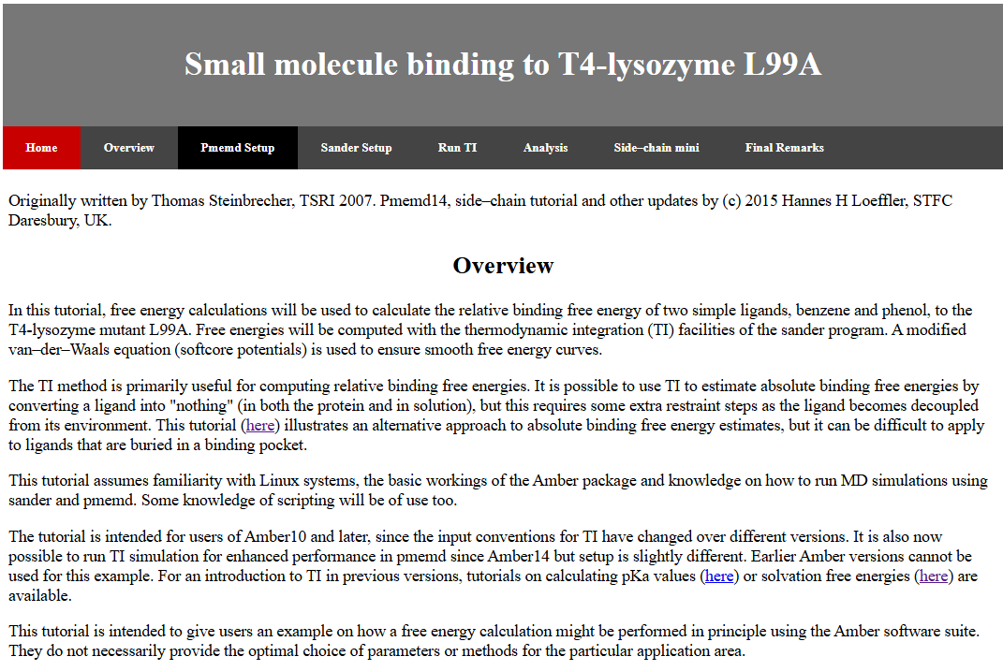
Demo 2
T4-lysozyme destroys bacteria by hydrolyzing the polysaccharide component of the cell wall.
An artificial cavity suitable for the binding of small non–polar molecules was introduced by single point mutation (See Eriksson et al., Nature 1992, 371–373).
The binding affinities of several small molecules to this enzyme have been determined, making it a good model system for the study of protein–ligand binding.
Benzene is bound in the lipophilic cavity with a ΔG_{Bind} of -5.2 kcal/mol, while the more polar phenol does not bind at all.
Analysis tool:
alchemrs
https://github.com/helmutcarter/alchemrs https://helmutcarter.github.io/alchemrs/introduction.html
alchemlyb
https://github.com/alchemistry/alchemlyb
https://alchemlyb.readthedocs.io/en/latest/index.html
https://ambermd.org/tutorials/advanced/tutorial9/index.html
https://github.com/yuxuanzhuang/amber_fep_tutorial/tree/amber.20.cuda

