Slide 1
AI赋能的生物大分子模拟和计算
Week 07
Yi Xue, School of Life Sciences, THU April 8, 2026

Slide 2
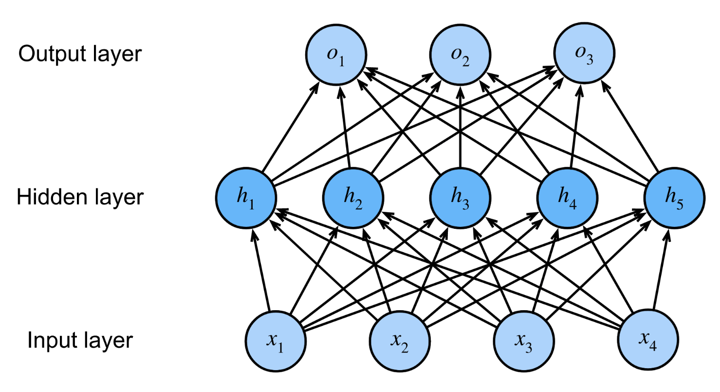
Multi-Layer Perceptron (MLP)

Slide 3
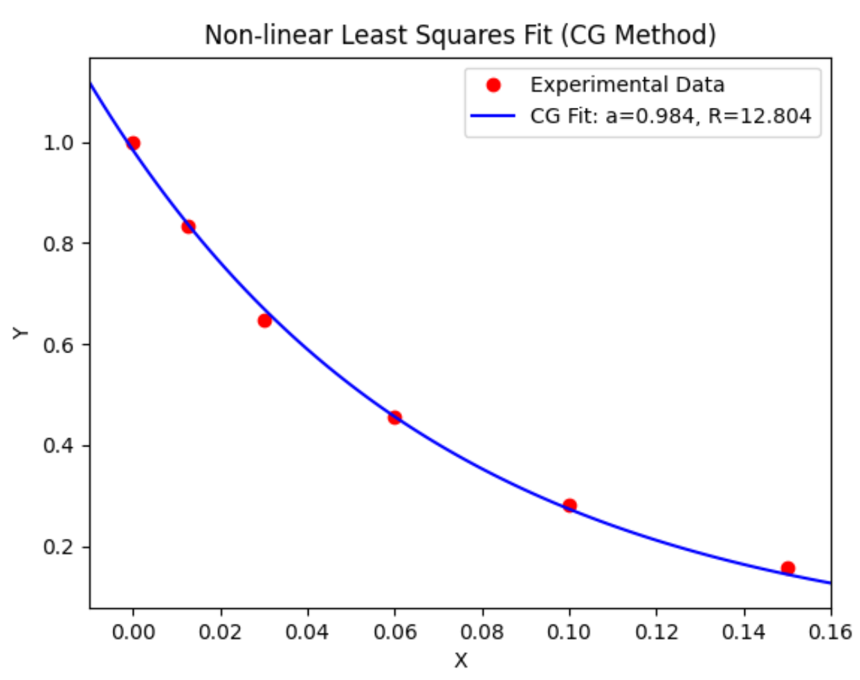
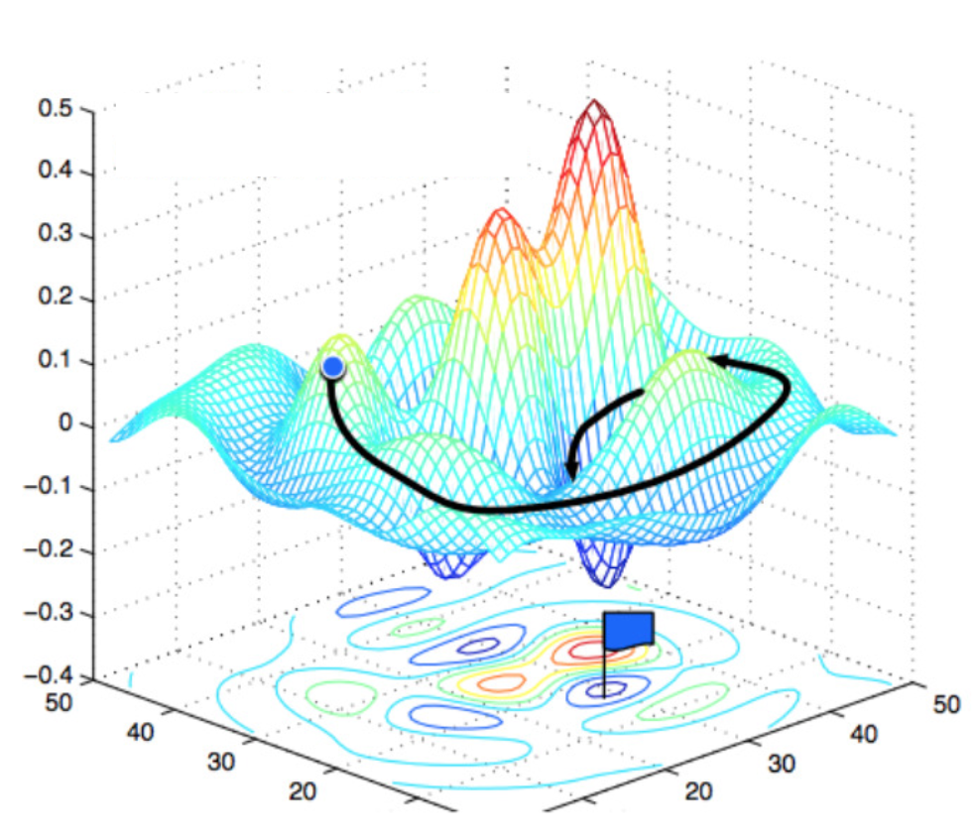
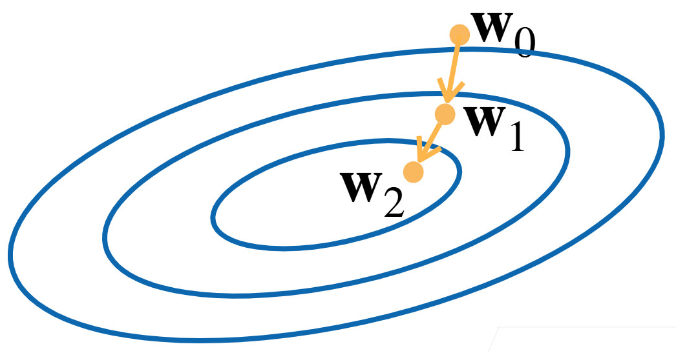
An analog: nonlinear fitting

Slide 4


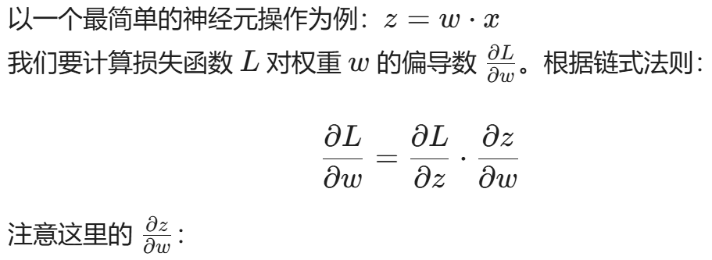

Multi-Layer Perceptron (MLP)
我们可以把神经网络看作一系列函数的嵌套
根据链式法则：
这意味着： 为了算出 w 的梯度，你必须知道这一层的输入信号 x 是多少。而 x 正是前向传播时的输出结果

Slide 5
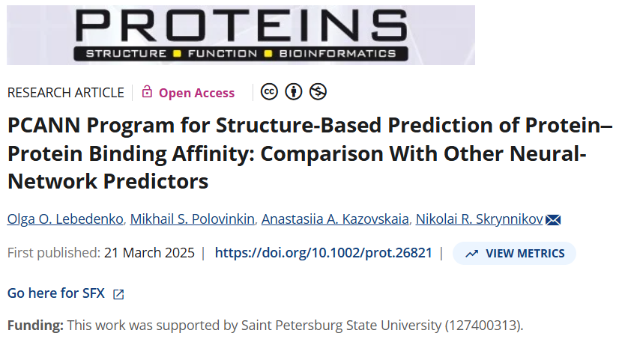
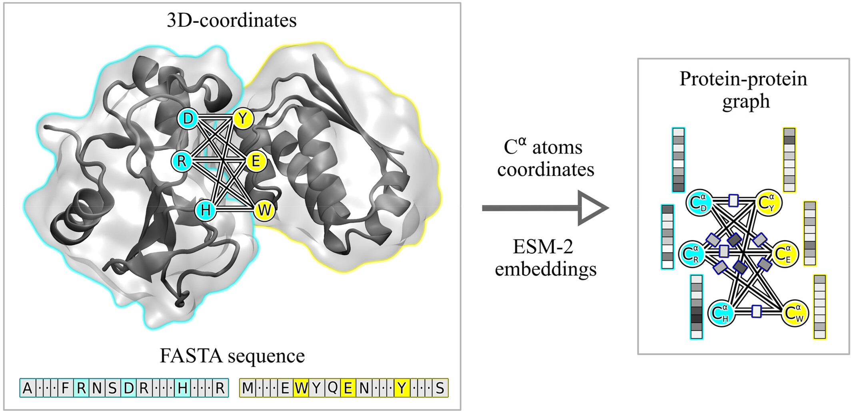
Prediction of Protein–Protein Binding Affinity
训练快。CPU上单次训练四分钟
代码易读。文件层级清楚，代码可读性强
开源。训练数据集、训练脚本、推理脚本
Lebedenko et al., Proteins: Structure, Function, and Bioinformatics (2025)
Notes:
在CPU上，4 分钟就可以训练完成

Slide 6

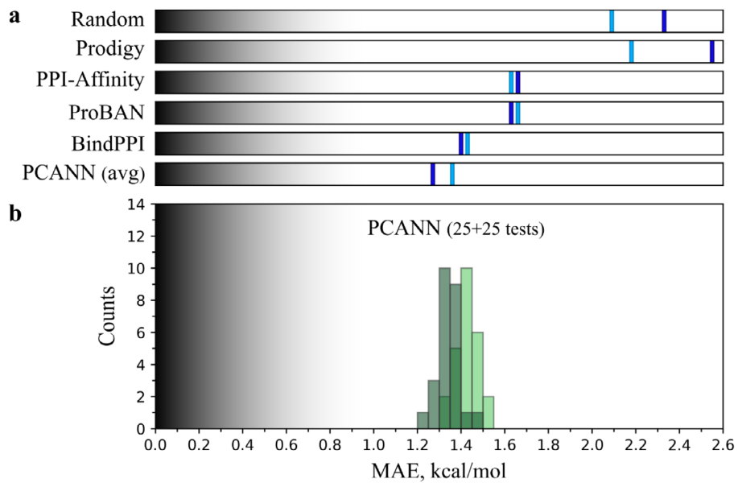
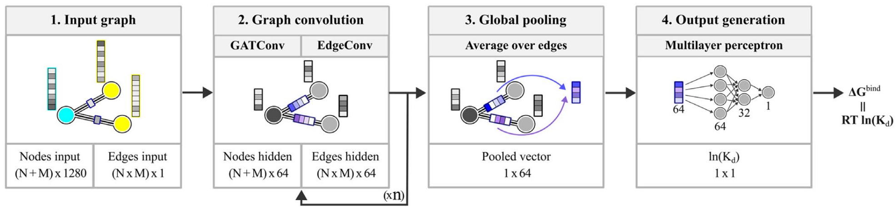
Outline
Dataset
Model
Result
training or validation
585
test A/B
75/75
test C
93
Lebedenko et al., Proteins: Structure, Function, and Bioinformatics (2025)

Slide 7
0. Preparation
Clone the repository
git clone https://github.com/bionmr-spbu-projects/PCANN.git
Installation of miniforge
bash /home/data/public/Miniforge3-25.9.1-0-Linux-x86_64.sh
Enter / Space / yes / ~/work/miniforge3 / yes
Creation of a virtual environment
based on its requirement file (environment.yaml, requirements.txt, …)

Slide 8
1. Dataset
raw pdb files
feature extraction
definition of interface
embedding of one residue
label preparation
ln(Kd) = dG/R/T
Units: Kd-M, dG-kcal/mol, R=1.987204258e-03 kcal/mol/K, T=298 K

Slide 9
1.1 Database
training or validation: 585
PDBbind v.2020, SKEMPI v2.0, MPAD, …
crystallographic or cryo-EM structures
resolution of 3.5 Å or better
no less than 15 residues
test A/B: 75/75
a further PDB search
never been seen by any of the other predictors
11% loosely homologous to the training set
test C: 93
NMR, or resolution in (3.5, 6)
to be downloaded…
PCANN-ta/reproduce/database/1_download.py

Slide 10
1.2.1 Interface
residues within 5 Å of the partner
x=[66, 1280]
edge_attr=[2178, 1]
edge_index=[2, 2178]
PCANN-ta/reproduce/interpretation/1_data.ipynb

Slide 11
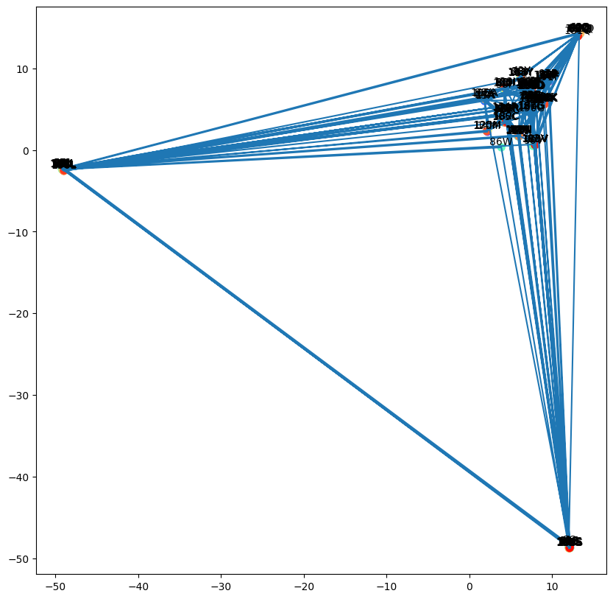
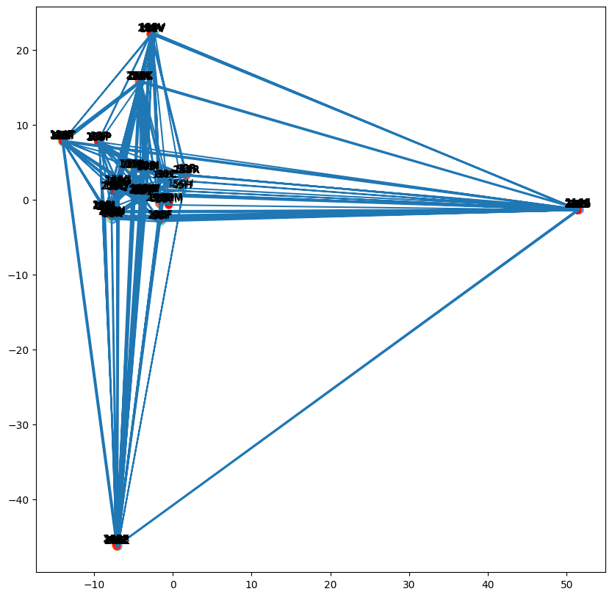
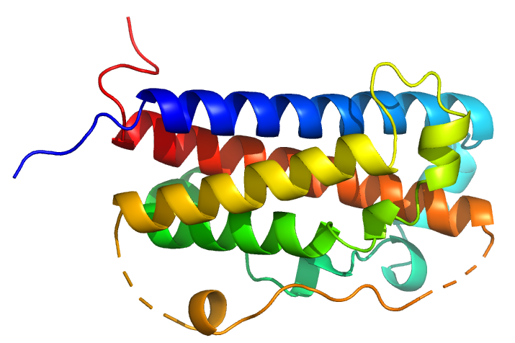
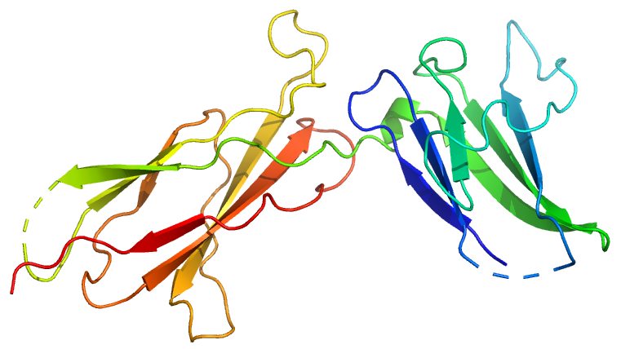
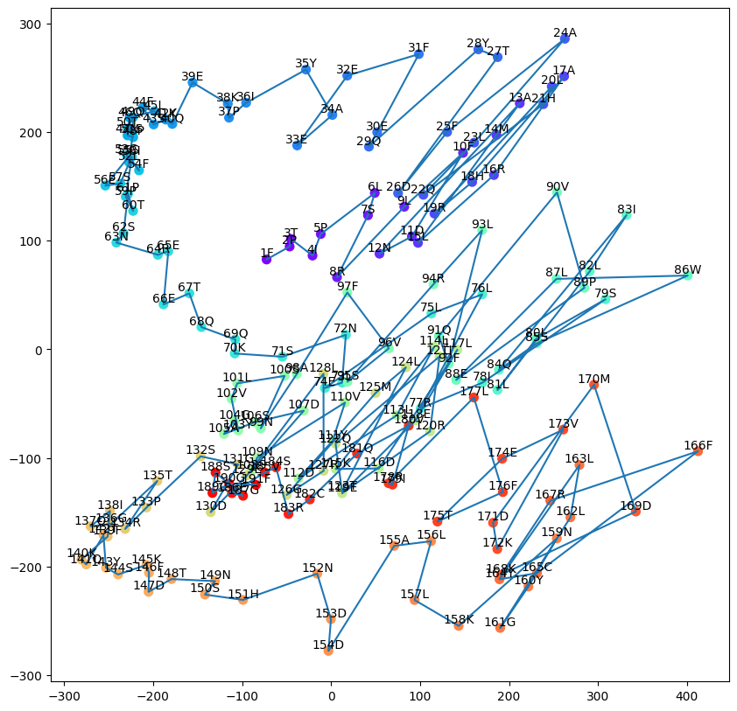
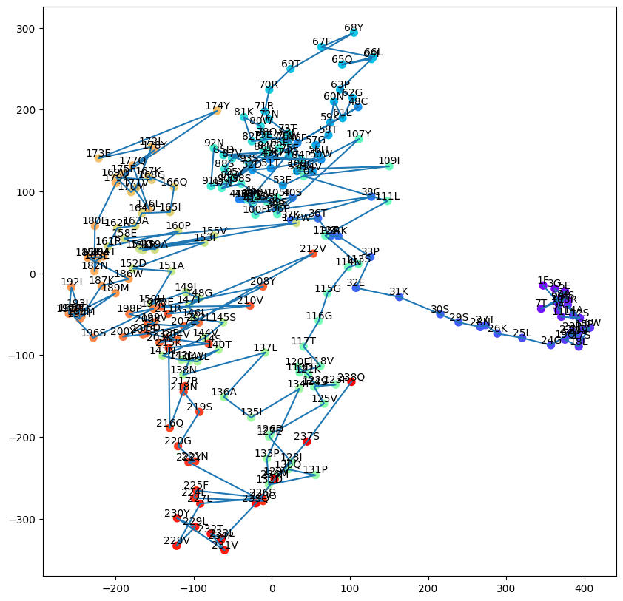
1.2.2 Embedding
with initialized ESM2
1. Embedding of two independent sequence
1A22-A
1A22-B

Slide 12
1.2.2 Embedding
2. Concatenation of two embeddings’ slices
x=[66, 1280]
edge_attr=[2178, 1]
edge_index=[2, 2178]

Slide 13
1.2.2 Embedding
Transformer
[1706.03762] Attention Is All You Need
Transformer论文逐段精读【论文精读】_哔哩哔哩_bilibili
68 Transformer【动手学深度学习v2】_哔哩哔哩_bilibili
Transformer常见问题与回答总结 - 知乎
BERT
BERT: Pre-training of Deep Bidirectional Transformers for Language Understanding
BERT 论文逐段精读【论文精读】_哔哩哔哩_bilibili
69 BERT预训练【动手学深度学习v2】_哔哩哔哩_bilibili
ESM2
Evolutionary-scale prediction of atomic-level protein structure with a language model | Science
GitHub - facebookresearch/esm

Slide 14
1.3 Feature-label
Feature
x=[66, 1280]
edge_attr=[2178, 1])
edge_index=[2, 2178]
Label
y=[1, 1]

Slide 15
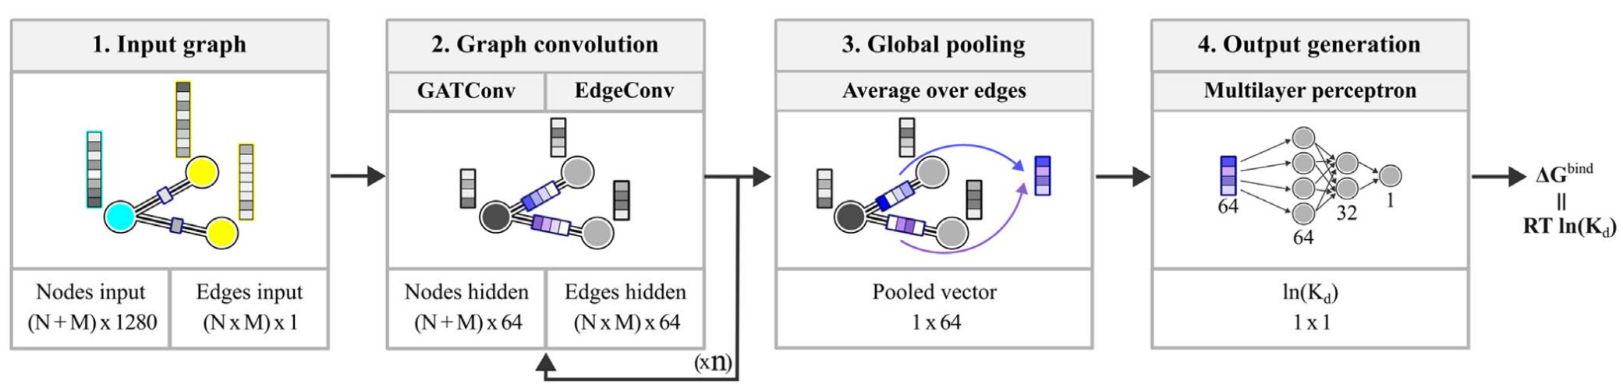
2. Model
[ 66, 64]
[2178, 64]
[1, 64]
[ 66, 1280]
[2178, 1]
[ 66, 64]
[2178, 64]
[1, 32]
[1, 64]
[1, 1]
[ 66, 64]
[2178, 64]
PCANN-ta/PCANN/model/model.py

Slide 16
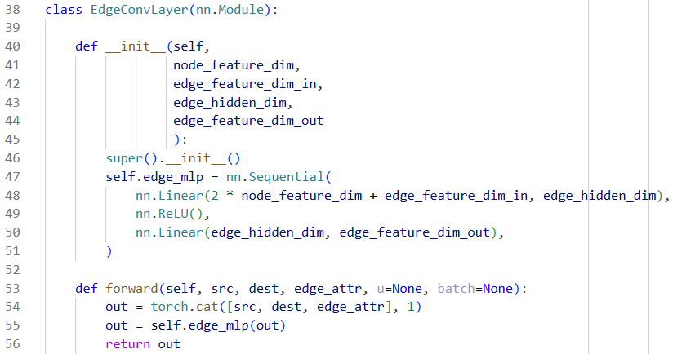
2.1 EdgeConv
For one edge
source point: [1, 1280 or 64]
destination point: [1, 1280 or 64]
edge attribute: [1, 1 or 64]
concatenation: [1, 2561 or 192]
updated edge: [1, 64]
PCANN-ta/PCANN/model/model.py:

Slide 17
2.2 GATConv
For one point
all points : [ NM, 1280 or 64]
neighbor : [NM-1, 64]
center : [ 1, 64]
affinity : [NM-1, 1]
weighted all : [NM-1, 64]
weighted sum: [ 1, 64]
Attention

Slide 18
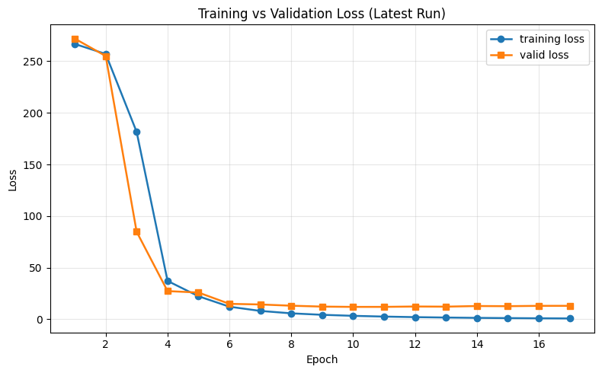
3.1 Training

Slide 19
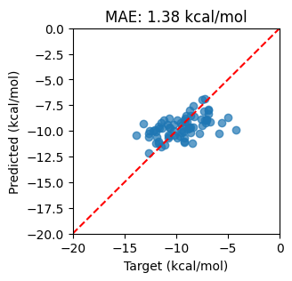
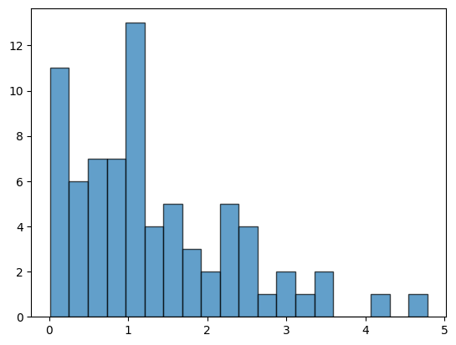
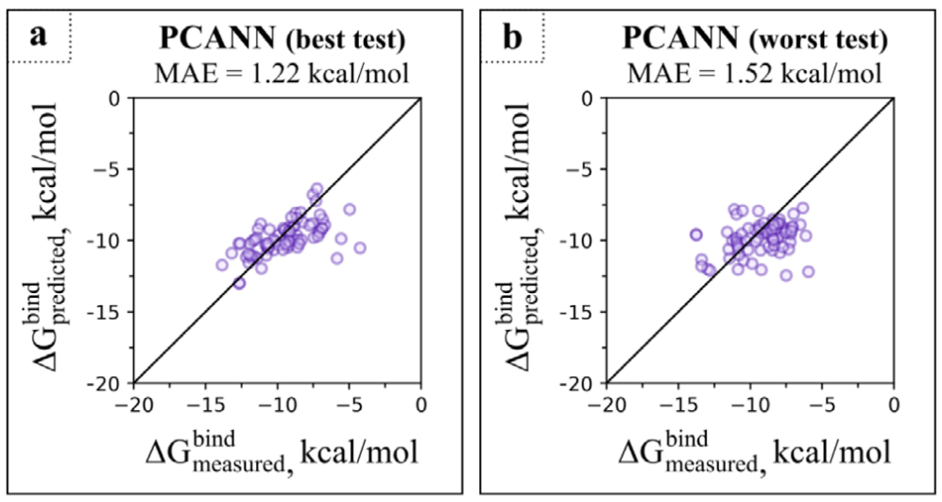
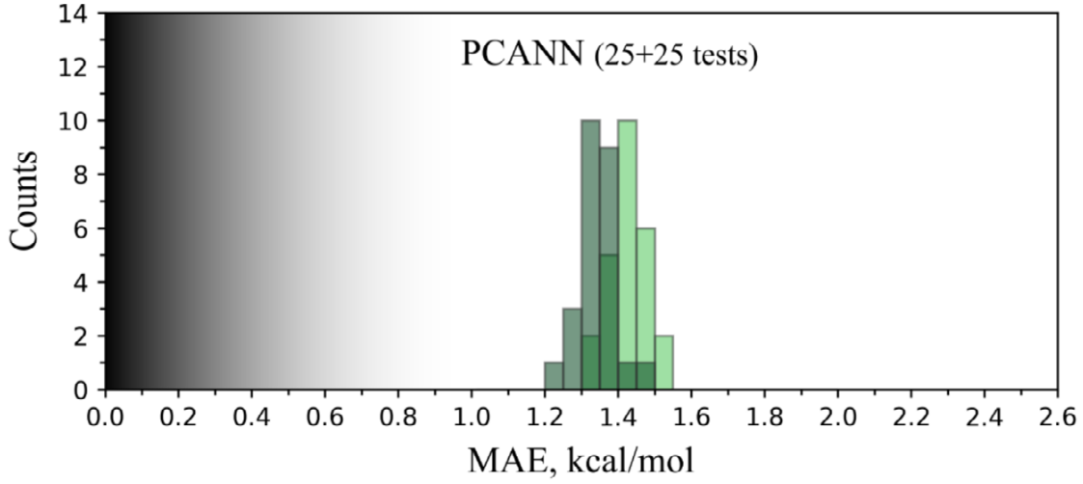
3.2 Testing

Slide 20
Practice
1. train another duplicate and check the results
PCANN-ta/reproduce/database/3_TrainOrValid.ipynb: create another train/validation dataset
PCANN-ta/reproduce/run_training_01/config.json: specify the locate of two csv files
PCANN-ta/reproduce/run_training_01 python run_train.py
2. check the result of testB and testC
python run_test.py
analyze.ipynb

Slide 21
More
clean the database more carefully
PCANN-ta/reproduce/database/2_preprocess.ipynb
accelerate the training with GPU
add residual connection to the model and make it deeper
change esm2_650M to esm2_150M or esm2_3B
“we have also tested the smaller and larger ESM-2 models, esm2_t30_150M_UR50D and esm2_ t36_3B_UR50D, but the results were not quite as good”
change cutoff distance
“we have also tested longer cutoff distance of 10 Å, but did not observe any improvement in the predictions”
search for more entries for the database

