Slide 1
AI赋能的生物大分子模拟和计算
Week 08
Yi Xue, School of Life Sciences, THU April 15, 2026

Slide 2
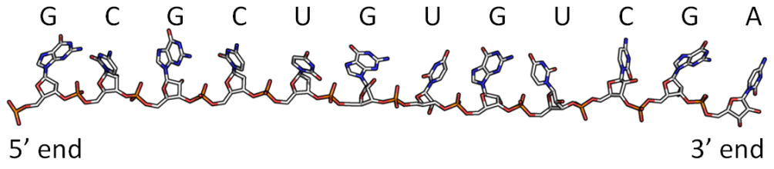
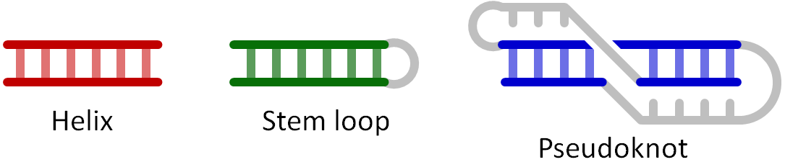
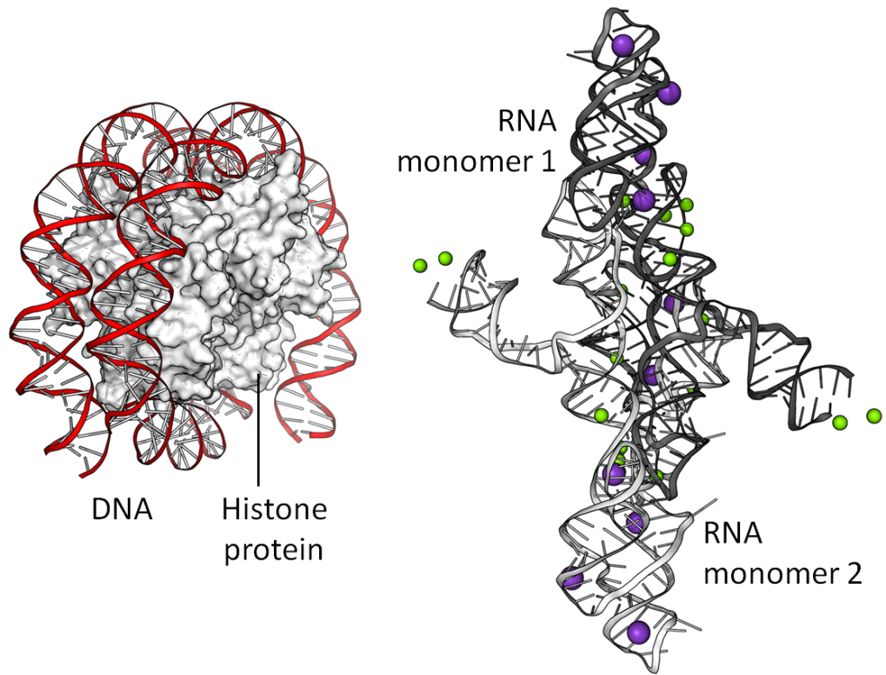
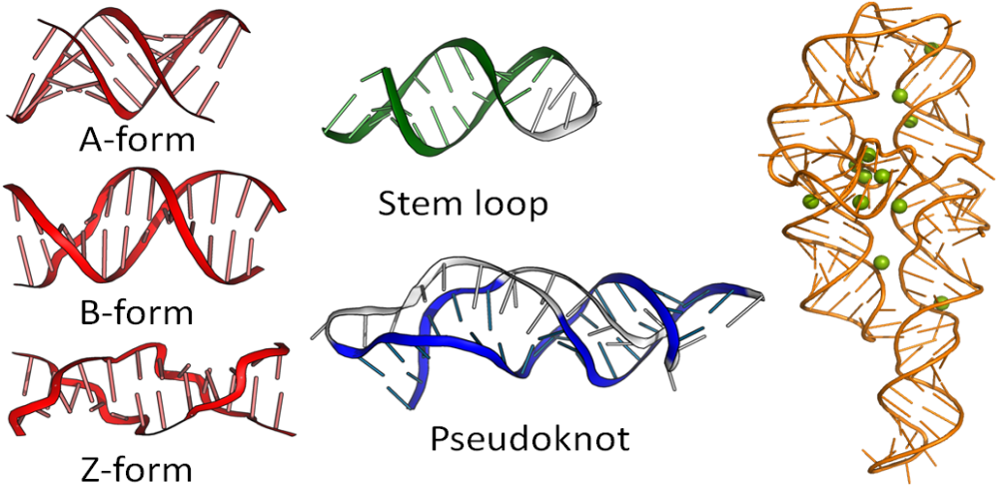
RNA primary, secondary, tertiary, and quaternary structures
“Sequence → Structure” holds true also for RNAs
Notes:
Nucleic acid quaternary structure refers to the interactions between separate nucleic acid molecules, or between nucleic acid molecules and proteins. The concept is analogous to protein quaternary structure, but as the analogy is not perfect, the term is used to refer to a number of different concepts in nucleic acids and is less commonly encountered.
One of the things that's important to keep in mind is that, for any biomolecule, very often one sequence will lead to a unique structure, and this is true for proteins and it's also true for many RNA molecules. Today, I hope to tell you how that can be achieved.
But unlike proteins, where the secondary and tertiary structures are not hierarchical, and are often interwinded. In RNAs, the secondary and tertiary structures are essentially hierarchical. When an RNA folds into its native conformation, in most of the cases the secondary structures form first, and then secondary structure segments interact each other leading to high-order tertiary structure.

Slide 3
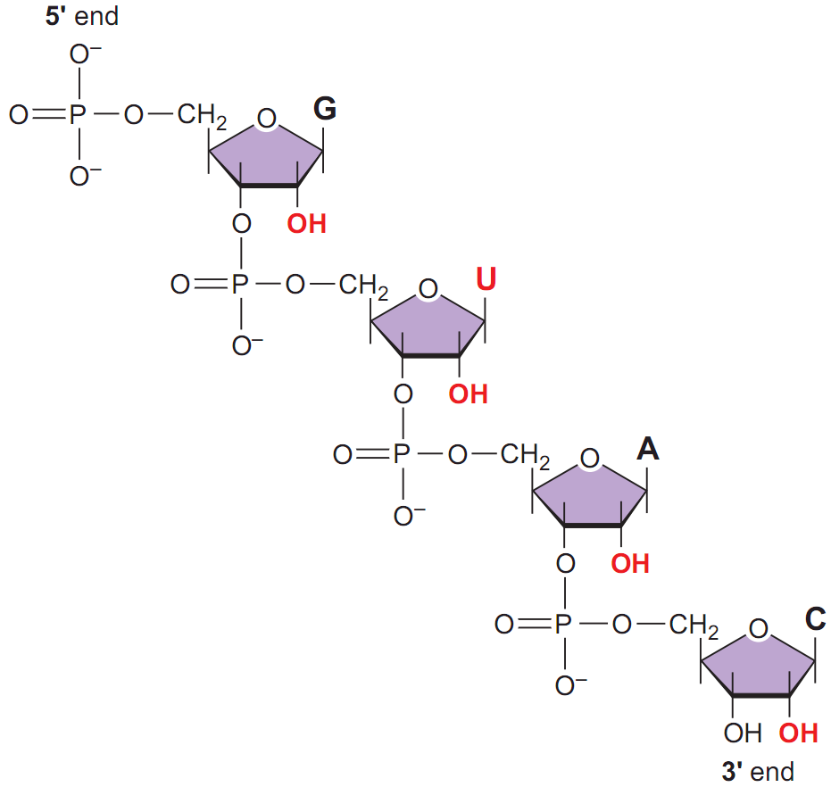
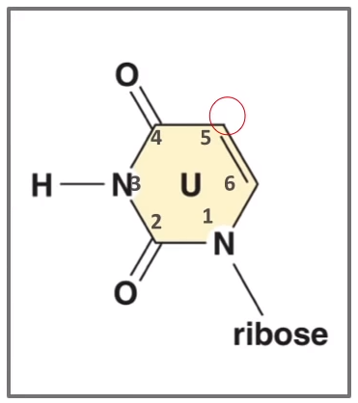
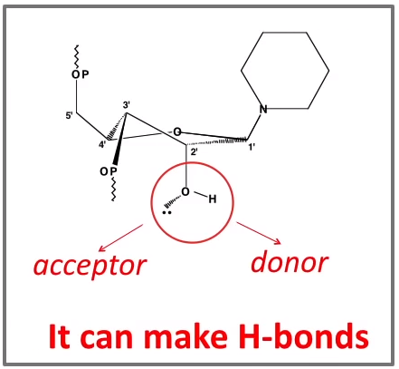
The chemical structure of nucleic acids
The 2’-OH group gives RNA Special Powers
Adapted from Pyle’s slides
Notes:
因此，RNA的化学结构在很大程度上决定了它如何实现众多功能以及如何形成这些复杂的结构。RNA与其近亲DNA分子有几个非常重要的区别。首先，除了你在这里看到的2'羟基（2'-OH）外，RNA中的尿嘧啶（Uracil）碱基看起来与胸腺嘧啶（Thymidine）非常相似，但它在这个位置缺少一个5-甲基。因此，RNA中的一个碱基与DNA不同。
2‘羟基（2’-OH）是赋予RNA特殊能力的关键。可以说2'-OH基团赋予了RNA“特殊力量”，原因是这个取代基既可以接受也可以提供氢键。因此，每个2'-OH基团最多可以形成两个氢键。归根结底，这使得RNA骨架具有很强的粘性，并使RNA能够形成多种类型的相互作用，而这些作用在仅存在脱氧核糖的情况下是不可能实现的。

Slide 4
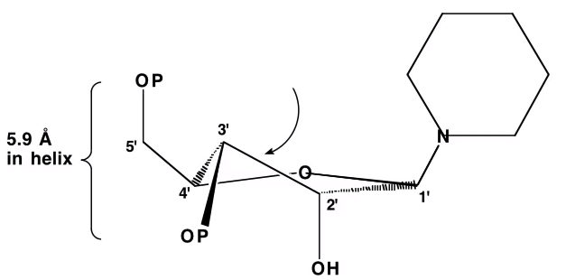
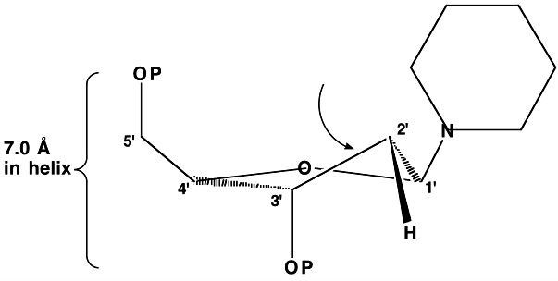
Sugar pucker
Import factor: Sugars are not flat! They buckle, or pucker. This gives DNA (and RNA) their distinctive shapes.
C3’-endo (RNA duplex)
C2’-endo (DNA duplex)
The five-membered sugar ring is generally non-planar. It can be puckered in an envelope (E) form - four of the five atoms lie in a plane and the fifth atom lies out of plane by ~0.5 angstrom; or in a twist (T) conformation where two adjacent atoms are displaced on opposite sides of a plane through the three other atoms.
Conformations in which the atoms are displaced from these three or four atom planes are on the same side as the C5' are called endo and those on the opposite side are called exo.
Adapted from Pyle’s slides
Notes:
除了RNA的化学结构外，另一个赋予其形状并使其与DNA区别开来的因素是糖基部分的结构。很多时候，人们认为DNA和RNA分子的特殊性在于碱基序列以及它们之间的碱基配对。但实际上，糖-磷酸骨架也起着重要作用，尤其是要记住糖分子并不是平面的。由于它们是五元环，通常会弯曲或折叠，这赋予了RNA和DNA独特的形状。
核糖中的糖折叠主要有两种构象，其中一种是C3'-内折叠（C3'-endo pucker）。如果我们想象糖分子处于这个位置，糖的3'原子会向上推，我喜欢说它朝着碱基平面方向推，这样就形成了C3'-内折叠构象。这种构象的结果是磷酸基团之间的距离非常小：在RNA类糖中，这个距离仅为5.9埃。然而，这些糖分子始终处于动态变化中，特别是在缺乏周围结构的情况下，核糖还可以采取另一种构象，即C2'-内折叠（C2'-endo pucker），这实际上是DNA中的主要构象。当这个碳原子向上翘起，C2'位置更接近碱基时，就会形成这种构象。其结果是磷酸基团之间的距离变得非常大：达到7埃。这就是为什么在后续的讲解中你会看到，DNA双链比RNA双链更加细长和分散。这也是赋予RNA和DNA螺旋形状的重要因素之一。

Slide 5
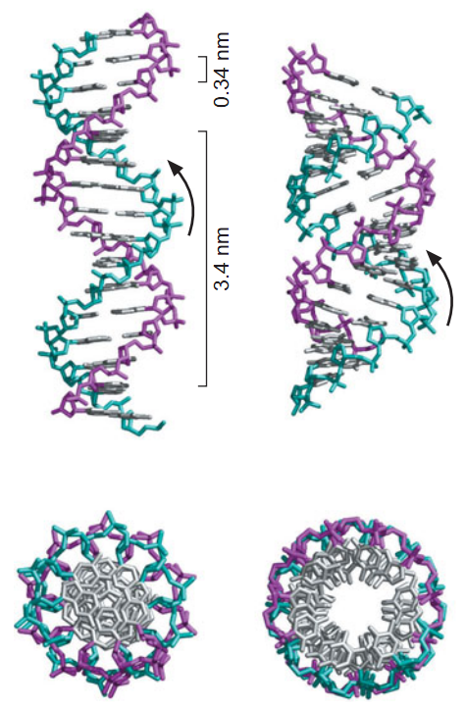
A-form and B-form
B-form
A-form
B-form
right-handed
10 base pairs per helical turn
6 degree base tilt
C-2' endo sugar pucker conformation
anti glycosyl bond conformation
A-form
right-handed
11 base pairs per helical turn
20 degree base tilt
C-3' endo sugar pucker conformation
anti glycosyl bond conformation

Slide 6
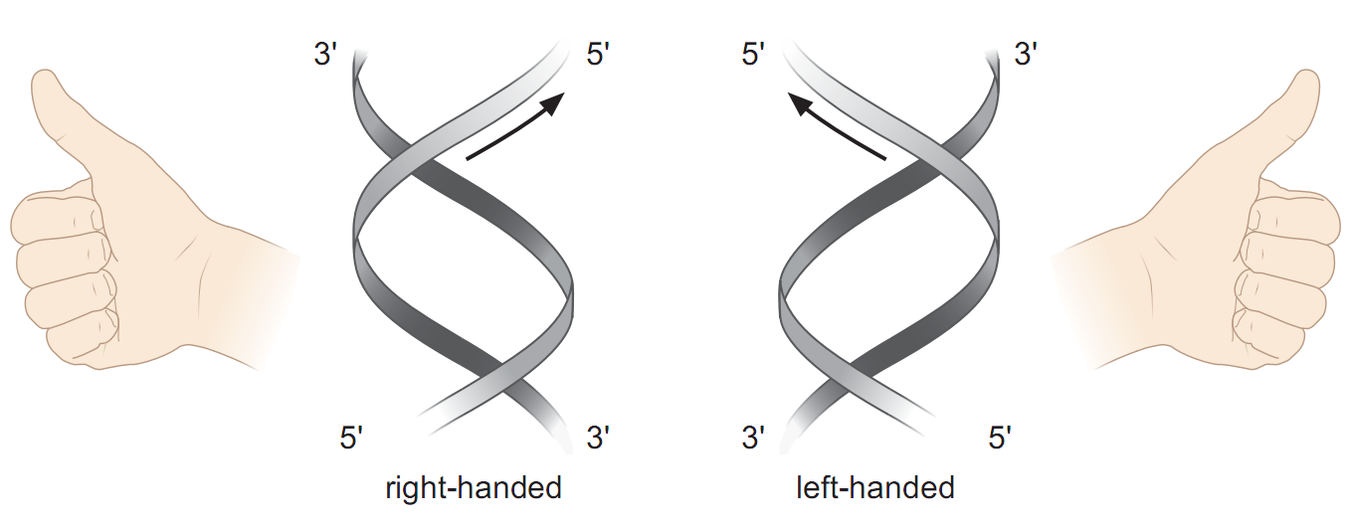
Right-handed and left-handed

Slide 7
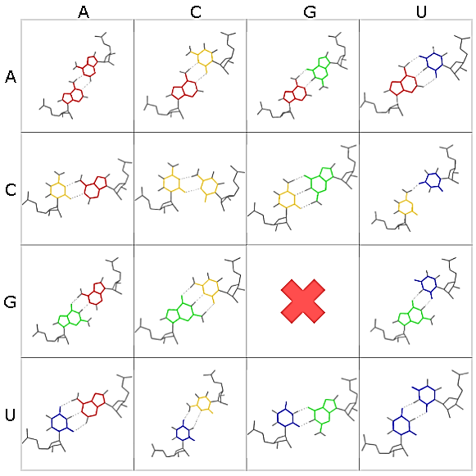
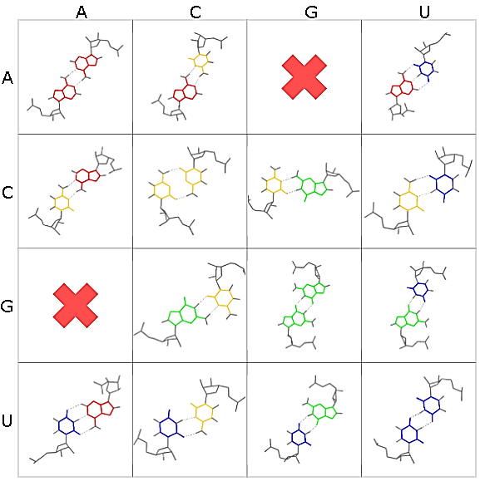
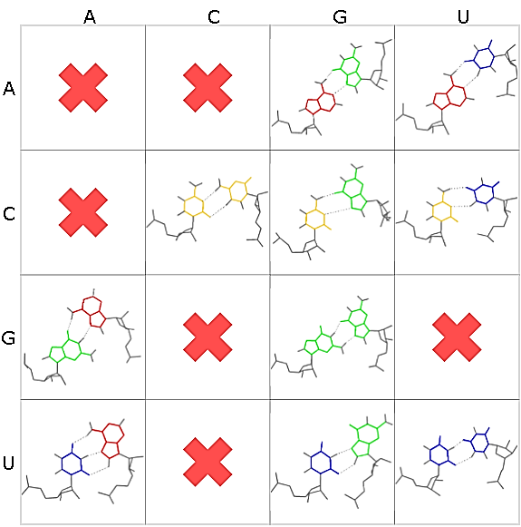
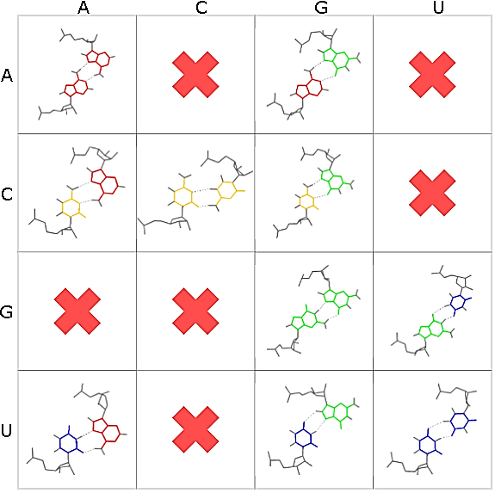
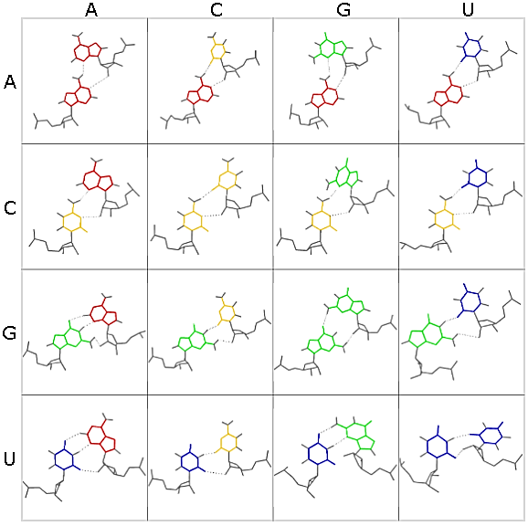
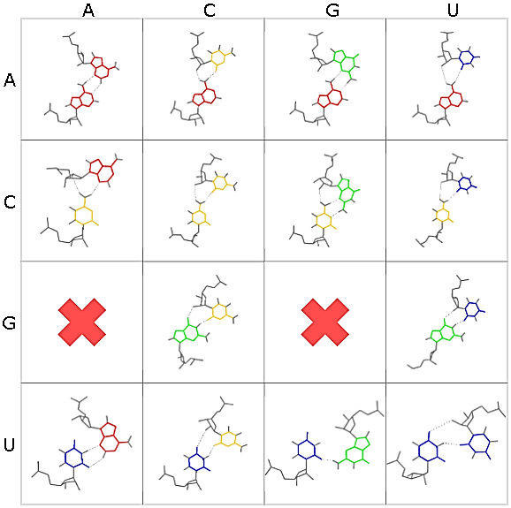
Base pair dictionary of RNA (1)
Web link
cWW
tWW
cWH
tWH
cWS
tWS
Notes:
192 = 48(x) + 144 (93: 2bond, 17: 3bond+, 34: 1bond)

Slide 8
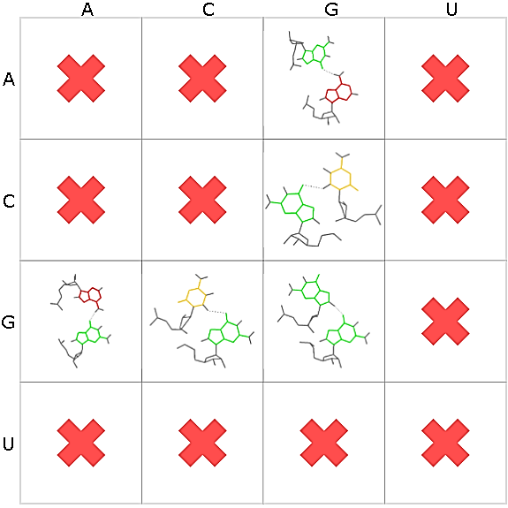
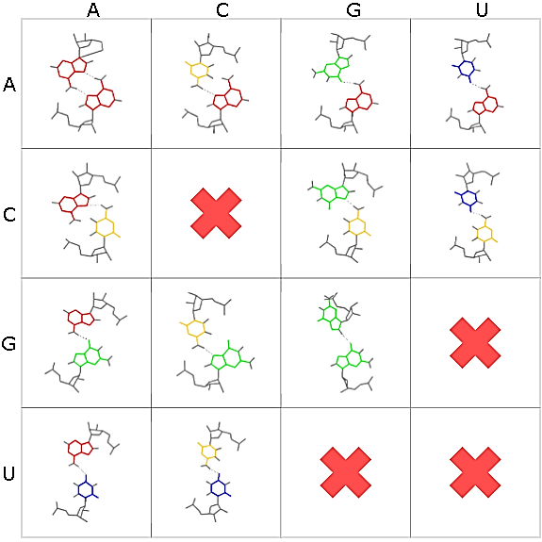
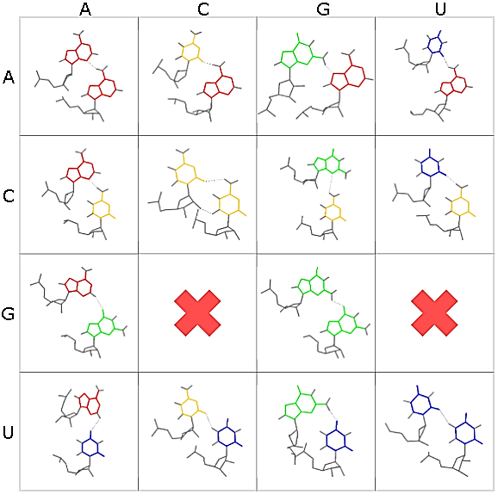
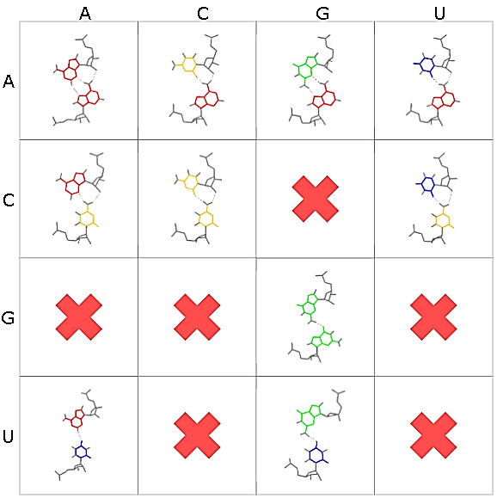
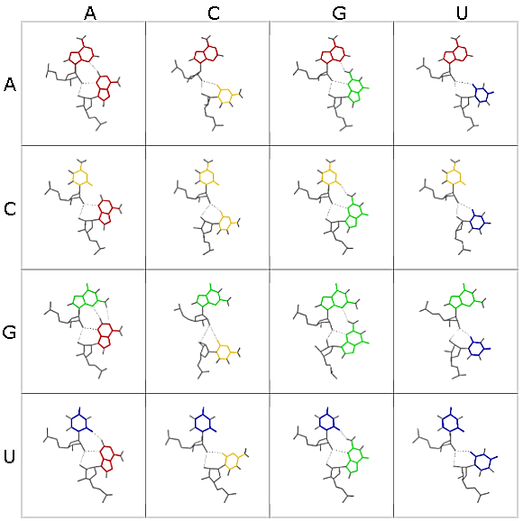
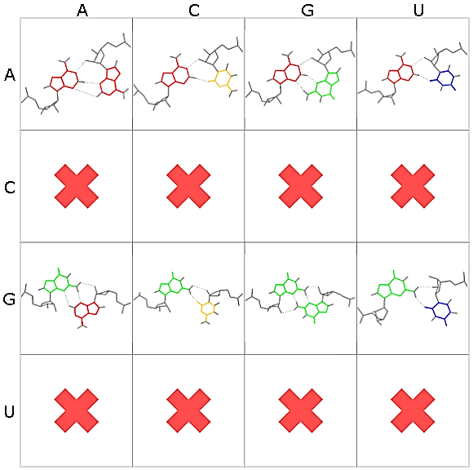
Base pair dictionary of RNA (2)
Web link
cHH
tHH
cHS
tHS
cSS
tSS
Notes:
192 = 48(x) + 144 (93: 2bond, 17: 3bond+, 34: 1bond)

Slide 9
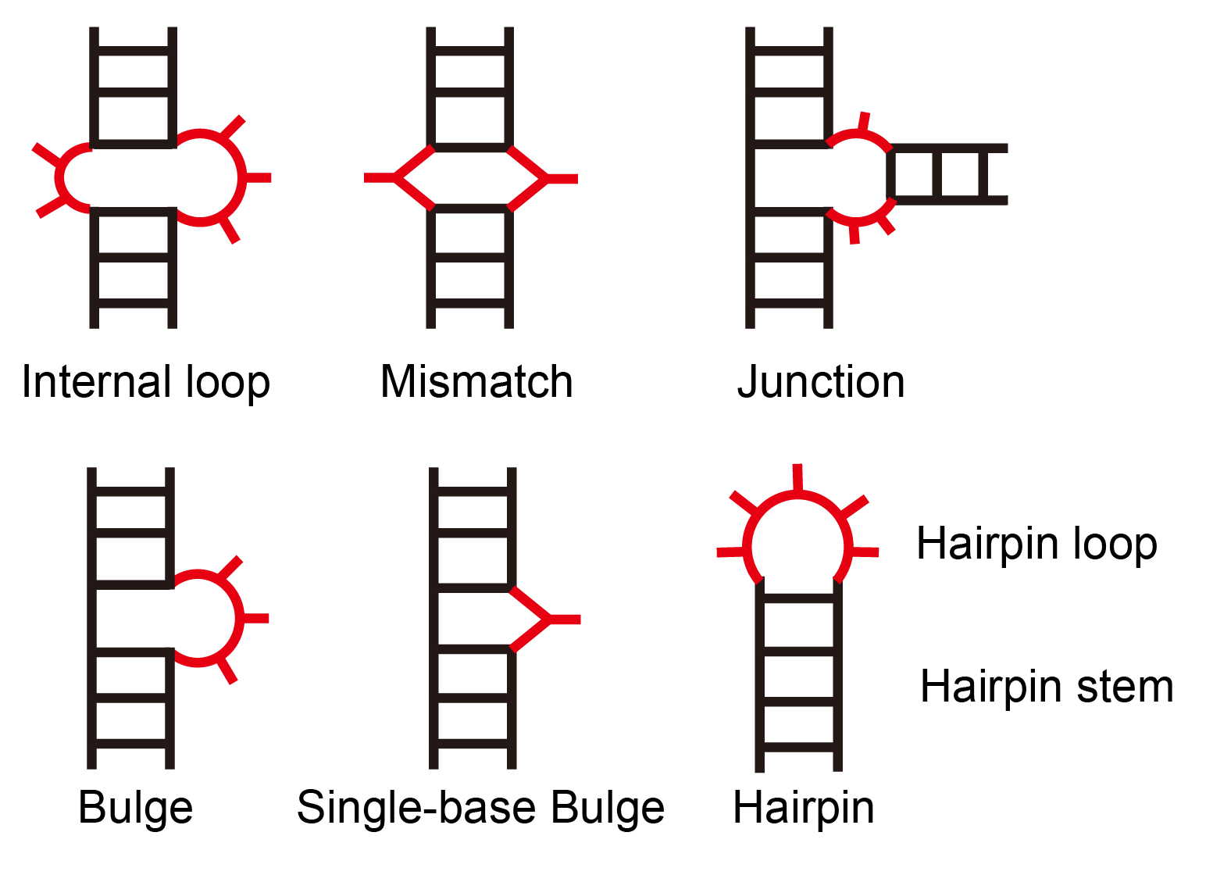
RNA secondary structure
RNA duplexes can contain Bulges and Loops

Slide 10
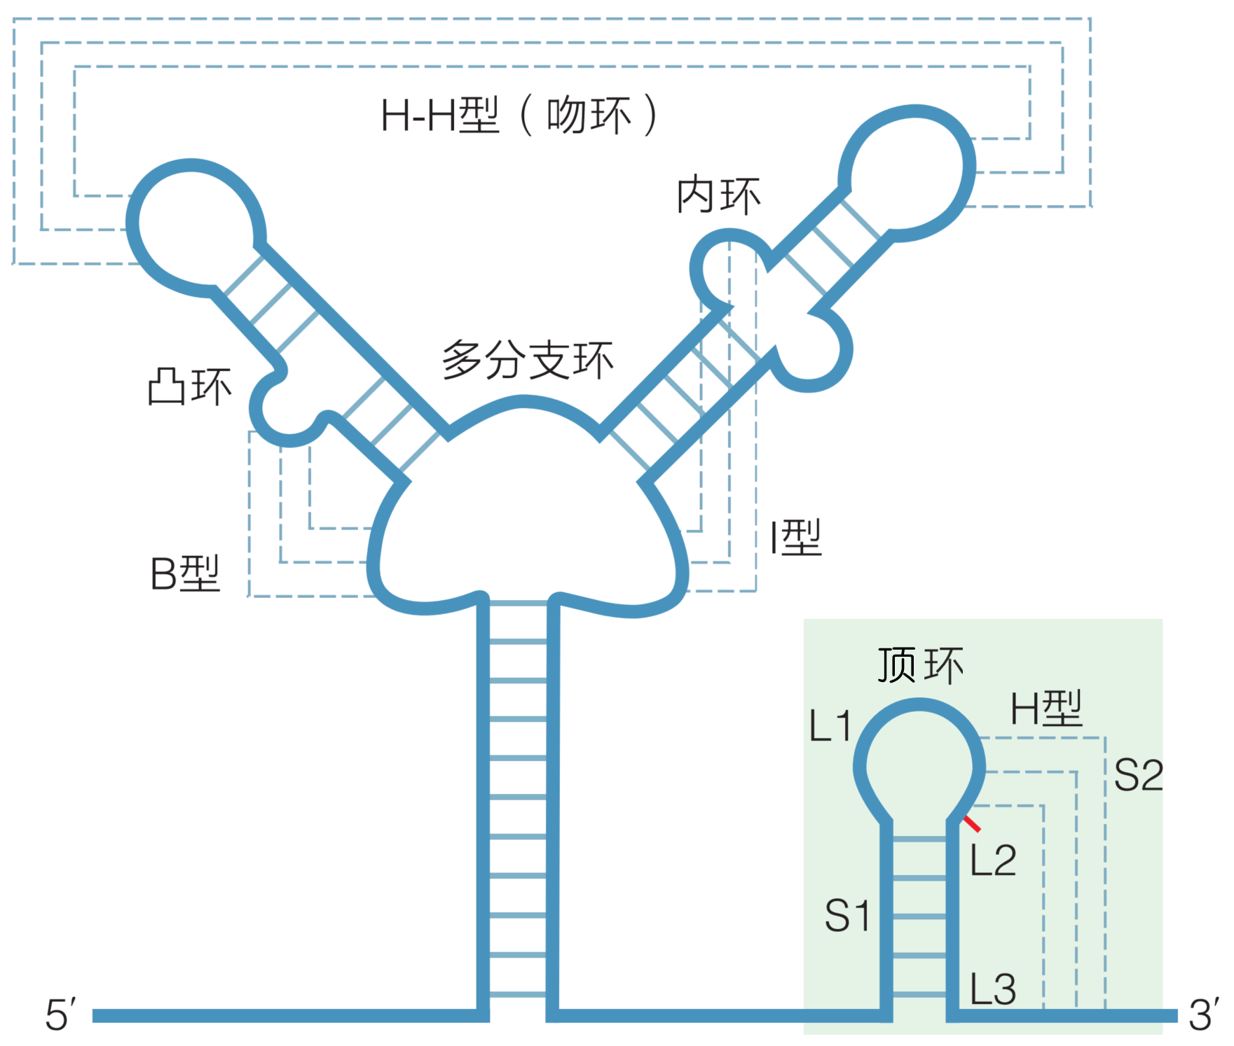
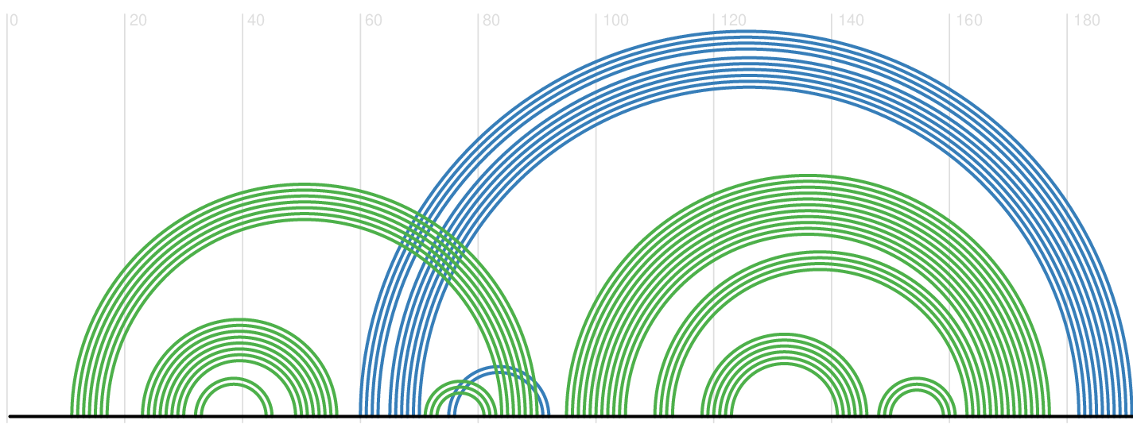
Pseudoknot
Pseudoknot (假结) is a type of motif commonly found in RNA. Pseudoknot structures can be classified into types such as H-type, B-type, and I-type.
H-type: between a hairpin loop and a single-stranded region, which is also the most common type.
B-type: between a bulge loop and a single-stranded region.
I-type: between an internal loop and a single-stranded region.

Slide 11
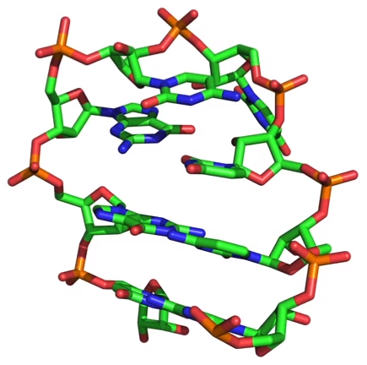
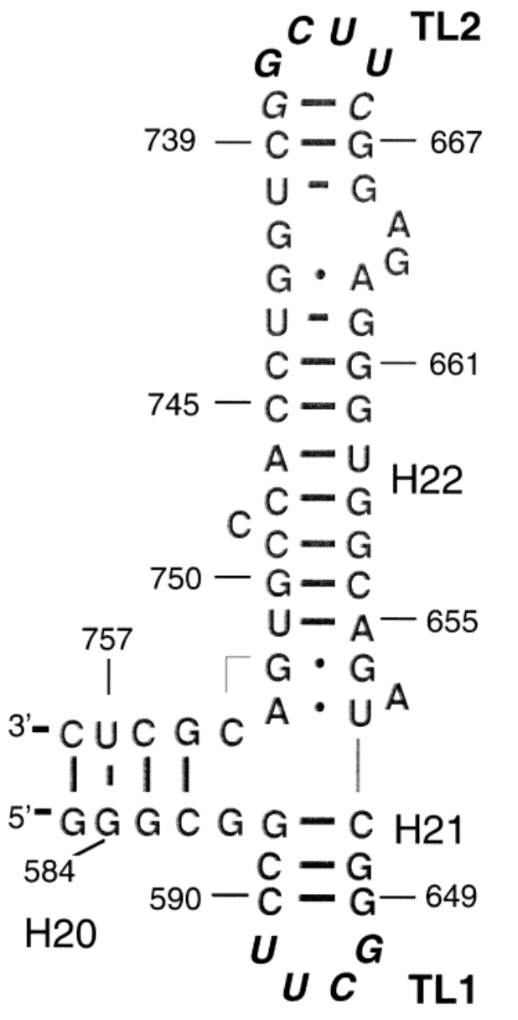
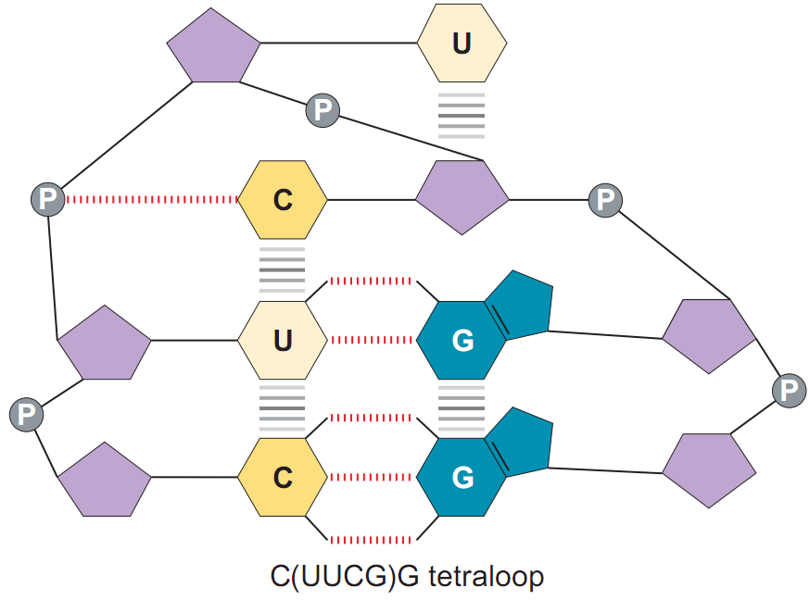
RNA secondary structure “UNCG” tetraloop
PDB ID: 2KOC NAR 2010, 38:683
57 nt 16S ribosomal RNA fragment
JMB 2000, 304:35
Notes:
The majority of 16S-rRNA tetraloops fall into two sequence categories: the UNCG motif and the GNRA motif. N: any nucleotide
The sequences at duplex termini are often highly conserved in sequence. This sequence here (UUCG) is frequently found within substructures that require extra stabilization and, interestingly, if you solve the structure of hairpin sequences like this, this region here will always have the same three-dimensional structure as shown here, which was one of the original NMR structures that characterized the arrangement of bases in this sequence.

Slide 12
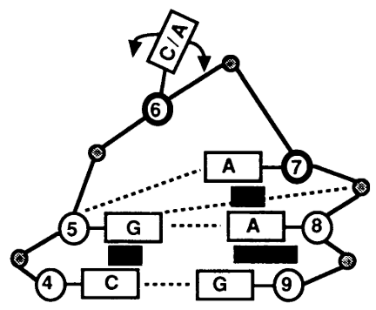
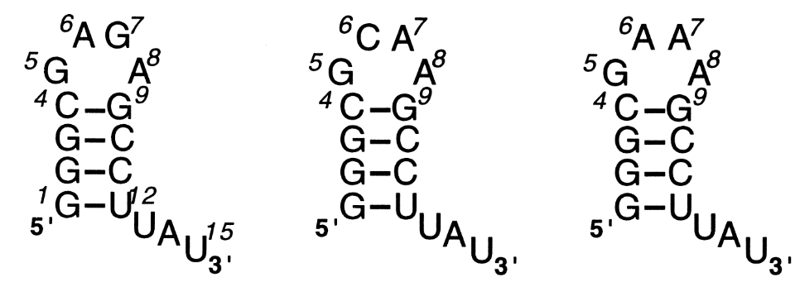
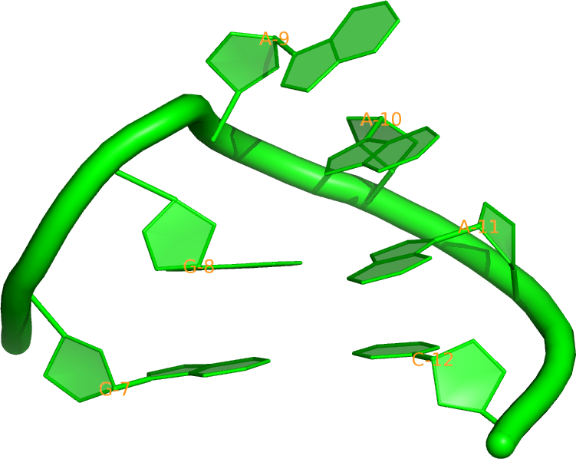
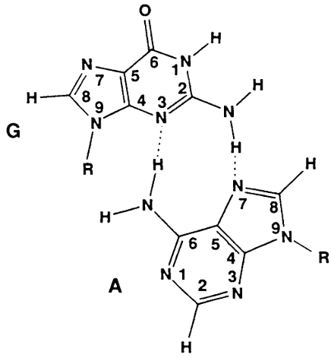
RNA secondary structure “GNRA” tetraloop
GAGA, GCAA, and GAAA
GAsheared
Notes:
GNRA, R=A/G

Slide 13
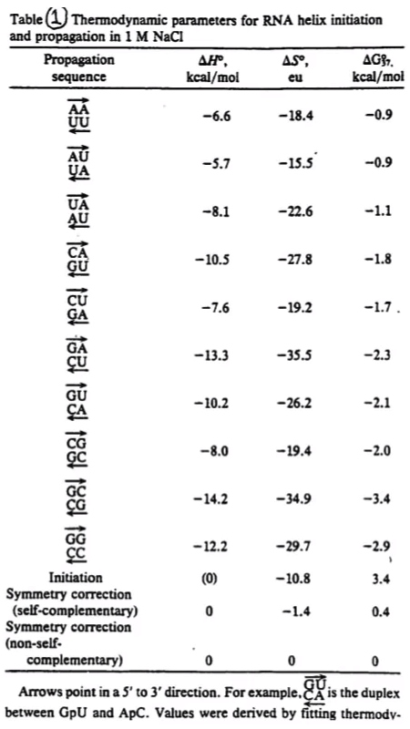
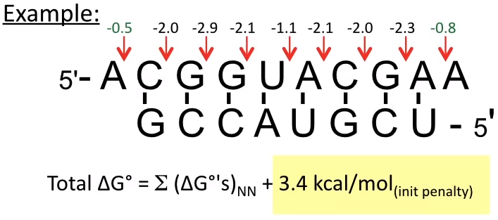
RNA duplex stability: Turner’s Rules
Doug Turner figured out the parameters for duplex stability, after monitoring the sequence-dependent stability of thousands of duplexes
These parameters allow you to sum up the relative stability of each “nearest neighbor pair” in a duplex.
Parameters for internal mismatches, overhanging ends, loops and other heterogeneities are also available.
PNAS 1986, 83:9373 JMB 1999, 288:911
Biochem 1999, 38:14214
Adapted from Pyle’s slides

Slide 14
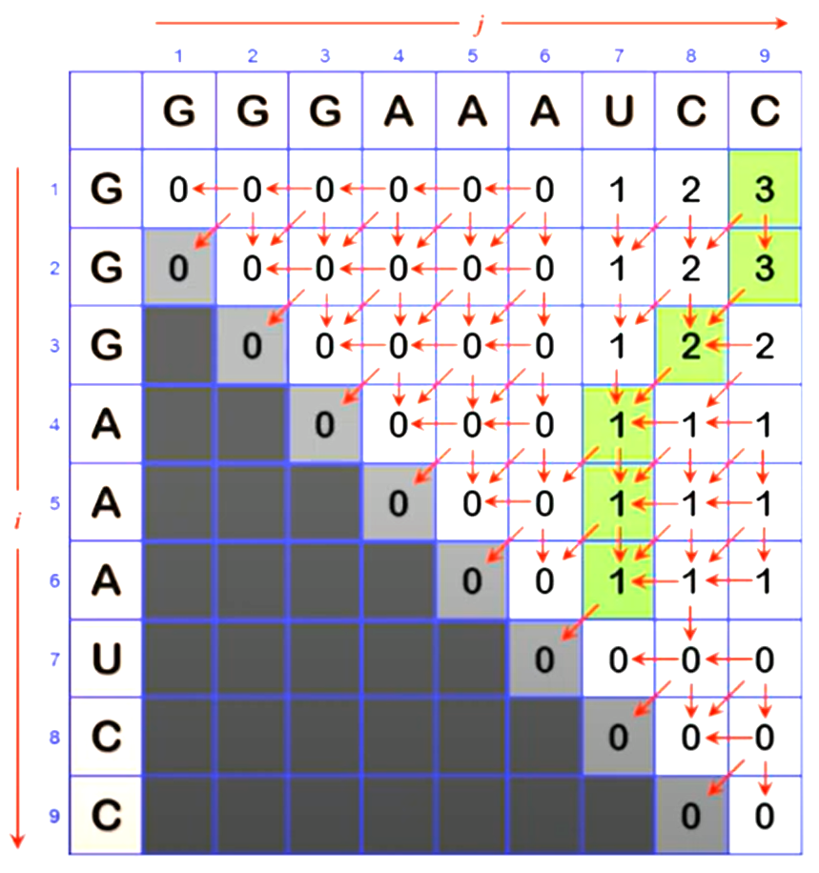
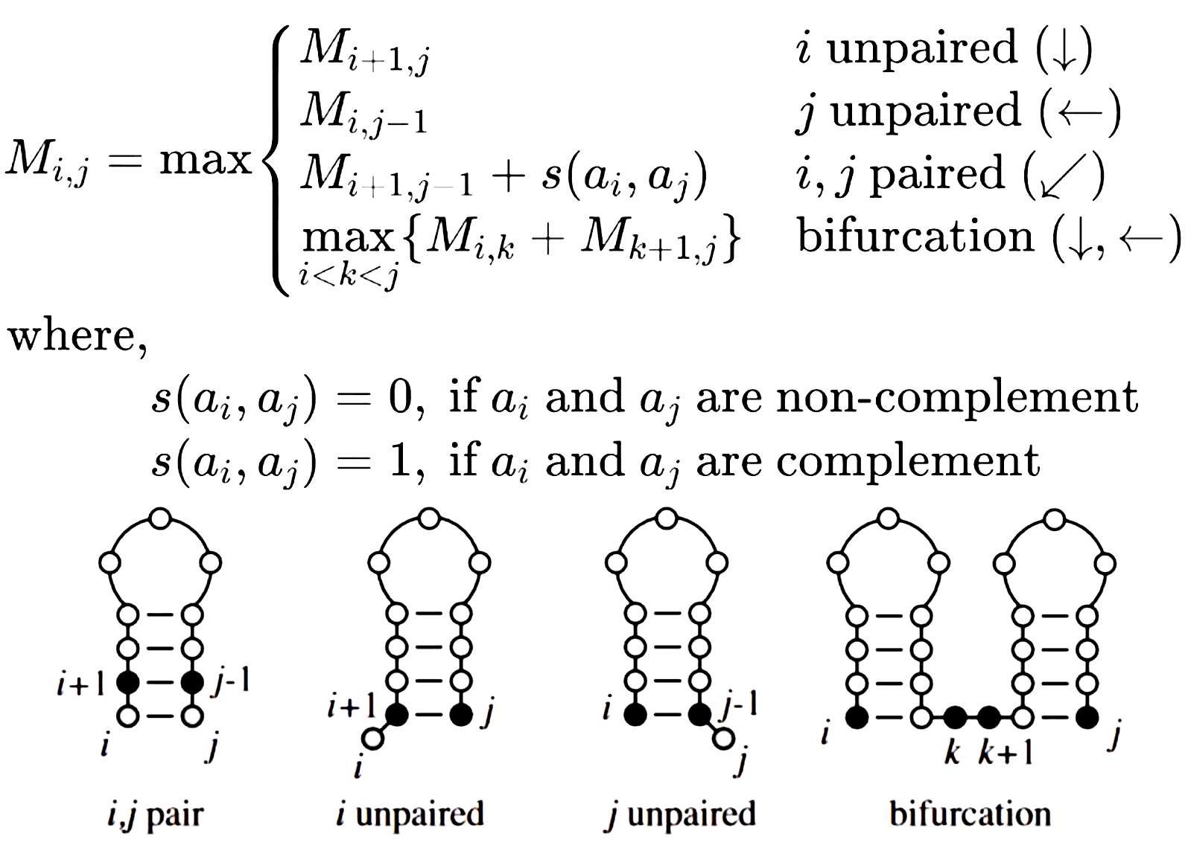
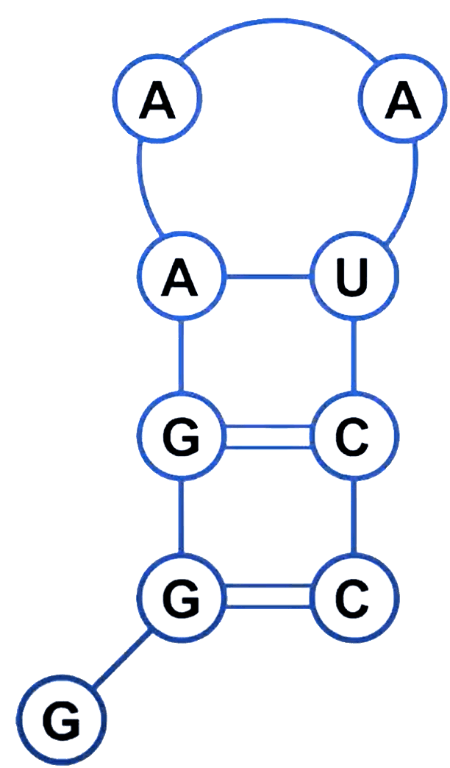
Dynamic programming: Nussinov Algorithm
Initialization
Matrix Filling
Trace Back
Notes:
Note from AI:
动态编程（Dynamic Programming，简称DP）是一种解决问题的算法思想，它主要用于优化问题，特别是那些可以被分解为相互重叠子问题的问题。通俗地说，动态编程的思想可以这样理解：
分而治之：将一个大问题拆解成若干个相似的小问题，这些小问题往往更容易解决。
记住过往：在解决这些小问题的过程中，我们会记录下已经解决过的问题的答案。这样，当同样的问题再次出现时，我们就可以直接使用之前记录的结果，而不需要重新计算，从而节省时间和资源。
构建解决方案：通过解决所有相关的小问题，并将它们的解组合起来，最终得到原问题的解。
举个例子，假设你要计算从你家到公司的最短路径。你可以将整个路线分成若干段，比如从家到地铁站，从地铁站到公司等。对于每一段路，你都计算出最短路径，并记录下来。当你需要计算从家到公司的总路径时，你只需要将各段的最短路径加起来，而不需要每次都重新计算每一段的最短路径。
动态编程的关键在于“记忆化”，也就是保存子问题的解，避免重复工作。这种方法在很多领域都有应用，比如计算机科学、经济学、生物信息学等，它能够有效地提高算法的效率，减少不必要的计算。

Slide 15
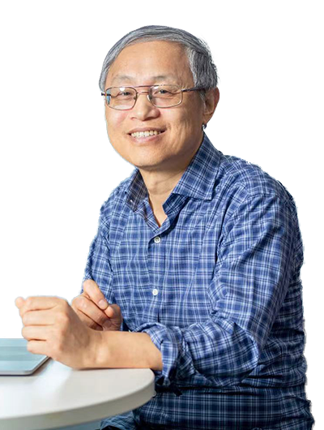
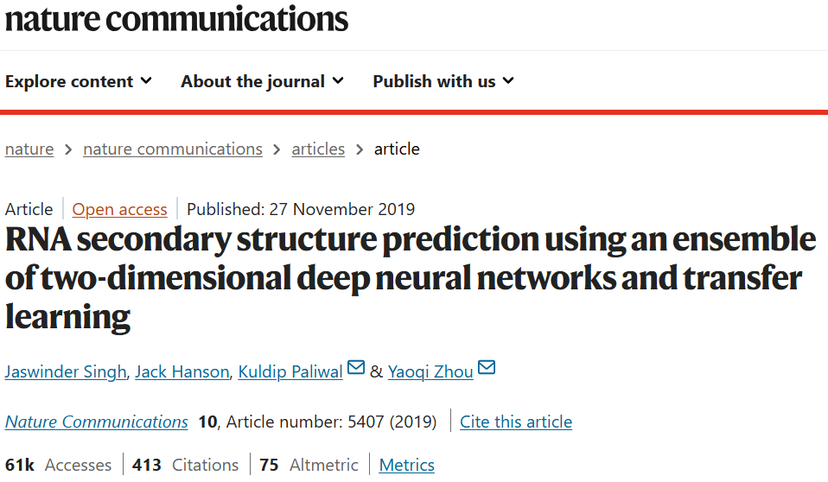
RNA Secondary Structure Prediction
周耀旗 深圳湾实验室
科学网—周苑
RNA secondary structure prediction using an ensemble of two-dimensional deep neural networks and transfer learning | Nature Communications

Slide 16
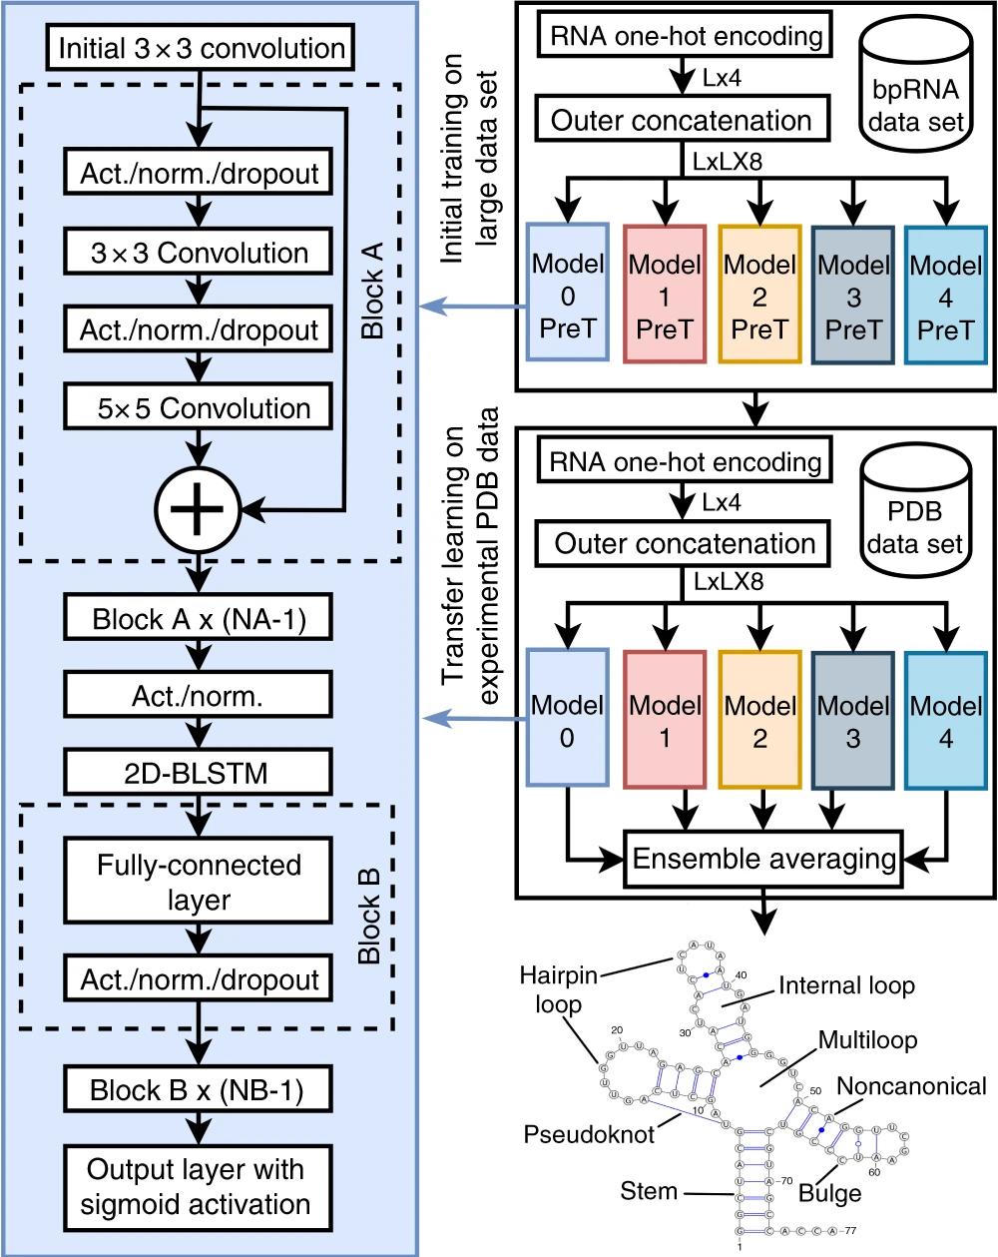
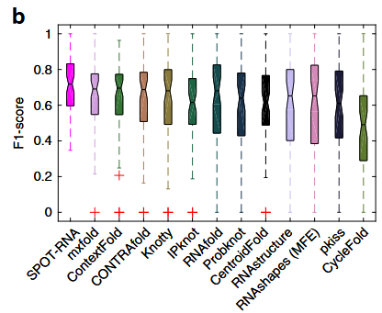
Outline
Dataset
Model
Result
bpRNA
1 M → 13419
8:1:1
PDB
217
120,30,67

Slide 17
0. Preparation
Clone the repository
git clone https://github.com/jaswindersingh2/SPOT-RNA.git
Installation of miniforge
bash /home/data/public/Miniforge3-25.9.1-0-Linux-x86_64.sh
Enter / Space / yes / ~/work/miniforge3 / yes
Creation of a virtual environment
TensorFlow vs PyTorch
/home/md_ta/work/week08/demo1/README.md

Slide 18
1. Dataset
raw files
feature extraction
label preparation

Slide 19
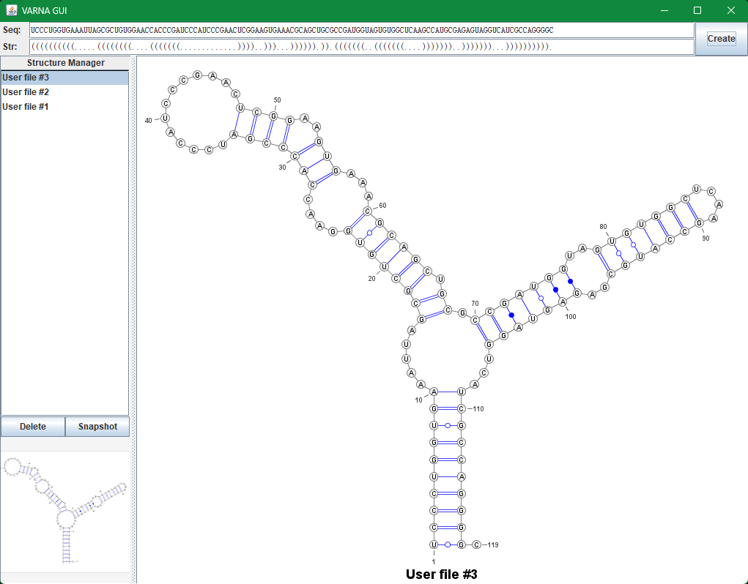
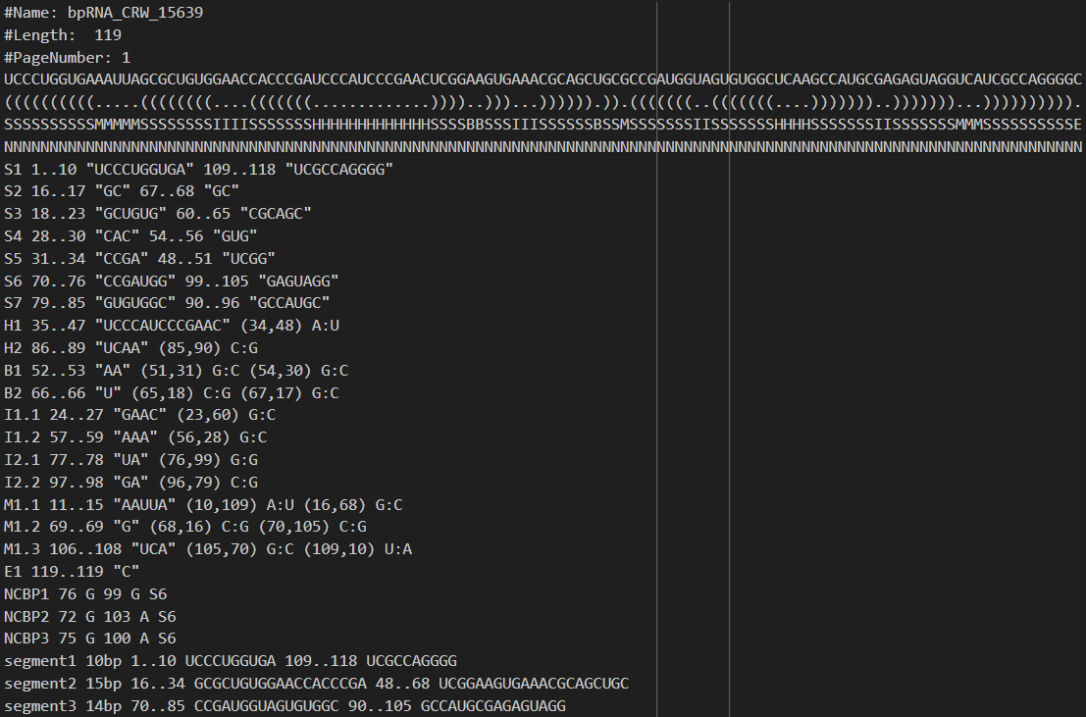
1.1 bpRNA
1 M → 13419
8:1:1
/home/md_ta/work/week08/demo1/doc/bpRNA
VARNA

Slide 20
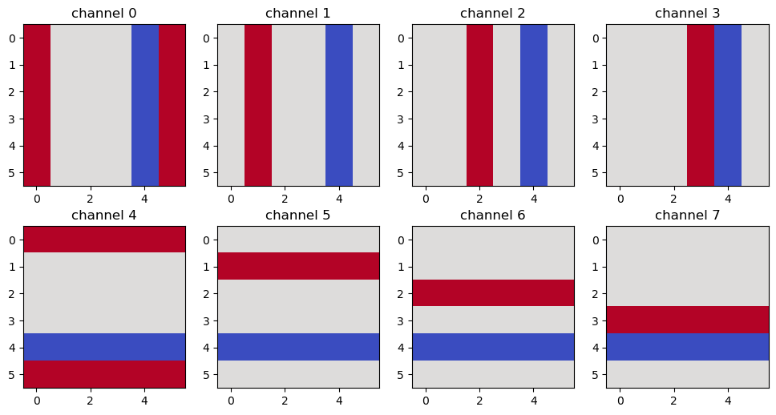
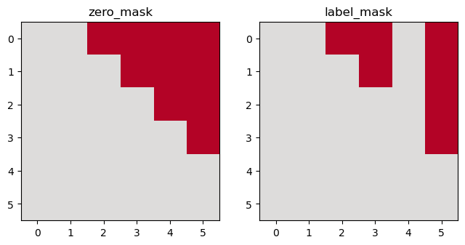
1.2 Feature
Sequence → one-hot array → Feature
L → [L, 4] → [L, L, 8]
feature: [L, L, 8]
zero_mask: [L, L]
label_mask: [L, L]

Slide 21
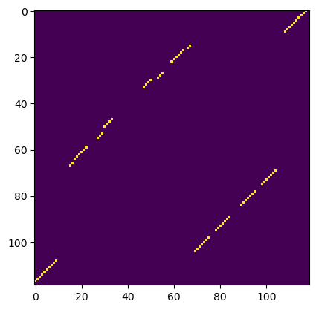
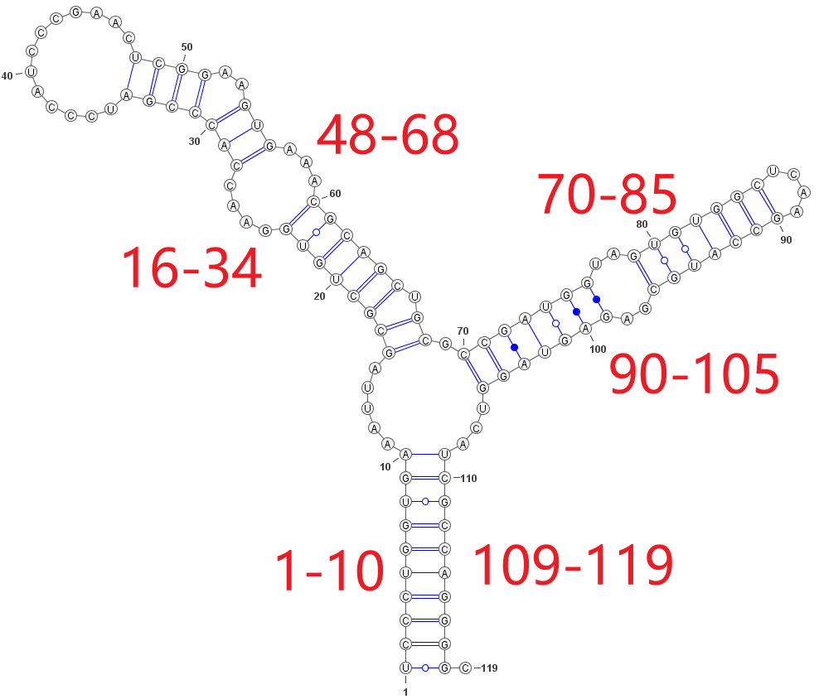
1.3 Label
label: [L, L]
(contact map)
secondary structure

Slide 22
1.4 Summary
Input: sequence → [L, L, 8]
Output: [L, L]

Slide 23
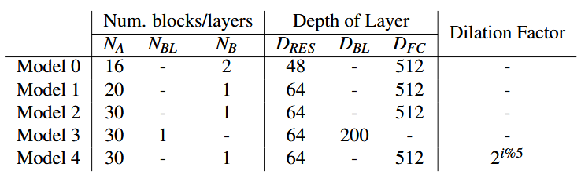
2. Model
N_{A}: number of residual blocks
N_{BL}: with or without BLSTM
N_{B}: number of FC layers

Slide 24




3.0 Metrics
accuracy
准确率，分类正确的样本占总样本个数的比例
precision
精确率（查准率），把更少的负样本认为是正的
recall
查全率，把更多的正样本认为是正的
f1 score
精确率和召回率的一个加权平均
mcc
机器学习-理解Accuracy，Precision，Recall, F1 score以及sklearn实现

Slide 25
3.1 Training
Training on bpRNA dataset
Training on PDB dataset

Slide 26
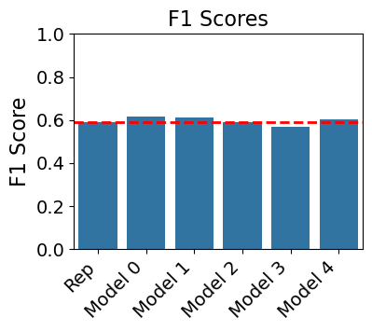

4. Evaluation

Slide 27
Practice
Preprocess the dataset by yourself (100-10-10)
week08/demo1/dataset/bpRNA_dataset_student
reference: demo1/doc/reproduce-qiuhaoren/data_preprocess.py
Pairing probability to secondary structure
doc/SPOT-RNA/SPOT-RNA.py: 100
doc/SPOT-RNA/utils/utils.py: 250-316
LayerNorm or InstanceNorm
doc/SPOT-RNA-pytorch/model.py
一文弄懂Batch Norm / Layer Norm / Instance Norm / Group Norm

