Slide 1
AI赋能的生物大分子模拟和计算
Week 09
Yi Xue, School of Life Sciences, THU April 22, 2026

Slide 2
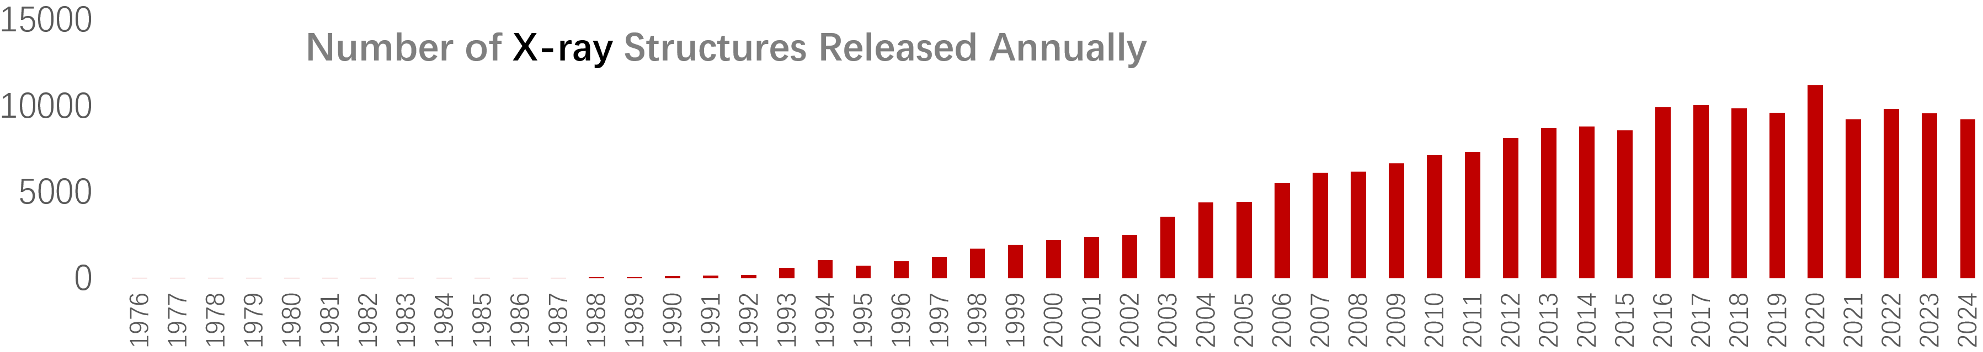
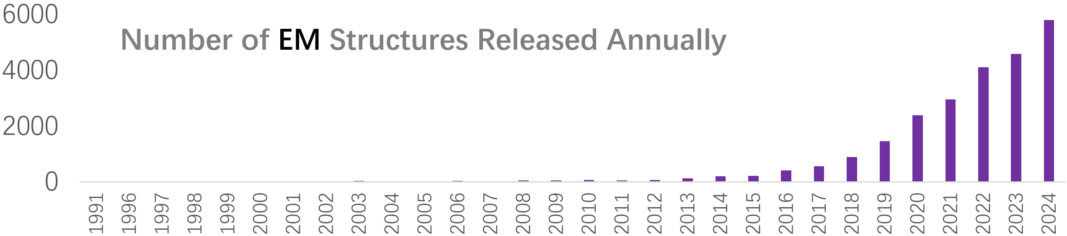
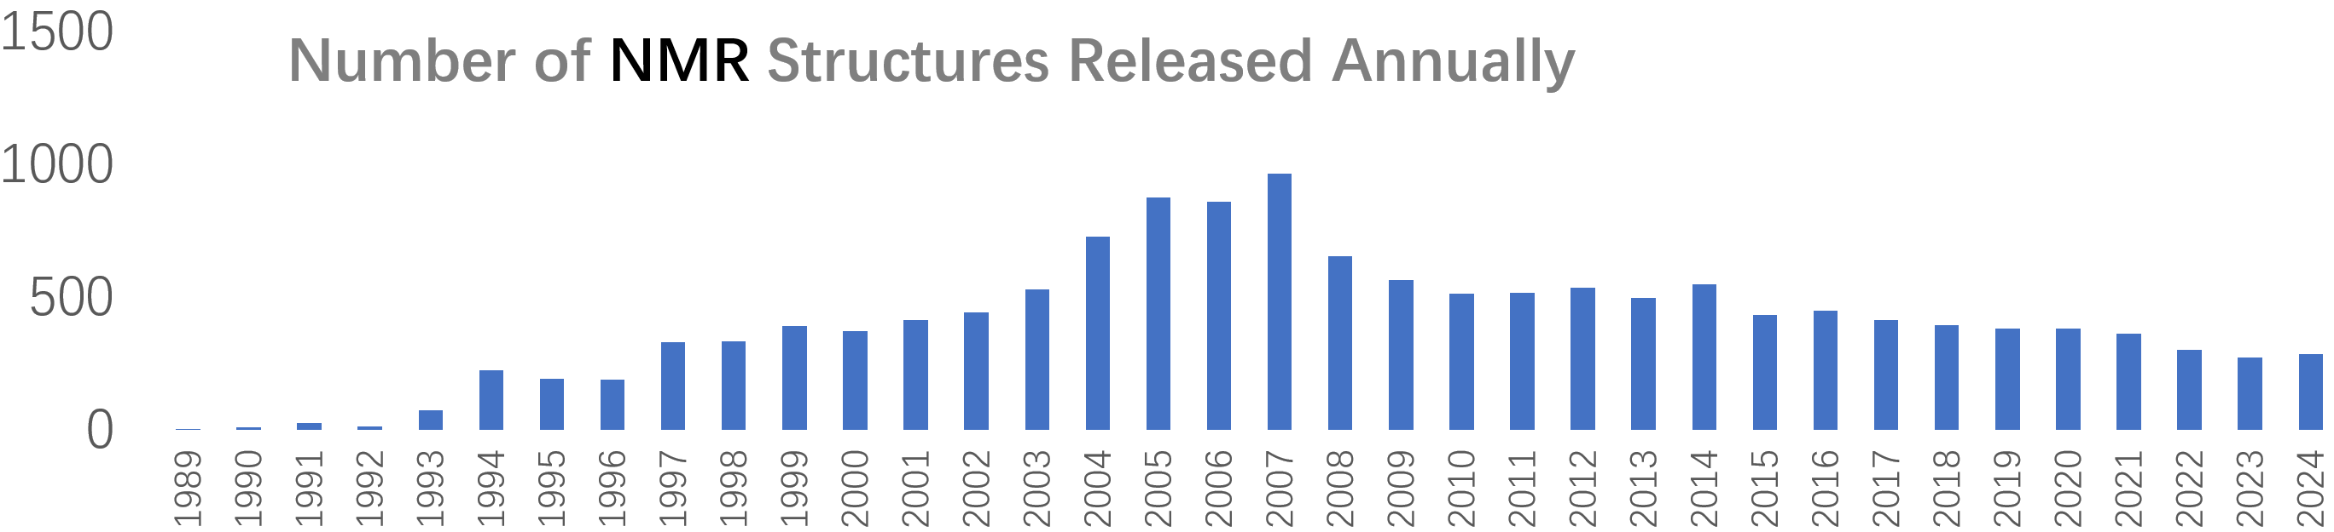

Slide 3
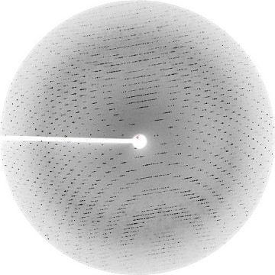
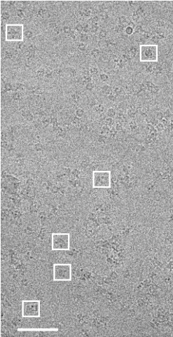
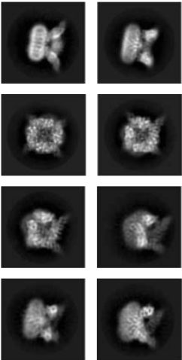
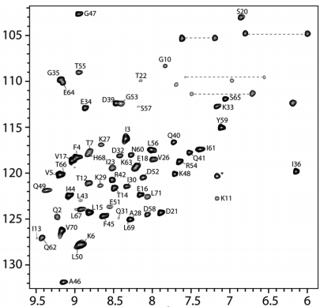
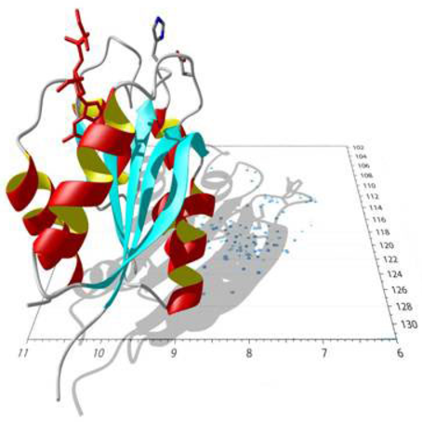
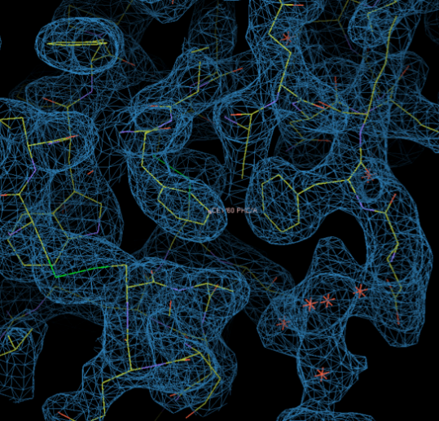
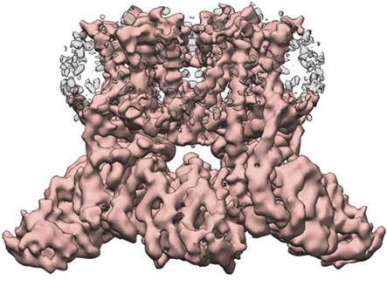
X-ray crystallography
Cryo-EM
NMR
Notes:
四大名谱(IR, MS, NMR, UV)

Slide 4
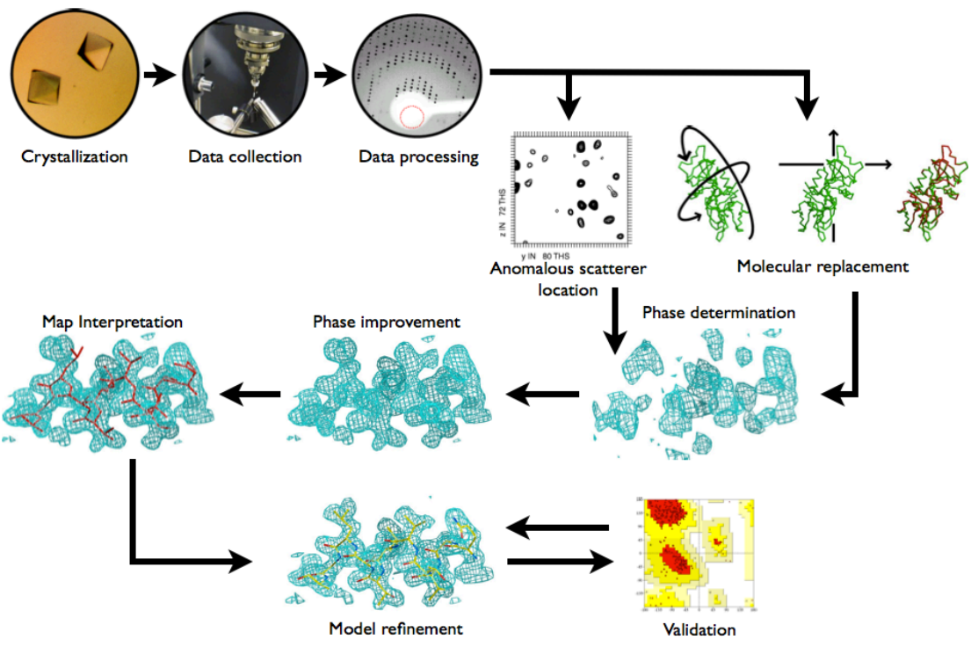
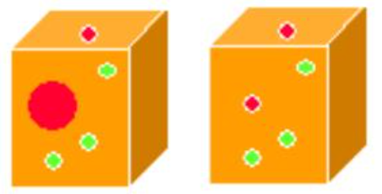
X-ray
Isomorphous replacement

Slide 5
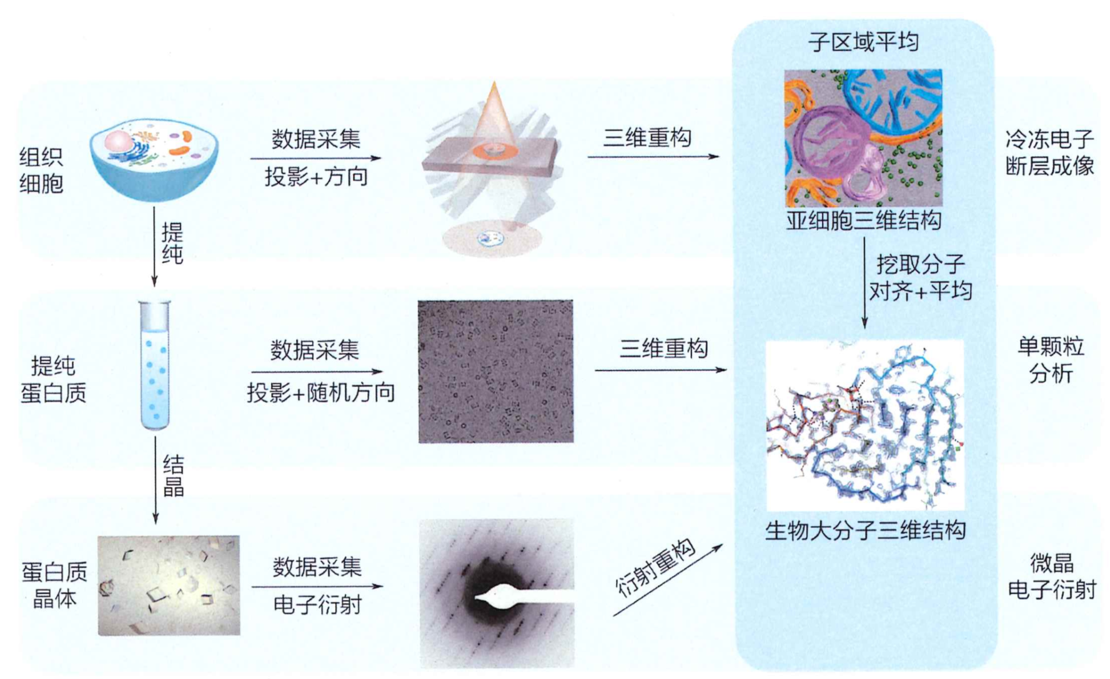
cryoEM
Cryo-ET
cryo-electron tomography
SPA
single-particle analysis
MicroED
micro-crystalline electron diffraction

Slide 6
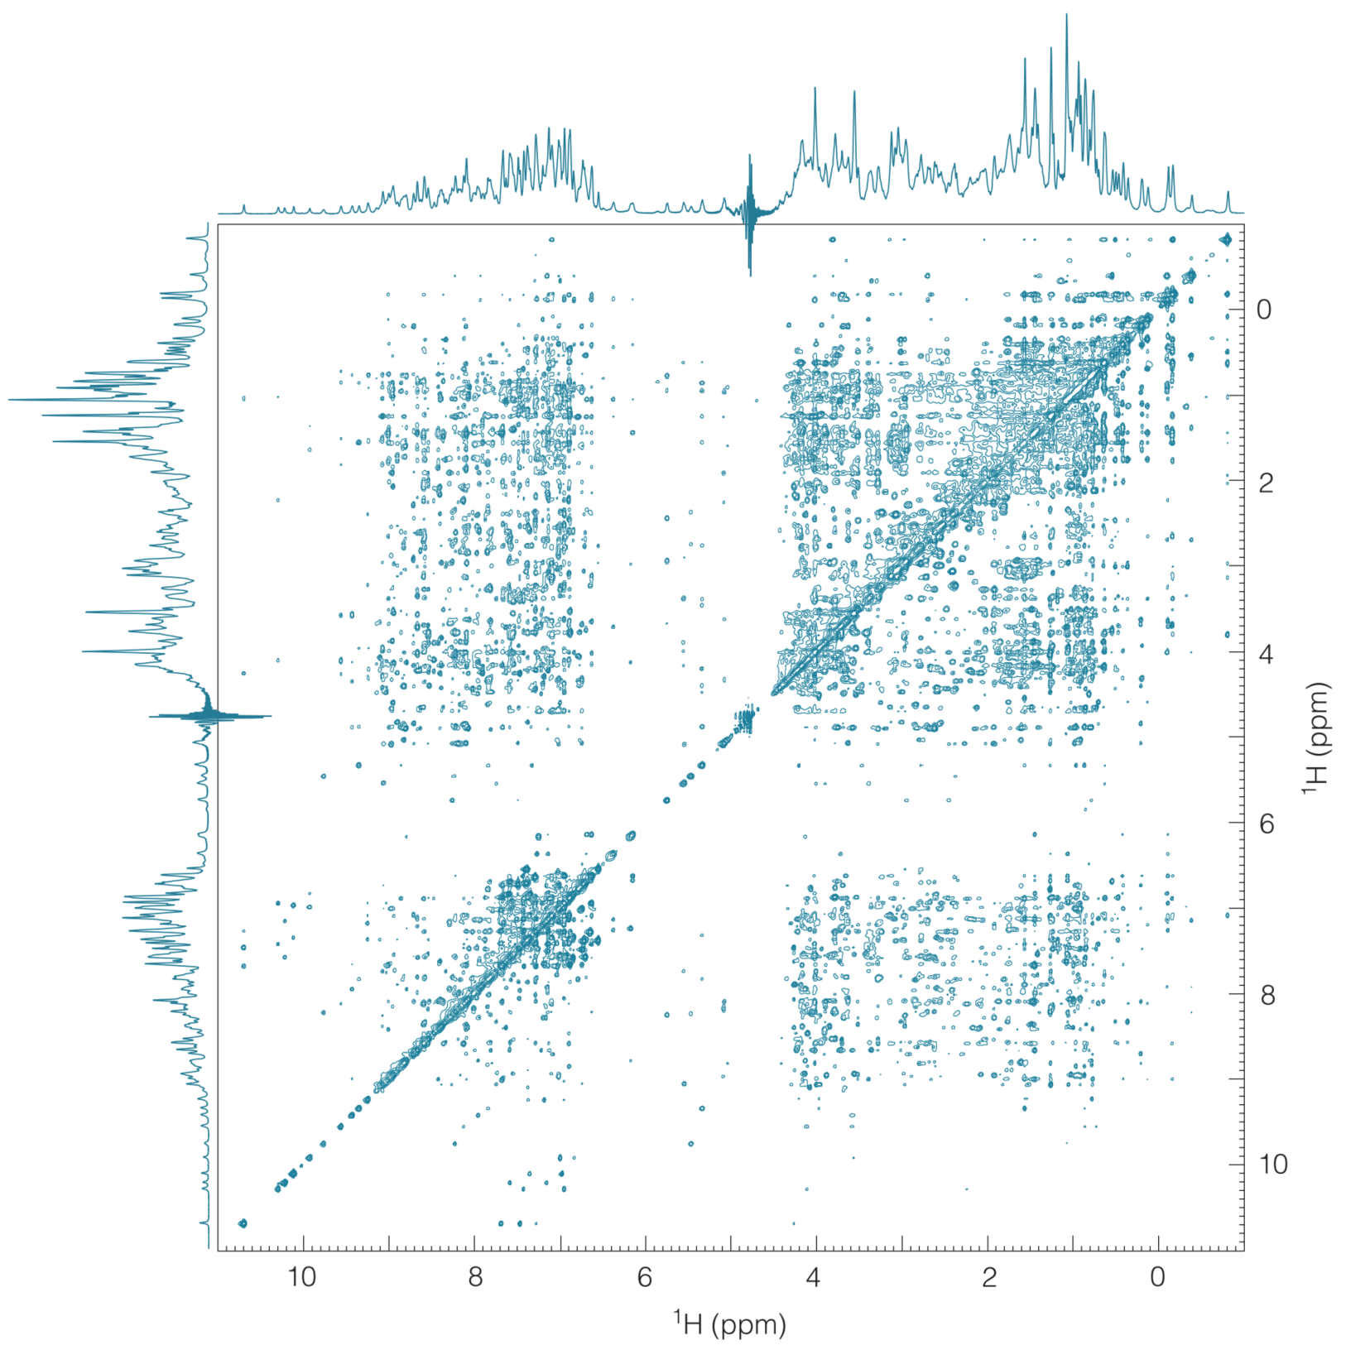
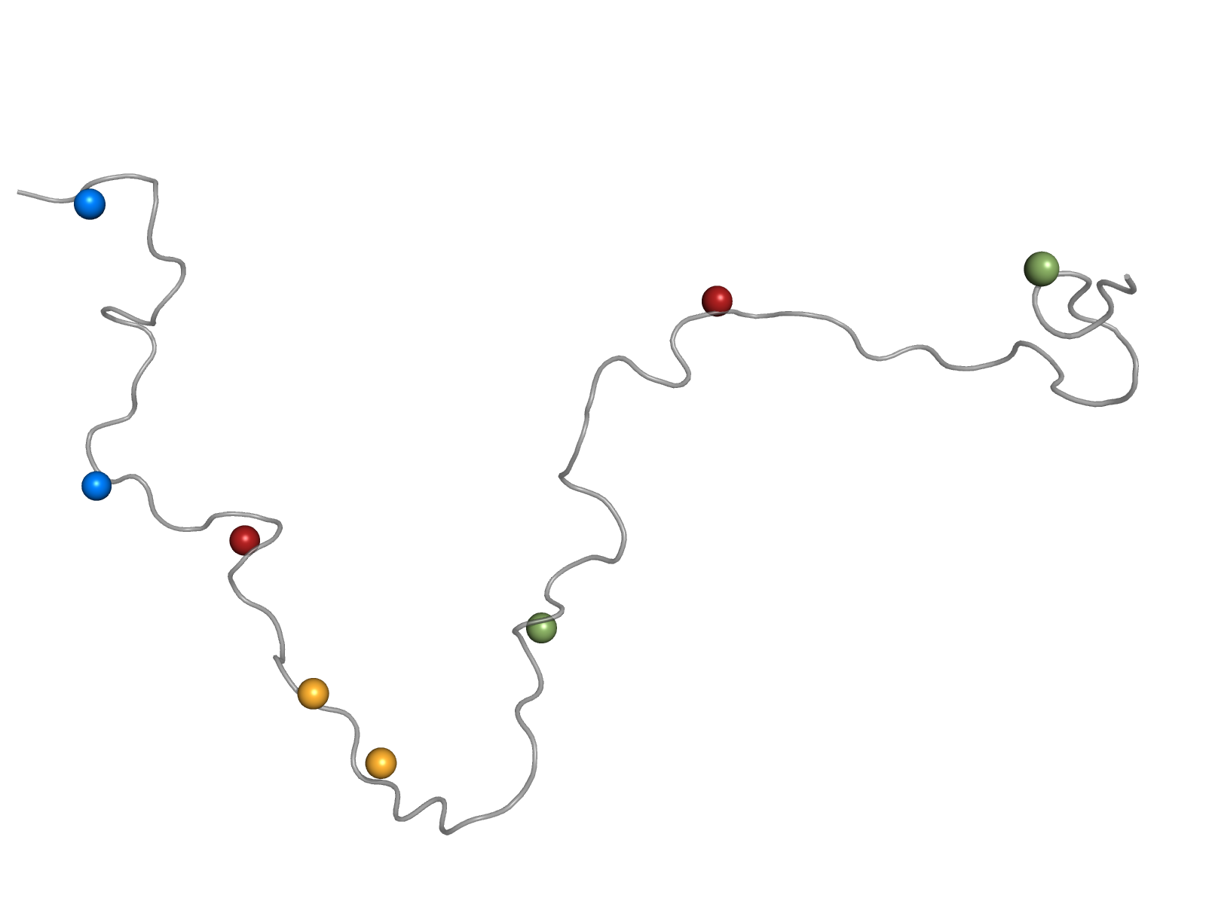
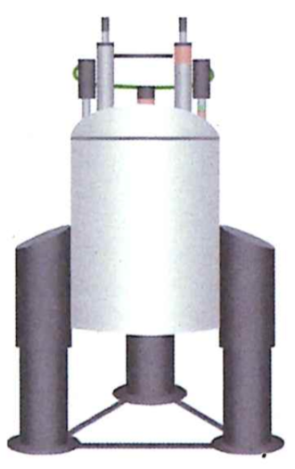
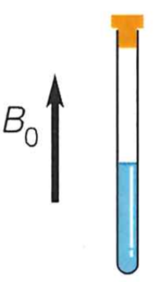
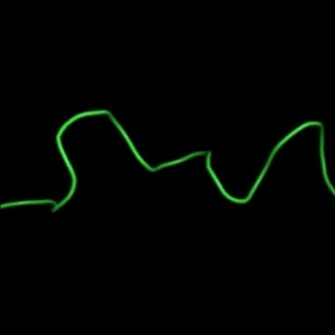
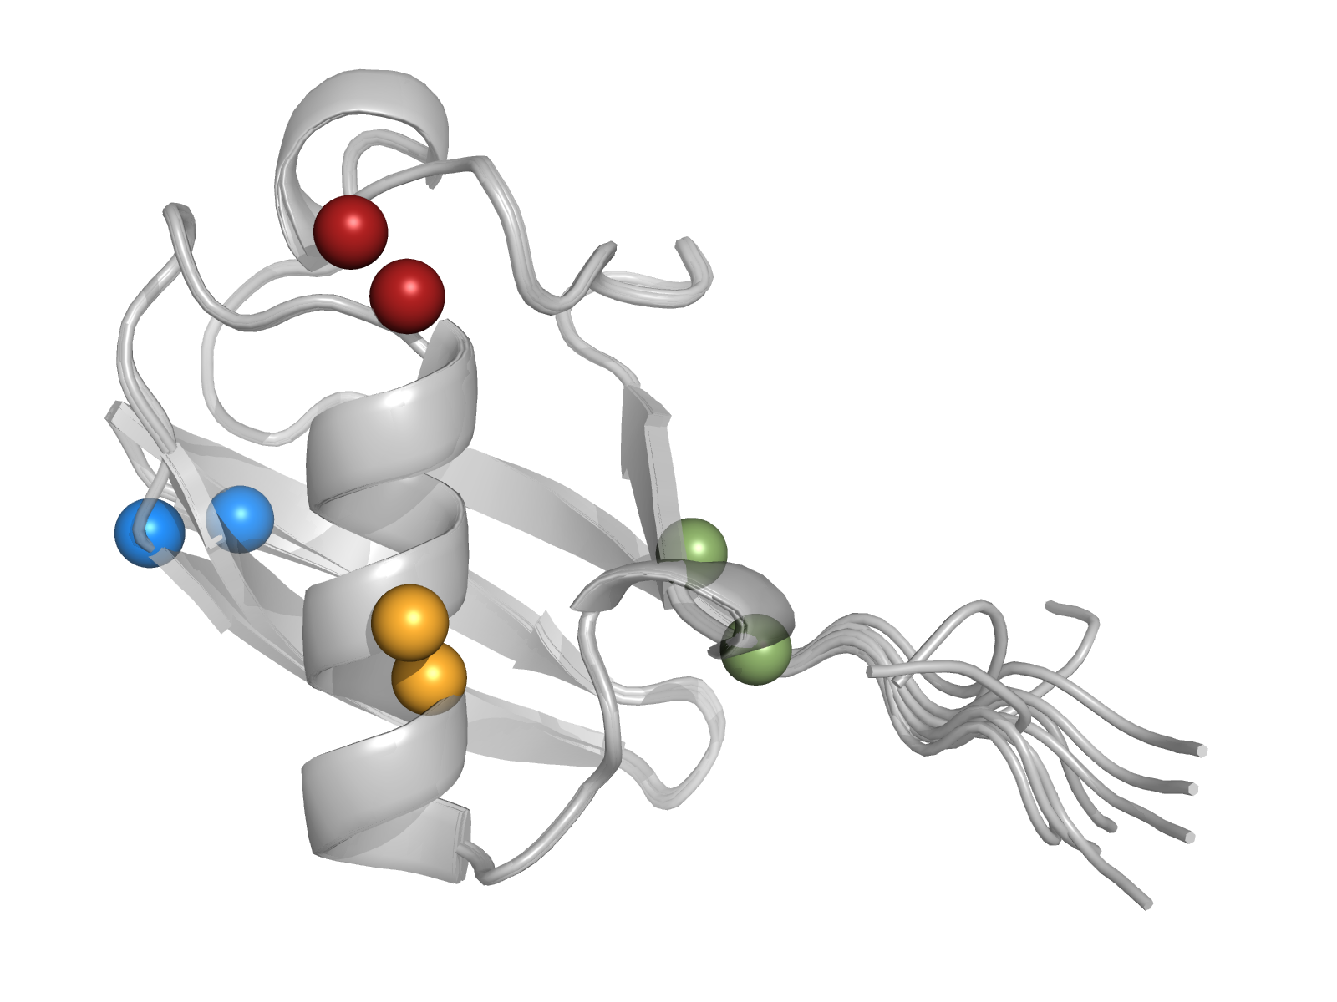
NMR
NOEs provide H-H distance restraints

Slide 7
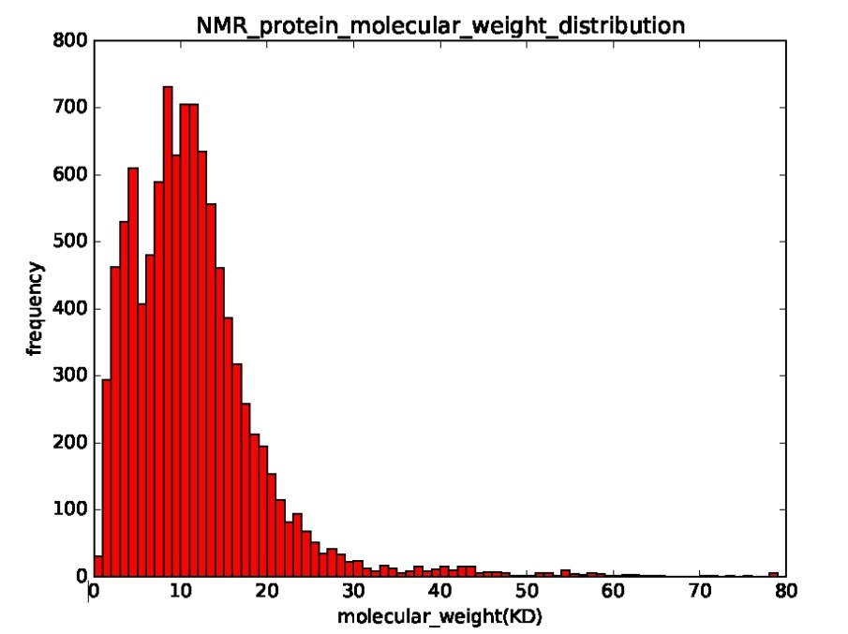
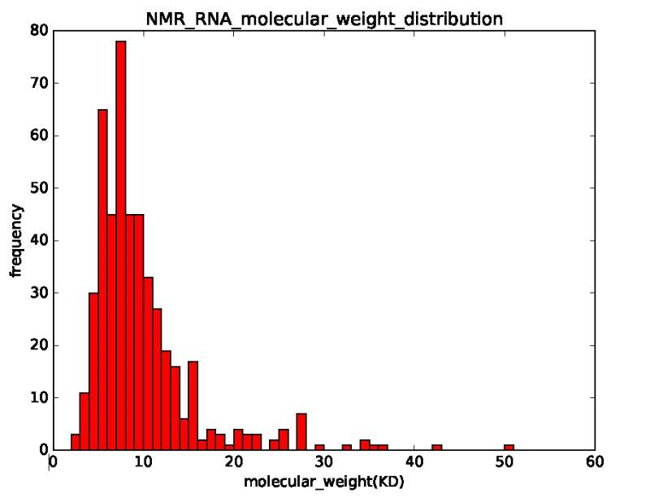
Solving structures by NMR
Conventionally by using NOE data and sometimes RDC data as restraints
 | NMR | X-ray
Protein | 10199 (9%) | 103623 (91%)
RNA | 482 (42%) | 678 (58%)
Up to ~30 kD for structure determination
Statistics up to Nov. 2016
Notes:
从上面的两张统计分析图，我们可以得出以下结论：
1）目前NMR方法解出来的蛋白质结构的数目大于RNA的数目。
2）RNA分子量的范围在0-38KD左右，蛋白质的分子量在0-50KD左右。
3）解出来的RNA的结构大部分在10KD附近，解出来的蛋白质的结构大部分在0-20KD。

Slide 8
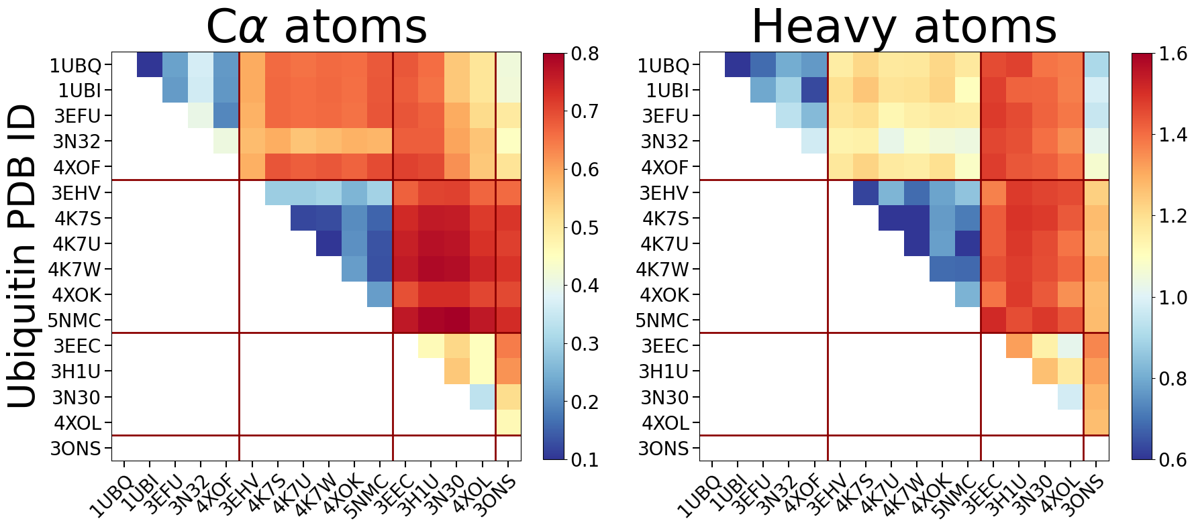
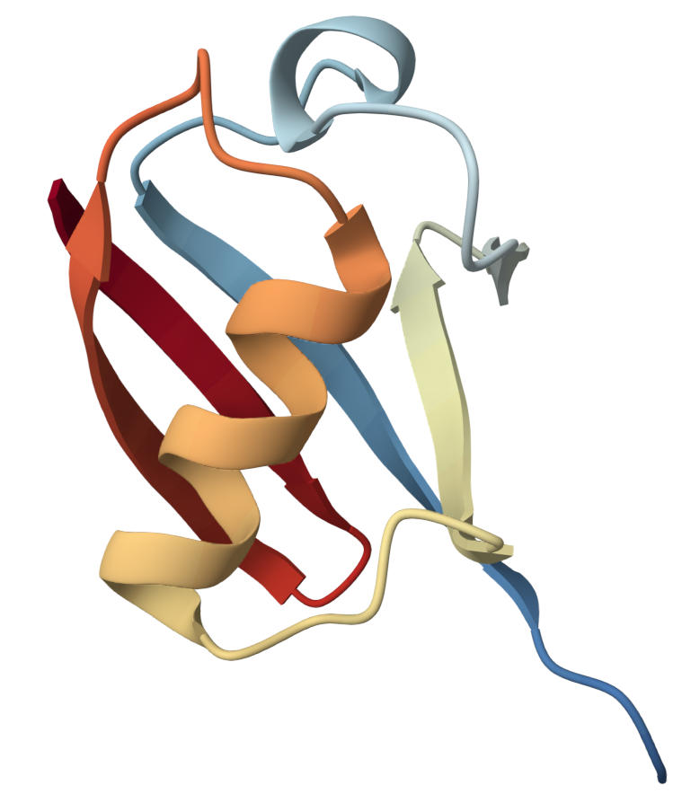
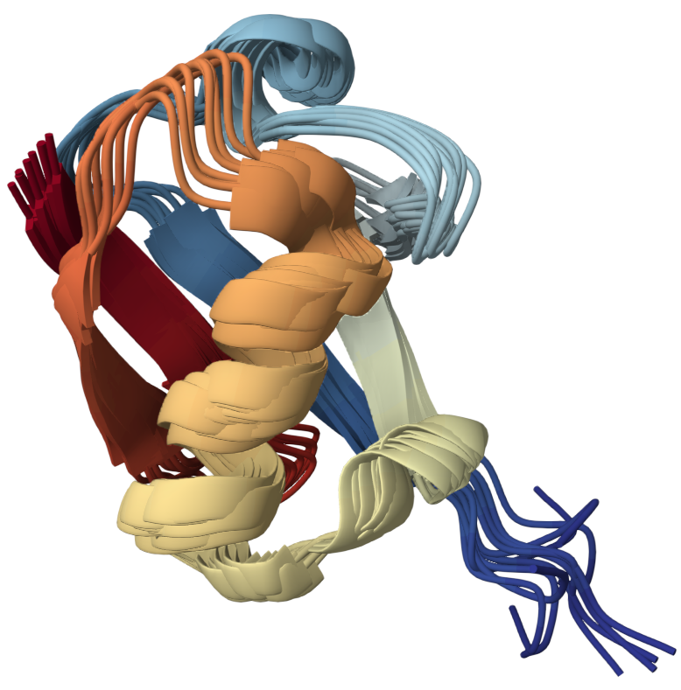
For a protein, you cannot define a “TRUE” structure!

Slide 9
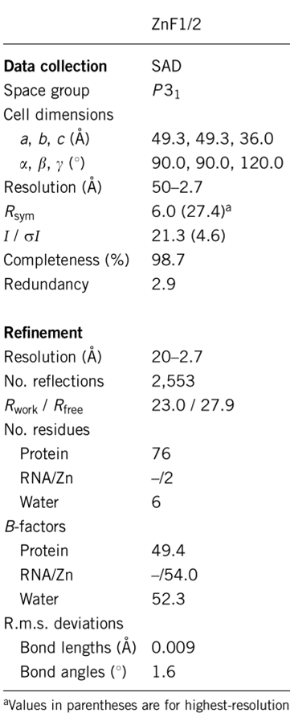
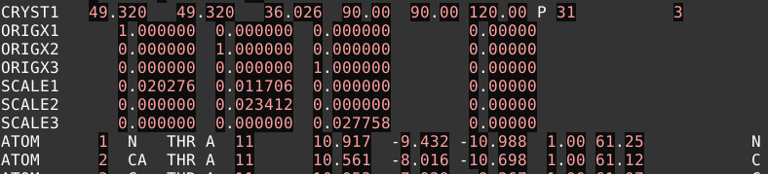
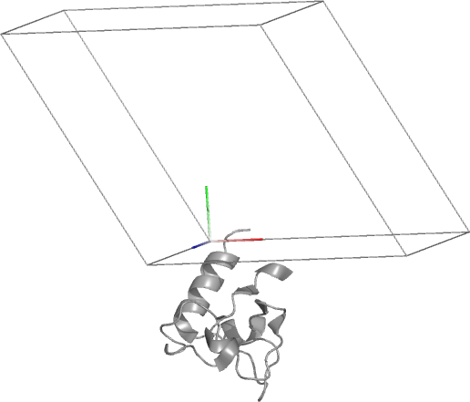
Unit cell
PDB ID: 3D2N
In pymol, type: show cell
Asymmetric Unit

Slide 10
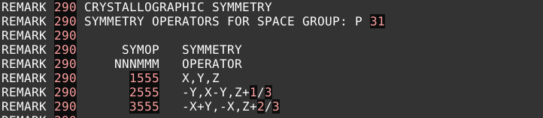
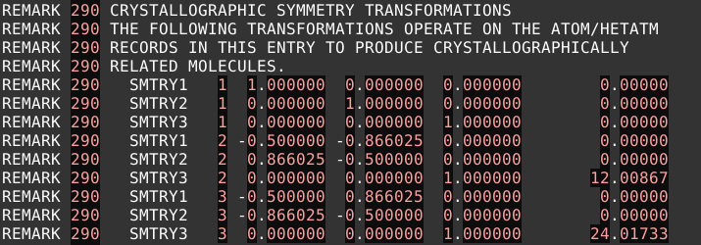
Symmetry operators
In pymol, type: show cell

Slide 11
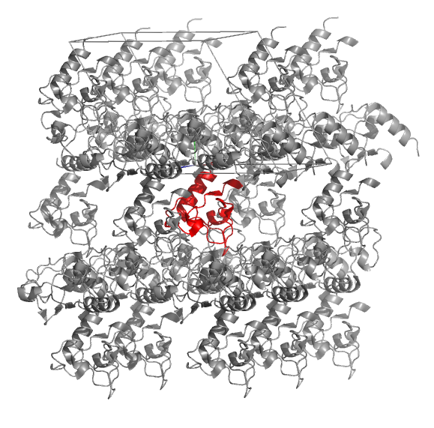
Lattice
In pymol, type: symexp sym, 3D2N, (3D2N), 30

Slide 12
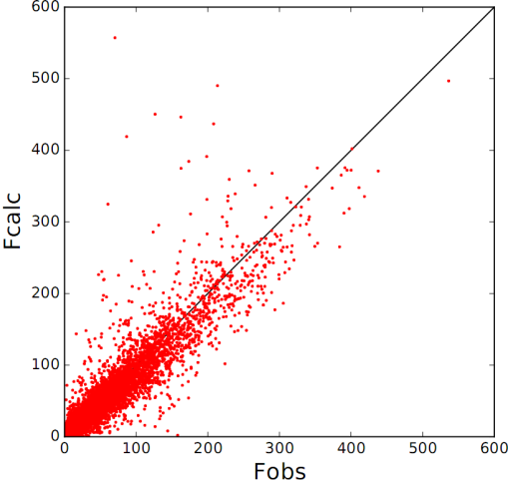
R-factor
R = 0.227
N_{reflection} = 7247
Expected value for a random model: ~59%
Perfect model: 0%
A desirable target R-factor for a protein model refined with data to 2.5 Å is ~20%
Small organic molecules commonly refine to < 5%

Slide 13
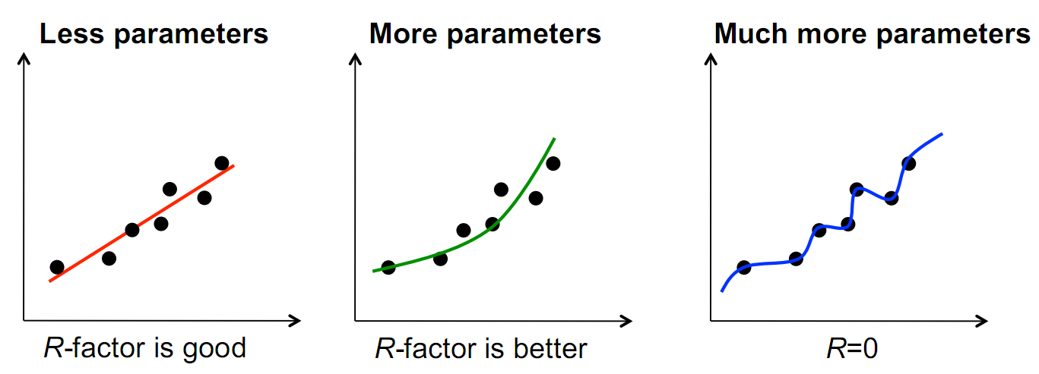
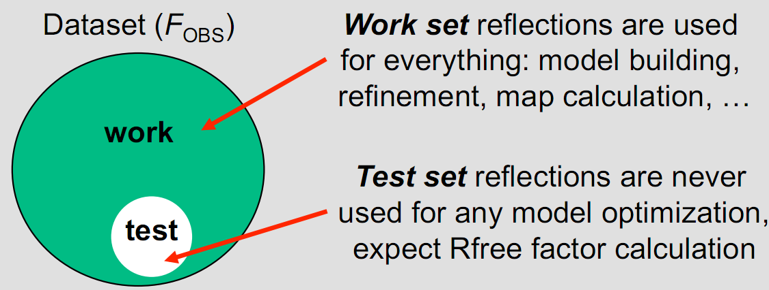
Overfitting
Test set ~5-10% of randomly selected data
Work set the rest
Notes:
The gap Rfree–Rwork depends on resolution and ranges from 5-7% (at medium to low resolution) to ~ 1% (at ultra-high resolution).

Slide 14
Demo
以机器翻译为例子
翻译句子：解释decoder中的qkv
理解句子：解释encoder中的qkv，以及self-attention
以Evoformer为例子
MSA ⬄ Contact map
Vanilla transformer → Axial transformer → pair bias
简述Triangular update和Structure module
SPIRED
dataset / model / training

Slide 15
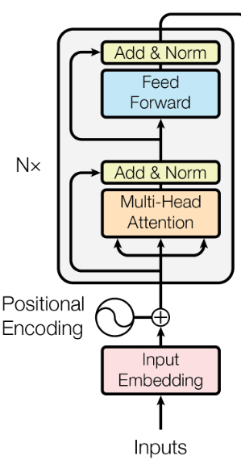
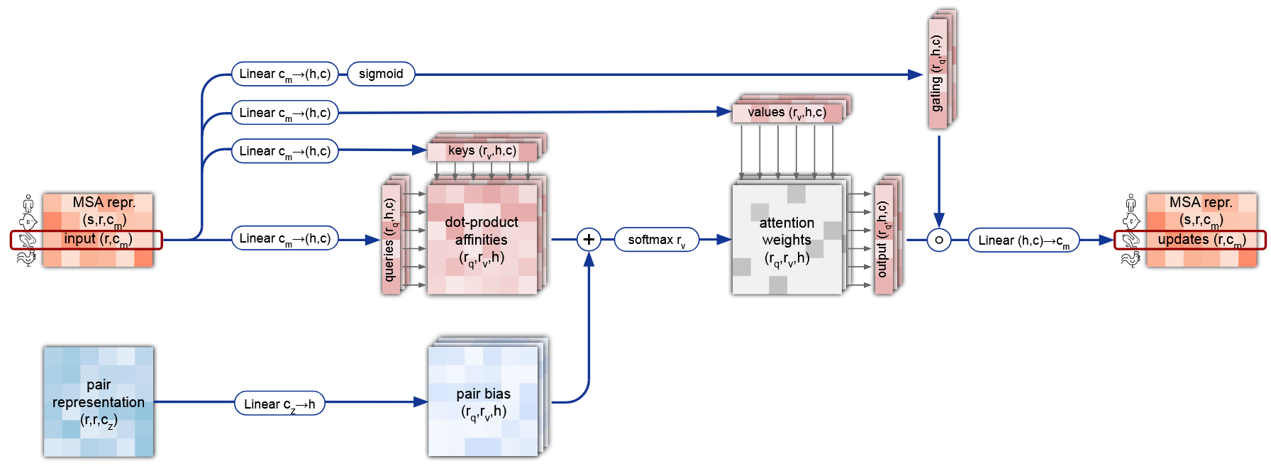
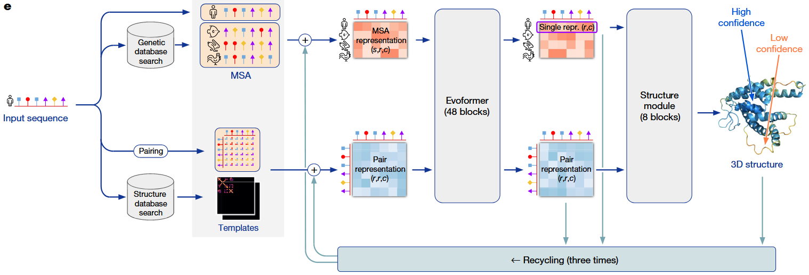
Key points
Attention
MSA / Sequence ⬄ Evolution / Contact map / 3D interaction
Transformer variants ⬄ Alphafold2

Slide 16
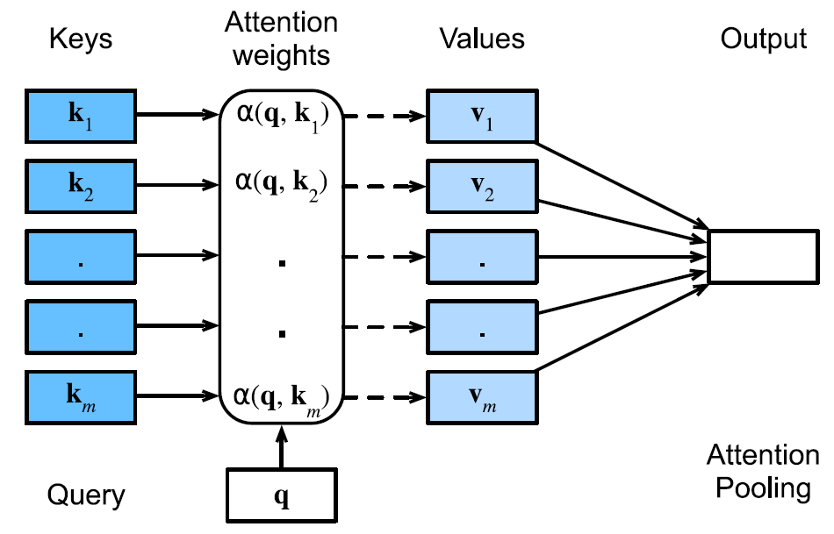
1.1 q/k/v in machine translation
一: 1e-5
I
二: 1e-5
0.4
love
…
0.5
0.4v₁+0.5v₂+0.1v_{m}
…
爱: 0.8
喜: 0.1
…
you
…
0.1
𰻞: 1e-10
我
11. Attention Mechanisms and Transformers — Dive into Deep Learning 1.0.3 documentation
Notes:
英译中，原句是I love you，中文的第一个词是我，下一个词是什么

Slide 17
1.1 q/k/v in machine translation
Attention
Feed-forward
[L, c]
[1, L]
[L, c]
I
[1, c]
[1, c]
[1]
love
[1, c]
[1, c]
[1]
[1, c]
[1, 4c]
[1, c]
Feed-forward
you
[1, c]
[1, c]
[1]
Attention
c: embedding dimension
L: length of src sentence
我
[1, c]
Notes:
英译中，原句是I love you，中文的第一个词是我，下一个词是什么

Slide 18
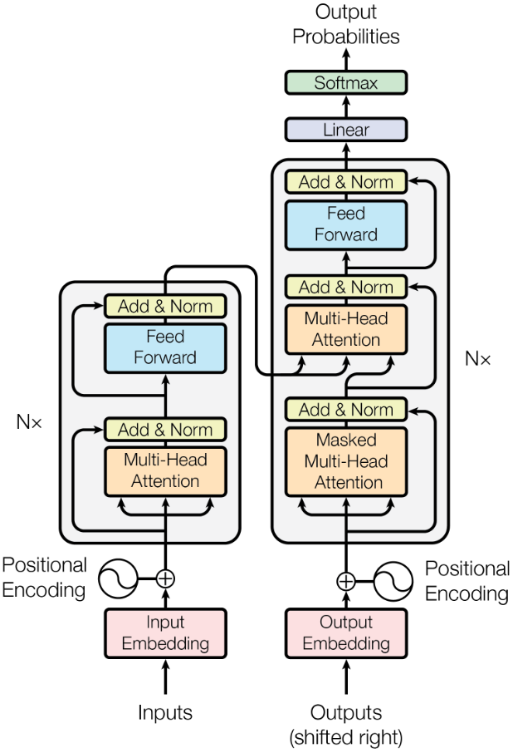
1.1 q/k/v in decoder
week09/demo1/basics.ipynb:
attention in a decoder
爱：0.8
I love you
我
[1706.03762] Attention Is All You Need

Slide 19
1.2 q/k/v in encoder
I
q₁
o₁
love
q₂
o₂
.
.
.
.
you
q_{m}
o_{m}
[L, c]
[L, c]
[L, c]
[L, L]
[L, c]
[L, c]

Slide 20
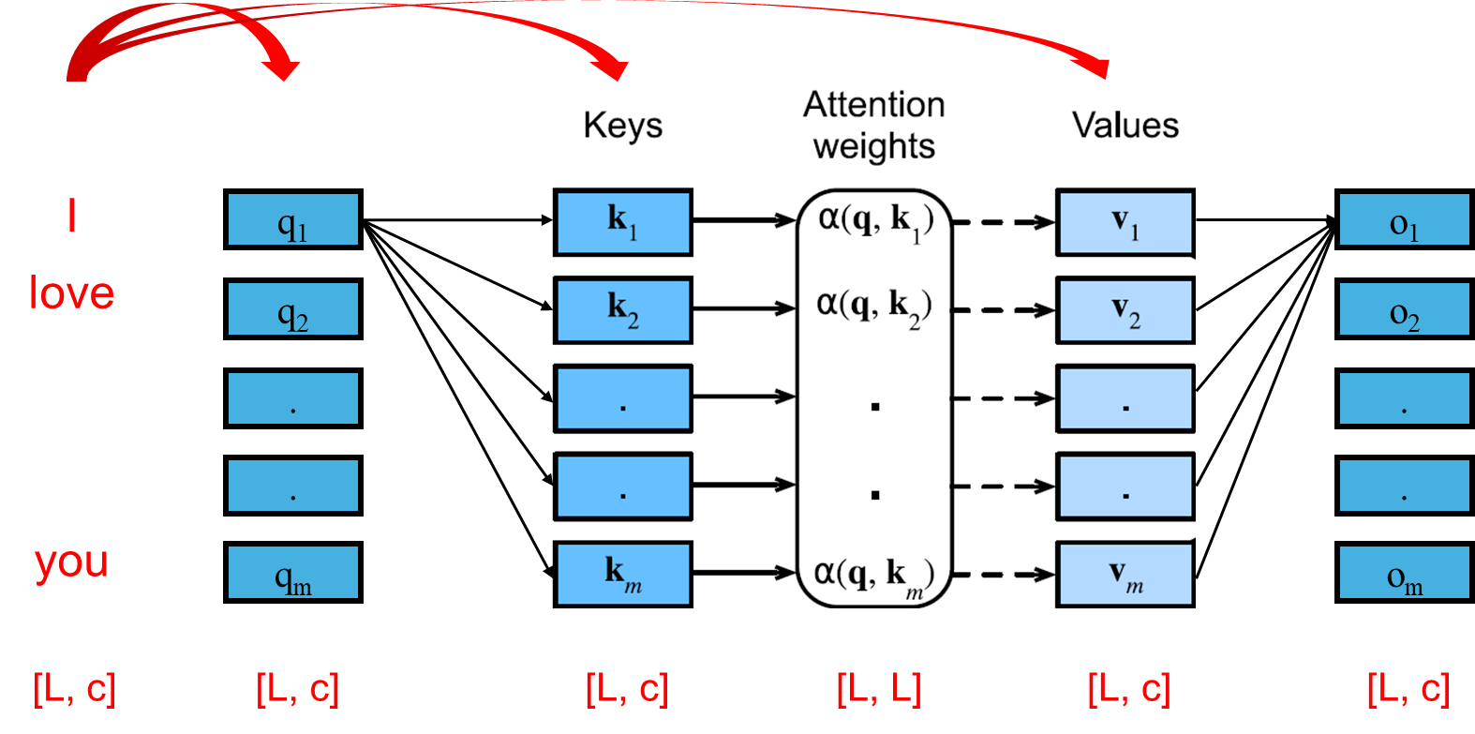
1.2 q/k/v in encoder
week09/demo1/basics.ipynb:
self-attention

Slide 21
1.3 Summary

Slide 22
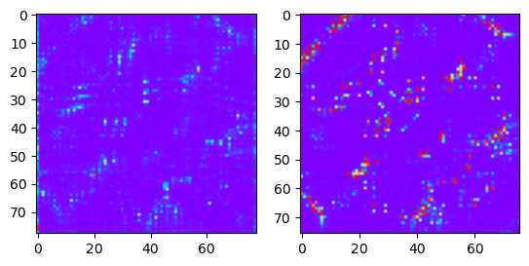
2. Attention in AlphaFold2
[L, C]
attention score
contact map
queries
residue index
[L, C]
keys
residue index
Highly accurate protein structure prediction with AlphaFold | Nature

Slide 23
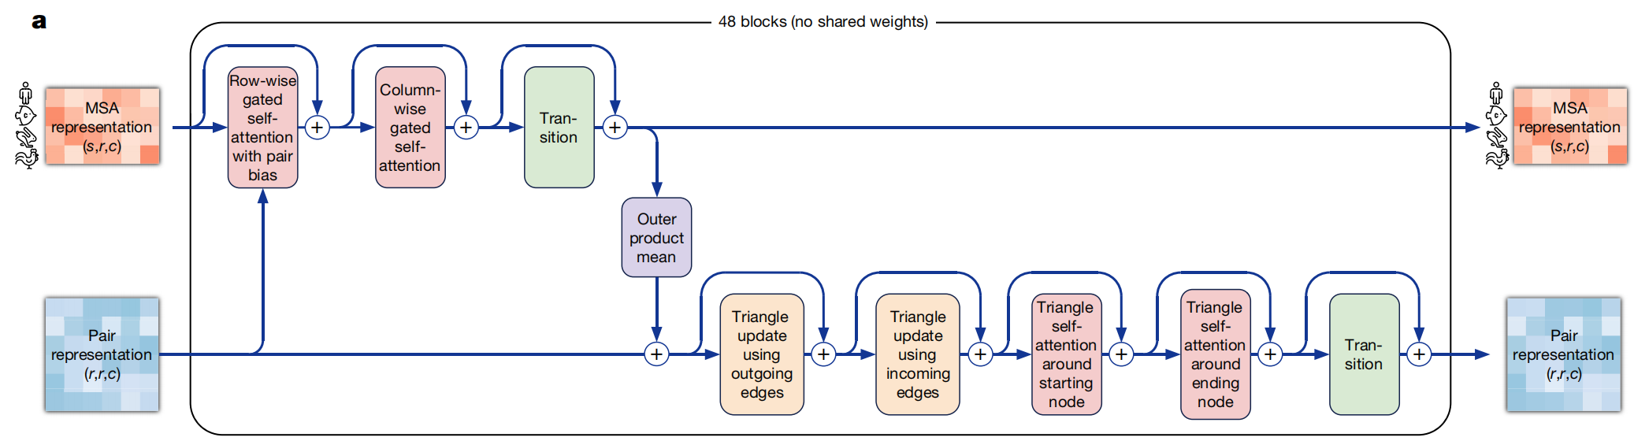
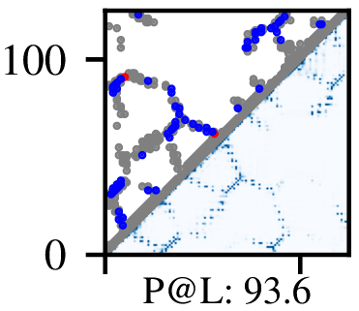
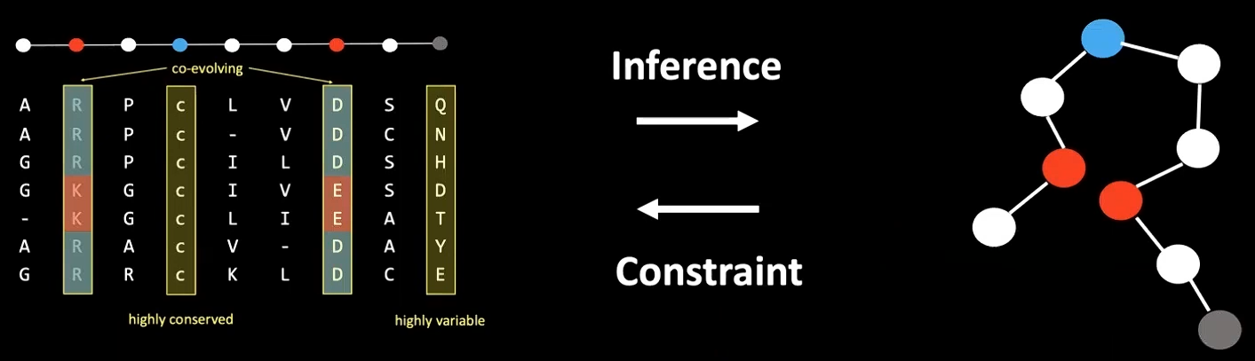
2.1 Vanilla Transformer
2D-Attention
Rao et al., ICML(2021)
MSA and pairwise contacts
Notes:
任务：输入MSA，输出contact
MSA是多序列比对，和contact的关系

Slide 24
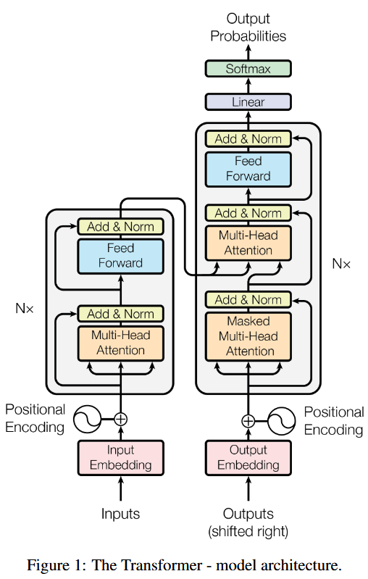
2.1 Vanilla Transformer
x 48
2D-Attention
Rao et al., ICML(2021)
Operations: O(s²r²)
OP for 1 point: sr A(v₁₁,v₁₁)*v₁₁ + A(v₁₁, v₁₂)*v₁₂ + … + A(v₁₁, v_{sr})*v_{sr}
num of points: sr
MSA and pairwise contacts
Notes:
算法实现：
vanilla Transformer要用2D attention
对于矩阵中的一个点，比如第一行第一个（1，1），计算与自身的点积，得到相似度，然后乘以自身；
与当前残基（1，1）相似度越高，就把那个残基的信息加一部分用来更新（1，1）
问题：
问题是计算量太大了，为了降低计算量，使用axial attention

Slide 25
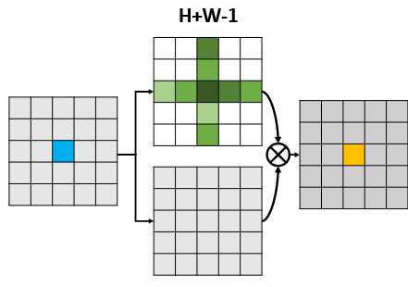
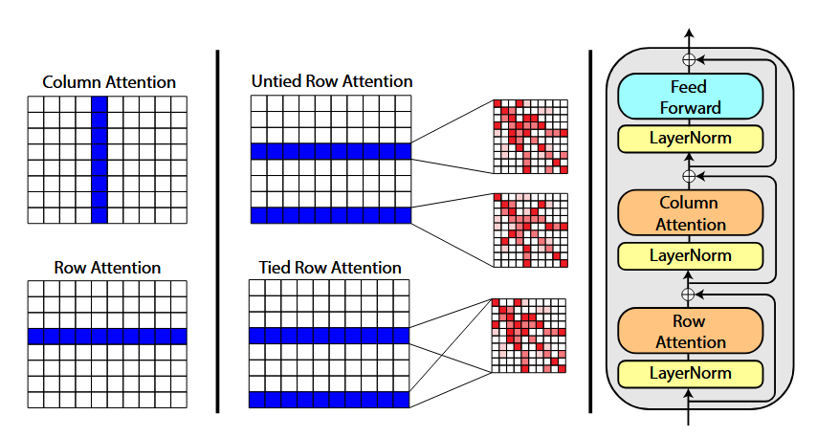
2.2 Axial attention
x 48
Axial Attention
Rao et al., ICML(2021)
Zilong Huang et al.,
IEEE(2020)
Operations: O(s²r²)
OP for 1 point: sr
num of points: sr
Operations: O(s²r+sr²)
OP for 1 point: (s+r)
num of points: sr
Rao et al., MSA Transformer, ICML(2021)
Notes:
算法实现：
axial attention在计算attention的时候，计算当行和当列。
对于某个残基，只考虑同一序列其他残基（行），以及其他序列的同一位点（列）
将计算量降低了几百几千倍 实现了MSA Transformer
问题与方法： 引入已知同源蛋白的信息

Slide 26
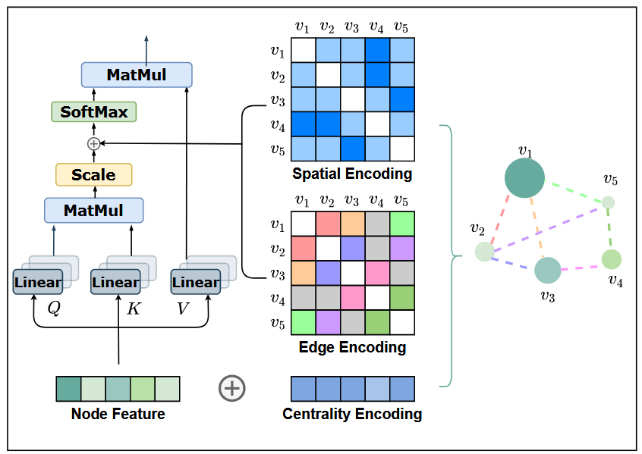

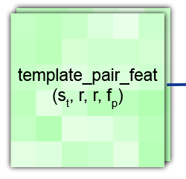
2.3 Addition of pair bias
x 48
Ying et al., NiPS(2021)
Notes:
改动：
axial attention → row-wise and column-wise attention
Pair representation from template
算法实现： attention不是用for loop，而是用矩阵运算实现的，所以会有一个affinity matrix，形状是[r, r, h]，刚好就是两两残基之间的关系；我们在引入pair representation，也是两两残基之间的关系
可以看一下有没有pair bias的区别
联想到BPFold
借鉴自
问题与方法：
MSA更新迭代48次之后，目标序列的表示，已经包含了共进化的信息，能不能用来更新Pair

Slide 27
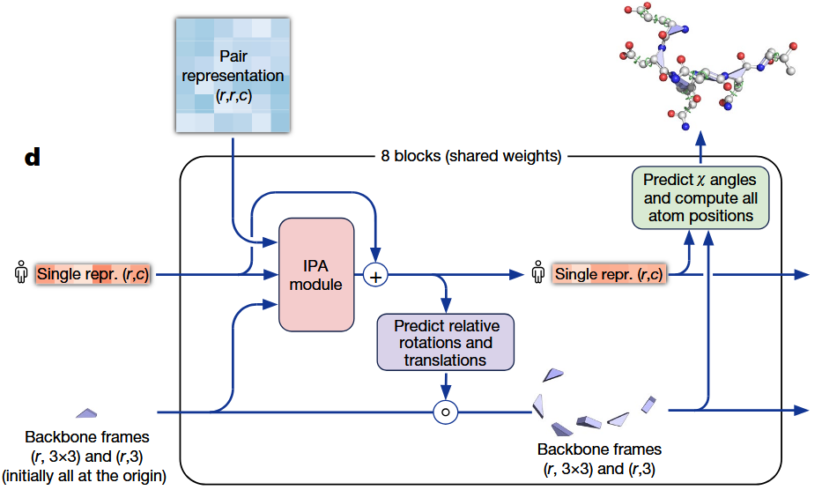
2.4 The other components
Pair representation
Structure module

Slide 28
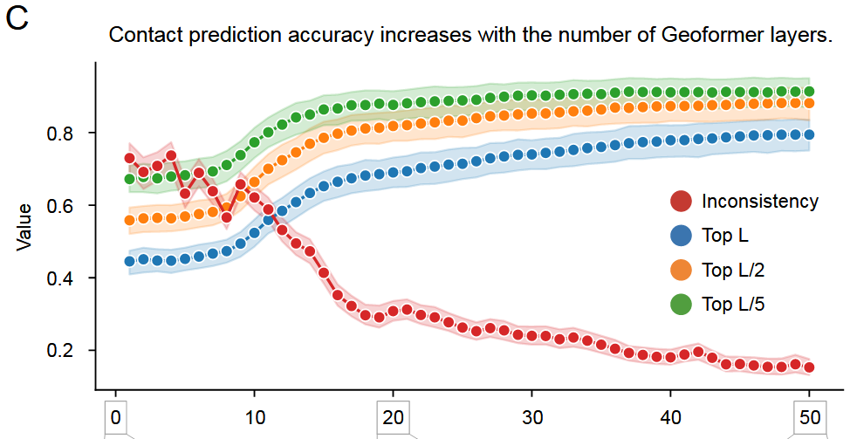
2.4.1 Pair representation
Wu et al., 2022 (OmegaFold)

Slide 29

2.4.2 Structure module

Slide 30




2.4.2 Structure module
translation
backbone frame
black hole initialization
backbone frames

Slide 31

2.4.2 Structure module
CG
backbone frame

Slide 32
2.5 Summary

Slide 33


3. SPIRED
龚海鹏

Slide 34


3. SPIRED
spired-rerun
spired-stage1
85 A100*days
3456 A100*days
5 RTX 4090 * days
low cost for training, 85 A100*days vs 3456 A100*days
5 x faster for inference (excluding that for MSA)

Slide 35

3.1 Data preparation
week09/demo2/scripts/0.1_download.py
raw PDB files (single chain)
24 K for stage 1
138 K for stage 4
features x and labels y
x: model input
y: reference of prediction
Notes:
362 MB vs 69 GB
invariant variables

Slide 36




3.2 Model construction
week09/demo2/pspred/spired/Model.py
Restraint
Model
Minimization
Sequence
SPIRED
Restraint
Model
Model
Minimization
MSA
Sequence
trRosseta
ESMFold

Slide 37

3.3 Training
week09/demo2/train_stage1.sh
training
file locations
device
hyperparameters
epoch
batch size
learning rate
…
Notes:
python -u : force the stdout and stderr streams to be unbuffered;
valid_length: largest length for validation

Slide 38
3.4 Evaluation
week09/demo2/test_SPIRED.ipynb
spired-rerun
spired-stage1

