Slide 1
AI赋能的生物大分子模拟和计算
Week 10
Yi Xue, School of Life Sciences, THU
April 29, 2026

Slide 2
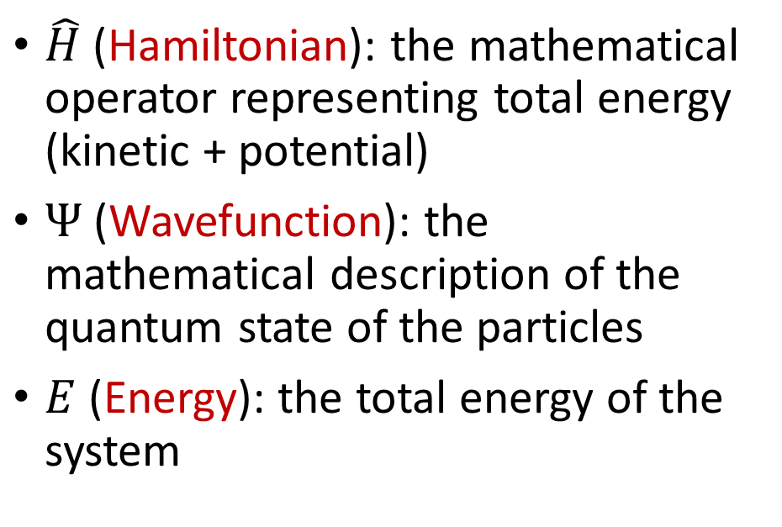
Introduction to Density Functional Theory (DFT)
Quantum mechanics dictates that the exact energy and properties of a molecule can be calculated by solving this equation
$\hat{H}$(Hamiltonian): the mathematical operator representing total energy (kinetic + potential)
$Ψ$(Wavefunction): the mathematical description of the quantum state of the particles
$E$(Energy): the total energy of the system
The Catch: For anything larger than a simple one-electron system (like a Hydrogen atom), finding an exact solution to this equation is mathematically and computationally Impossible.

Slide 3
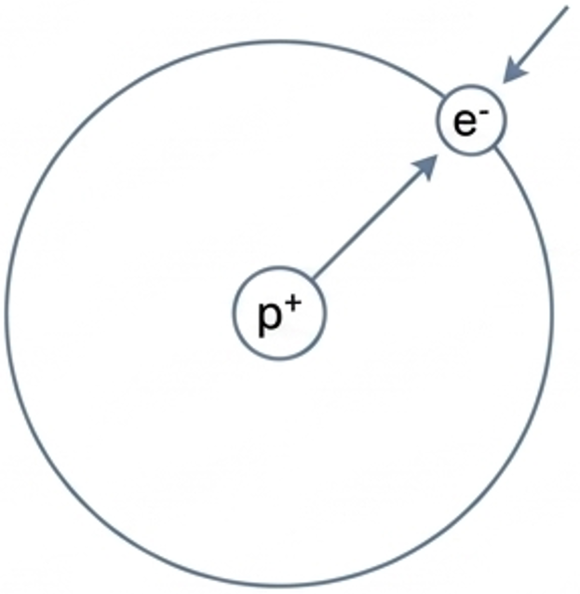
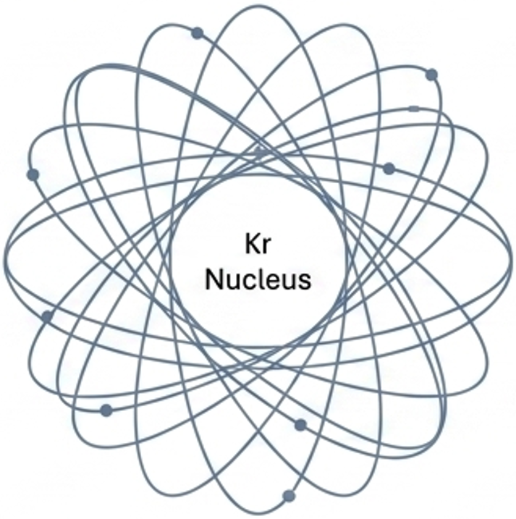
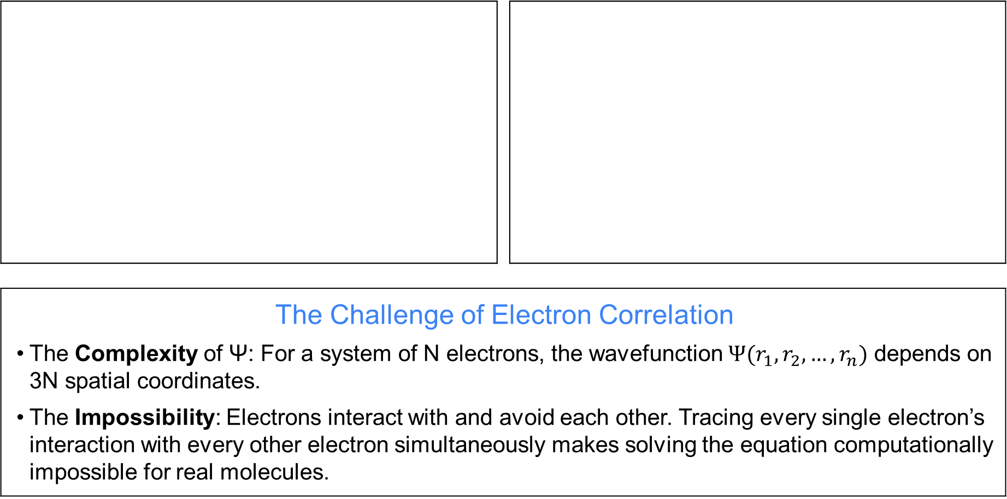
The Many-Body Problem
The Challenge of Electron Correlation The Complexity of Ψ: For a system of N electrons, the wavefunction $Ψ(r_{1},r_{2},…,r_{n})$ depends on 3N spatial coordinates. The Impossibility: Electrons interact with and avoid each other. Tracing every single electron’s interaction with every other electron simultaneously makes solving the equation computationally impossible for real molecules.
N = 1 electron: 3 spatial variables (x, y, z)
N = 36 electrons: 108 spatial variables

Slide 4
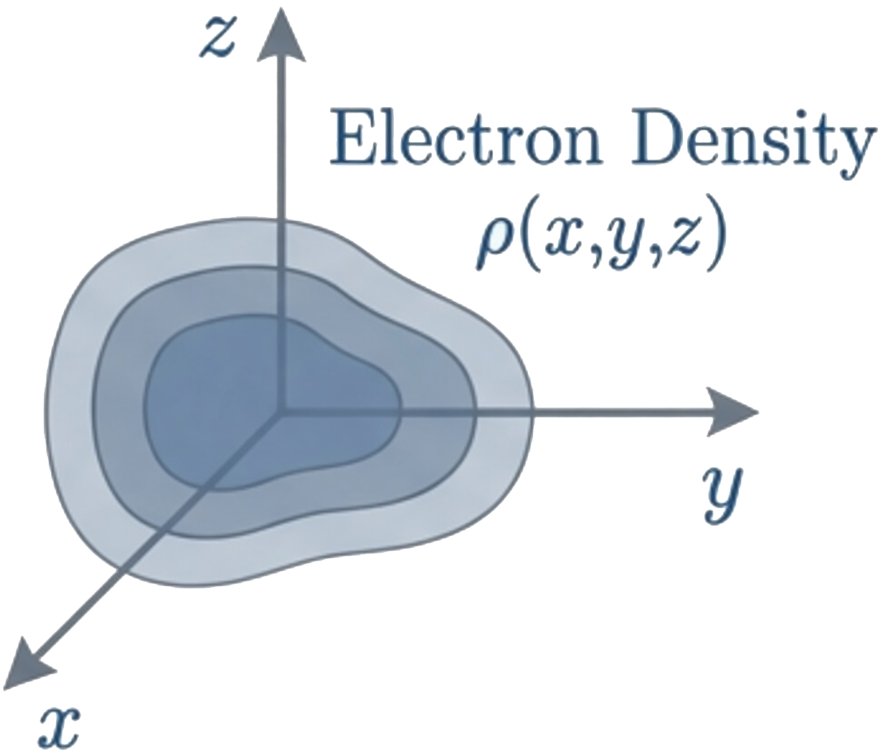
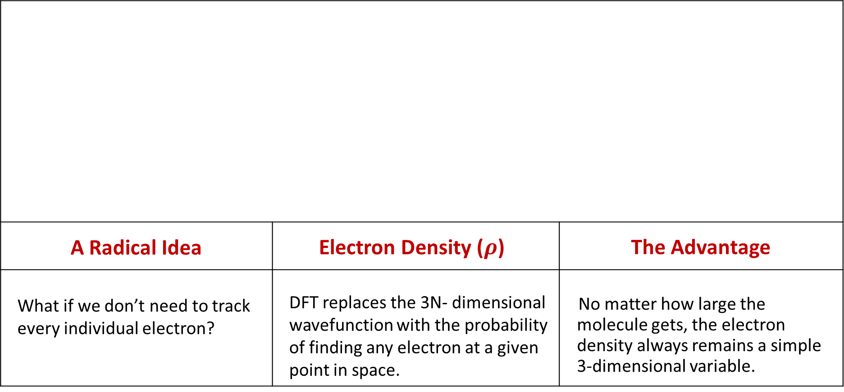
DFT: comes to rescue
A Radical Idea | Electron Density ($ρ$) | The Advantage
What if we don’t need to track every individual electron? | DFT replaces the 3N- dimensional wavefunction with the probability of finding any electron at a given point in space. | No matter how large the molecule gets, the electron density always remains a simple 3-dimensional variable.

Slide 5
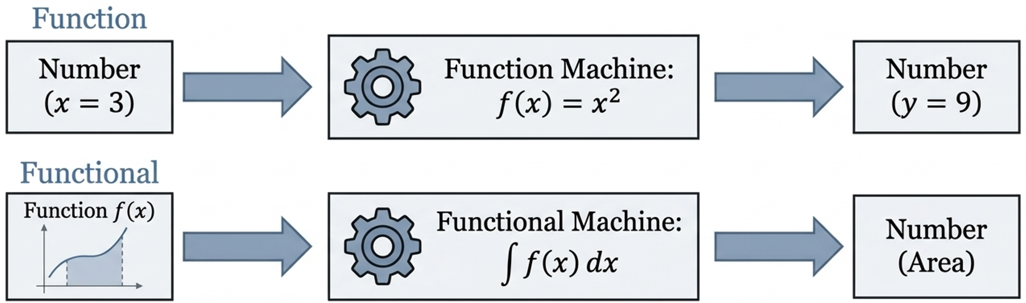
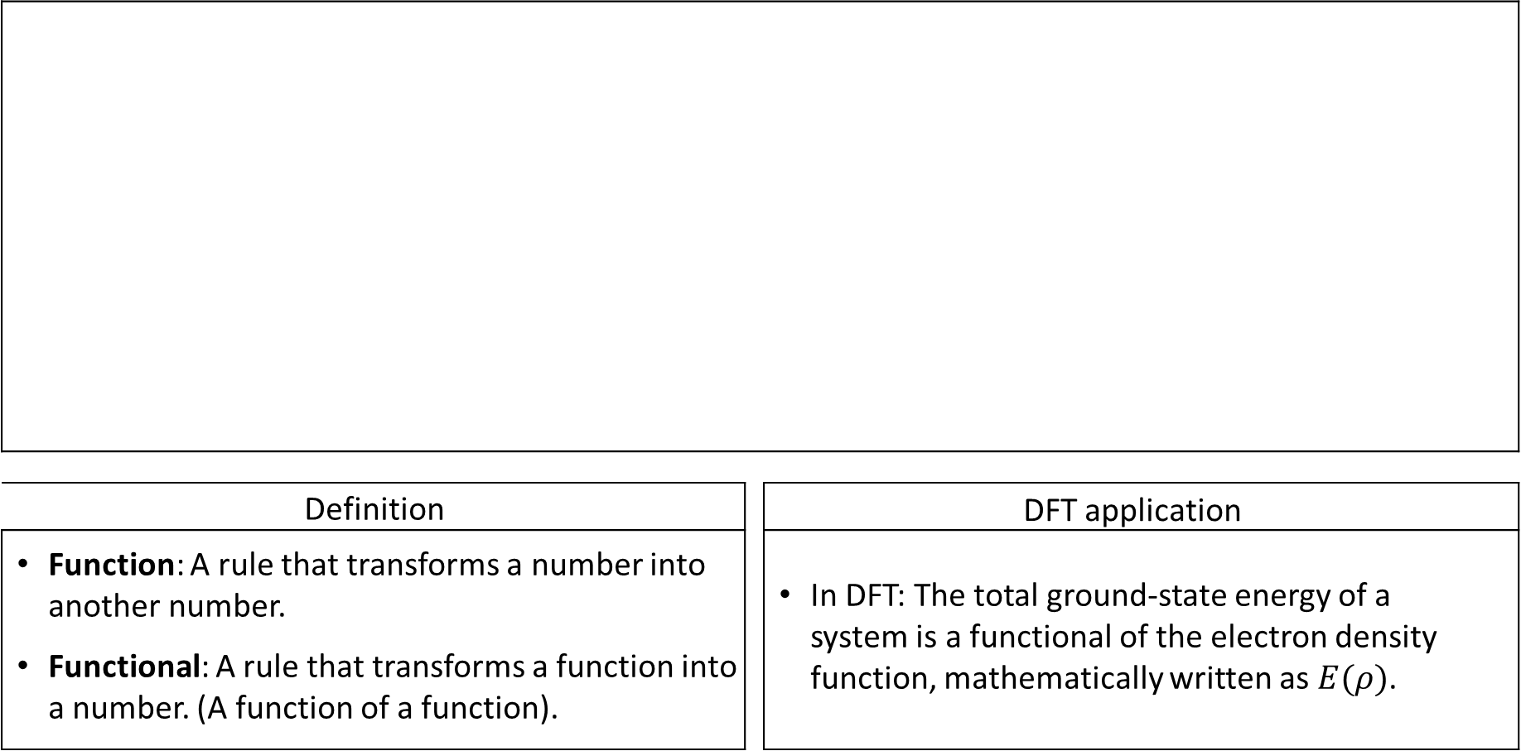
What is a functional?
Definition |  | DFT application
Function: A rule that transforms a number into another number. Functional: A rule that transforms a function into a number. (A function of a function). |  | In DFT: The total ground-state energy of a system is a functional of the electron density function, mathematically written as $E(ρ)$.

Slide 6
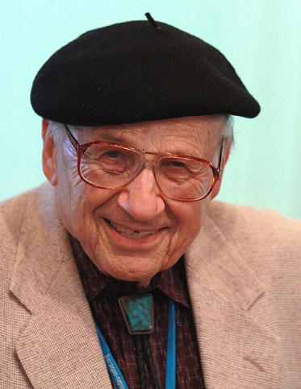
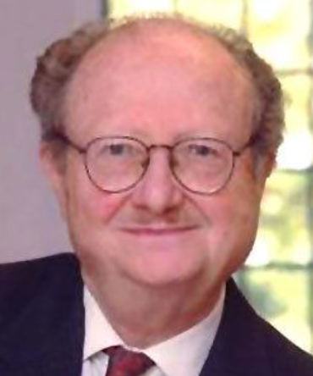
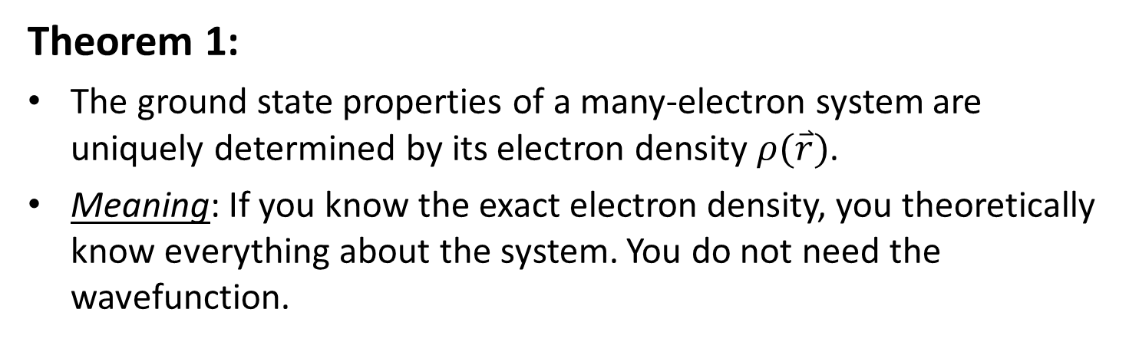
Theoretical Pillar I: Hohenberg-Kohn Theorems (1964)
Theorem 1:
The ground state properties of a many-electron system are uniquely determined by its electron density $ρ(\overset{⃑}{r})$.
Meaning: If you know the exact electron density, you theoretically know everything about the system. You do not need the wavefunction.
Walter Kohn (1923-2016)
Nobel Prize in Chemistry, 1998
Theorem 2:
The true ground state electron density is the one that minimizes the total energy.
Meaning: This gives us a practical way to find the correct density: we continuously adjust our mathematical density model until the calculated energy reaches its absolute lowest point.
Pierre Hohenberg (1934-2017)

Slide 7
Theoretical Pillar II: The Kohn-Sham Scheme (1965)
The Hohenberg-Kohn theorems prove DFT is valid, but they do not tell us how to calculate the kinetic energy of interacting electrons.
Step 1: Real System
Real Interacting Electrons
(Math is too complex).
Step 2: Fictitious System
Electrons do not interact, but maintain the exact same overall density as the real system. Kinetic energy is now easy to calculate.
Step 3: The Bucket
All the complicated, unknown quantum effects (like electrons avoiding each other) are swept into a single mathematical term.
The Exchange-Correlation (XC) Functional: The mathematical "bucket". If we knew the exact formula for the XC functional, DFT would yield perfect, exact results. Because we do not, we must approximate it.

Slide 8
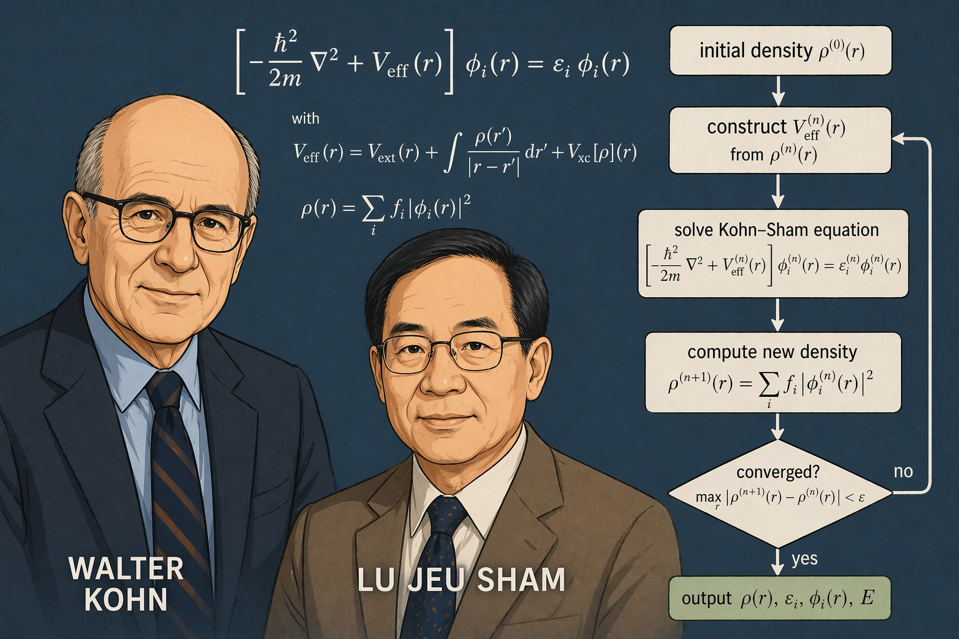
Theoretical Pillar II: The Kohn-Sham Scheme (1965)
SCF (Self-Consistent Field) is an iterative procedure to solve the Kohn-Sham equations self-consistently.
Key idea
The effective potential V_{eff} depends on the electron density p(r), which is obtained from the orbitals Pi(r).SCF iterates until p(r) (and Veff) is self-consistent.
Summary
SCF iteratively updates the electron density and effective potential until the solution of the Kohn-Sham equations is self-consistent. This self-consistent solution yields the ground-state density, energy, and related properties within DFT.
沈吕九(1938-)

Slide 9
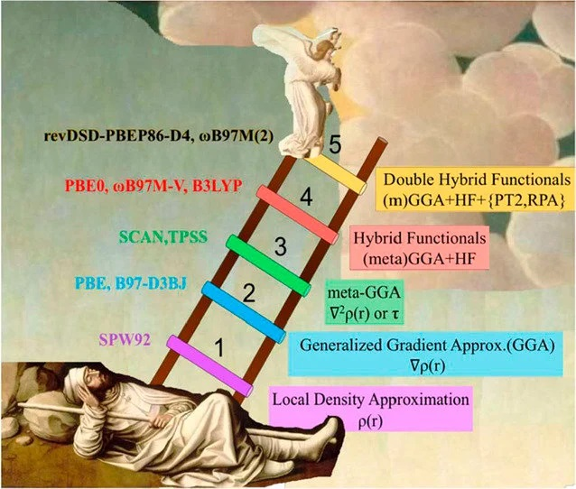
Jacob's ladder of DFT
Dung 1 (LDA): Assumes density is uniform locally.
Dung 2 (GGA): Accounts for the slope (gradient) of the density.
Dung 3 (Meta-GGA): Adds the second derivative of the density
Dung 4 (Hybrid): Mixes DFT with exact Hartree-Fock exchange. Highly accurate for chemistry (e.g., B3LYP, M06-2X)
Dung 5 (Double Hybrid): Add dependence on virtual orbitals
Notes:
局域密度近似(Local density approximation,LDA):最原始的一类泛函，交换-相关势只依赖于相应位置的电子密度，对于任多分子体系结果很差，严重高估键能，如今已完全没有使用价值
广义梯度近似(Generalized-gradient approximation,GGA):此类泛函的交换-相关势同时依赖于相应位置电子密度和密度的梯度，各方面结果比LDA大有改进，但依然有低估势垒、低估gap和激发能、高估(超)极化率等问题
meta-GGA:相比GGA，还额外依赖于相应位置的轨道动能密度或者电子密度的二阶导数以试图改进结果，但改进有限
杂化泛函 (Hybrid functional):此类泛函的交换能里面掺入了一定程度的HF交换能，对于多数问题性能比GGA都有了明显整体提升
meta-杂化泛函: meta-GGA中引入HF交换能

Slide 10
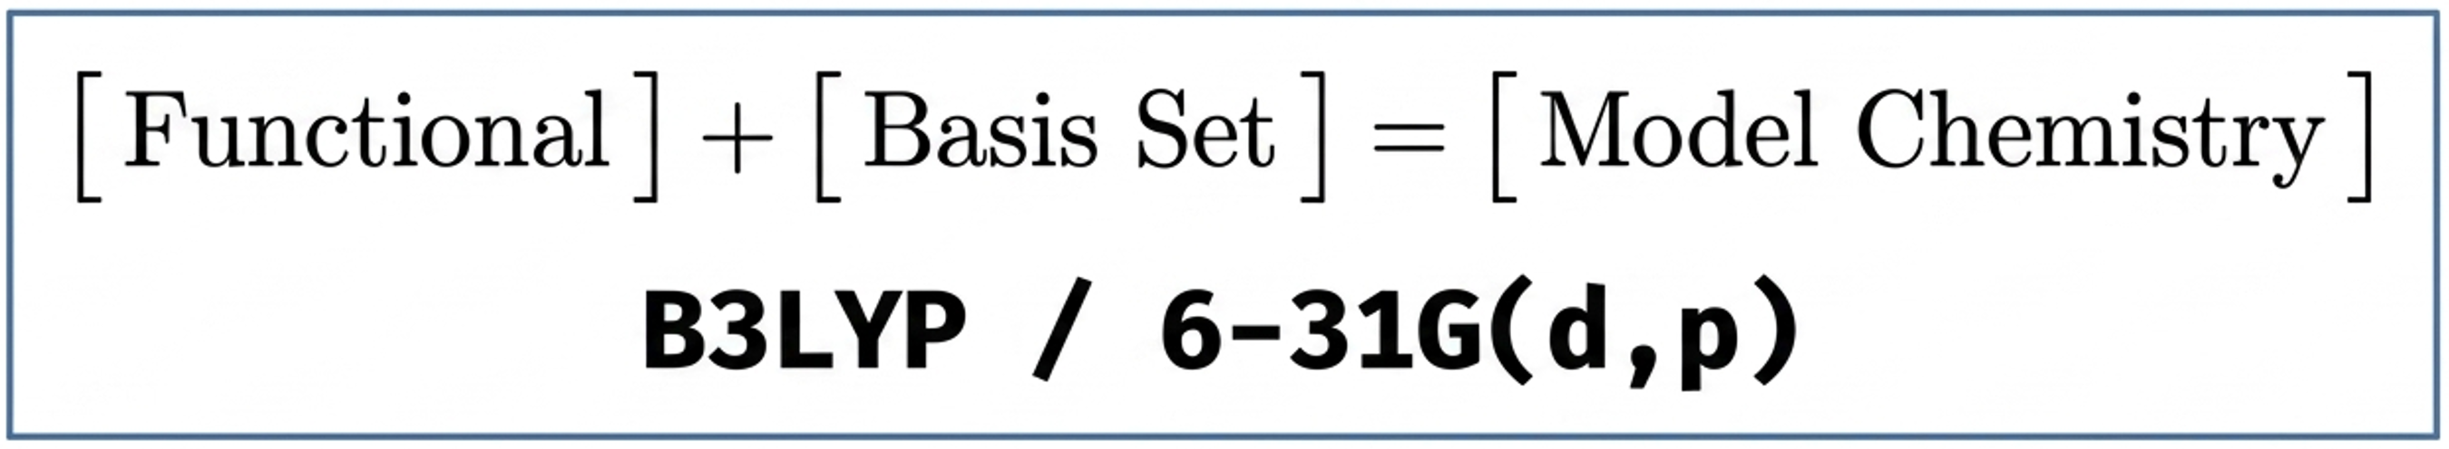
Defining a Model Chemistry
The Requirements | The Golden Rule
Every DFT calculation requires the user to specify two distinct things: How to treat the physics (The Functional). The mathematical building blocks to use (The Basis Set). | Results can only be fairly compared or subtracted if they were calculated using the exact same Model Chemistry.

Slide 11
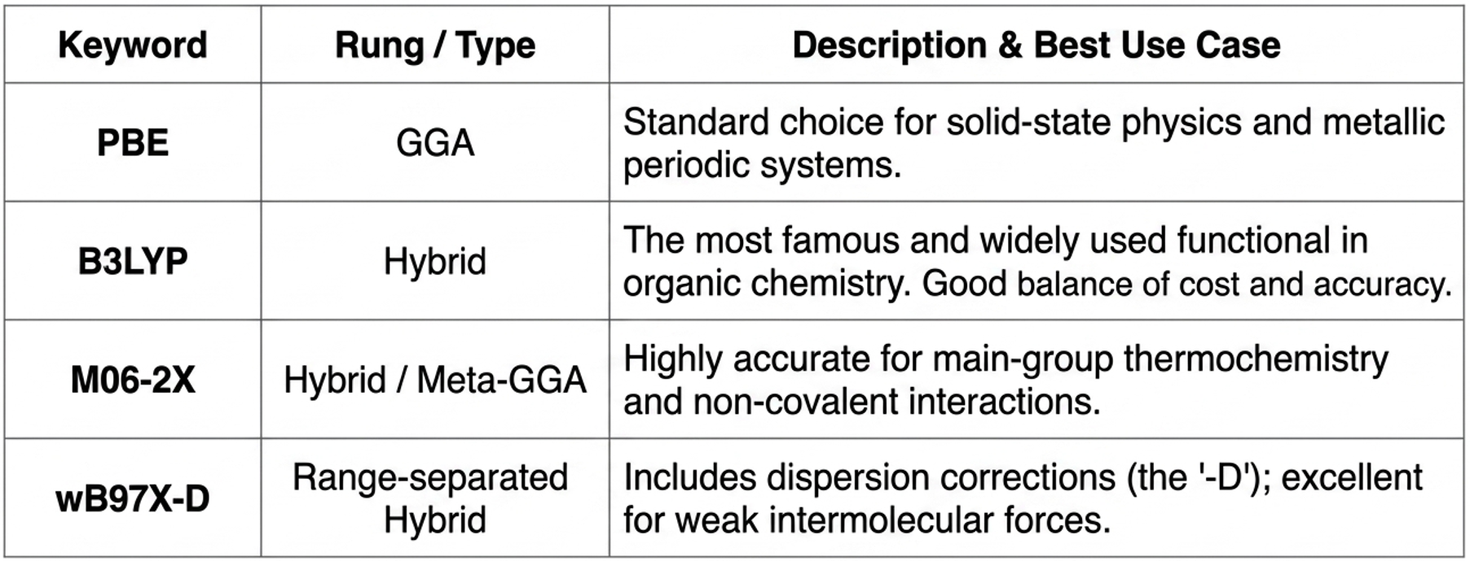
Common Functional Options
Note: Pure DFT methods sometimes struggle with weak Van der Waals forces. Methods with ‘-D’ (like DFT-D3) add specific empirical corrections to fix this gap.

Slide 12
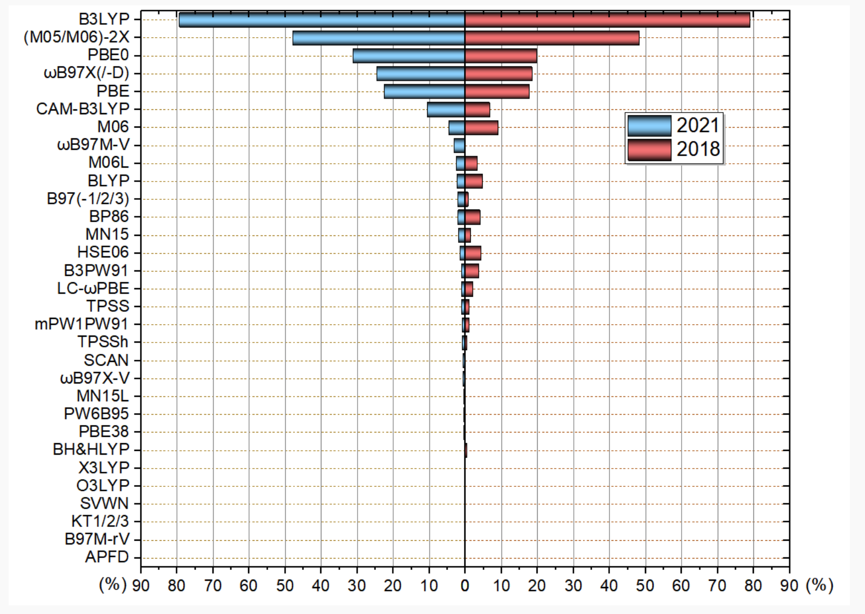
最常用泛函投票
http://sobereva.com/599

Slide 13
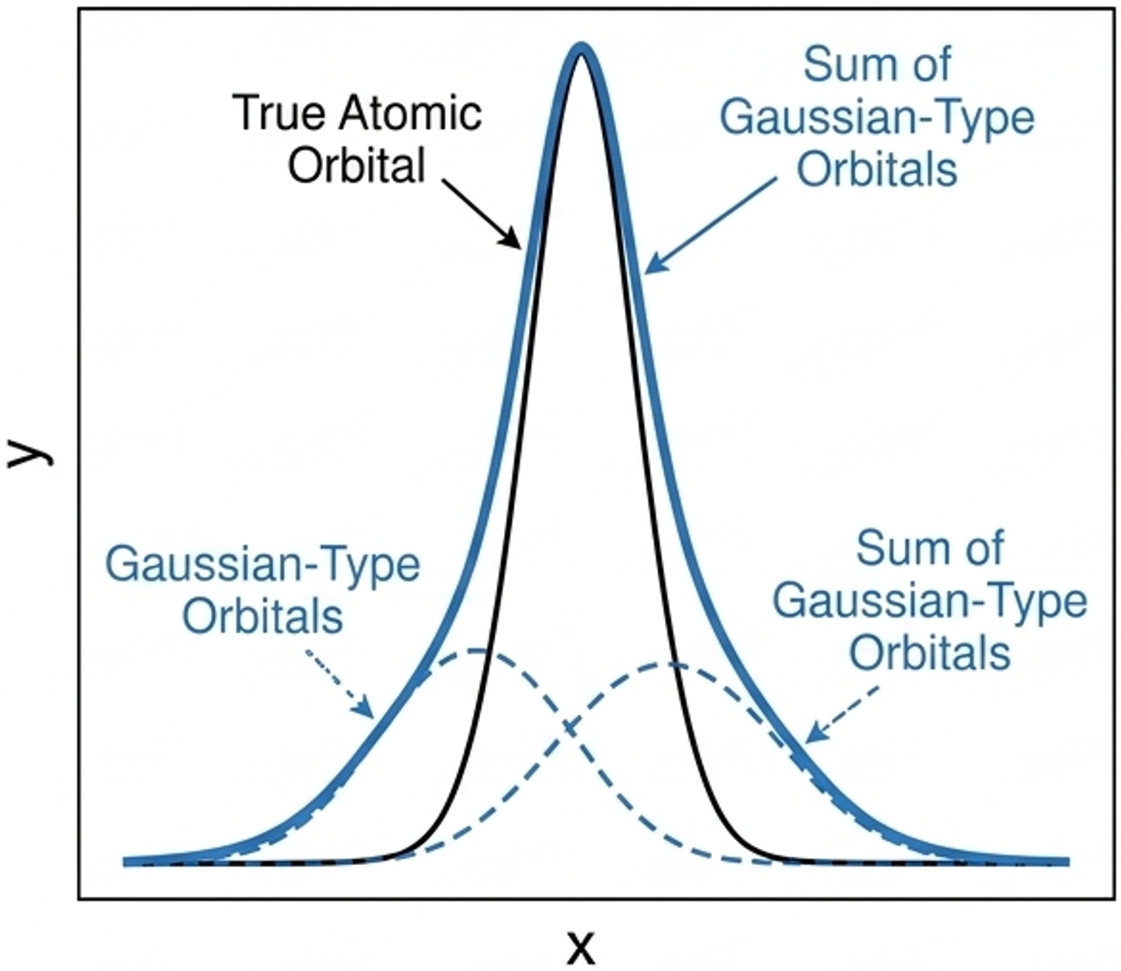
Computational Tools: What is a Basis Set?
What is a Basis Set?
A basis set is a set of mathematical functions (“building blocks’) used by the software to construct the molecular orbitals and electron density.
Gaussian Type Orbitals (GTOs)
True atomic orbitals are mathematically difficult for computers to integrate. DFT software uses combinations of Gaussian functions because they are vastly faster for computers to calculate.
The Trade-off
Larger basis sets impose fewer constraints on electrons, yielding more accurate results, but require significantly more computational time.

Slide 14
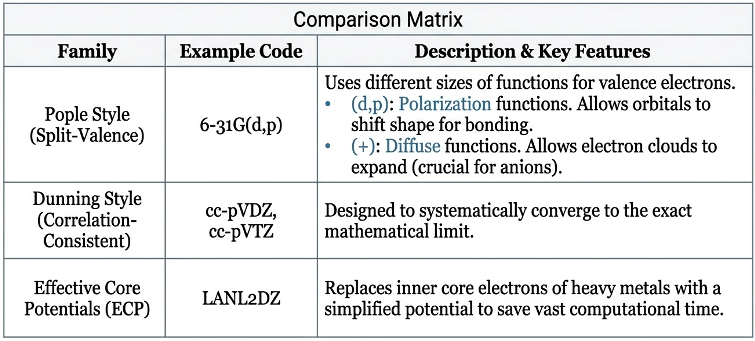
Basis Set Options

Slide 15
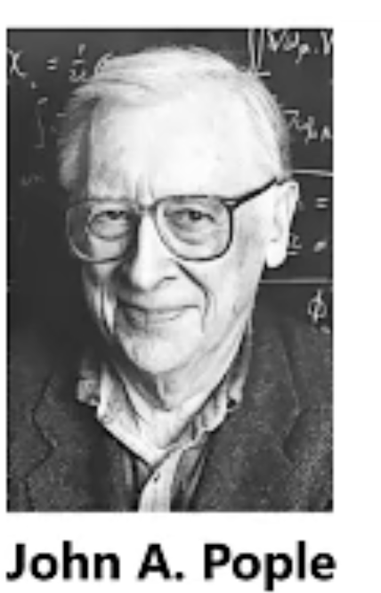
Development of software
Pople led the development of the Gaussian (first released in 1970) series of quantum chemistry programs, which integrated various ab initio methods (such as HF, MPn, CI, CC) and DFT methods, greatly advancing the application of computational chemistry in both scientific research and industry.
The widespread availability of software such as Gaussian has enabled experimental scientists who are not specialists in theoretical calculations to conveniently use first-principles methods to assist their research.
Share Nobel Prize
w/ Kohn in 1998

Slide 16
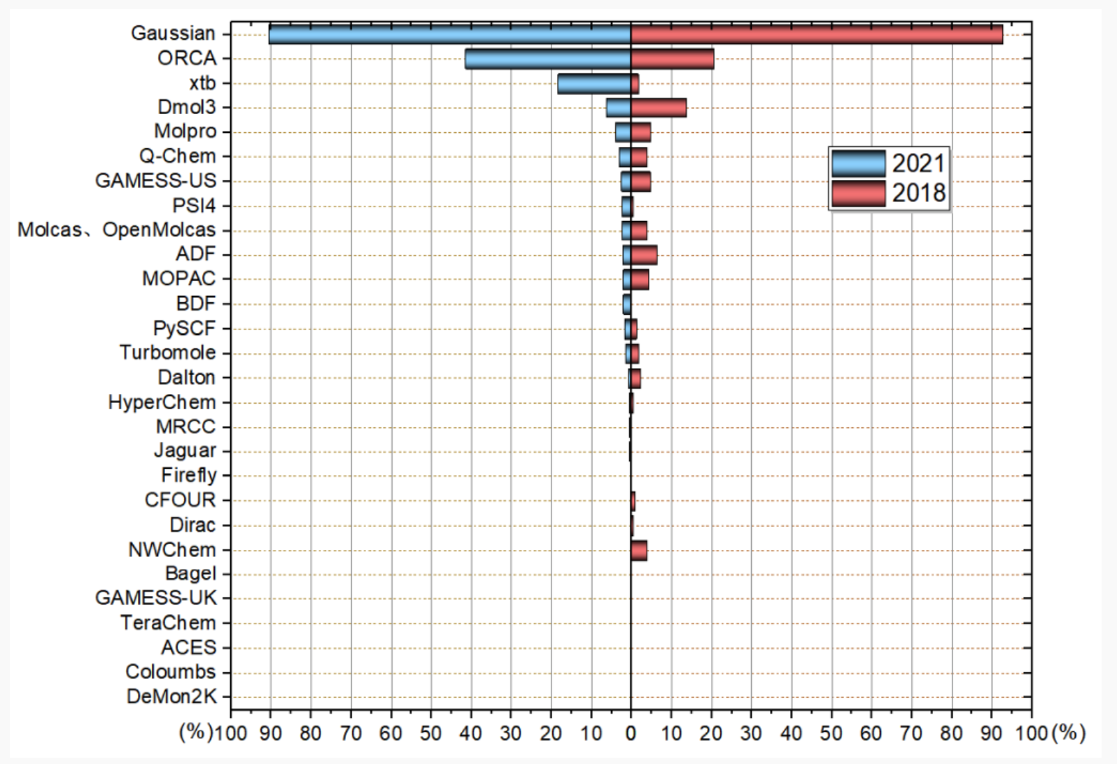
主要量化计算软件排名
Gaussian：>90%量化研究者必用的程序，常用功能一应俱全，大部分功能代码效率较高。价格基本合理
ORCA：量化程序中最有发展潜力的，发展迅猛，免费。虽然最常用的功能做得尚不如Gaussian，但是很多地方已经明显超越Gaussian，深入做量化计算时，第二个应当较好掌握的程序
Dmol3:只做密度泛函计算的程序。非主流量化软件，功能偏弱，具有Material Studio的图形界面，计算周期性体系具有一定价值。
常见可视化、建模程序：
GaussView, Multiwfn, VMD, Chem3D, ChemCraft, Avogadro, Gabedit, Molekel, Chimera, Chimera X, Molden, CYLview, XCrySDen, VESTA, Pymol, Material Studio, Discovery Studio, Diamond, Arguslab, Sirius-wxMacMolPIt, Jmol, gOpenMol, QuteMol, Aten. luscus, Swiss-PdbViewer, OVITO,
WebMO, Iqmd, Jamberoo, MaSK, MoleCoolQt, RasMol, Raster3D, YASARA View, VEGA ZZ. Winmostar, SAMSON
Notes:
周期性体系，材料领域相关的计算程序这里未提及。可视化程序，大家在读文献时有个印象。

Slide 17
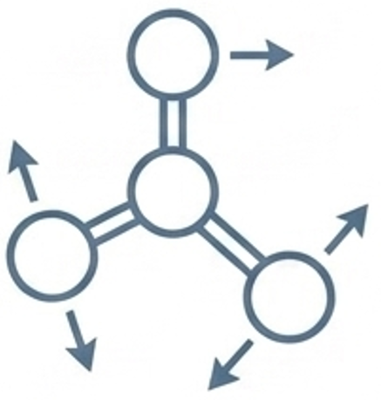
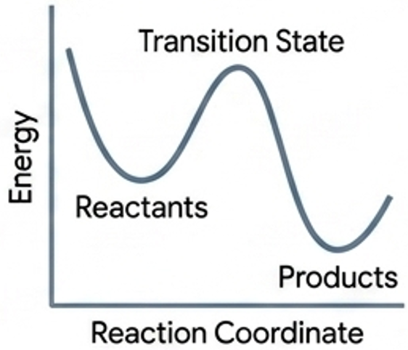
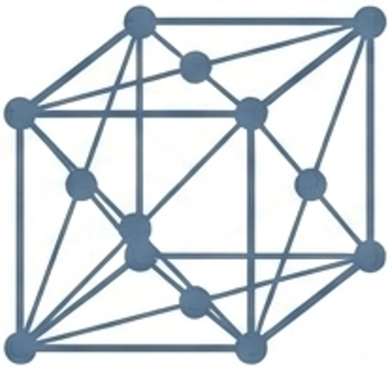
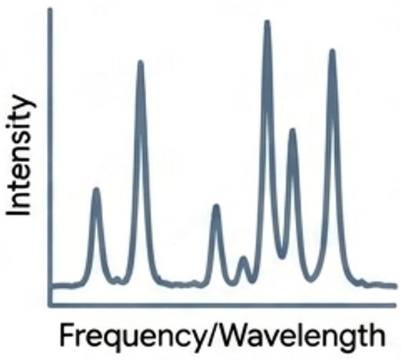
Applications of DFT
 | Geometry Optimization Finding the most stable 3D arrangement of atoms by minimizing the total energy of the system. |  | Thermochemistry Calculating reaction energies, bond dissociation energies, and activation barriers (transition states).
 | Spectroscopy Pred. Simulating IR, Raman, and NMR spectra to help experimentalists identify unknown synthesized compounds. |  | Materials Science Calculating band structures, surface chemistry, and crystalline defects.

Slide 18
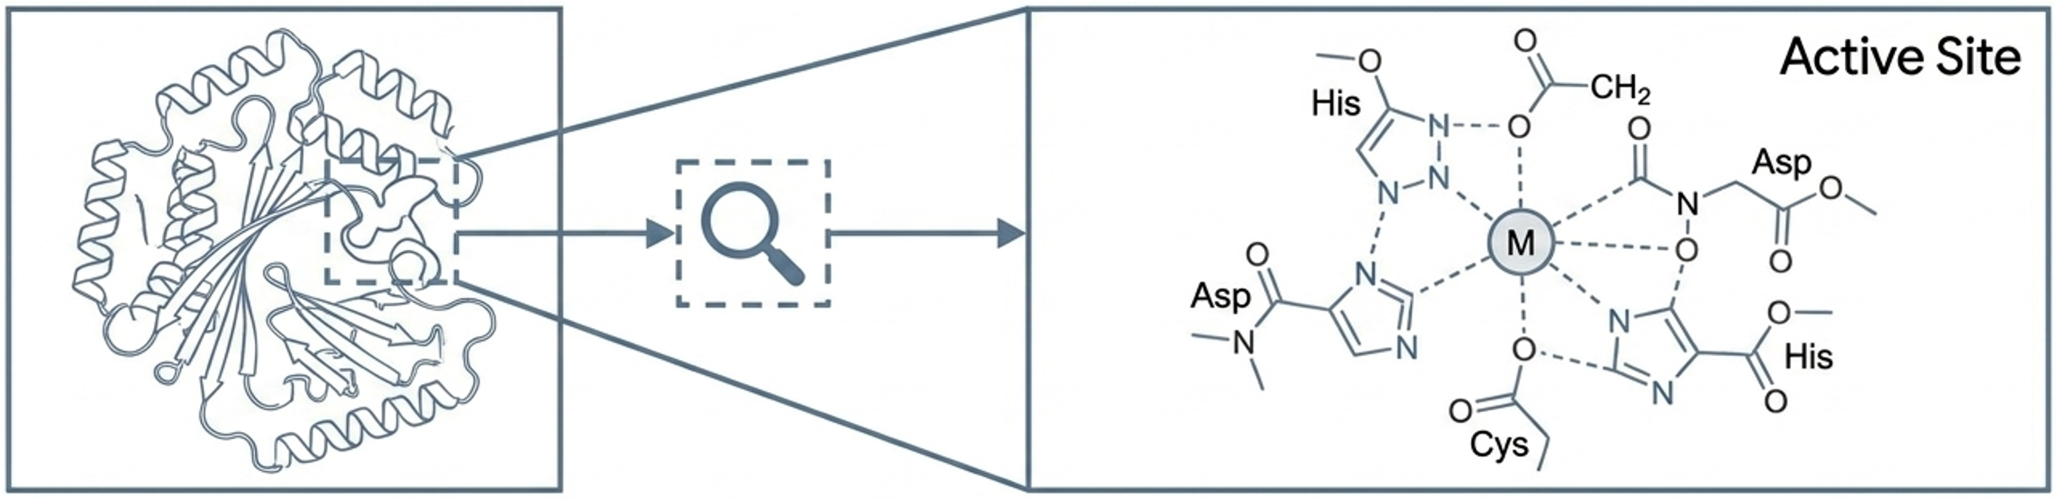
DFT in the Biological Field
Entire proteins are currently too large for pure DFT. Instead, DFT bridges the scales by focusing on the active site.
Enzyme Catalysis | Metalloproteins | Drug Design
Modeling the exact transition states within active sites to understand how enzymes lower reaction barriers at the quantum level. | Traditional mechanics fail at modeling transition metals. DFT excels at mapping the complex electron coordination of metals like Iron or Zinc. | Accurately mapping charge distributions and highly specific binding energies of pharmaceuticals interacting with biological targets.

Slide 19
Antechamber & GAFF
Antechamber:
Part of AmberTools, designed to generate prmtop and inpcrd files for systems with a small molecule as the ligand
Designed to be used with the "general AMBER force field (GAFF) ", which covers pharmaceutical organic chemical space (C, N, O, S, P, H, Halogens).
GAFF:
Compatible with traditional AMBER macromolecular force fields, with the atom types much more general such that they cover most of the organic chemical space (missing parameters rarely occur).
The charge methods: RESP or AM1-BCC.
A useful molecular mechanical tool for rational drug design. Especially in binding free energy calculations and molecular docking studies.

Slide 20







Antechamber & GAFF
Rapid Generation
Auto-Assignment
Script Integration
Enables fast topology generation for large-scale compound screening and docking studies.
Automatically identifies bond/atom types and suggests parameters for missing force field data.
Designed for seamless inclusion in shell scripts to process and simulate thousands of ligands.
Warning: Antechamber shouldn’t be used in a "Black Box" approach! Users must maintain Due Diligence—closely examine assigned atom types and verify parameters to ensure scientific validity.

Slide 21
Advanced tools
Amber tutorial
https://ambermd.org/tutorials/advanced/tutorial1/index.php
R.E.D.
https://upjv.q4md-forcefieldtools.org/
https://upjv.q4md-forcefieldtools.org/REDServer-Development/

Slide 22
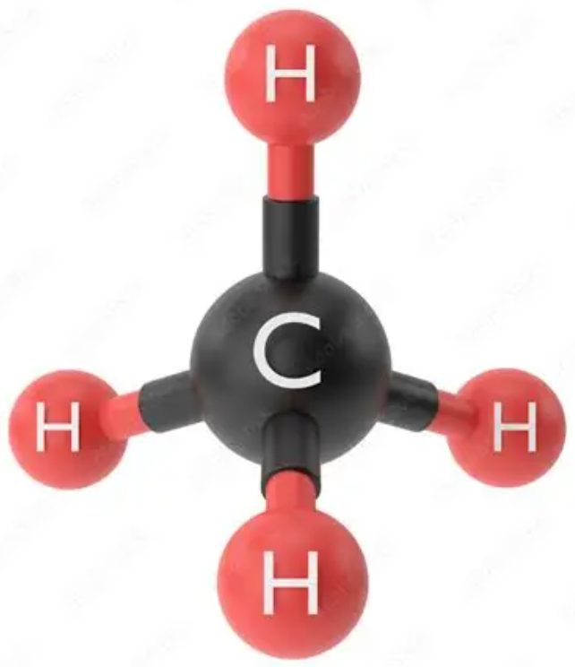
Demo 1: Gaussian

Slide 23
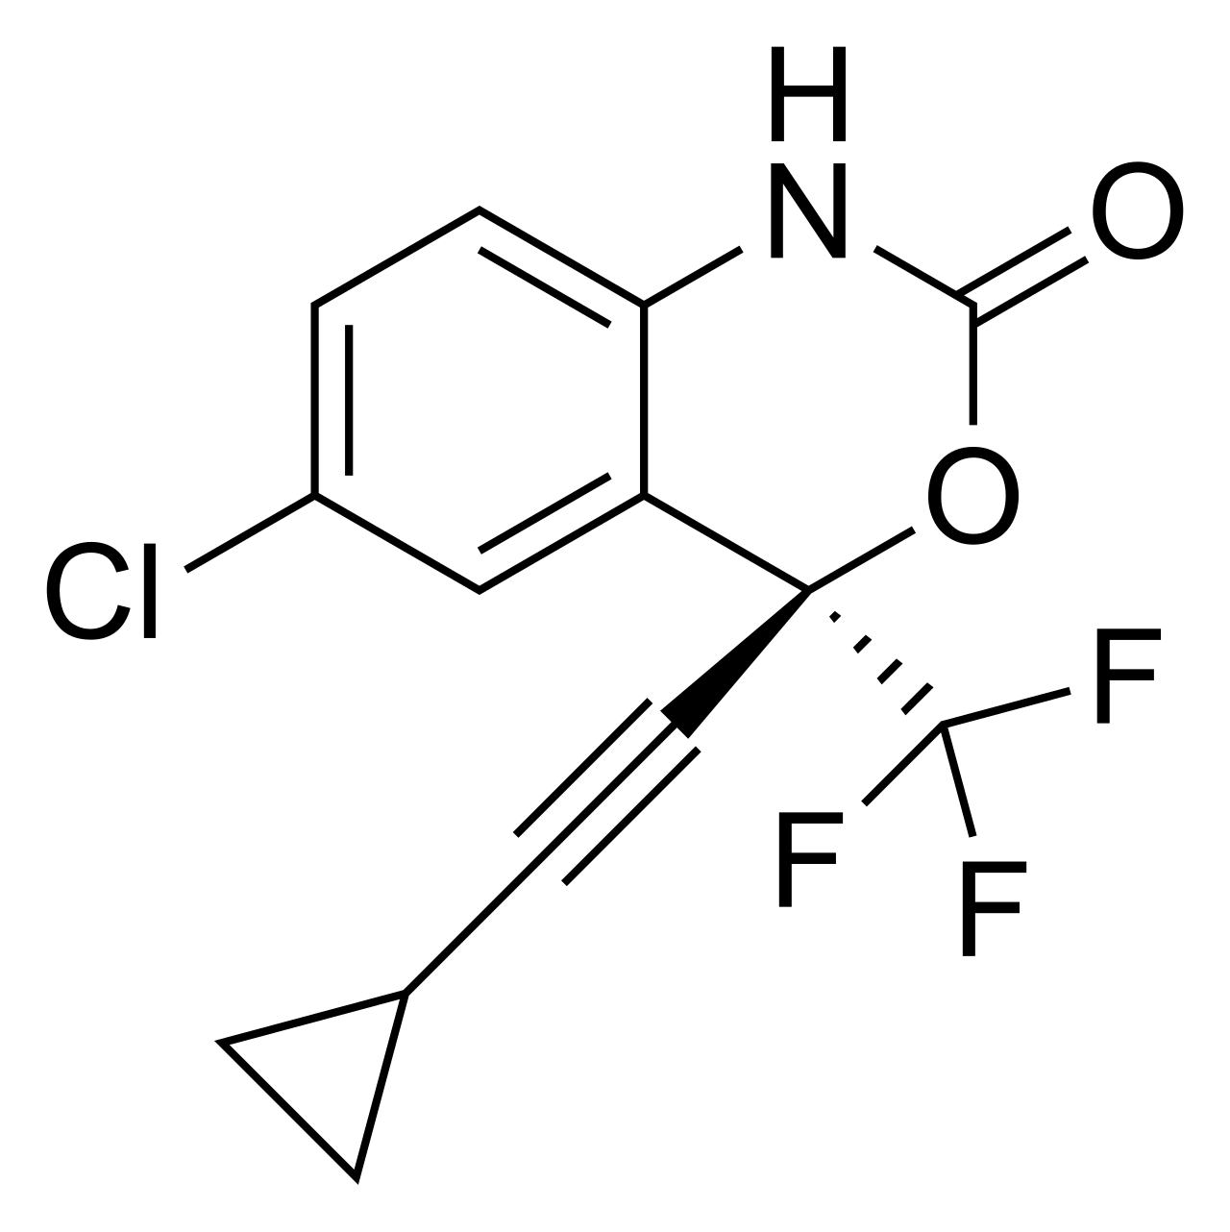
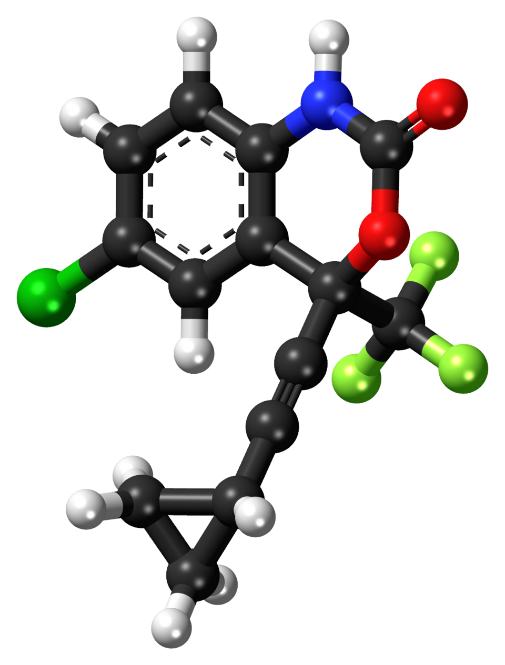
Demo 2: GAFF
Sustiva (Efavirenz, 依法韦仑), an HIV-1 specific, non-nucleoside, reverse transcriptase inhibitor
小分子3D结构来源
公用小分子数据库
PubChem (NIH)
(https://pubchem.ncbi.nlm.nih.gov/)
ZINC20 / ZINC-22
(https://zinc.docking.org/
https://zinc22.docking.org/)
PDB数据库
In this case, we use PDB structure 1FKO, and extract residue EFZ

Slide 24

Demo 3: Docking (AutoDock Vina)
Docking of imatinib to kinase domain of c-Abl
Autodock Vina
https://github.com/ccsb-scripps/AutoDock-Vina
MGLTools (including ADT: AutodockTools)
https://ccsb.scripps.edu/mgltools/downloads/
通用名：伊马替尼 (Imatinib)
商品名：格列卫 (Gleevec)
电影《我不是药神》中提到的靶向药“格列宁”的原型。
Notes:
**将一种致命的癌症变成了一种可控的慢性病**

Slide 25
Demo 4: AI-powered docking
Chai1
https://github.com/chaidiscovery/chai-lab/
Boltz2
https://github.com/jwohlwend/boltz

