Slide 1

Workshop
Introduction of CPPTARJ/PYTRAJ
CPPTRAJ
PYTRAJ
2023.6.3

Slide 2
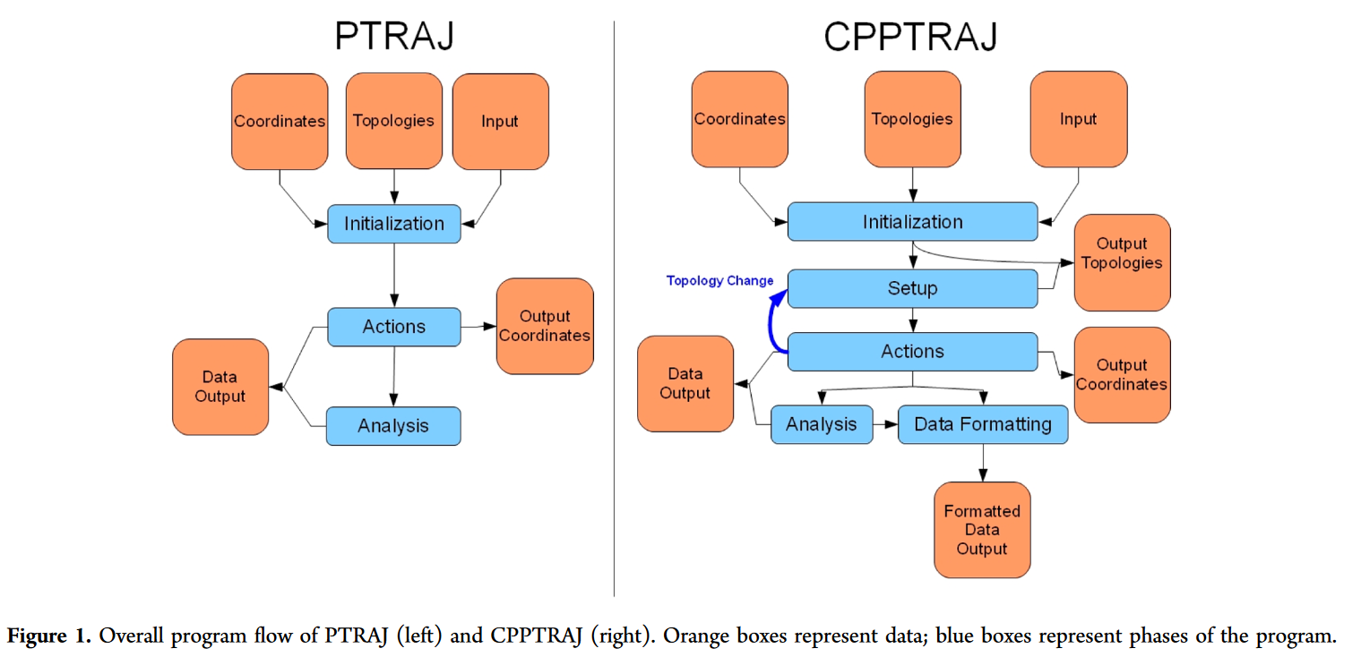
Program flow of CPPTRAJ
PTRAJ (Process TRAJectory)
CPPTRAJ, a rewrite of PTRAJ in C++
Roe, D. R. & Cheatham, T. E. PTRAJ and CPPTRAJ: Software for Processing and Analysis of Molecular Dynamics Trajectory Data. J. Chem. Theory Comput. 9, 3084–3095 (2013).

Slide 3
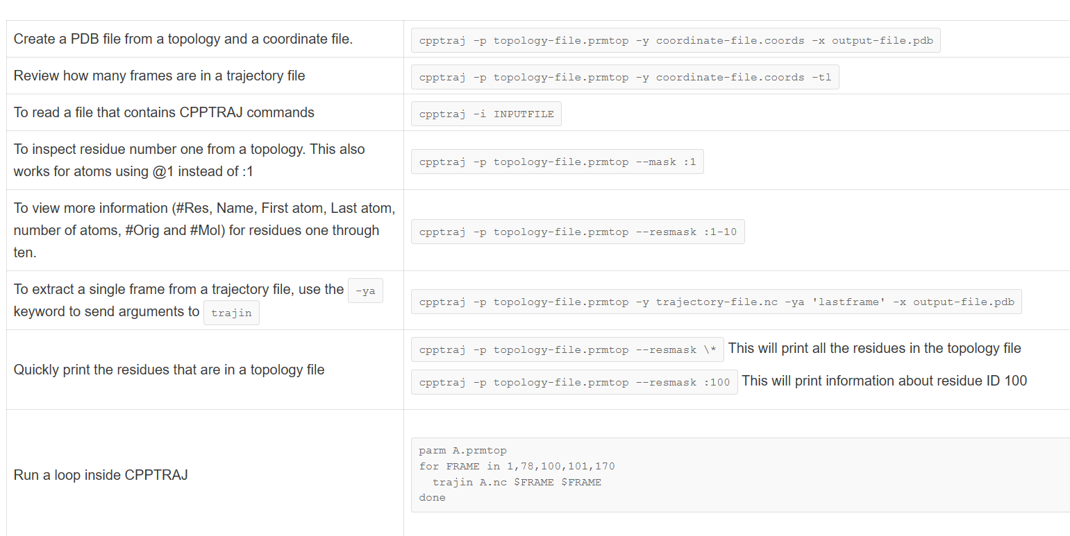
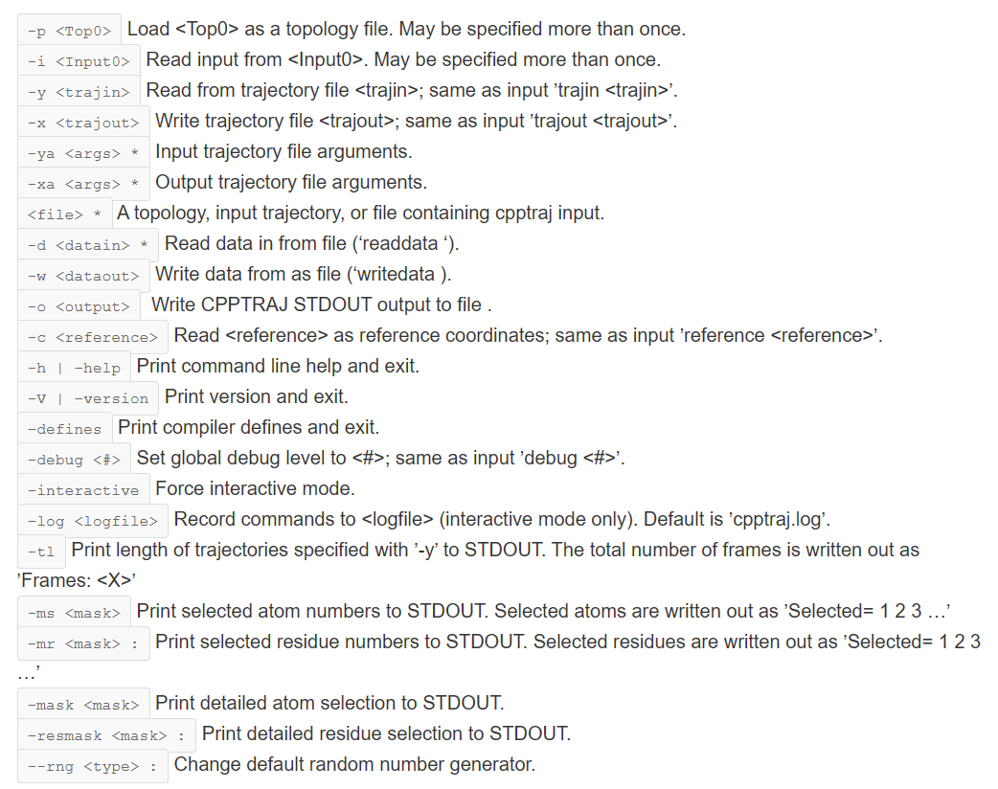
Program flow of CPPTRAJ
One-line commands
cpptraj xxx.sh
xxx.sh contain all commands

Slide 4
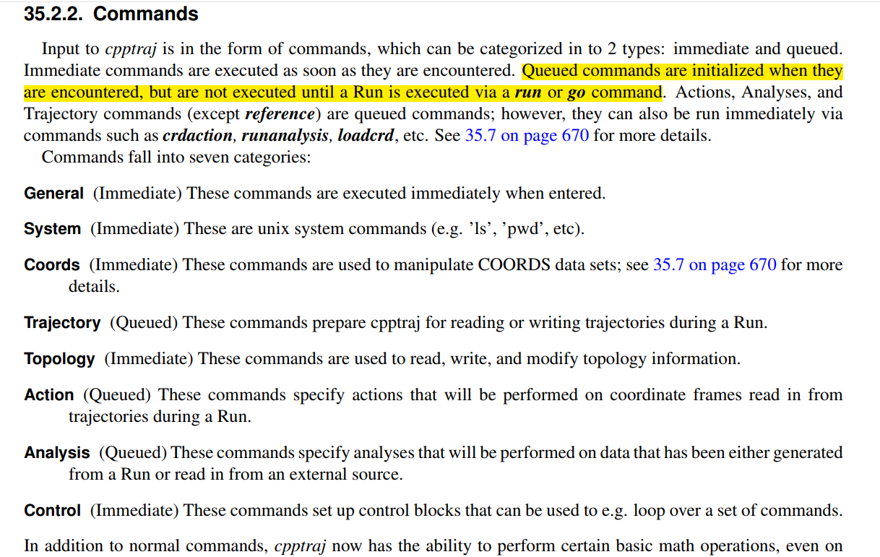
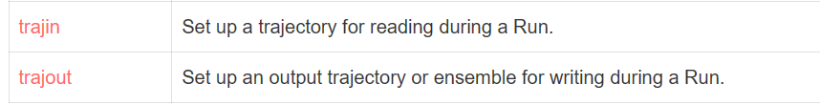
Commands of CPPTRAJ
Coords
trajectory coordinates may be saved as a separate data set via the loadcrd command or createcrd action.
Trajectory
Topology
These commands control the reading and writing of topology files.
parm xxx.prmtop
Unlike some other command types, when an Action command is issued it is by default added to the Action queue and is not executed until trajectory processing is started (e.g. by a run or go command). Such as rms/rmsd.
Action
a complete list of data sets available for analysis is shown after trajectory processing (prefaced by ’DATASETS’) or can be shown with the ’list dataset’ command.
Analysis
https://amberhub.chpc.utah.edu/cpptraj

Slide 5
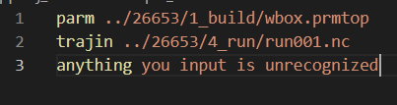

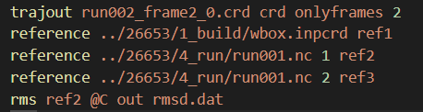
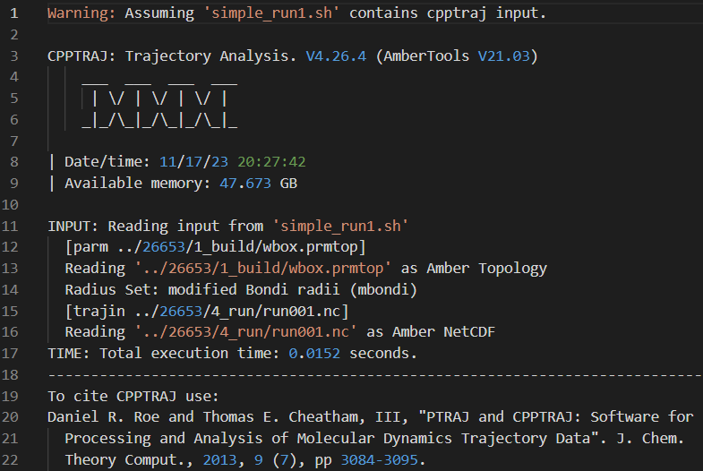
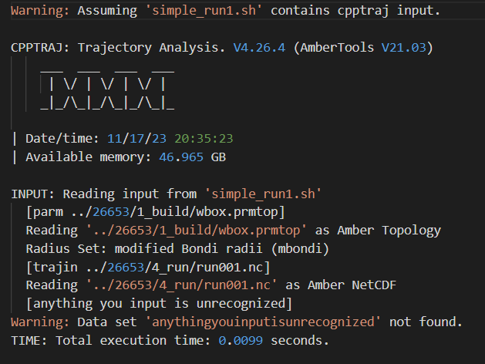
Simple command of CPPTRAJ
The important of run/enter
Strip the water and ions
strip !(:1-14<:6.0)
strip :WAT,Na+,Cl-

Slide 6
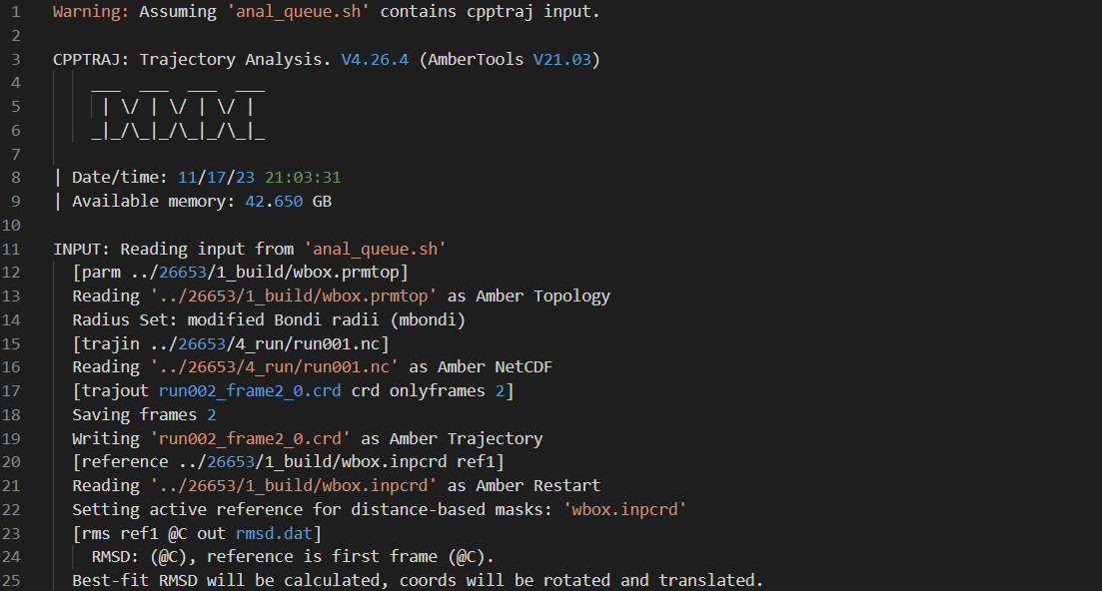
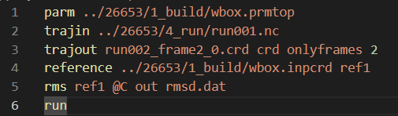
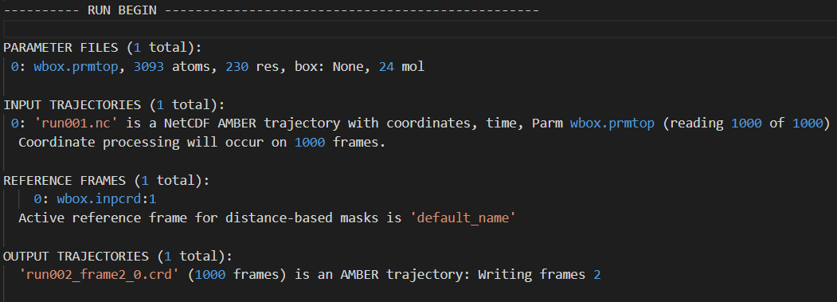
Queue in CPPTRAJ
Part 1
Read input
Translate command to readable
1->2->3->4->5->6
Trajout output the referenced crd rather than raw crd
General | Immediate
System | Immediate
Coords | Immediate
Trajectory | Queued
Topology | Immediate
Action | Queued
Analysis | Queued
Control | Immediate
Part 2
Load all input and prepare for output

Slide 7
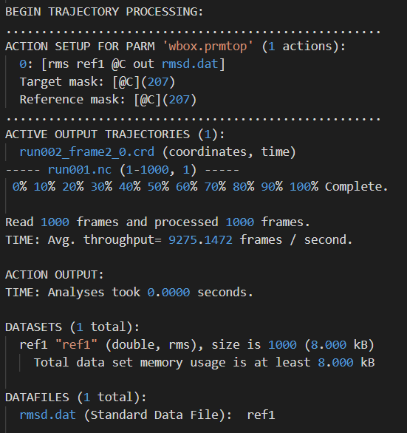
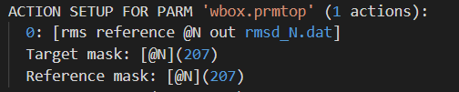
Queue in CPPTRAJ
Reference Action
During a run, write frames to trajectory specified by filename in specified file format (Amber trajectory if none specified) after all Action processing has occurred.
The last: write the dataset

Slide 8
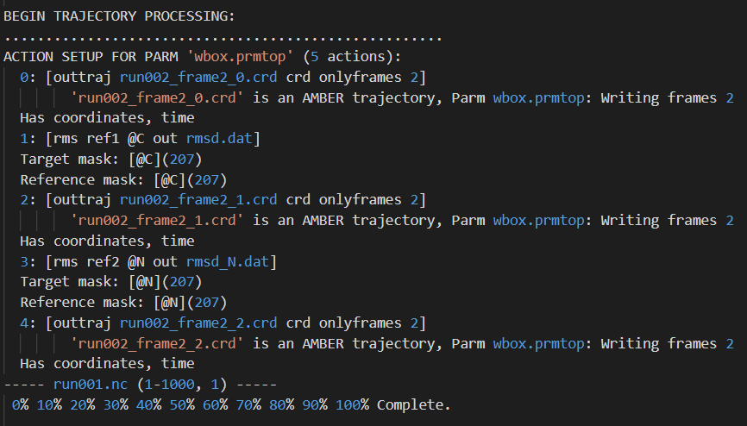
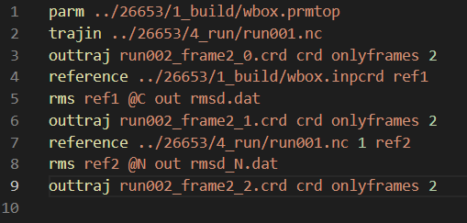
Queue in CPPTRAJ
A action command: outtraj

Slide 9
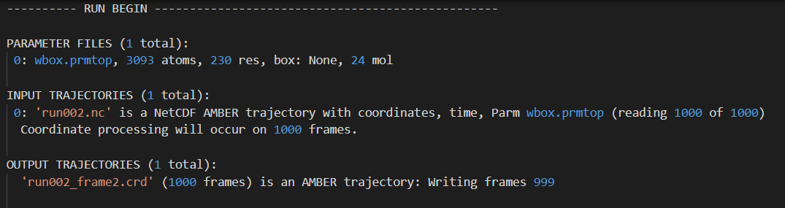
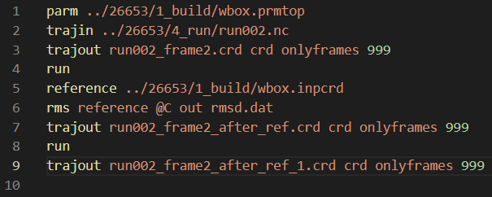
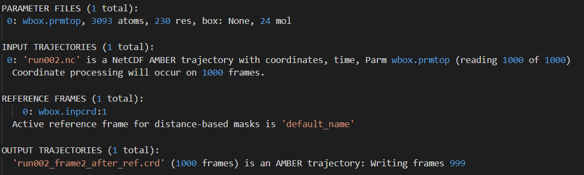
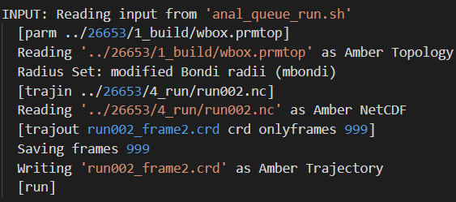
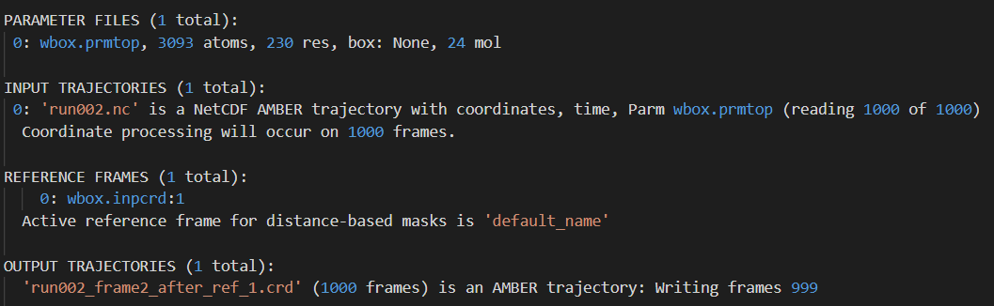
Queue in CPPTRAJ
Repeat load files
Fragment processing split by ‘run’

Slide 10
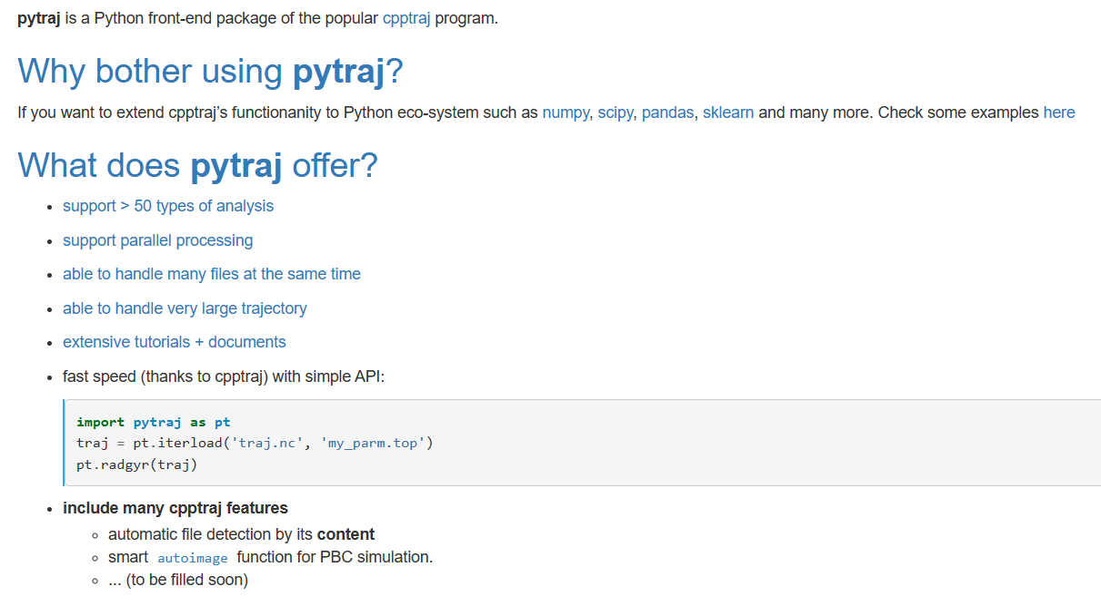
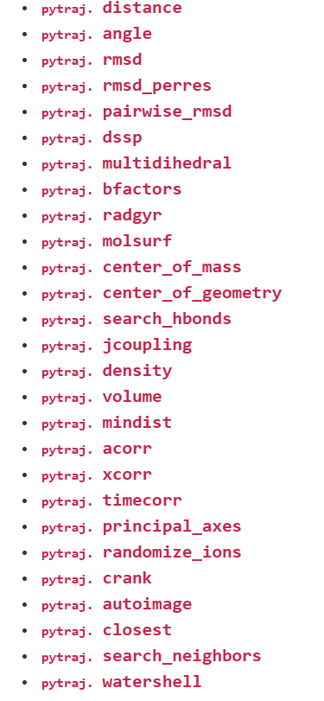
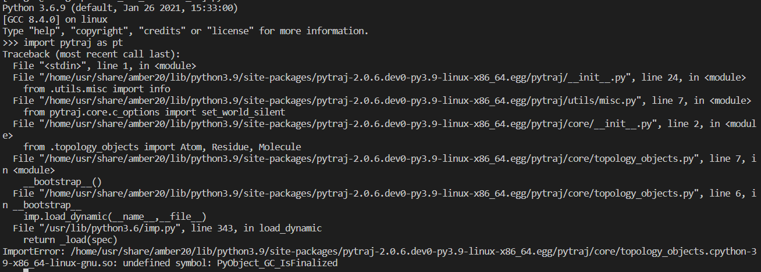
Program flow of CPPTRAJ
Need py39 because amber site-packages
https://amber-md.github.io/pytraj

