Slide 1
Weighted Histogram Analysis Method
2023/12/2
Lu YAN

Slide 2
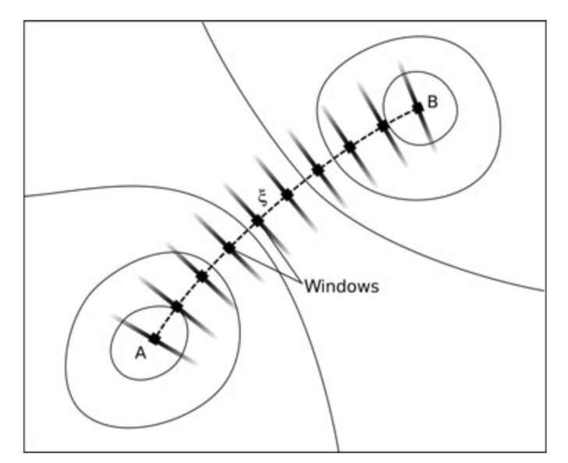
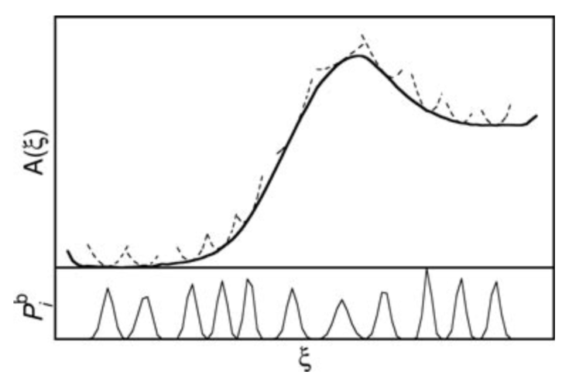


Umbrella sampling
The calculation of free energies is one of the most quantitative applications of MD or MC simulations of molecular systems. In umbrella sampling, a free energy profile(or potential of mean force) G(x) along a chosen physical or virtual coordinate x is obtained by performing a series of simulations with biasing potentials applied that as local restraints on x.
Simulations run for finite time, direct sampling for rare events with an energy barrier significantly larger than KBT is infeasible. However, to obtain a profile A(ξ), these are required.
The path is split into windows, each window covers only a small part of the range of ξ, and the results of the windows are combined to result in a global free-energy profile A(ξ).
PMF: calculation of the free energy along the reaction coordinate
if P rather than V is kept constant (T constant), delta A(Helmholtz) and delta G(Gibbs free energy) are numerically very similar)
Notes:
t时间 p 给定时间内ξ出现的频率（对应到直方图中就是一个特定宽度的变量），因此在MD模拟中，可以根据P(ξ)来得到A(ξ)。
我们可以选择一个特定的路径，从感兴趣的A状态到感兴趣的B状态。

Slide 3









WHAM
A set of S independent simulations at T, each corresponding to a window with a harmonic biasing potential
Our object: construct the unbiased free energy G(x) that is most consistent with the observed simulation data, thus we should determine the unbiased equilibrium probability distribution
If {Pl} is known, the expected probability distribution(biased) {pil} in simulation i is known:
Notes:
Ni: 第i次模拟中的总数，nil指的是第i次模拟中落到第l个bin中的数量。我们需要知道它在不受偏置势的影响下，落到每个Bin里面的概率。其中kb是玻尔兹曼常数，delta l是bin l的长度。
cil受到window中心的偏置势的影响，fi是一个归一化的因子，保证所有的pil之和为1

Slide 4
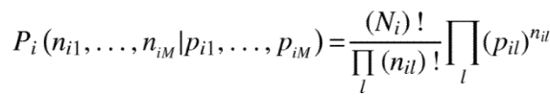



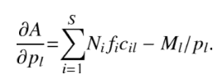

WHAM
Given the probabilities {pil} for simulation i, the likelihood of having {nil} counts in the respective bins obeys the multinominal distribution
The overall likelihood for jointly observing the counts in the S independent simulations is
Finding the max likelihood estimates of {pl} is equivalent to the min of A
Take the derivative of A and demand them to be zero
+
iteration
Notes:
第一个：多项分布的最大似然估计，也就是 在pi1,pi2,...piM的概率下，落入对应Bin的数量为ni1,..niM的概率
如果考虑所有窗口，由于窗口之间彼此独立，因此得到一个整体的可能性P({nil}|p1,..pM)
Ml是 在bin l里的所有样本（实际） 底下的 加和：本来应该落入l bin的样本·、
pl和fi的迭代，直到最后基本达到一致。
可以认为fi是加权函数.求解最大值，一般需要导数等于0.

Slide 5


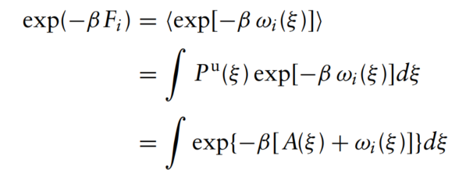
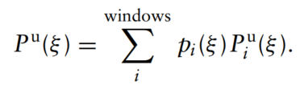




Iteration
In each window, a bias function is applied to keep the system close to the reference point ξi ref.
Estimate Fi → minimize the statistical error of Pu (ξ).
The global distribution
a weighted average of the distributions of the individual windows
Choose weights pi
Renew Pu during iteration
Calculate Fi
Iteration until convergence
Notes:
如果多个窗口的Ai要被合并成一个整体的A, 那需要计算Fi。K是bias的strength，不能太大（narrow biased distribution）也不能太小（无法跨越barrier）.WHAM 需要有偏分布的重叠，而UI则不需要。一般来说，合理的下一个窗口应该从前一个的半高峰位置起始。 Ni是第i个窗口的采样数
pi权重就是 coupling parameter λ

Slide 6


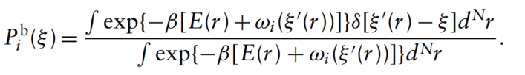
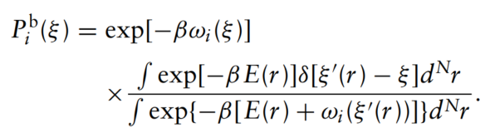
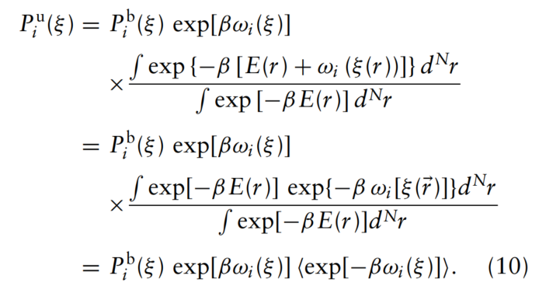
Biased potentials in umbrella sampling
Umbrella sampling was developed by Tprrie and Valleau based on related previous work.
In umbrella sampling, the reaction coordinate is not constrained, but only restrained and pulled to a target value by a bias potential. A bias, an additional energy term, is applied to the system to ensure efficient sampling along the whole reaction coordinate, aimed at in different simulations(windows), and the distribution of which overlap.
Notes:
wi 只依赖于反应坐标， b: biased quantities, u: unbiased quantities，正常情况下，没有上标的都是无偏统计量。
Pib(ξ)从Biased system MD中得到，wi(ξ)从整个系统中得到，Fi只与wi有关，而与ξ无关，因此可以计算出Ai(ξ)，这样就能得到想要的无偏Ai
认为： biased window density are Gaussian in form → sampling error, reduce error

Slide 7
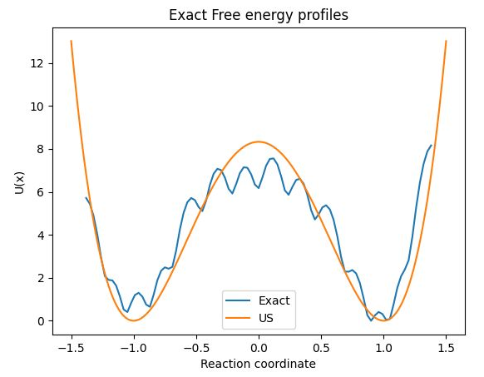
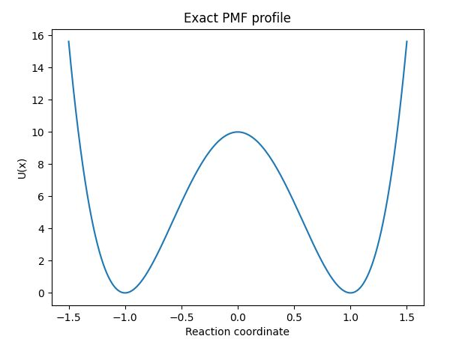
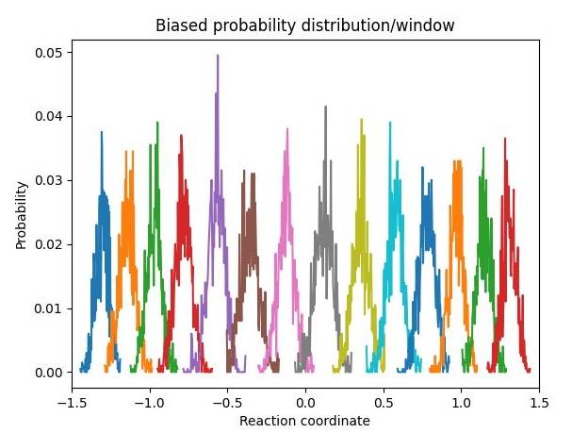
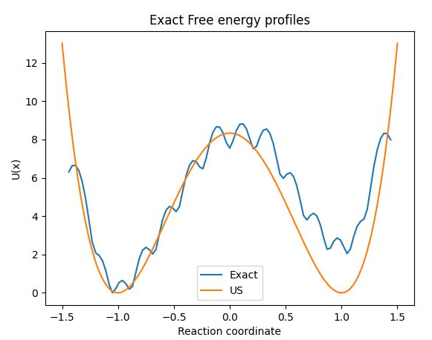
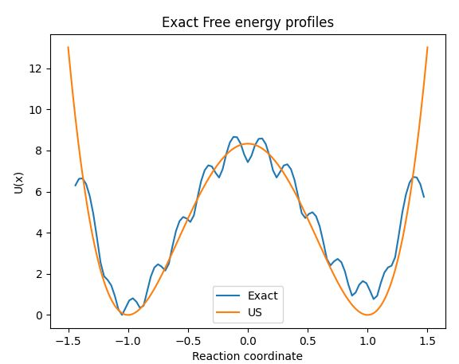
python script for umbrella sampling
Exact PMF profile: 10*(x-1)^2*(x+1)^2
计算物理：自由能计算-多直方图WHAM（Weighted Histogram Analysis Method） - 知乎 (zhihu.com)

