Slide 1
Workshop
沈扬
2023/01/13

Slide 2
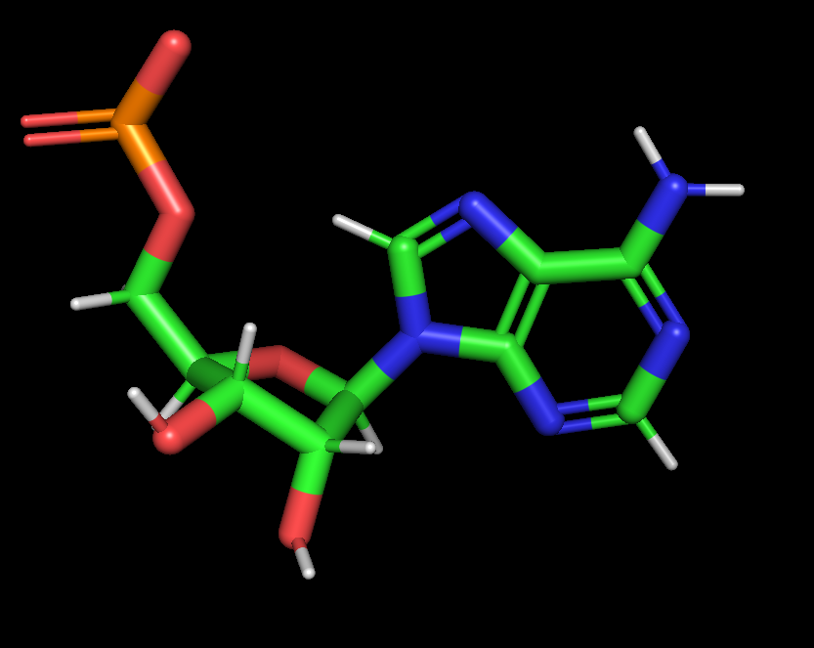
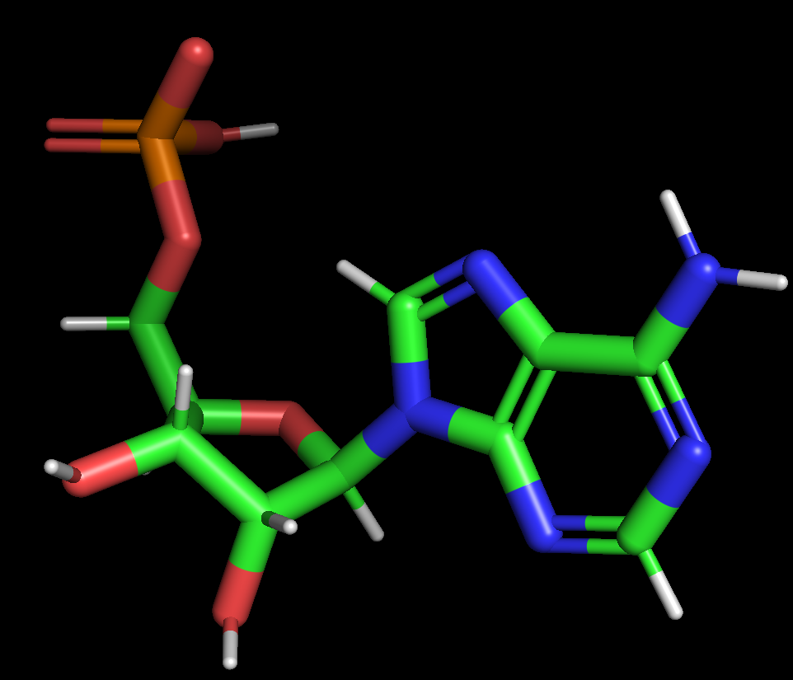
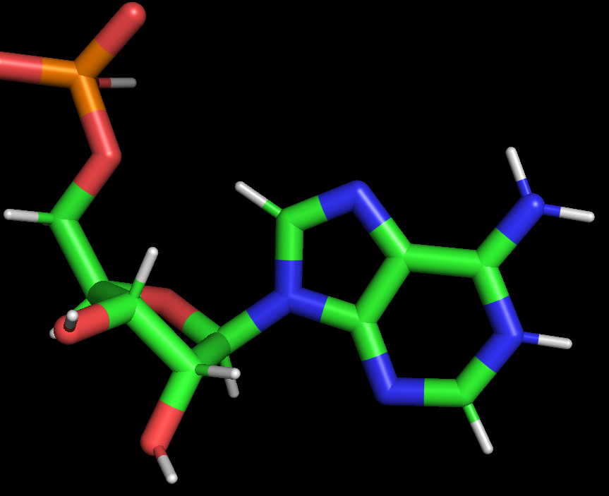
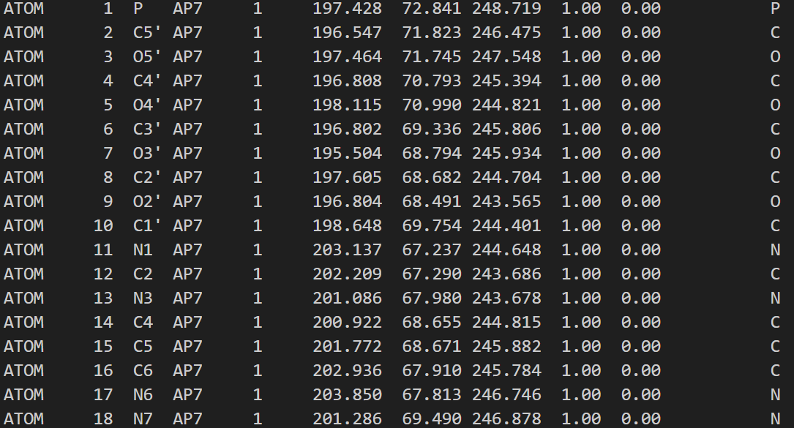
Create modified nucleotide
experiment structure
Add OP3 HOP3 HO3'
Add H1
patch
modify
change a res name for modified residue

Slide 3
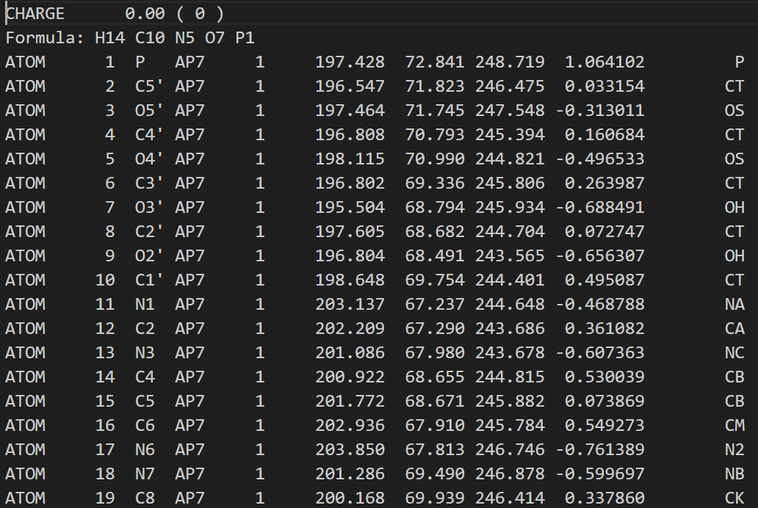
Charge using RESP
Notes:
AM1-BCC电荷在原理上只是RESP电荷的近似

Slide 4
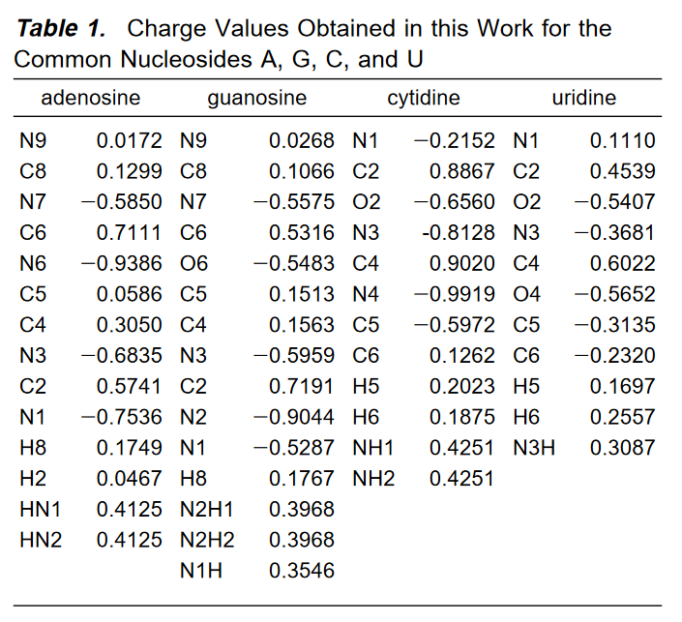
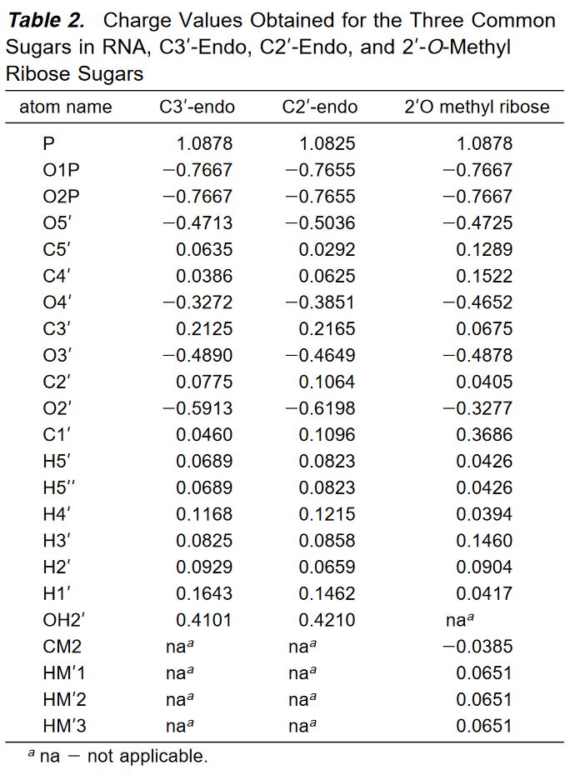
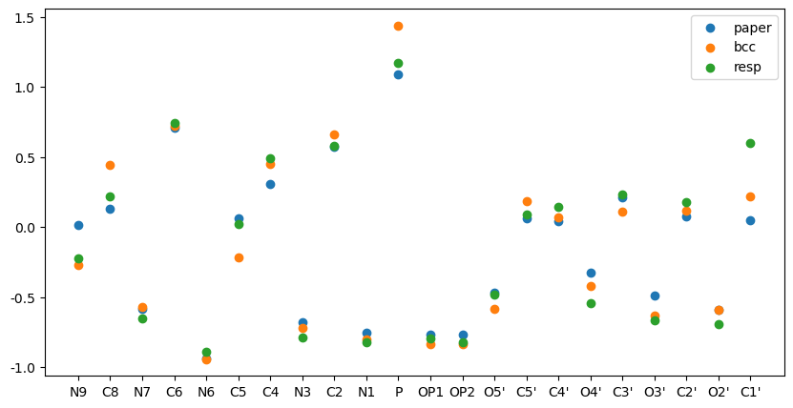
compare with paper result （You don‘t need to do it.）
Notes:
AMBER Force Field Parameters for the Naturally Occurring Modified Nucleosides in RNA

Slide 5
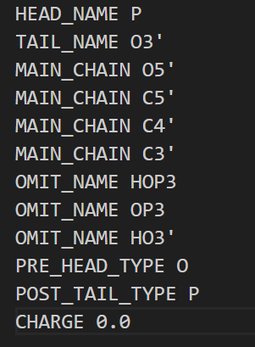
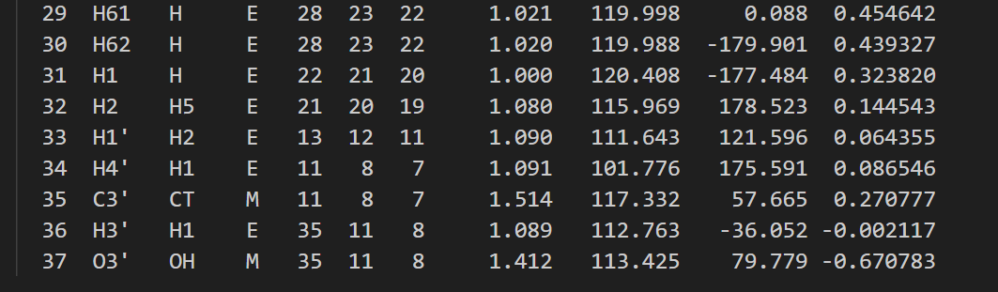
Preparing the residue library and force field parameters
A_patch_N1.prepin
change to OS
The HEAD_NAME and TAIL_NAME lines identify the atoms that will connect to the previous and following amino acids, respectively. The MAIN_CHAIN lines list the atoms along the chain that connect the head and the tail atoms. The OMIT_NAME lines list the atoms in the CRO residue that should be removed from the final structure, as they are not present in the intact protein. The PRE_HEAD_TYPE and POST_TAIL_TYPE lines let prepgen know what atom types in the surrounding protein will be used for the covalent connection. (Remember that prepgen can be used for polymers other than just proteins and peptides.) The CHARGE line gives the total charge on the residue; prepgen will ensure that the charges of the "omitted" atoms are redistributed among the remaining atoms so that the total charge is correct (i.e., 0 in this case).

Slide 6
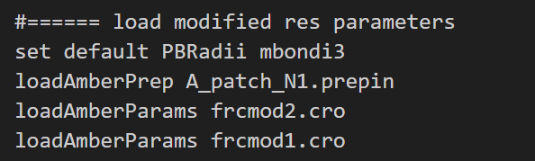
Build

Slide 7
Reference
indigo:/home/sheny/MD/amber_learn/Protonated_adenine
shenyang-1/Protonated_adenine (github.com)
Amber Basic Tutorials - Tutorial A26 (ambermd.org)
RESP拟合静电势电荷的原理以及在Multiwfn中的计算 - 思想家公社的门口：量子化学·分子模拟·二次元 (sobereva.com)
计算RESP原子电荷的超级懒人脚本（一行命令就算出结果） - 思想家公社的门口：量子化学·分子模拟·二次元 (sobereva.com)
RESP2原子电荷的思想以及在Multiwfn中的计算 - 思想家公社的门口：量子化学·分子模拟·二次元 (sobereva.com)
使用AmberTools+ACPYPE+Gaussian创建小分子GAFF力场的拓扑文件|Jerkwin
自动计算ESP和RESP电荷(AMBER and G09) | Hom (gohom.win)
AMBER Force Field Parameters for the Naturally Occurring Modified Nucleosides in RNA

Slide 8
Start from gauss View molecular

Slide 9
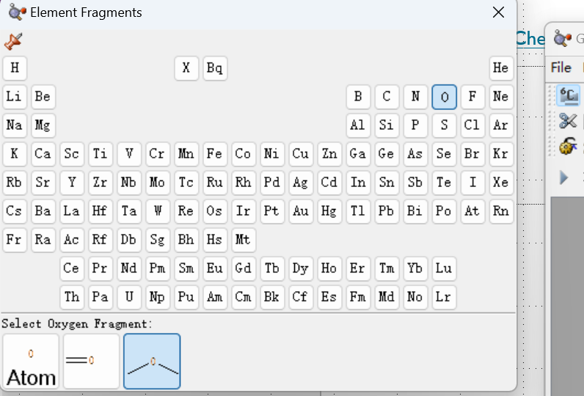
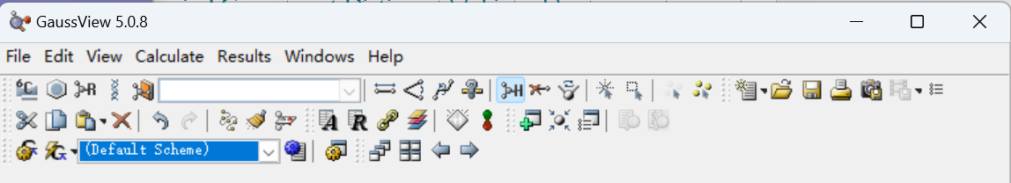
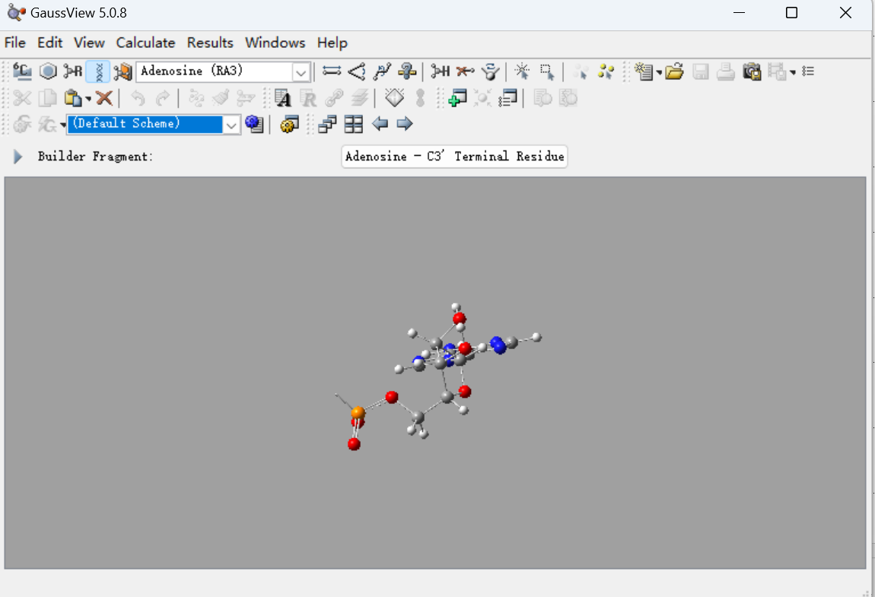
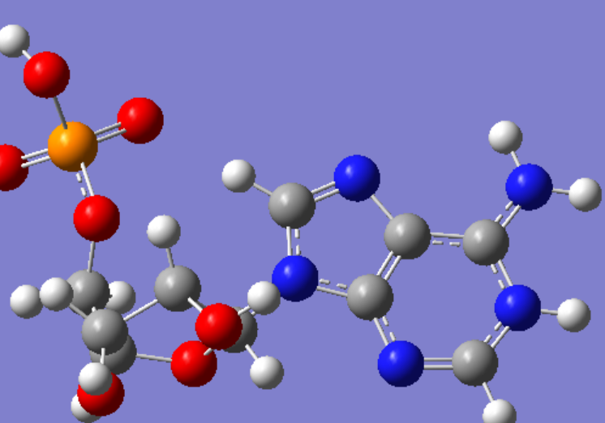
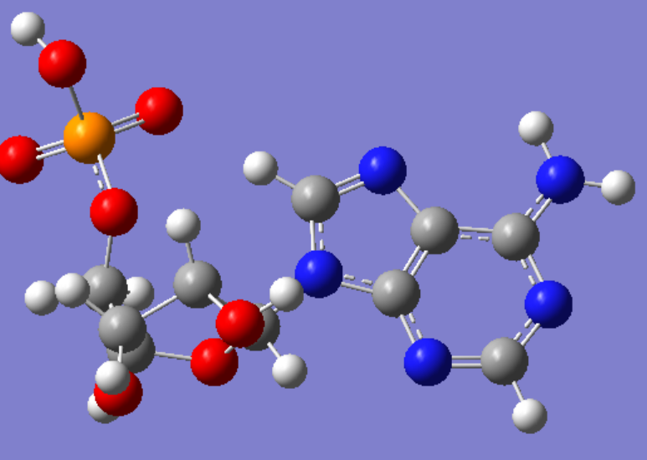



创建修饰分子
PDBeChem: Ligand Dictionary (PDB Ligand Chemistry - Chemical Component Dictionary) (ebi.ac.uk)
PDBeChem搜索已有结构或者gauss View创建
质子化腺苷酸为例：
选择 RA3
点击添加进view
加氧
加氢（质子化）

Slide 10
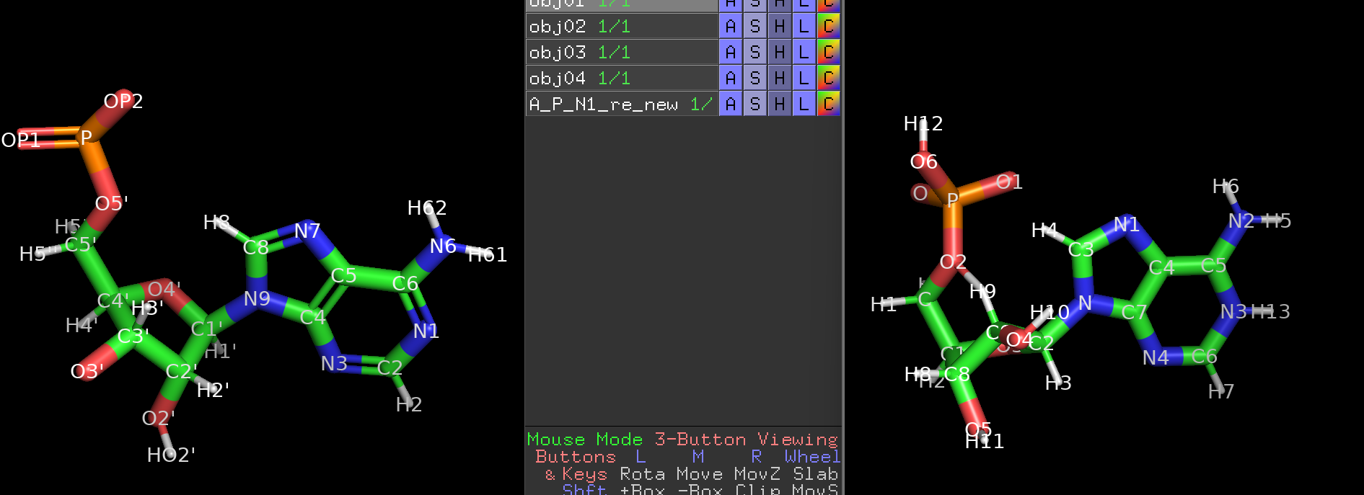
保存并依照参考分子修改原子名称
右键选择edit中的clean，随后save为pdb或其它格式
给要修改的pdb结构加氢
pdb4amber -i AG_cWH_start.pdb -o AG_cWH_start_H.pdb --dry –reduce
修改从gauss View得到pdb中原子名称（原始pdb原子名称相同，修改后按顺序添加后缀）
对照AG_cWH_start_H.pdb中的腺嘌呤和gauss View得到的质子化腺嘌呤，修改原子名称和顺序,并给AG_cWH_start_H.pdb添加N1处的氢
target
gauss pdb

