Slide 1
Codes representation and softwre recommendation
Presenter:周子航

Slide 2
Code representation
All codes related are in /home/zhouzh/learn_ai/xueyi/scripts on server white
All data related are in /home/zhouzh/learn_ai/
Comments and automatic error handling included

Slide 3
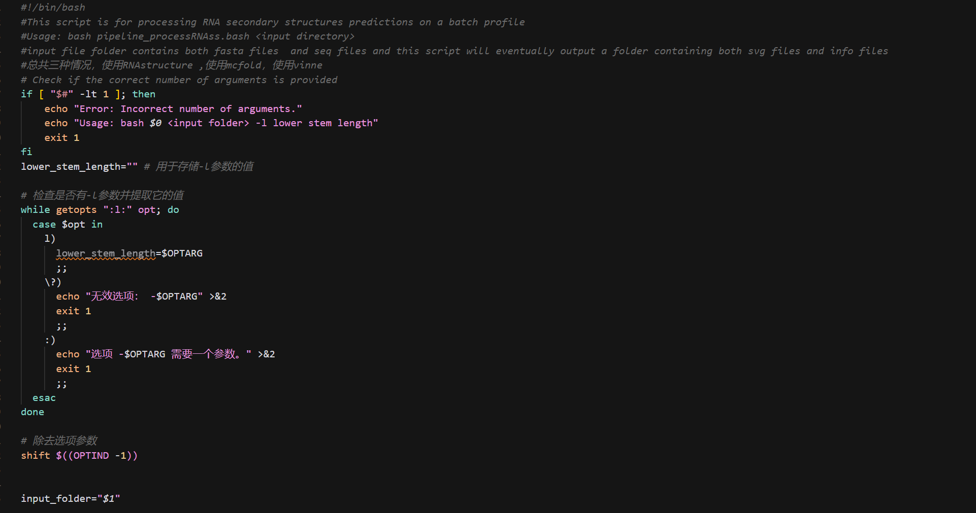
An illustration example

Slide 4
Fuctions achieved
1: pipeline for three RNA secondary structure prediction softwares.
2: converting ct and dot files to each other on a batch profile
3: Automatic energy plot
4: fasta related processing tools such as info extract, format, dnarna conversion and so on

Slide 5
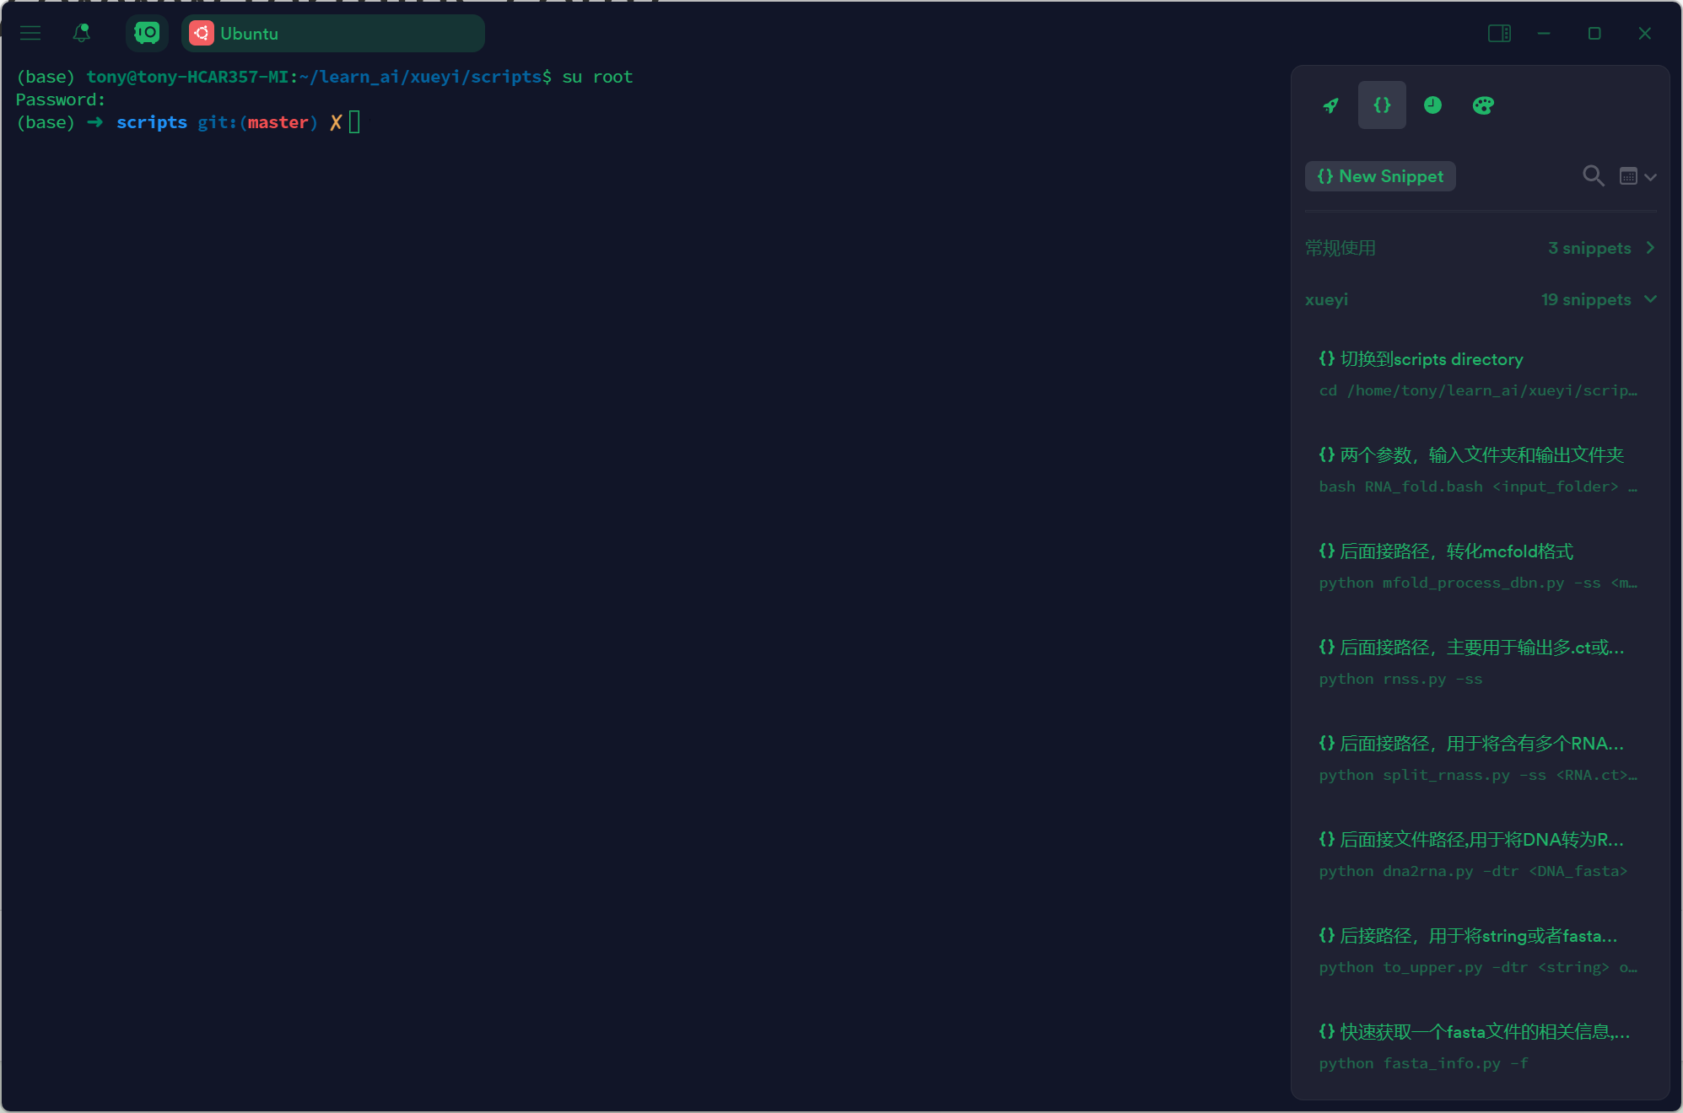
Software recommendation
https://www.termius.com/

