Slide 1
RNA secondary structure mapping by SHAPE
workshop
Yikan Zhang
03.02.2024

Slide 2
Outline
Why SHAPE reagents can be used to interrogate the structure of RNA?
Overview of the SHAPE experiment
SHAPE data process
SHAPE-directed RNA structure determination
SHAPE data superimposed on the RNA secondary structure

Slide 3
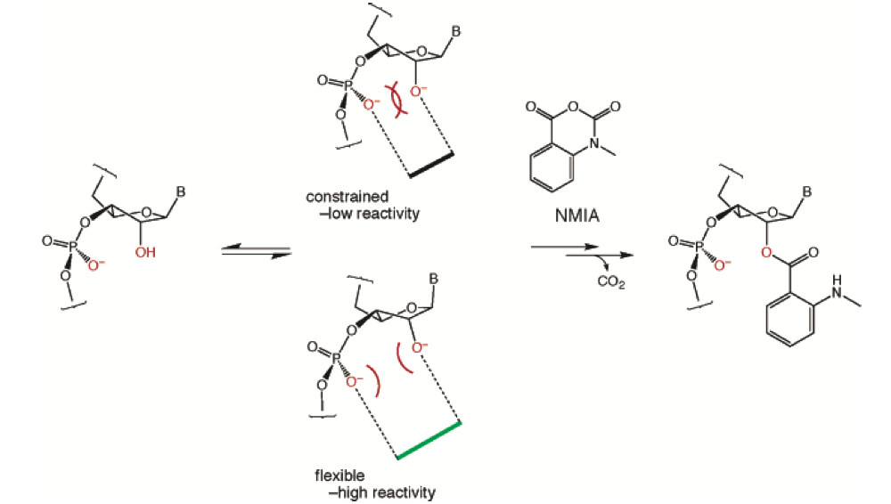
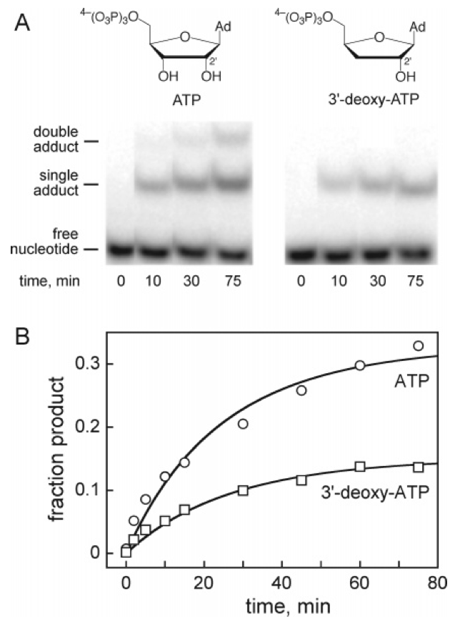
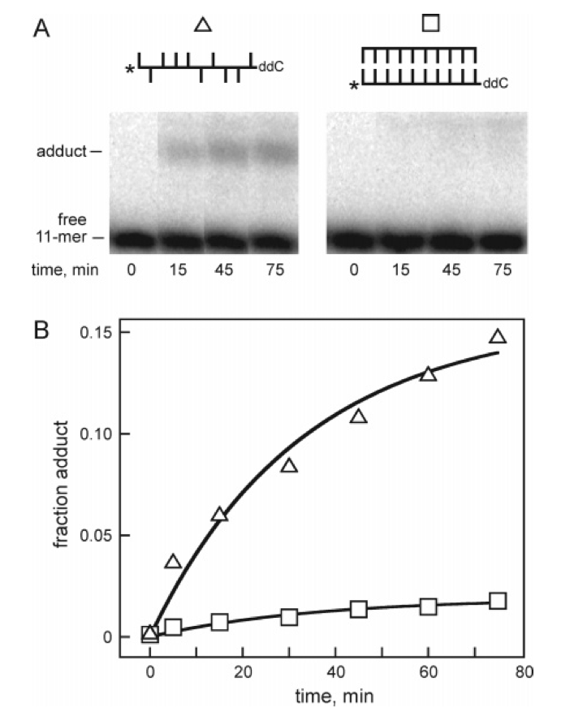
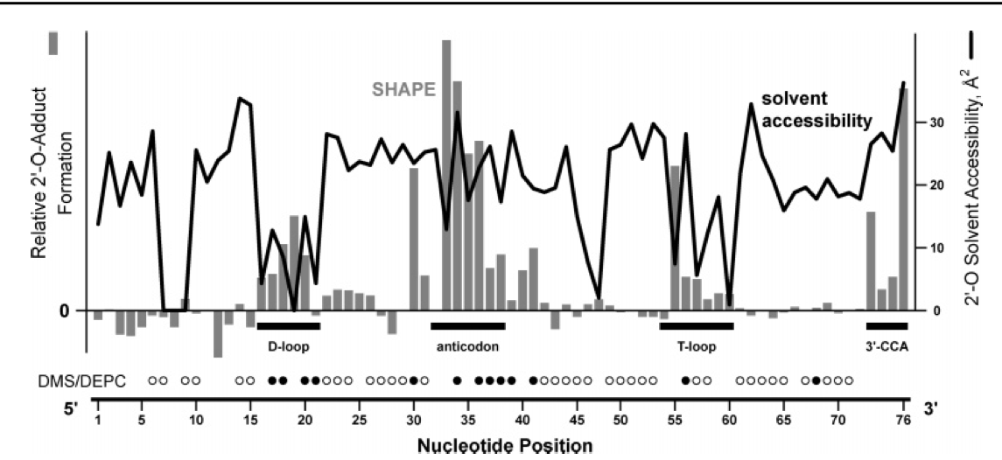
Why SHAPE reagents can be used to interrogate the RNA structure?
Merino et al., 2005
Notes:
与四种残基都能起反应，况且反应活性的高低应该与RNA的结构有关；反应时间与结构

Slide 4
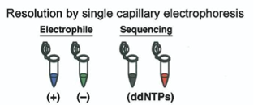
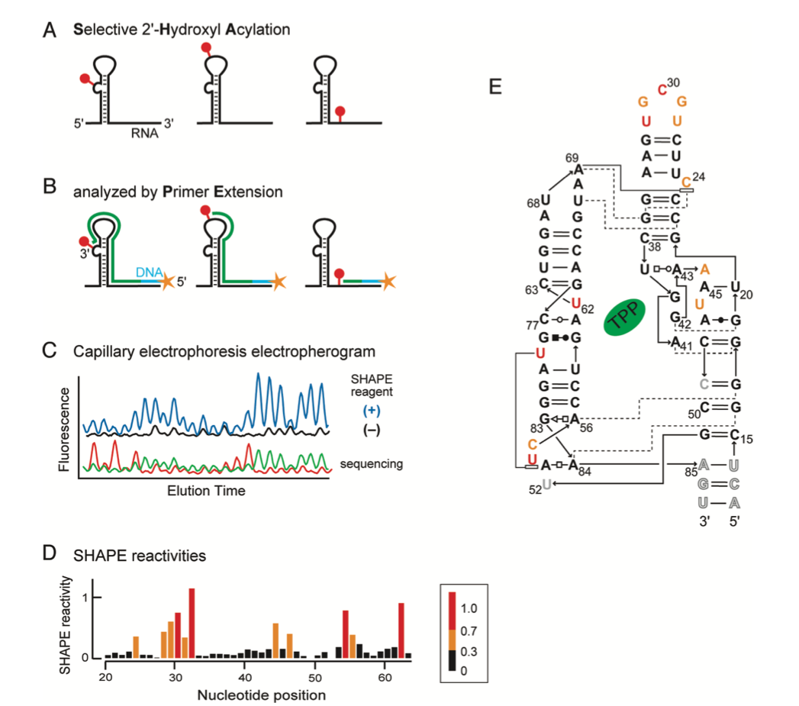
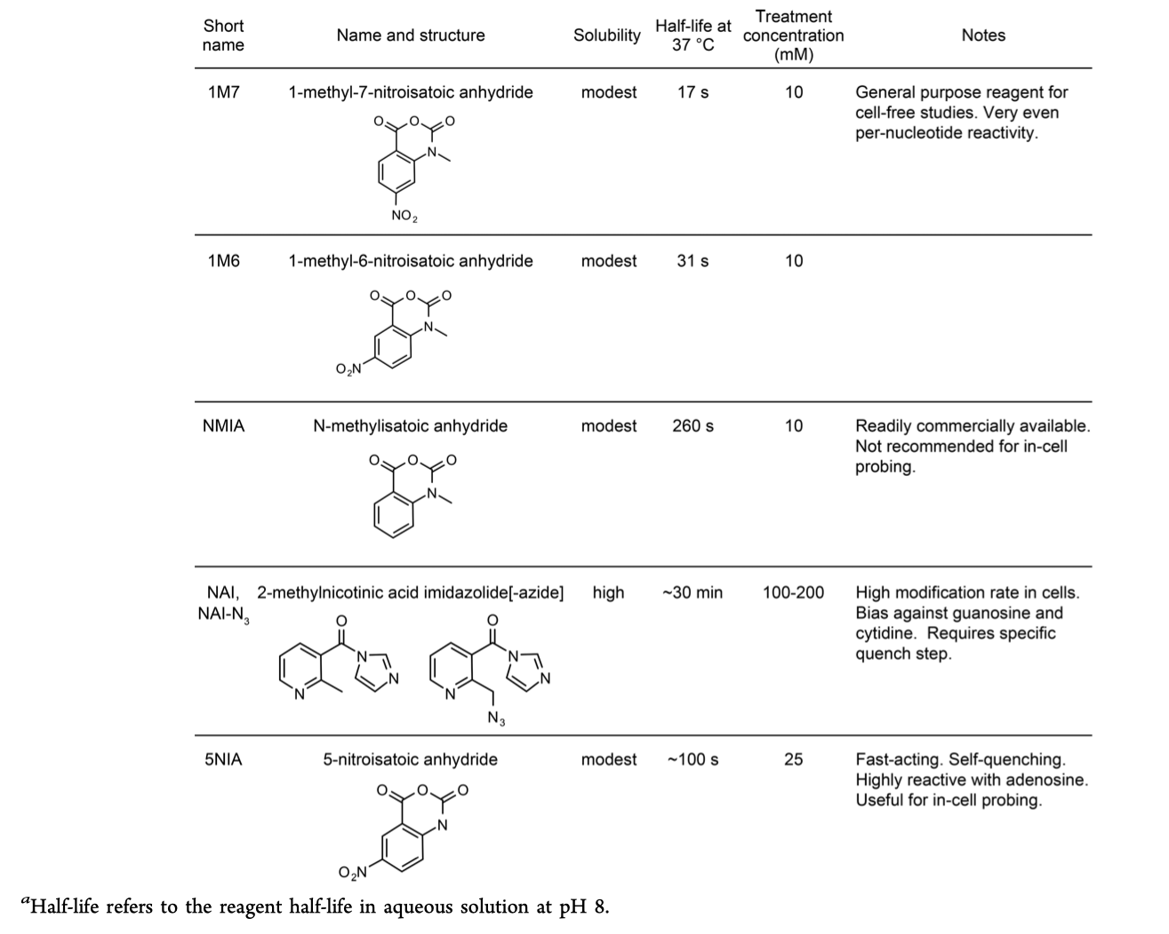
Overview of the SHAPE experiment
Busan et al., 2019

Slide 5
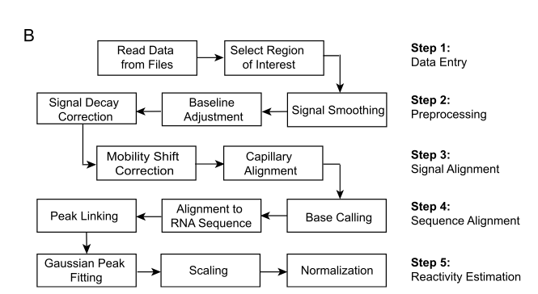
Qushape data-processing pipeline analysis
Karabiber et al., 2013

Slide 6
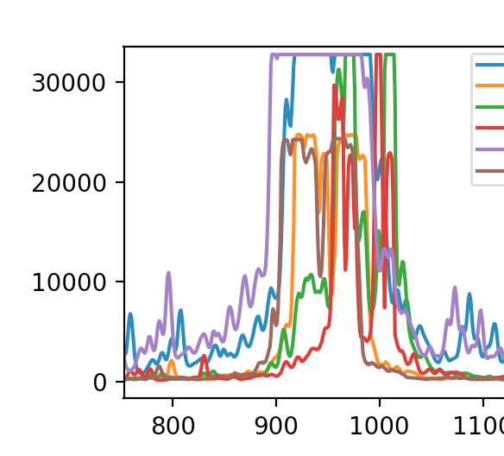
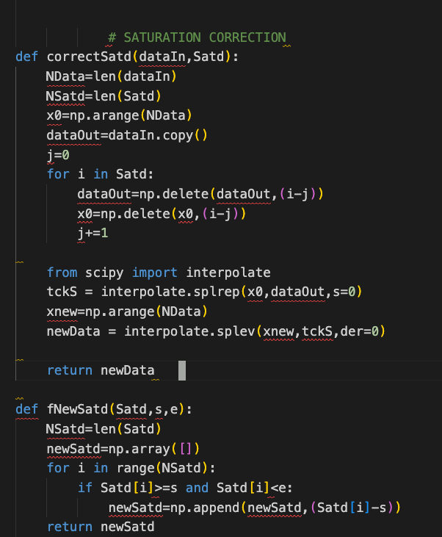
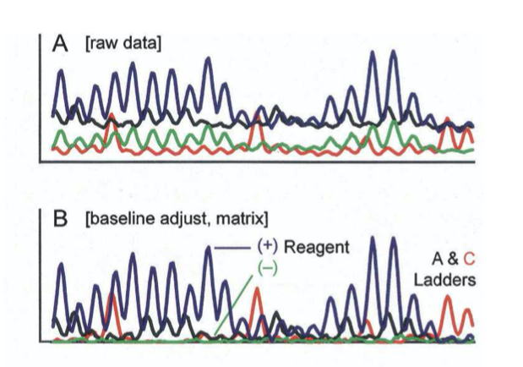
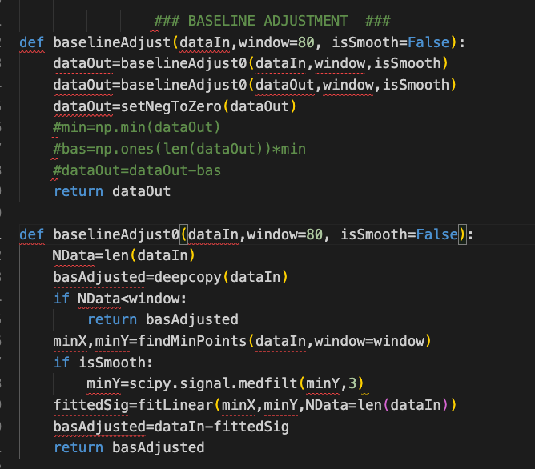
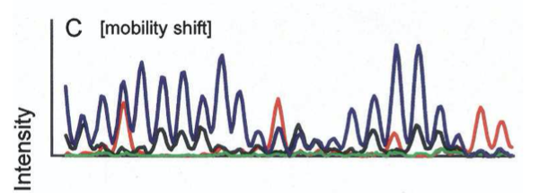
Data preprocessing
平滑多项式插值法
Vasa et al., 2008

Slide 7
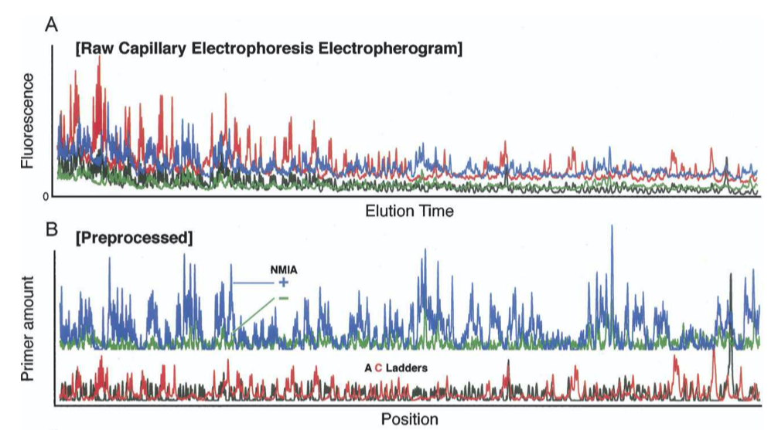
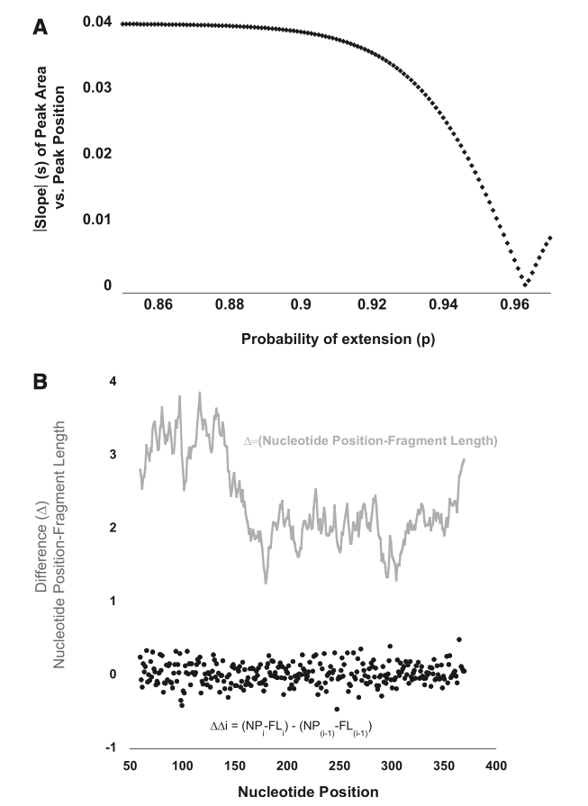


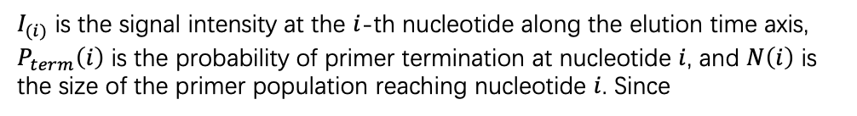
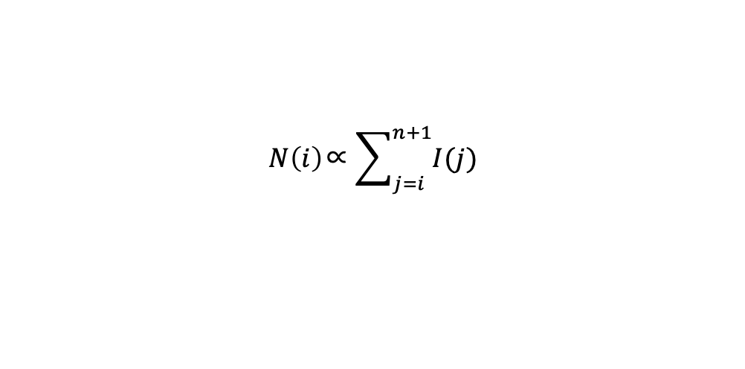
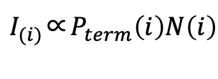
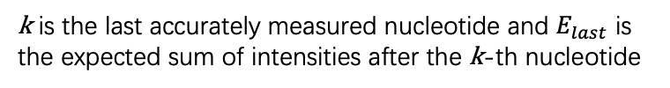
The signal decay correction
$I_{(i)}$ is the signal intensity at the $i$-th nucleotide along the elution time axis, $P_{term}\left(i\right)$ is the probability of primer termination at nucleotide $i$, and $N\left(i\right)$ is the size of the primer population reaching nucleotide $i$. Since
$$N\left(i\right)\text{∝}\sum_{j=i}^{n+1}{I(j)}$$
$I_{(i)}$∝$P_{term}\left(i\right)N\left(i\right)$
A heuristic solution to this loss of information reflects the expectation that, on average, probabilities of termination of primer extension for the first and second halves of the RNA are the same (Vasa et al. 2008; Pang et al. 2011).
k is the last accurately measured nucleotide and $E_{last}$ is the expected sum of intensities after the k-th nucleotide
D is the correction factor by which each peak area is divided; A and C are scaling factors for the initial and ﬁnal trace intensities, respectively; and P is the probability of extension.
Vasa et al., 2008
Pang et al., 2011
Karabiber et al., 2013
Notes:
这种现象被称为“信号衰减”(6)。信号衰减的一个原因是，虽然与亲电试剂的探测反应是这样进行的，任何给定的RNA分子只被修饰一次，但仍然会发生多次撞击。由于逆转录酶会在任何第一次修饰时暂停，这使片段的分布偏向于较短的片段。另一个原因是上标III逆转录酶的处理能力不完善(3)。此外，我们观察到盐和引物浓度似乎会影响信号衰减。

Slide 8
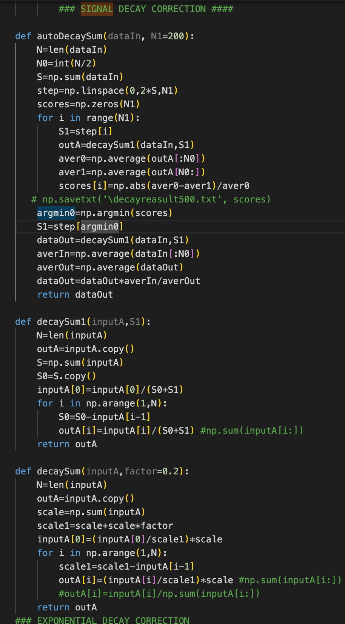
Vasa et al., 2008

Slide 9
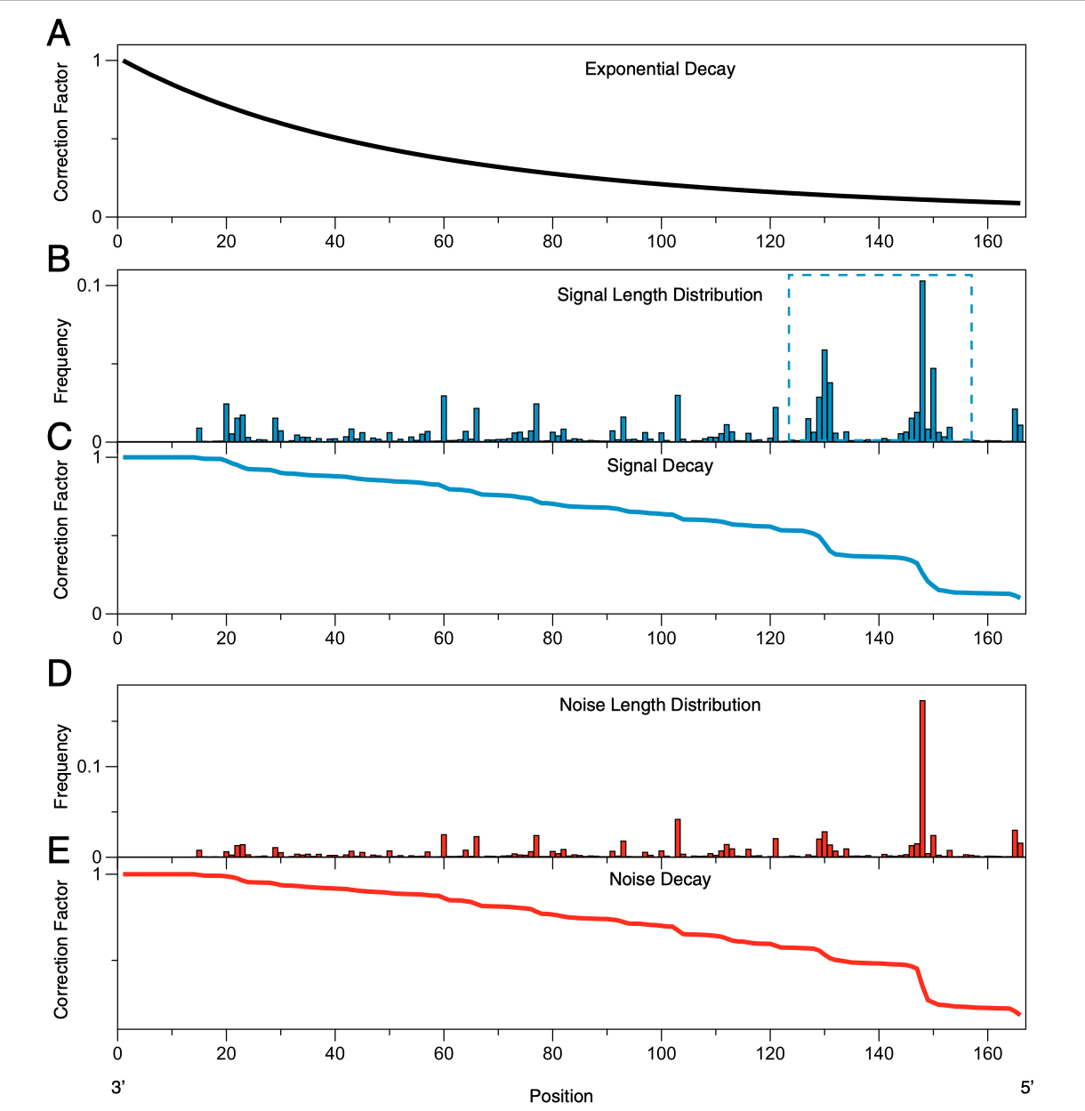
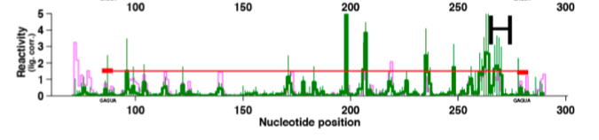
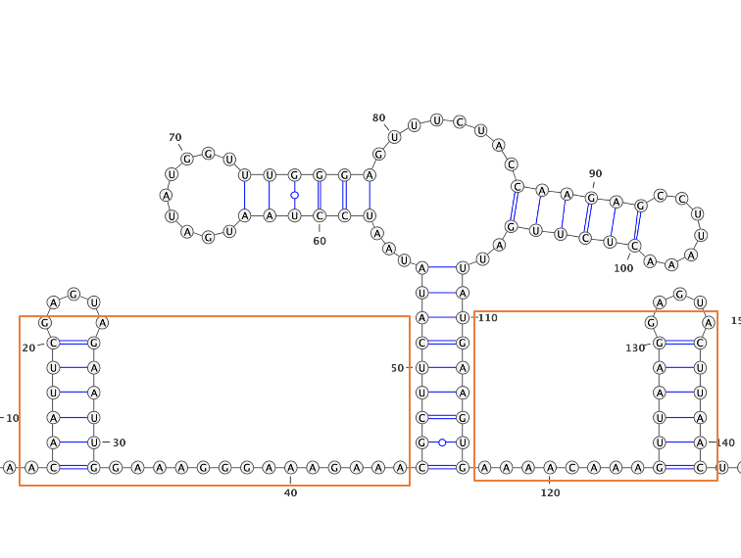
Other decay correction methods
Kladwang et al., 2014
Aviran et al., 2011

Slide 10
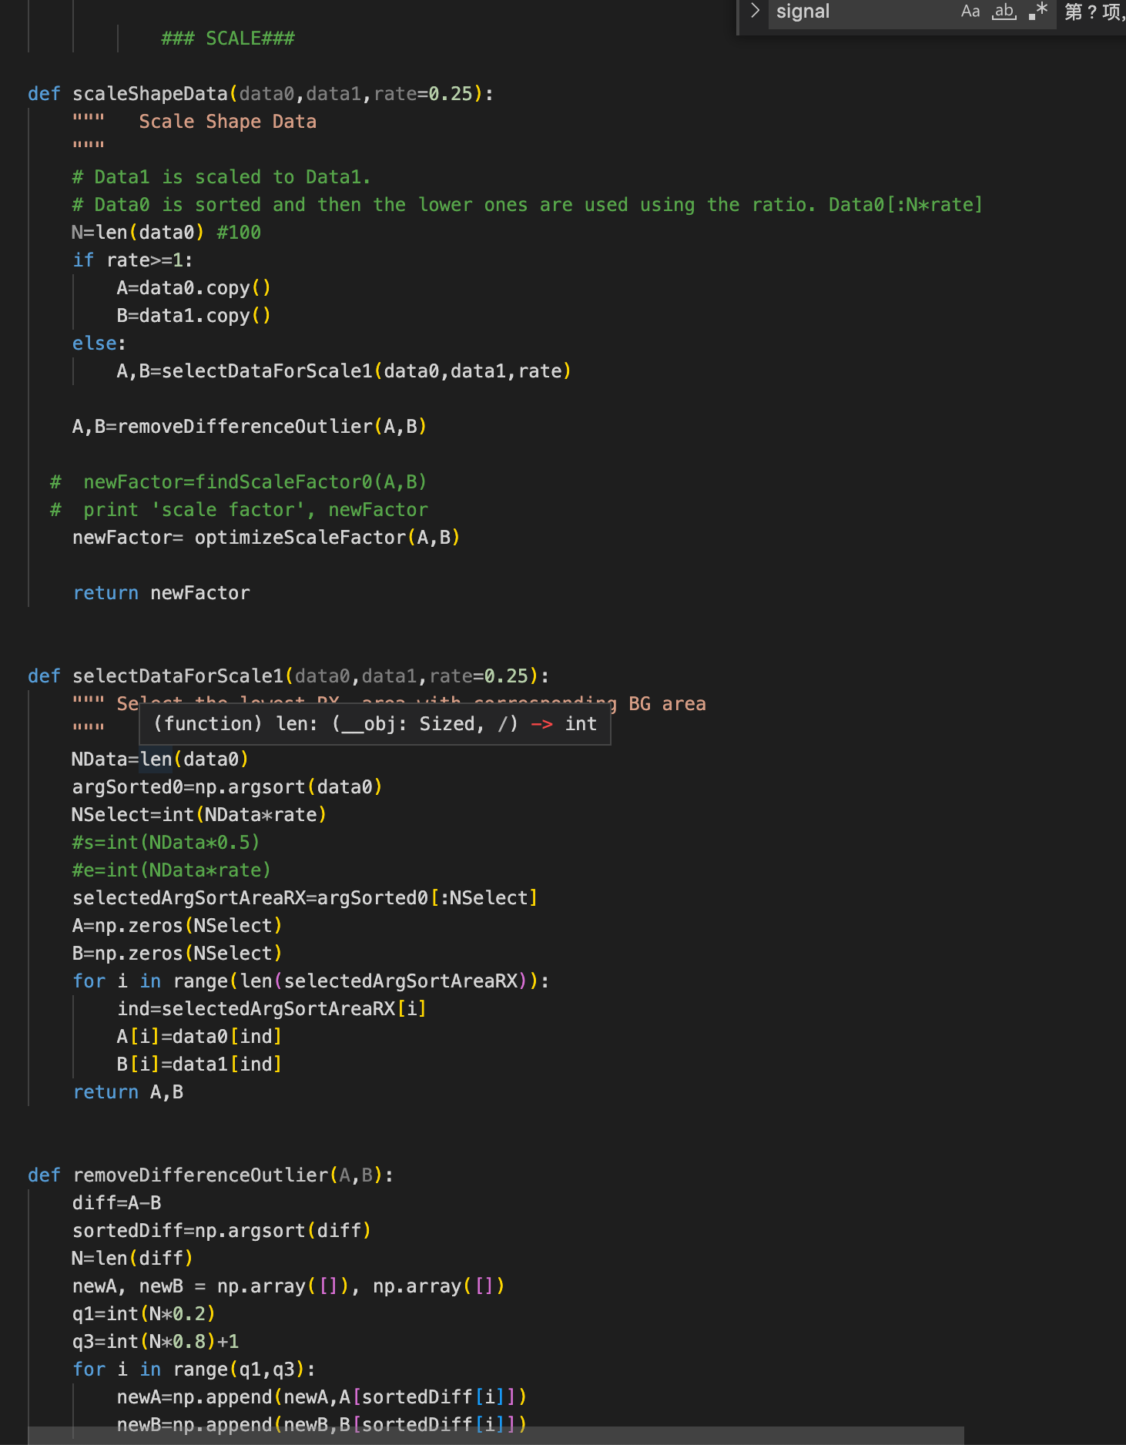
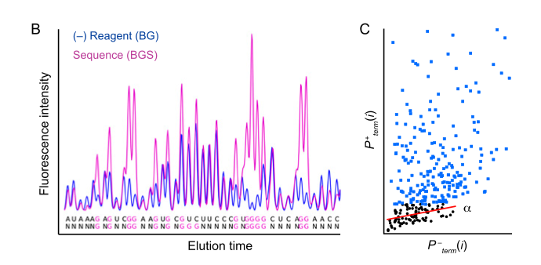
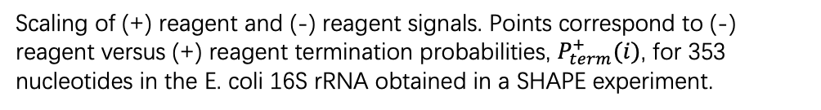
Scaling
S₂₀ , the 20% of nucleotides with the smallest $P_{term}^{+}$,
Scaling of (+) reagent and (-) reagent signals. Points correspond to (-) reagent versus (+) reagent termination probabilities, $P_{term}^{+}(i)$, for 353 nucleotides in the E. coli 16S rRNA obtained in a SHAPE experiment.
Karabiber et al., 2013
Notes:
说一下,sequence alignment 的过程

Slide 11
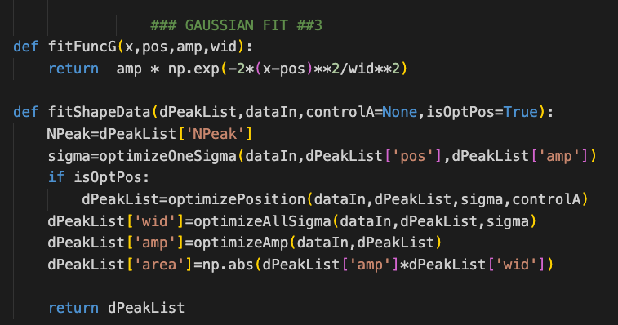

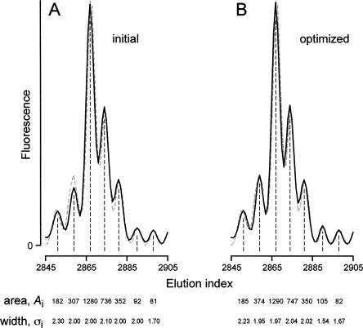
Whole-channel peak integration
Order the SHAPE reactivities from largest to smallest take the top 10% of the data - excluding outliers - this is your normalization factor - divide all the data by this number.
Outliers are defined either by --- anything higher than - 1.5*(Quartile3-Quartile1)+Quartile3 or the top 10% of the data - whichever is less.
Note - The quartiles come from the traditional box plot calculation (this can be done in Excel by doing =QUARTILE(B:B,1) if the reactivities are in column B)
Vasa et al., 2008

Slide 12
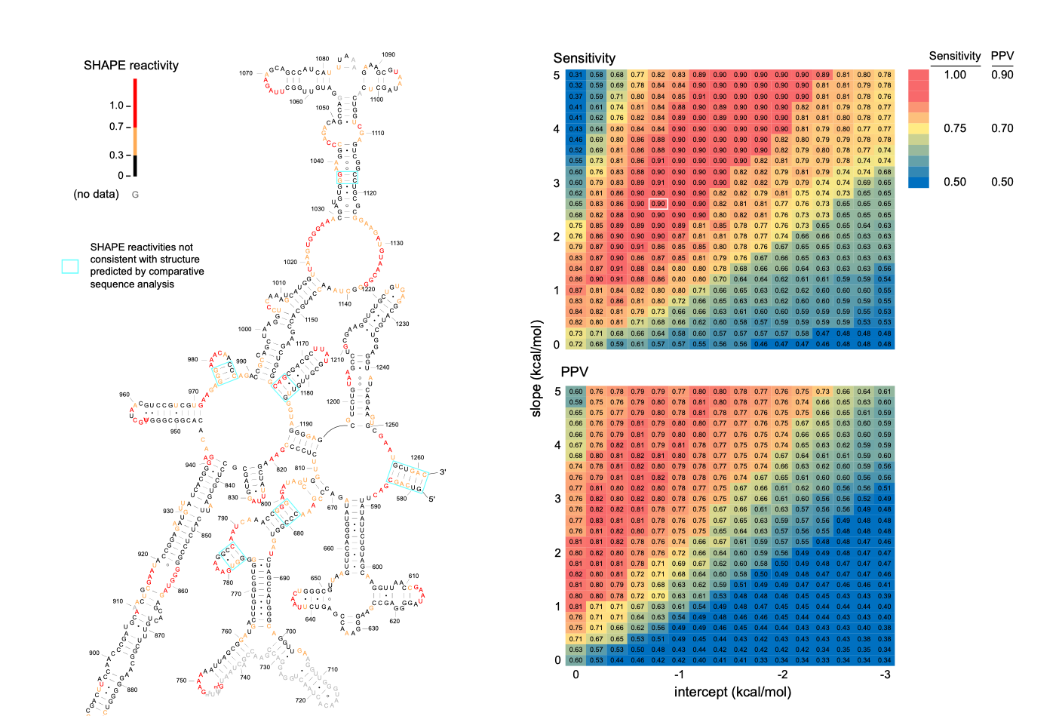
SHAPE-directed RNA structure determination
Deigan et al., 2009

Slide 13
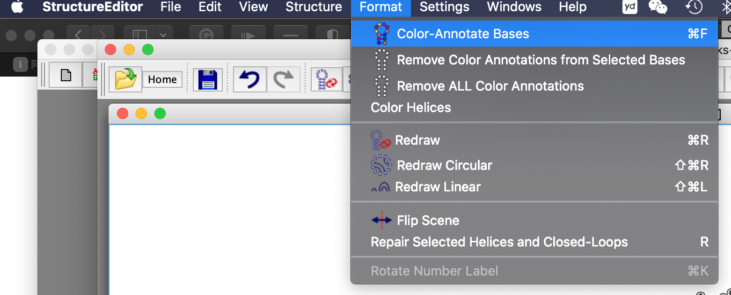
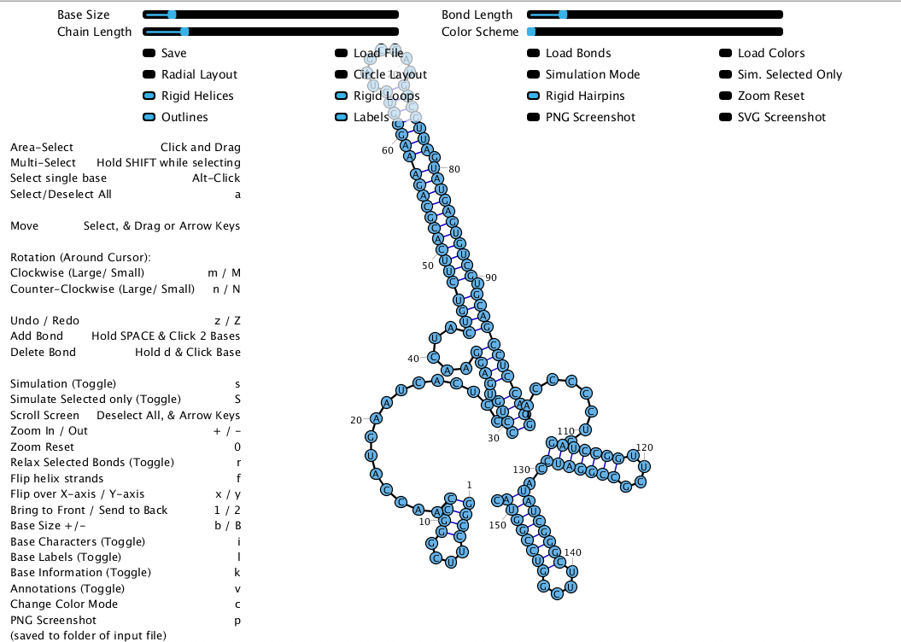
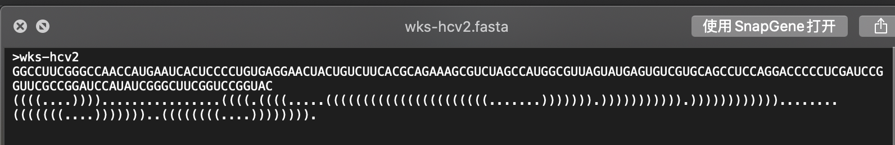
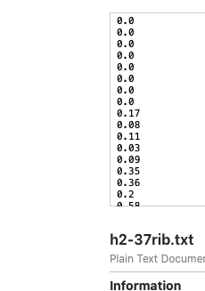
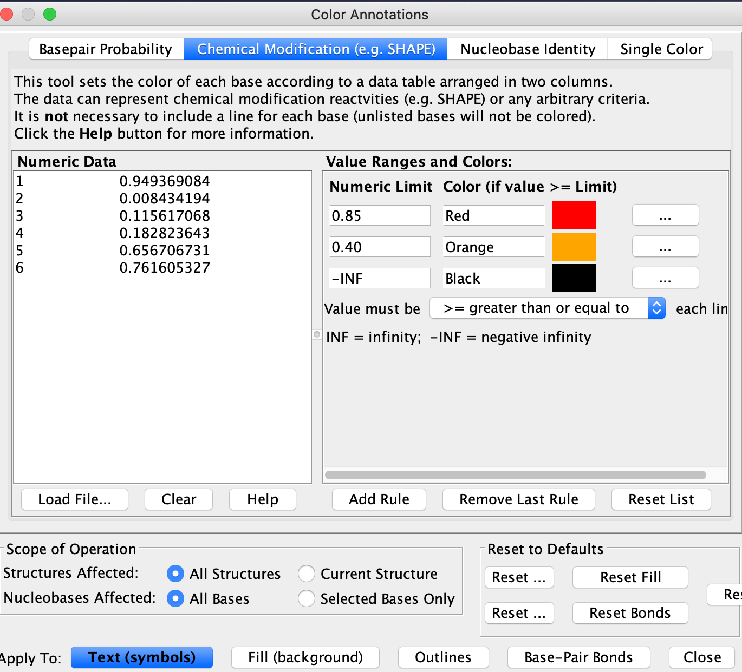
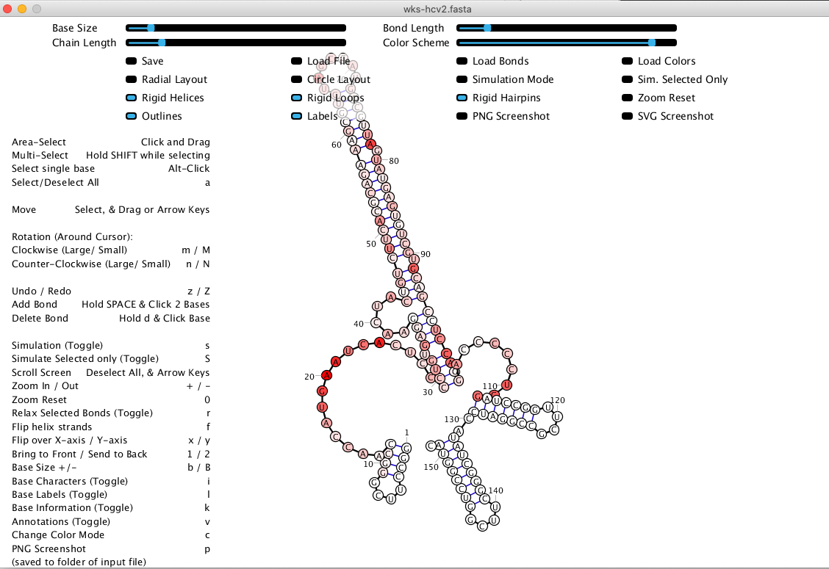
SHAPE data superimposed on the RNA secondary structure
Ribosketch
Ribosketch
.fasta
Mathews et al., 1996

Slide 14
References
Aviran, S., Trapnell, C., Lucks, J.B., Mortimer, S.A., Luo, S., Schroth, G.P., Doudna, J.A., Arkin, A.P., and Pachter, L. (2011). Modeling and automation of sequencing-based characterization of RNA structure. Proc Natl Acad Sci U S A 108, 11069-11074.
Busan, S., Weidmann, C.A., Sengupta, A., and Weeks, K.M. (2019). Guidelines for SHAPE Reagent Choice and Detection Strategy for RNA Structure Probing Studies. Biochemistry 58, 2655-2664.
Deigan, K.E., Li, T.W., Mathews, D.H., and Weeks, K.M. (2009). Accurate SHAPE-directed RNA structure determination. Proc Natl Acad Sci U S A 106, 97-102.
Karabiber, F., McGinnis, J.L., Favorov, O.V., and Weeks, K.M. (2013). QuShape: rapid, accurate, and best-practices quantification of nucleic acid probing information, resolved by capillary electrophoresis. RNA 19, 63-73.
Kladwang, W., Mann, T.H., Becka, A., Tian, S., Kim, H., Yoon, S., and Das, R. (2014). Standardization of RNA chemical mapping experiments. Biochemistry 53, 3063-3065.
Merino, E.J., Wilkinson, K.A., Coughlan, J.L., and Weeks, K.M. (2005). RNA structure analysis at single nucleotide resolution by selective 2'-hydroxyl acylation and primer extension (SHAPE). J Am Chem Soc 127, 4223-4231.
Pang, P.S., Elazar, M., Pham, E.A., and Glenn, J.S. (2011). Simplified RNA secondary structure mapping by automation of SHAPE data analysis. Nucleic Acids Res 39, e151.
Vasa, S.M., Guex, N., Wilkinson, K.A., Weeks, K.M., and Giddings, M.C. (2008). ShapeFinder: a software system for high-throughput quantitative analysis of nucleic acid reactivity information resolved by capillary electrophoresis. RNA 14, 1979-1990.

Slide 15
Thanks for your attention!

