Slide 1
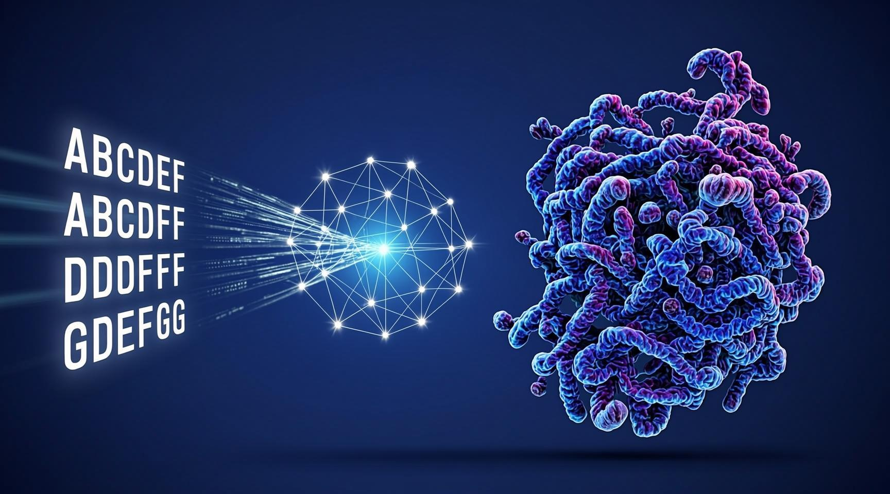
Protein Structure Prediction
Yuankuan Zhang
2026/1/24
Notes:
关闭“使用演示者视图”

Slide 2
Outline
Basics (20 min)
embedding (Embedding, ESM2)
linear, softmax, permute
sigmoid, dropout, conv2d, norm
Complex
attention
triangular attention
difference between AF2 and trRosseta
architecture: attention vs convolution
output: 1 (ensemble from different models) vs L (from 1 prediction)

Slide 3
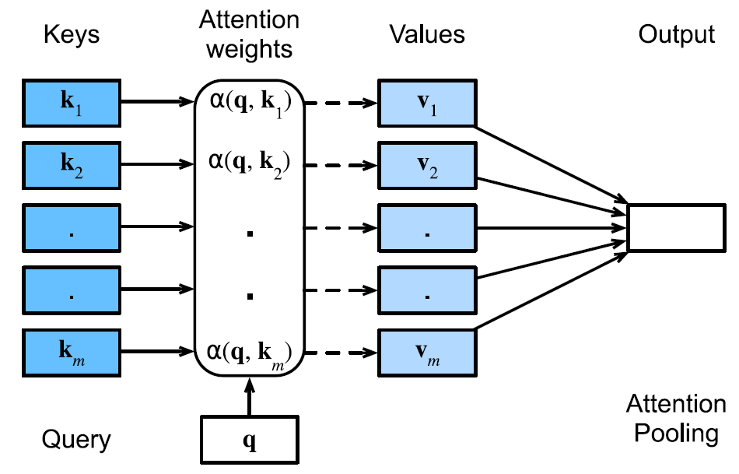
Attention in the decoder
L, c
1, L
L, c
1, c
1, c
1, c

Slide 4
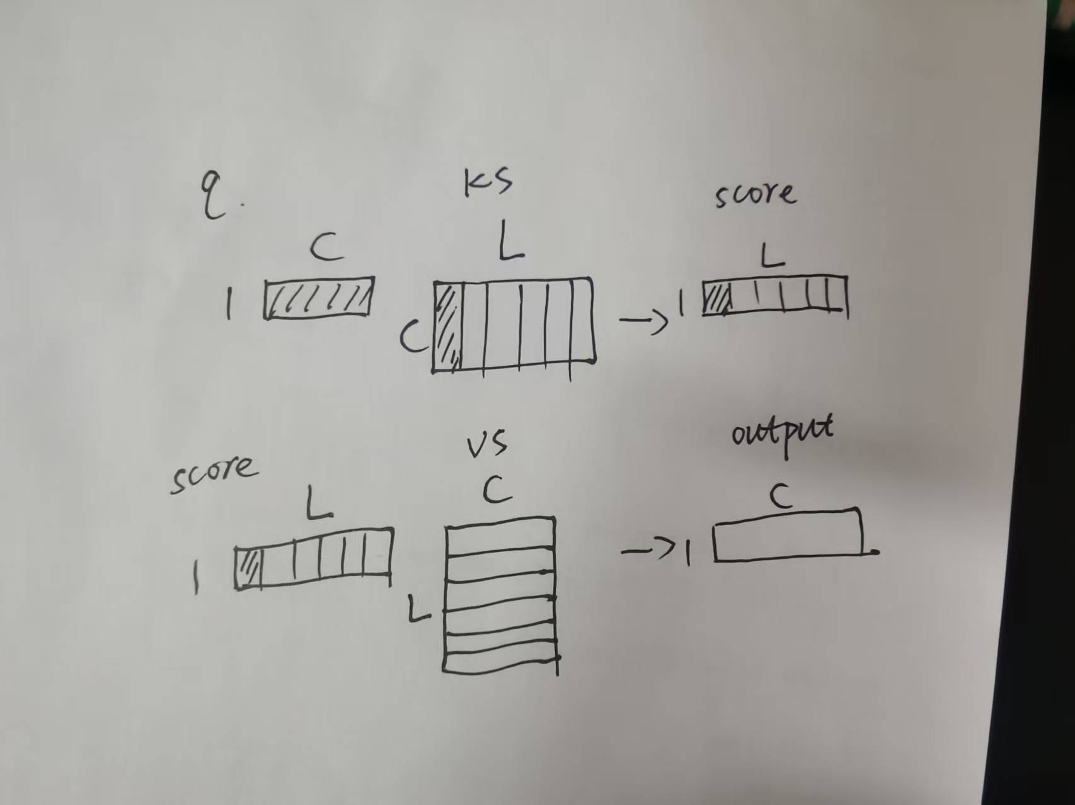
Matrix multiplication in attention

Slide 5
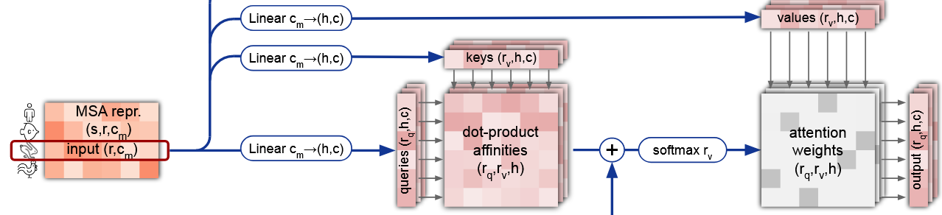
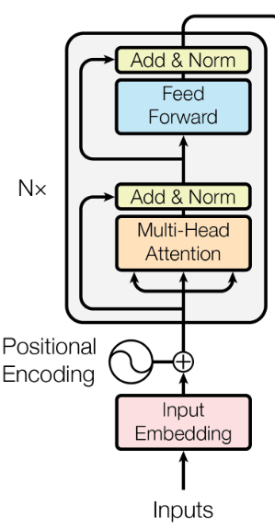
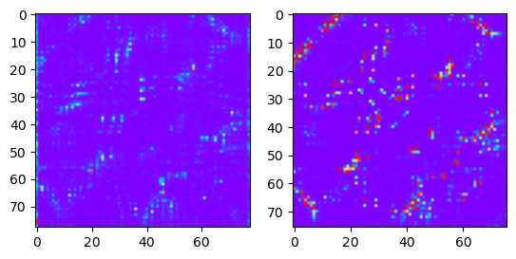
Self-attention in the encoder
[L, C]
attention score
contact map
queries
residue index
[L, C]
keys
residue index

Slide 6
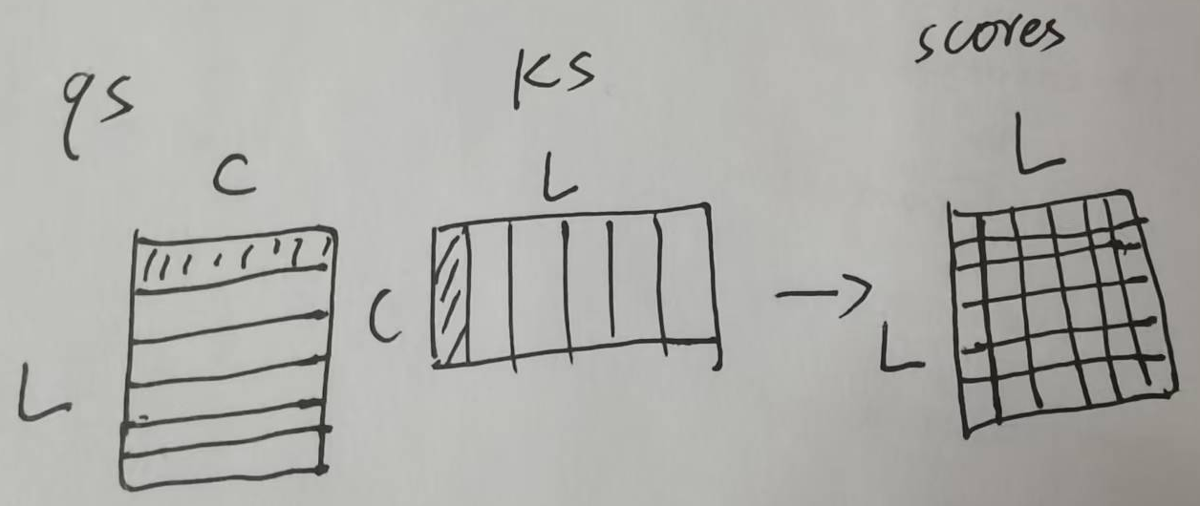
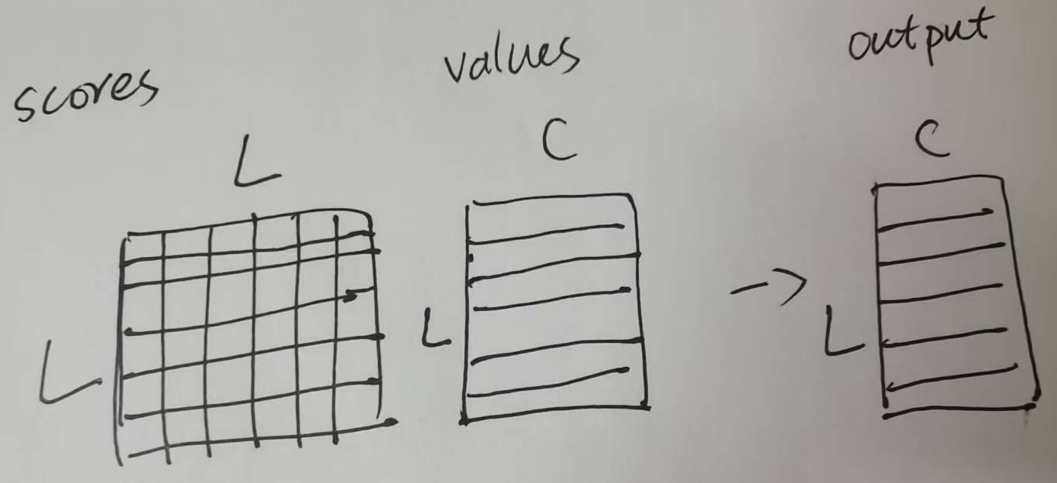
Matrix multiplication in self-attention
attention
self-attention

Slide 7
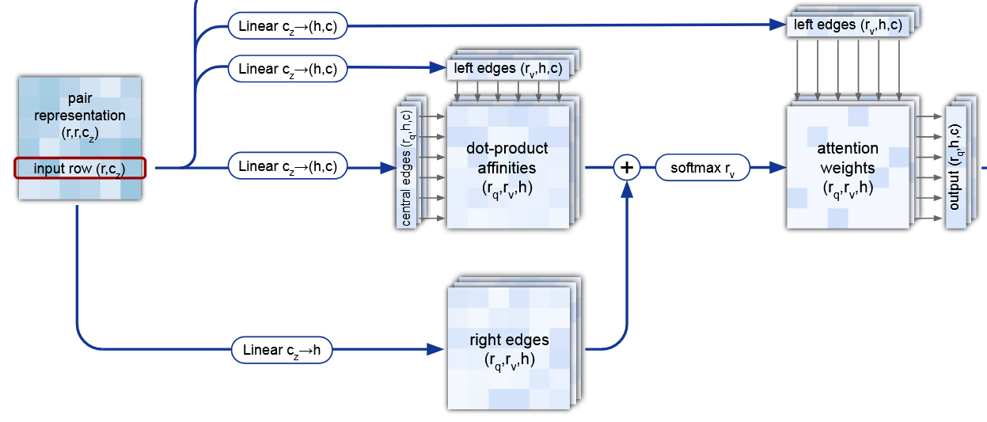
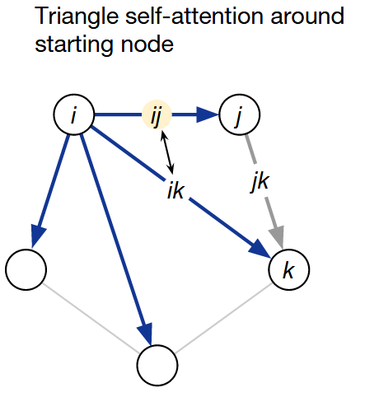

Triangular attention

Slide 8
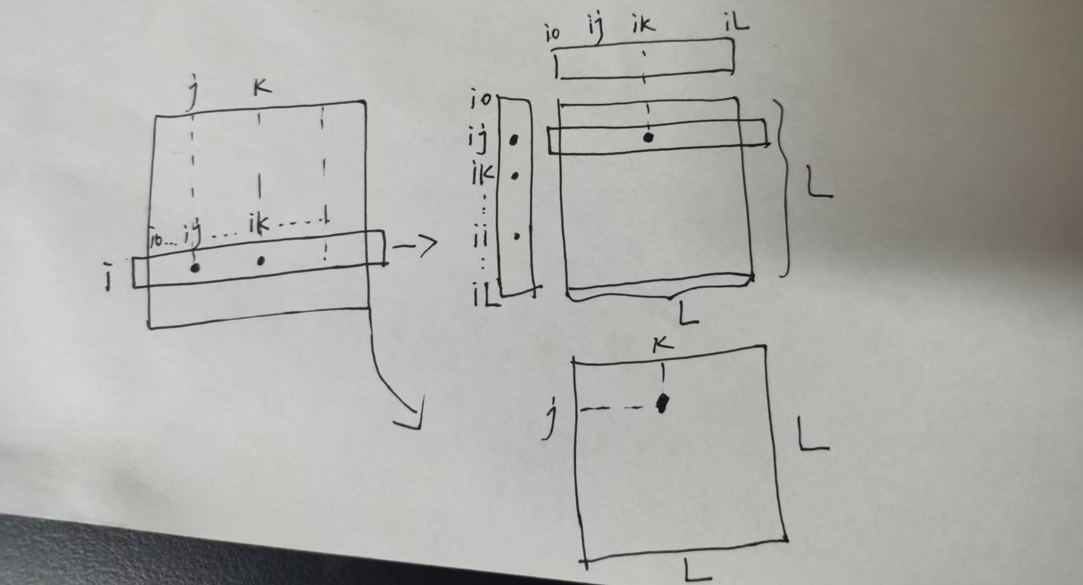
Addition of edge_{jk} as an bias
dot(ij, ik)
jk

Slide 9
Addition of edge_{jk} as an bias
[C, L]
[L, C]
[L, L, C]
dot(ij, ik)
[L, L]
[1, L, C]
jk
[L, L]

Slide 10
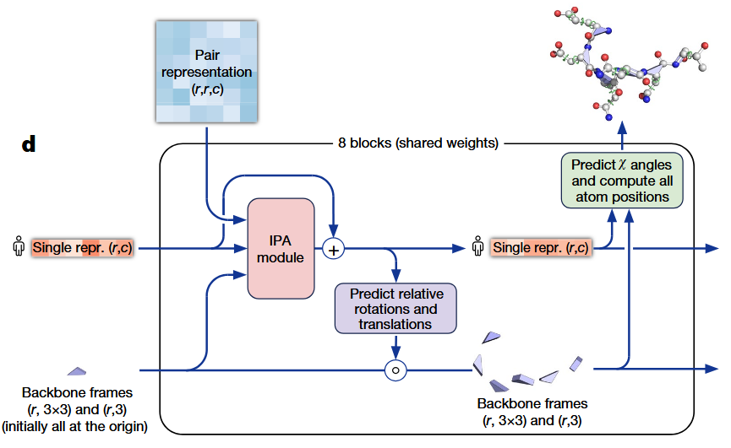
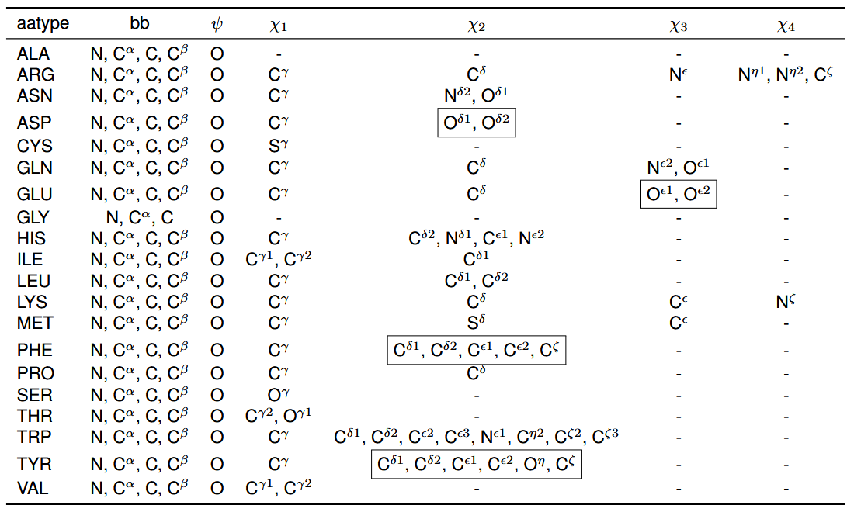
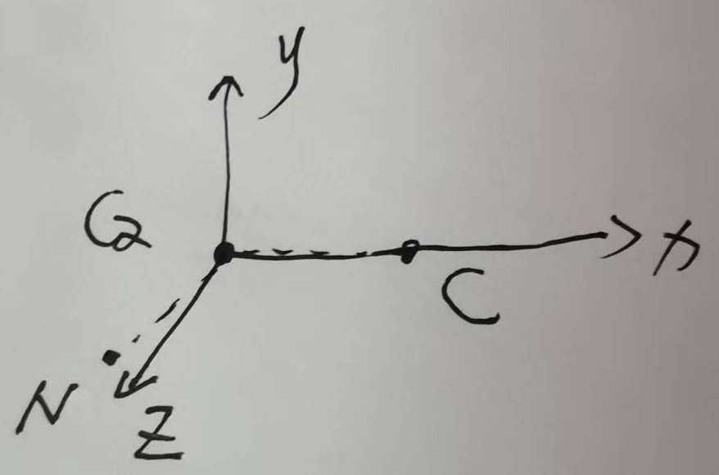
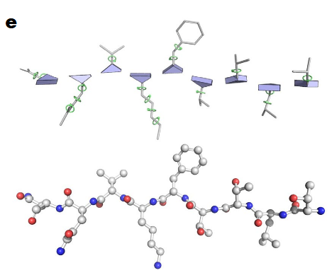
Structure module in AlphaFold 2
[L, 14]
[L, c_s]
backbone frame
[L, 3, 3], [L, 1, 3]

Slide 11
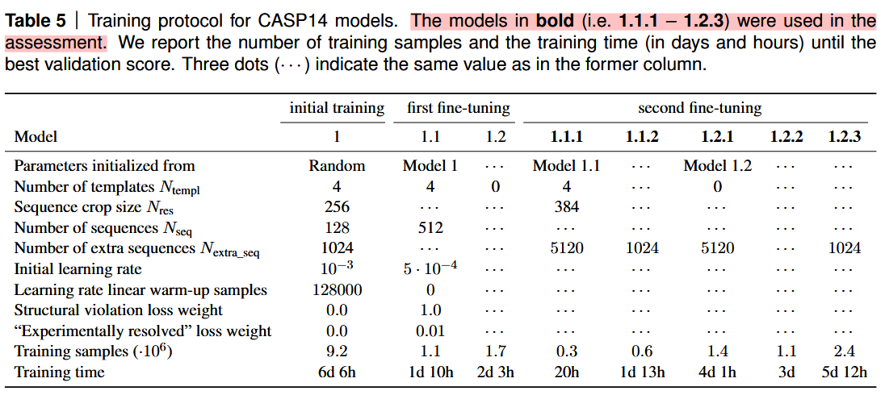
Fold head in SPIRED
[L, L, c_z] -> [L1, L2, 3]
L1: number of conformation
L2: number of residues

Slide 12
Transformer常见问题与回答总结 - 知乎
67 自注意力【动手学深度学习v2】_哔哩哔哩_bilibili

